Slide 1
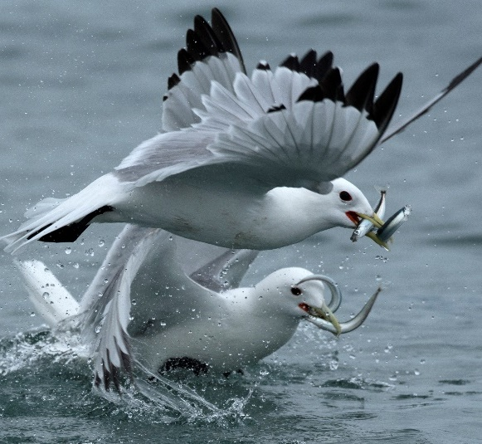
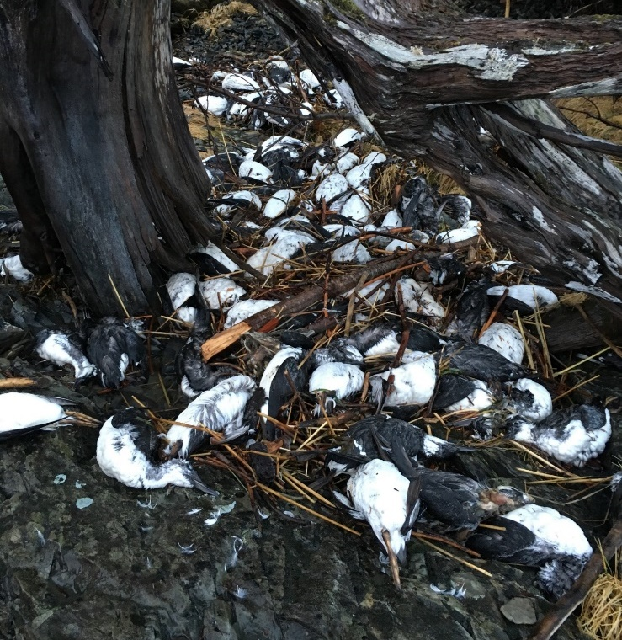
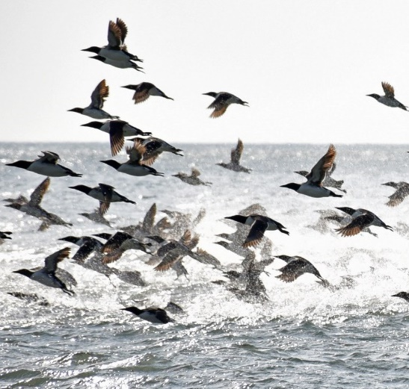

Harmful algal blooms and Alaska seabirds: saxitoxin associated with recent die-off events
Photos: S. Schoen
Caroline Van Hemert, Matthew M. Smith, Robert J. Dusek, Gwen Baluss, Gay Sheffield, John R. Harley, Susan Knowles, Sarah K. Schoen, and Robert Kaler

Slide 2
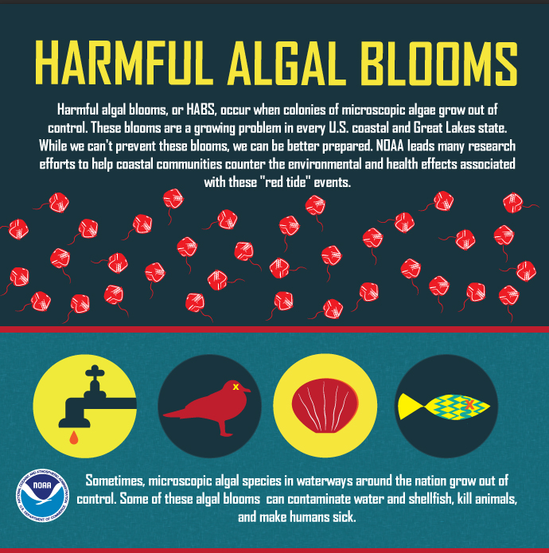
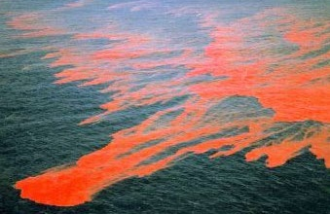
What are harmful algal blooms (HABs)?
Algal growth that can injure or kill fish, wildlife, and humans
Mechanism is often through production of algal toxins
Stockfile: FiS

Slide 3
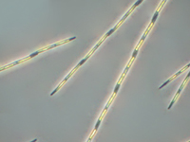
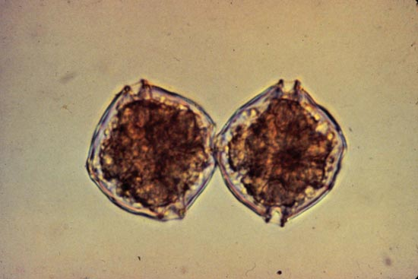
Toxins produced by marine HABs
Domoic Acid (DA)
Produced by diatom Pseudo-nitzchia
Excitotoxin: amnesic shellfish poisoning
Present in Alaska, but no documented illness in humans or wildlife
Saxitoxin (STX)
Produced by dinoflagellate Alexandrium
Paralytic toxin: paralytic shellfish poisoning
Most potent congener among larger group of paralytic shellfish toxins (PSTs)
Responsible for illness & death in humans and wildlife in Alaska
Photo: NOAA
Photo: Woods Hole Oceanographic Institution

Slide 4
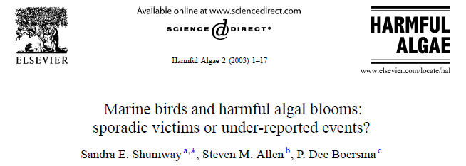
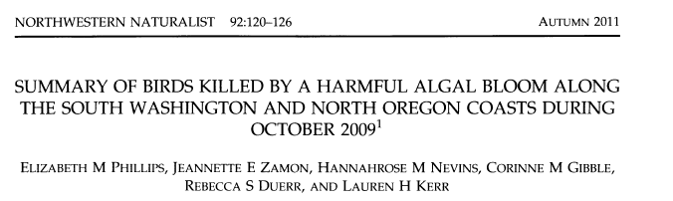
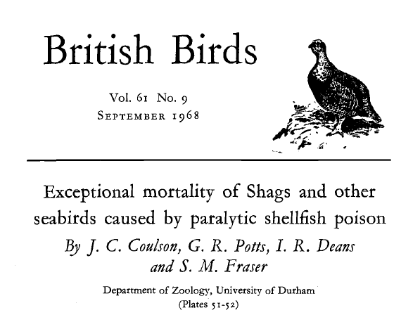
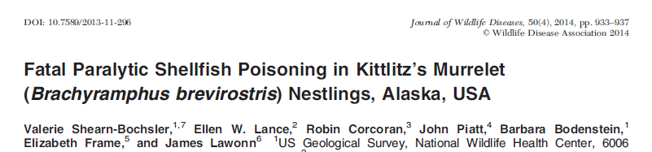
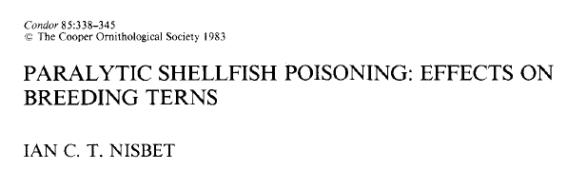

Seabird deaths attributed to HABs

Slide 5
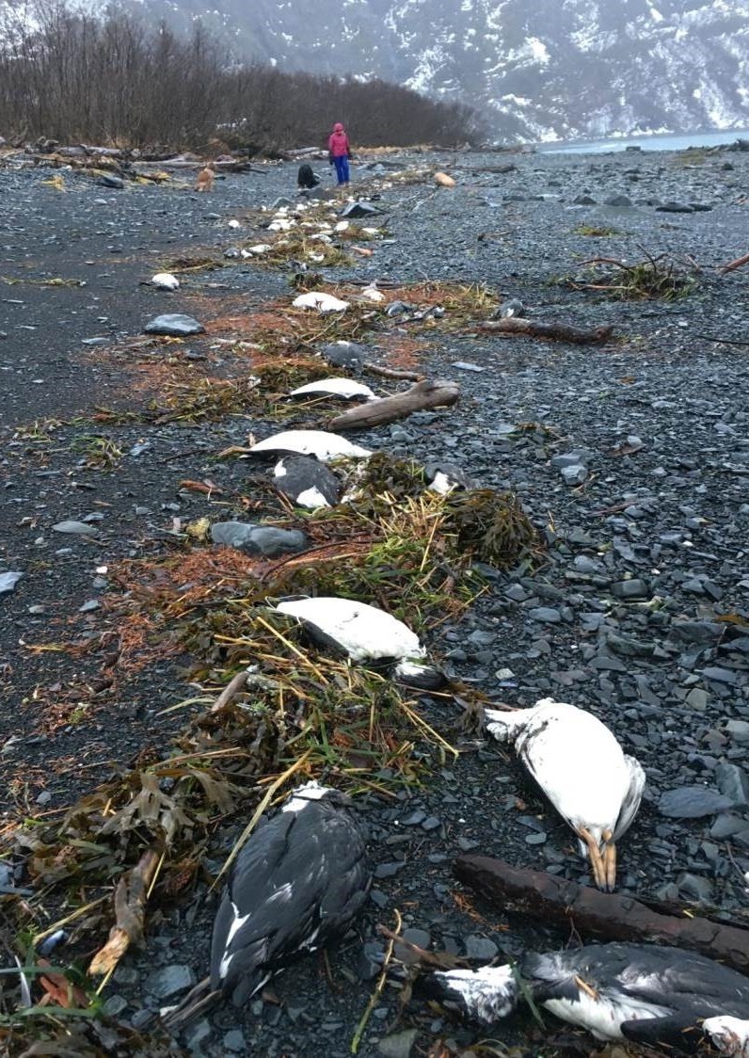
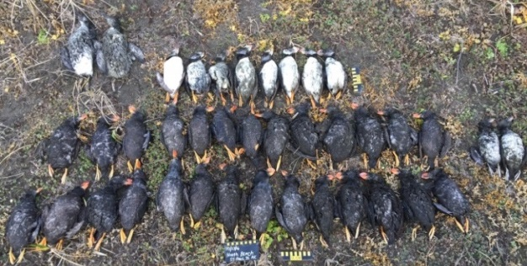
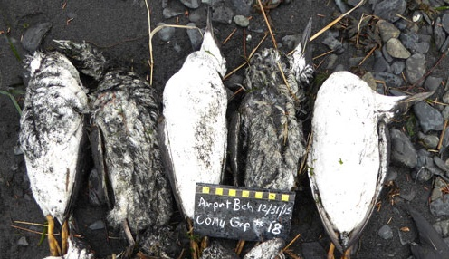
Recent seabird mortality events in Alaska
  Common Murres: Gulf of Alaska (2015–16)
  Tufted Puffins: Pribilof Islands (2016)
  Fulmars & shearwaters: Chukchi/Bering (2017)
  Various: Statewide (2018)
  Arctic Terns: Southeast Alaska (2019)
  Short-tailed Shearwaters: Chukchi/Bering (2019)
  Misc (2020-2021)
D. Irons

Slide 6
Ocean warming & HABs
HABs naturally occurring but increasing in frequency and intensity worldwide
STX positively correlated with water temperature
HABs predicted to increase with climate change
Issue of growing concern in northern waters
Walsch et al. 2018

Slide 7
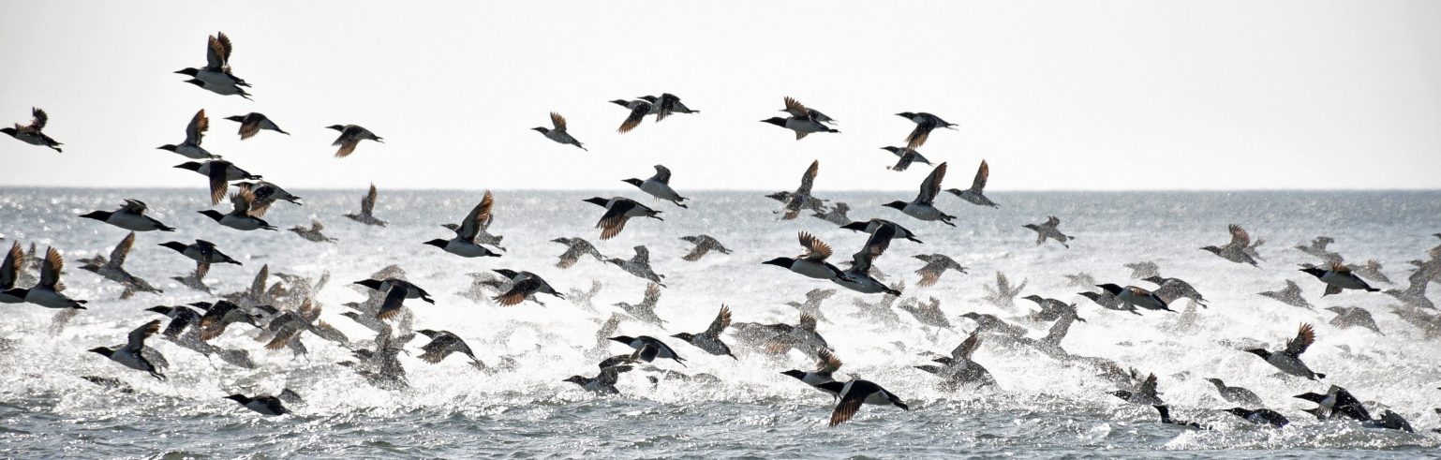
Background: Gulf of Alaska
STX widespread in birds, forage fish, and marine invertebrates in all seasons
DA present in forage fish and marine invertebrates; rarely detected in seabirds
No direct link to the 2015–16 Common Murre die-off but many unanswered questions about the impacts of HABs on seabirds in Alaska
Van Hemert et al. 2020 Harmful Algae

Slide 8
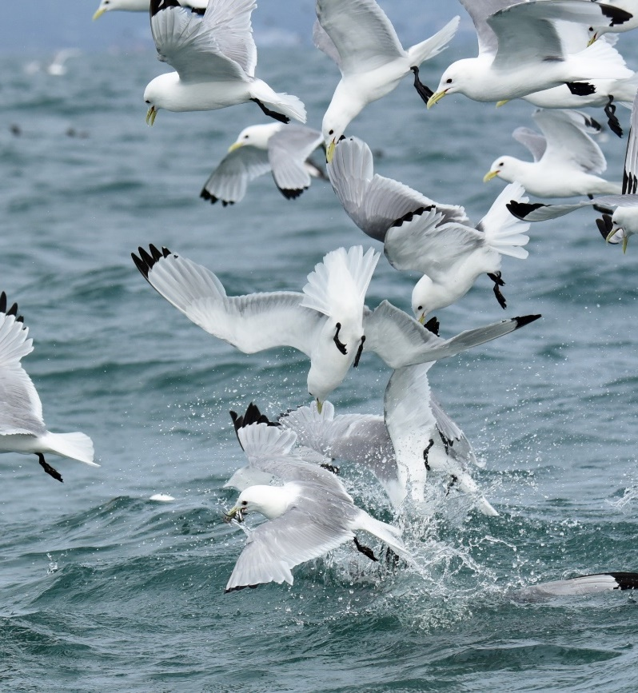
STUDY OBJECTIVES
Investigate role of HAB toxins in two recent seabird die-off events
  Multispecies die-off: Chukchi/Bering seas (2017)
  Arctic Tern die-off: Southeast Alaska (2019)
S. Schoen

Slide 9
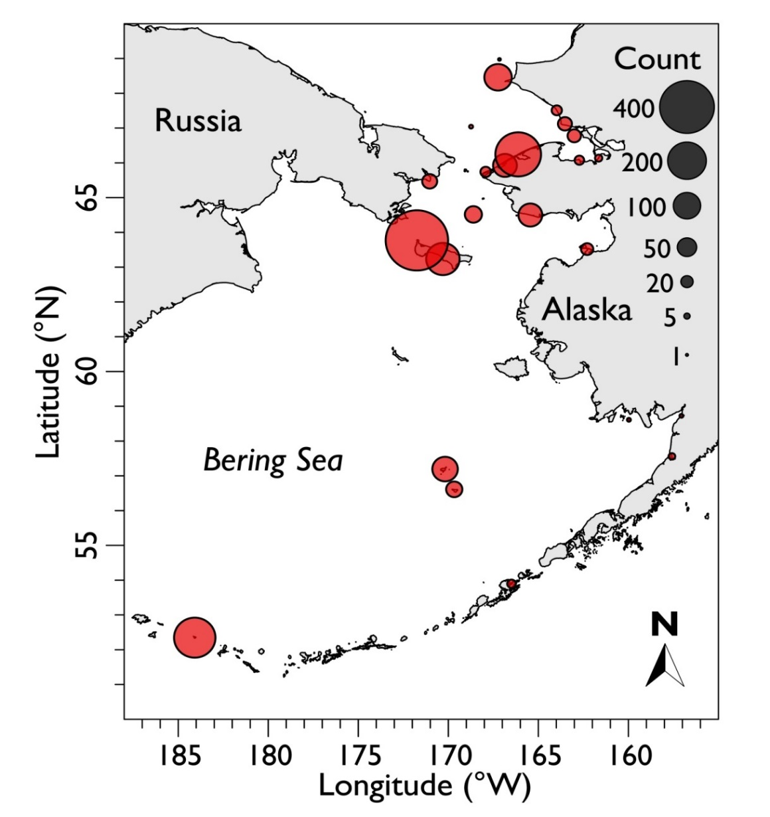
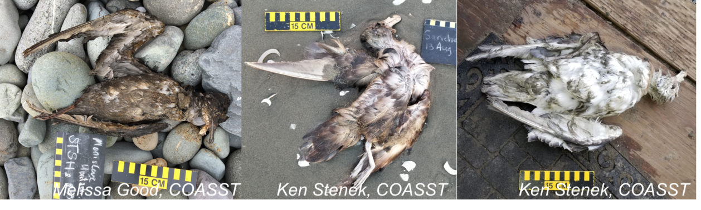
Multispecies die-off – Chukchi & Bering seas 2017
Primarily Northern Fulmars, Short-tailed Shearwaters; variety of other species
>1,500 birds found dead from Aleutian Islands to Pt. Hope (May – September 2017)
Map courtesy of USFWS

Slide 10
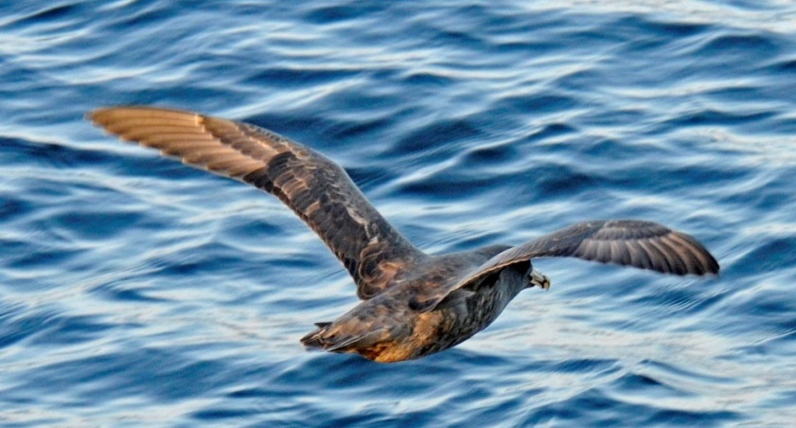
Results – STX detection in birds
STX in 60% of all carcasses (n=25); 88% of Northern Fulmars (n=16)
Tissue concentrations similar to those from other STX-induced seabird die-offs (maximum = 63 µg 100 g⁻¹ )
DA not detected
Van Hemert et al. 2021 Journal of Wildlife Diseases

Slide 11
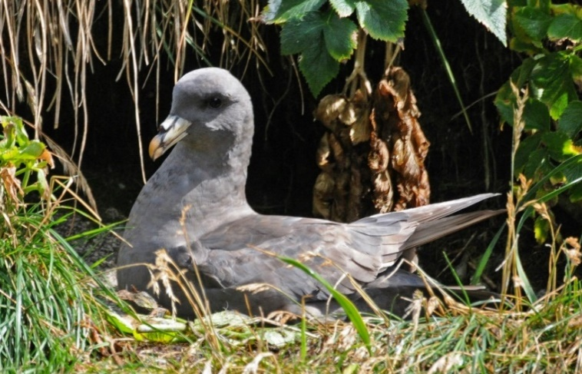
STX in Northern Fulmars
*Human regulatory limit: 80 µg 100 g⁻¹
µg 100 g⁻¹
Most common species in die-off
Highest concentrations in GI tract (maximum value = 63 µg 100 g⁻¹ )
No baseline information about STX toxicity in this species

Slide 12

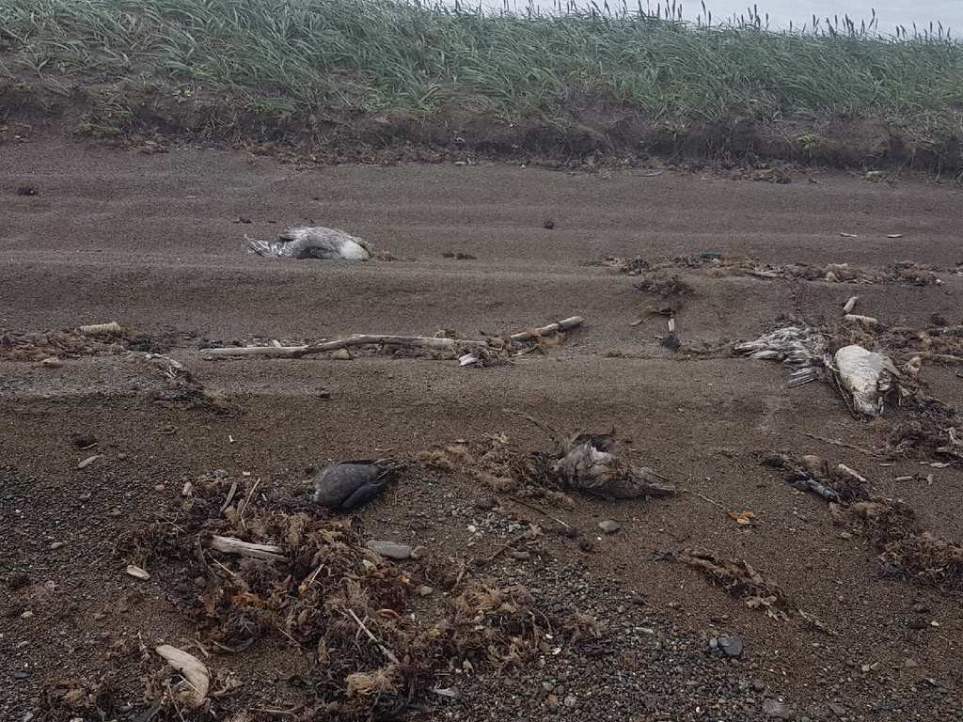

Conclusions from multispecies die-off in Bering/Chukchi seas:
STX suspected but not confirmed as a factor in mortalities, at least among Northern Fulmars
Starvation identified as proximate cause of death
Tissue concentrations suggest harmful STX exposure
Effects of sublethal STX exposure on seabirds unknown

Slide 13
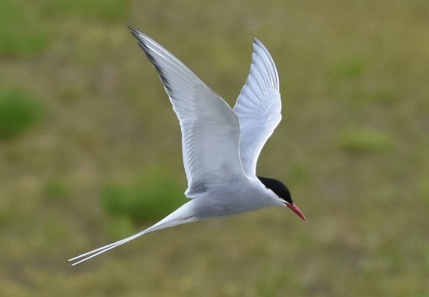
Arctic Tern die-off – Southeast Alaska 2019
~40 nestlings and ~5 adults found dead at Arctic Tern colonies near Juneau, AK
No obvious cause of death; fair to good body condition
HAB event documented concurrently in Southeast Alaska
Photo: G. Baluss

Slide 14
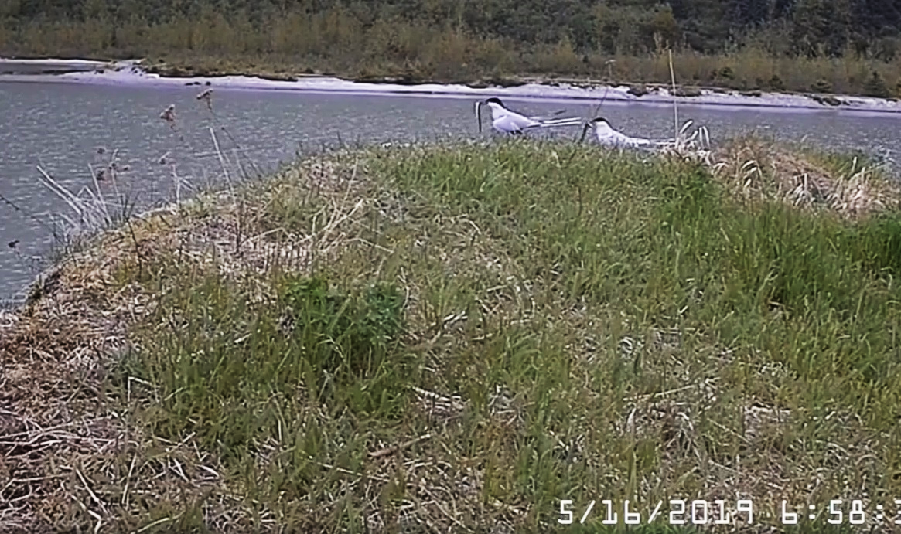
Background: Local HAB event
Sand lance observed in bill deliveries (known to accumulate STX)
*Human regulatory limit: 80 µg 100 g⁻¹
Courtesy Gwen Baluss/US Forest Service

Slide 15
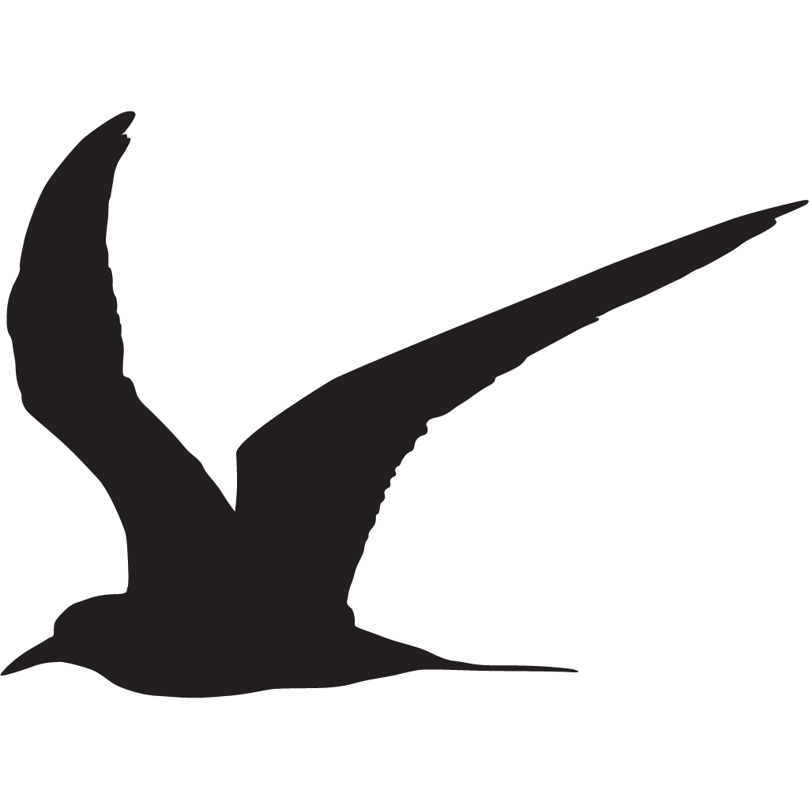
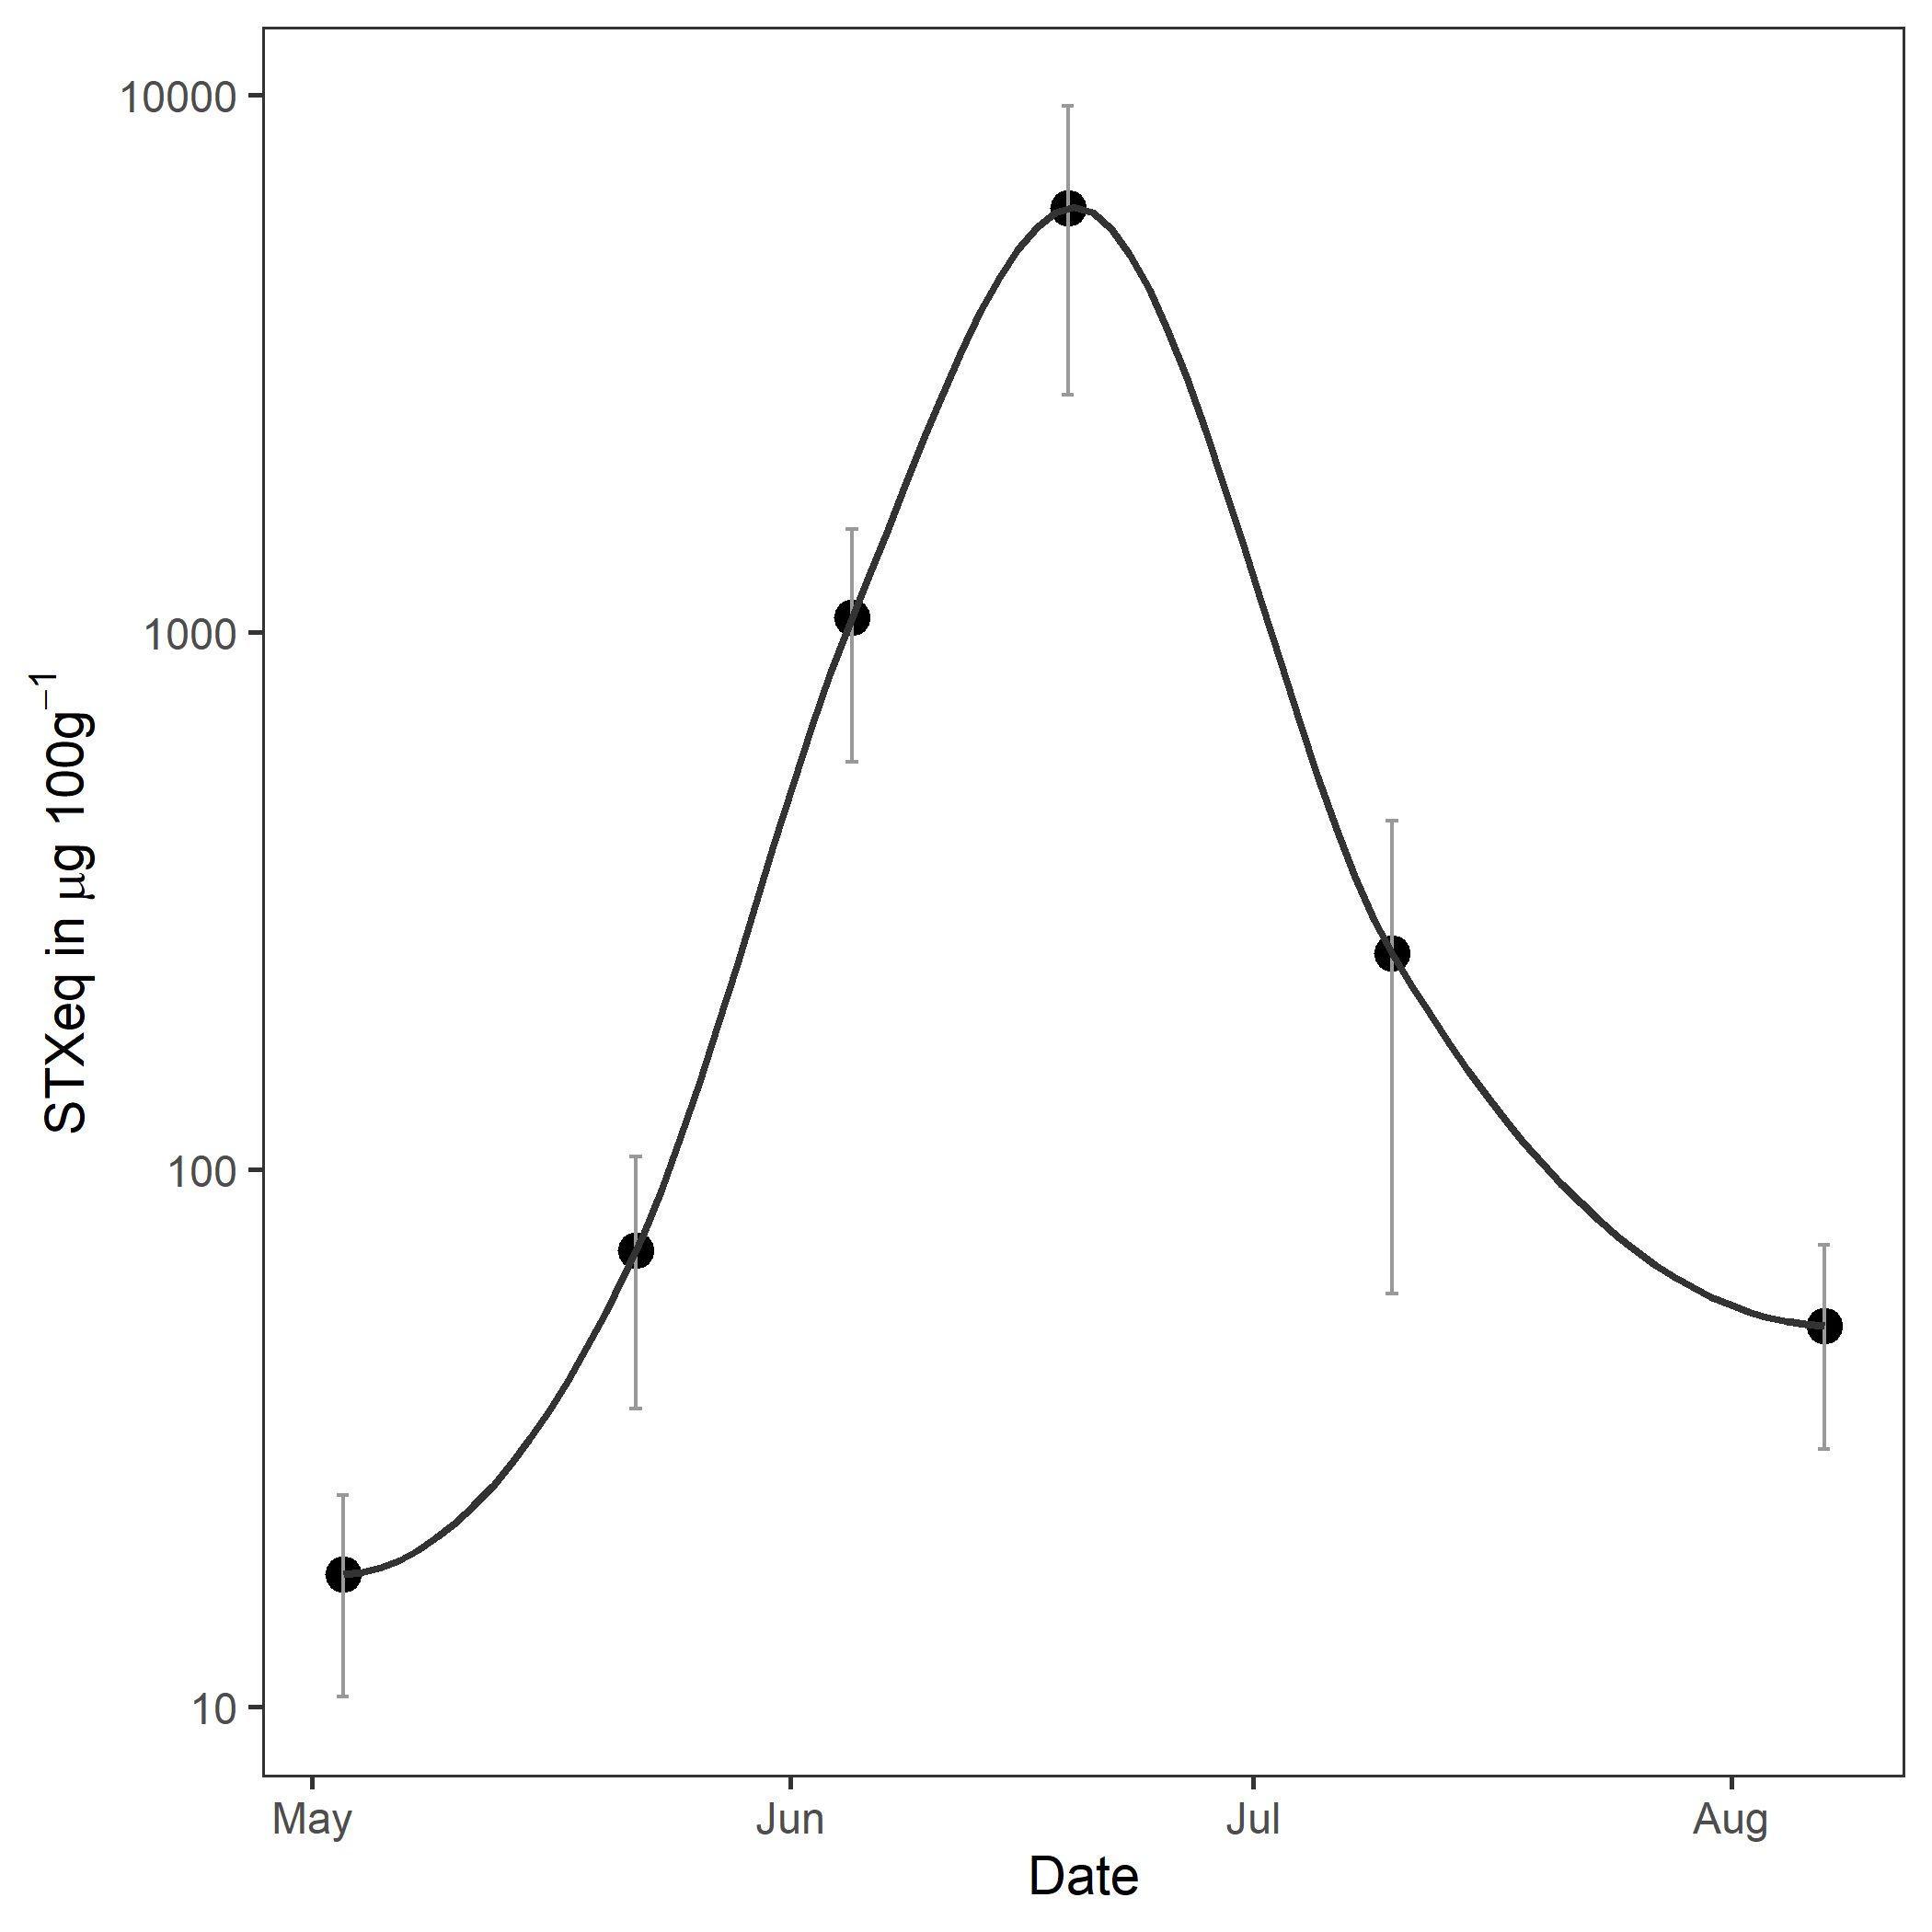
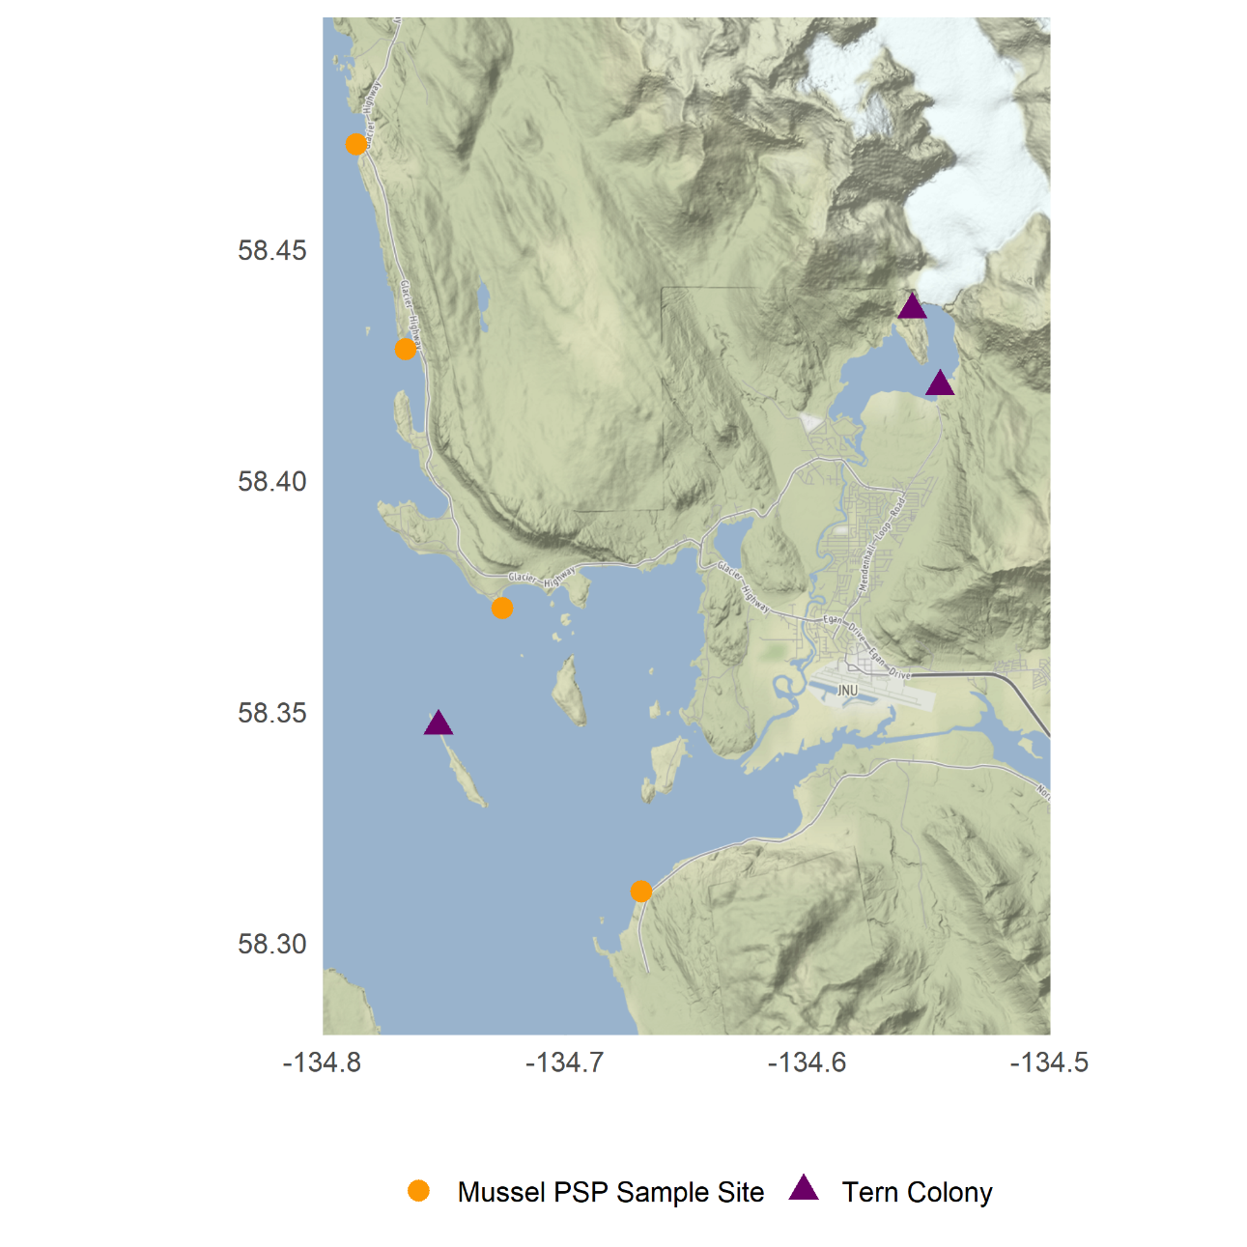

STX in blue mussels
Human regulatory limit: 80 µg 100 g⁻¹
Data courtesy of J. Harley
Mussel collection site
Tern colony
*Provisional data subject to review and revision

Slide 16
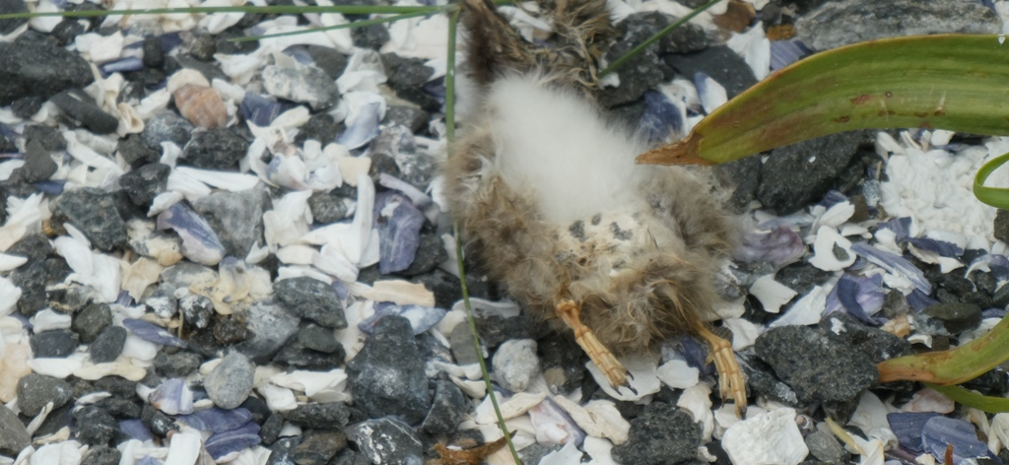
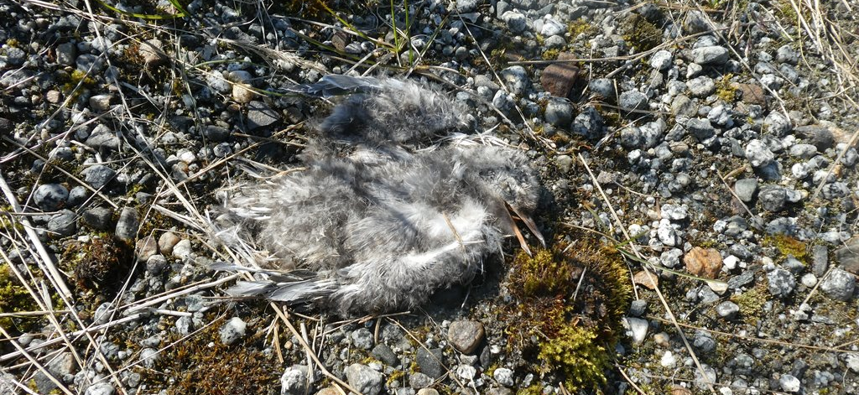
STX concentrations in Arctic Tern carcasses
STX detected in 1/1 adult and 3/4 nestlings tested
STX concentrations = 2 – 51 µg 100 g⁻¹
Many carcasses unsuitable for testing
*Provisional data subject to review and revision

Slide 17
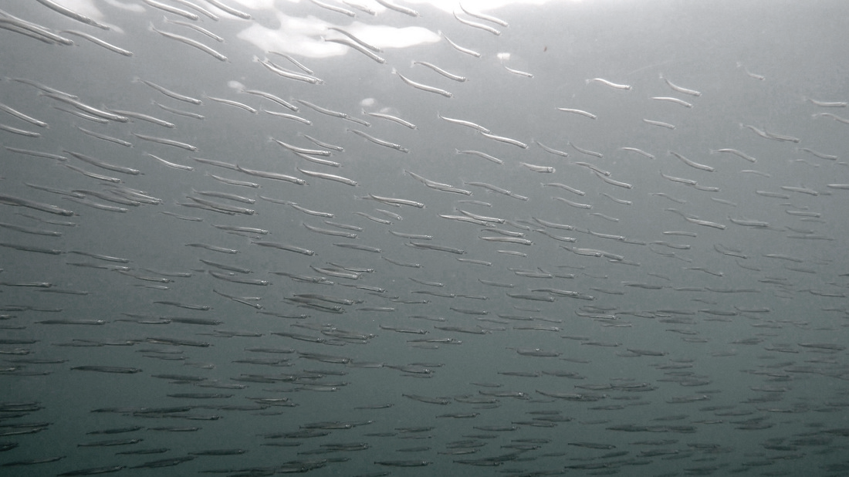
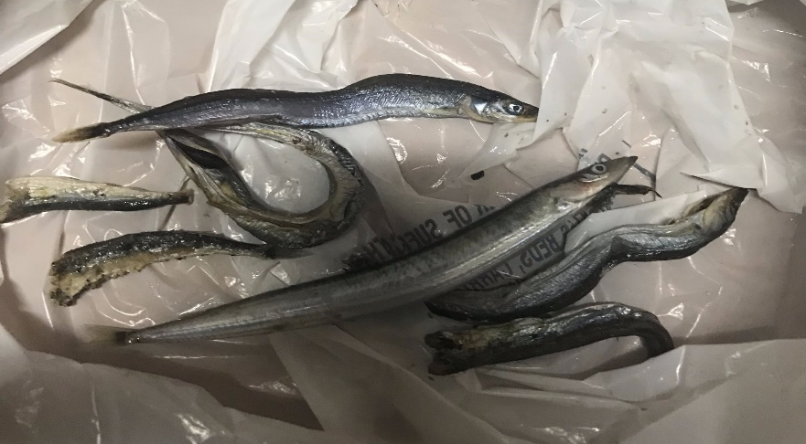
STX concentrations in forage fish
Sand lance and herring samples collected from tern nest sites and nearby bays
All forage fish samples (n = 12) STX positive
STX-eq concentrations up to 494 µg 100 g⁻¹
Lethal dose likely with a single feeding
Sand lance observed in bill deliveries (known to accumulate STX)
*Provisional data subject to review and revision
Photo: centralcoastbiodiversity.org
Courtesy Gwen Baluss/US Forest Service

Slide 18
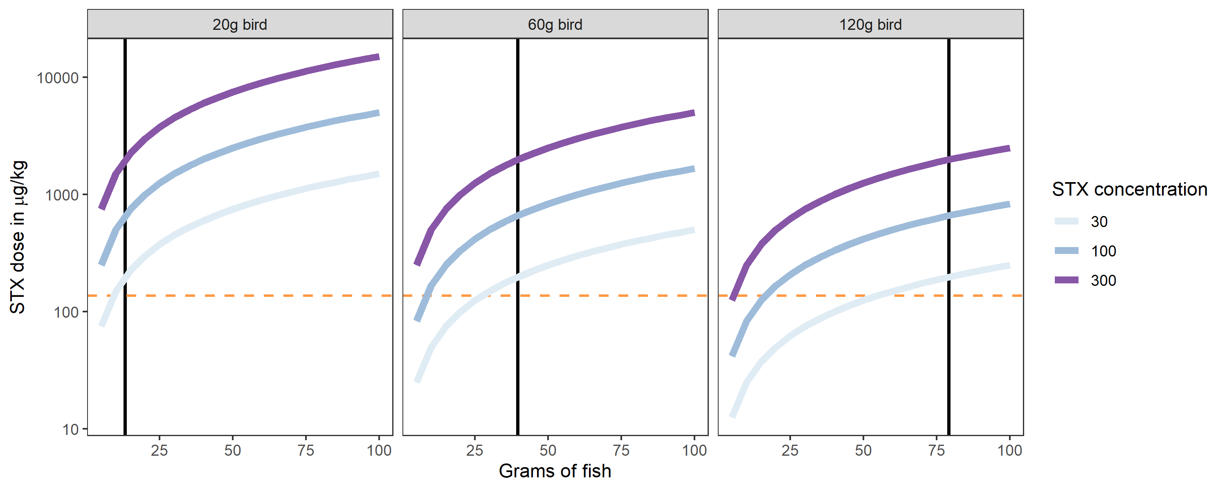
Tern energetics and estimated daily STX dose
Forage fish
STX concentration
µg 100 g⁻¹
Mallard LD50
(Dusek et al. in prep)
Daily
Daily energetic demand
Daily energetic demand
Daily energetic demand
(Tern and forage fish energetic values from Van Pelt et al. 1998, Uttley et al. 1994, Klaassen et al. 1989)
*Provisional data subject to review and revision

Slide 19
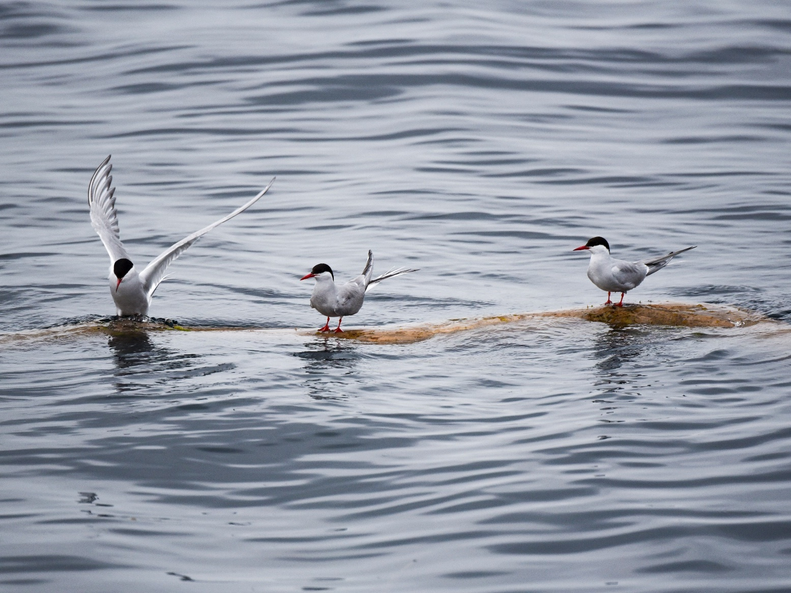
STX implicated in Arctic Tern die-off
Intense, prolonged HAB event
Concentrations in birds within range of other STX-induced die-off events
Concentrations in forage fish delivered to nest sites sufficient to cause acute mortality
Photo: S. Schoen
*Provisional data subject to review and revision

Slide 20
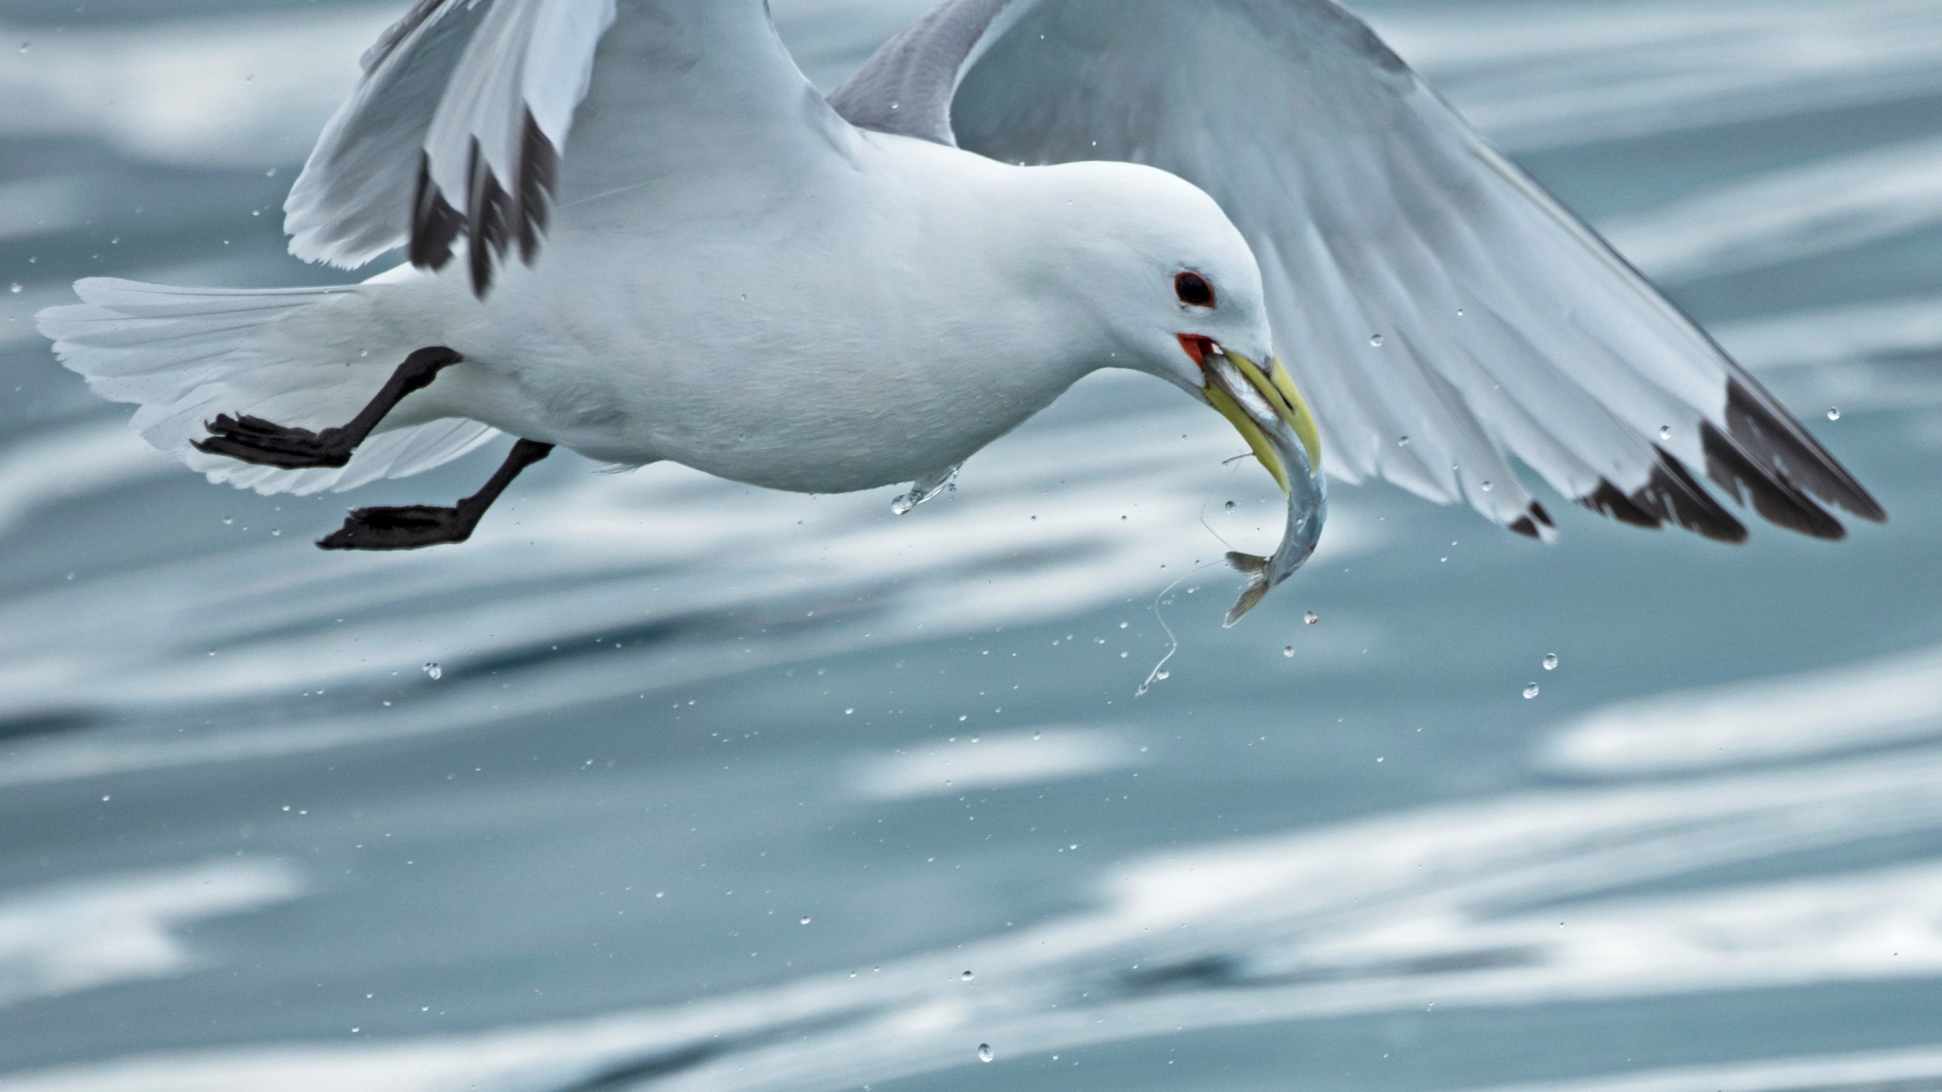
CONCLUSIONS
Photo: S. Schoen
STX linked to seabird mortality events in multiple regions of Alaska
Harmful/lethal doses of STX readily accumulated through prey
DA also present in the food web
HAB toxins should be considered in future die-offs and general assessments of seabird health

Slide 21
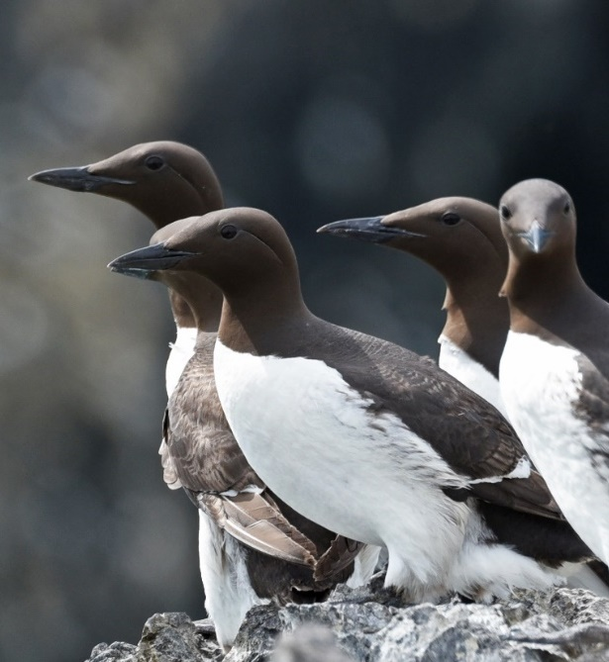
FUTURE DIRECTIONS
Ongoing investigation of HAB toxins in seabird mortality events
Effects of STX on seabird behavior and physiology (captive study in collaboration with Alaska SeaLife Center)
Distribution of HAB toxins in marine food web (seabirds as apex predators)
Biogeography of HAB toxins in Alaska seabirds
Photo: S. Schoen

Slide 22
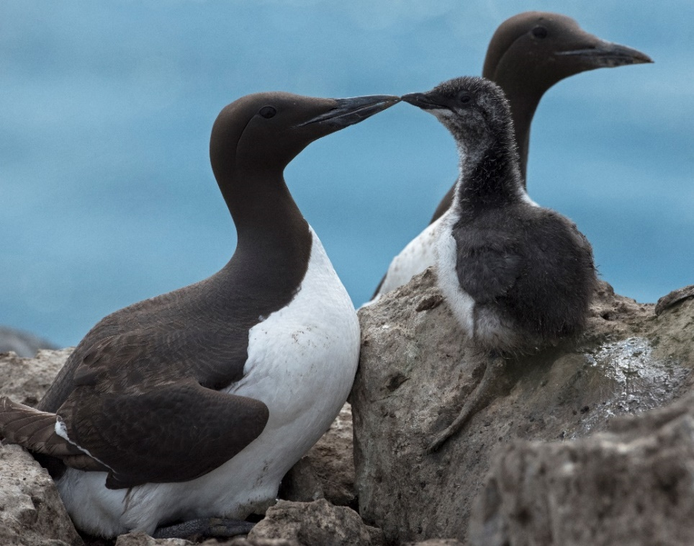


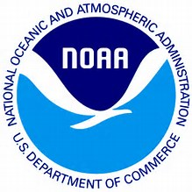

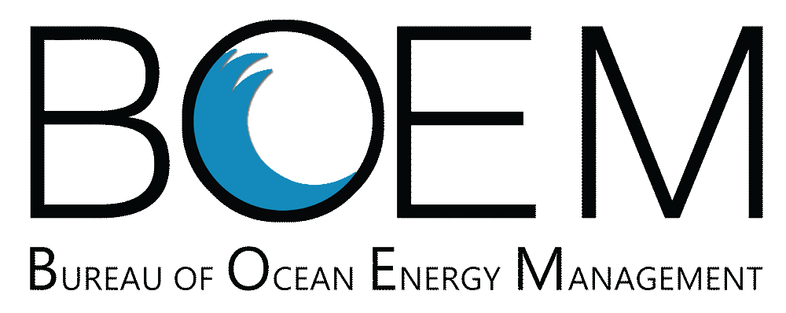



ACKNOWLEDGMENTS
Photo: S. Schoen
Funding and in-kind support: U.S. Geological Survey Alaska Science Center, National Wildlife Health Center, and Eco-Flex and Outer Continental Shelf (OCS) programs, NOAA, USFWS, NPS, and BOEM.
Field, lab and other support: Amber Wendler, Frank Spellman, Danielle Gerik, Rance Hardison, Yumi Arimitsu, Valerie Shearn-Bochsler, Julia Lankton, Robin Corcoran, Sitka Tribe of Alaska, SEATOR, Julia Parrish, Timothy Jones, COASST, residents of Bering Strait region.

