Slide 1
Circumpolar One Heath Winter 2018-19 Climate Review
Rick Thoman
Alaska Center for Climate Assessment and Policy
March 12, 2018

Slide 2
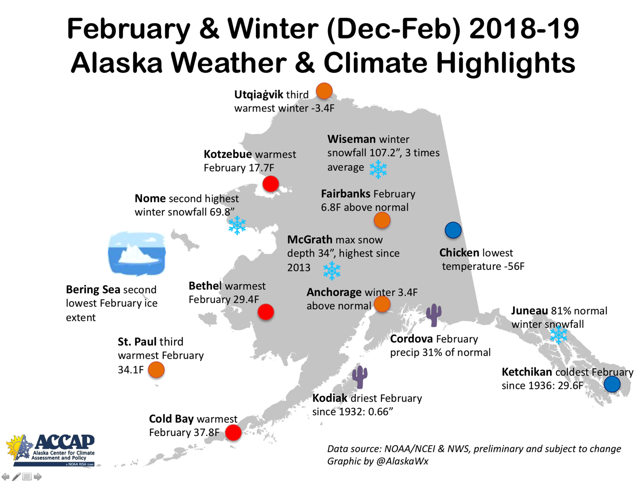

Slide 3
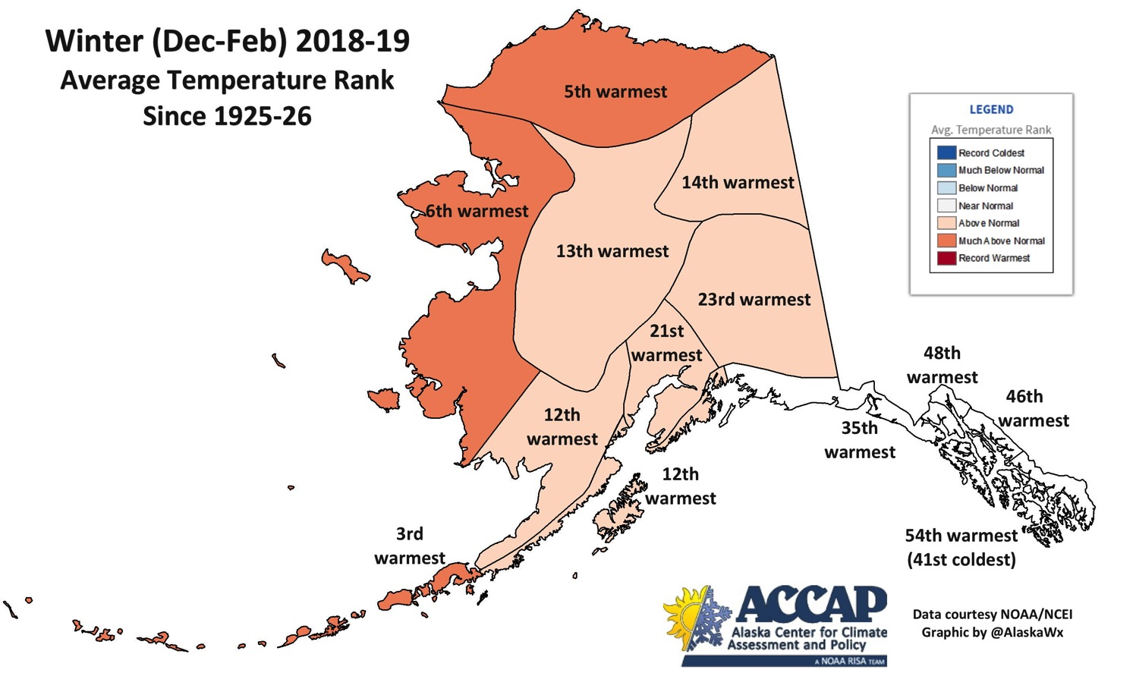
Warm North and West, Normal SE

Slide 4
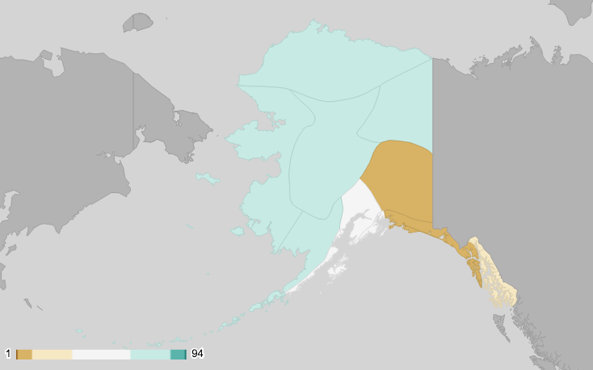
December-February 2018-19 Precipitation: Big Regional Differences

Slide 5
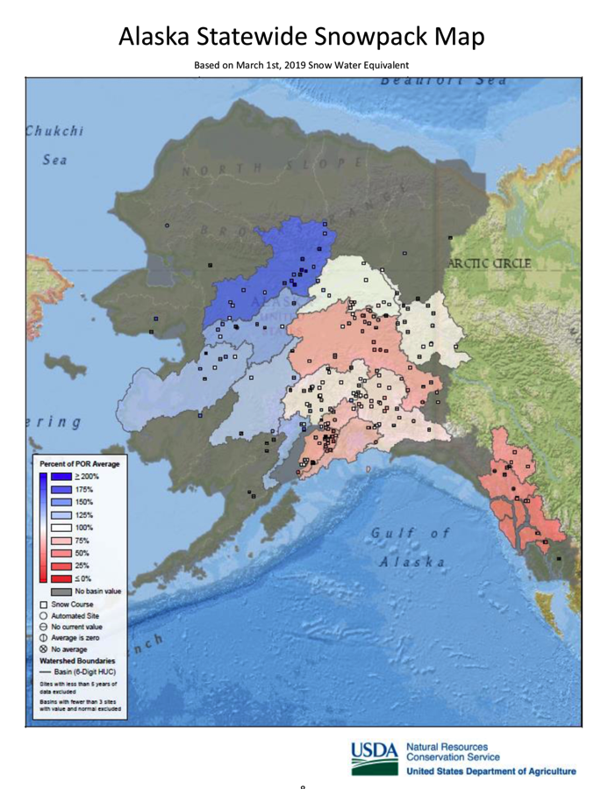
March 01 Snowpack Analysis

Slide 6
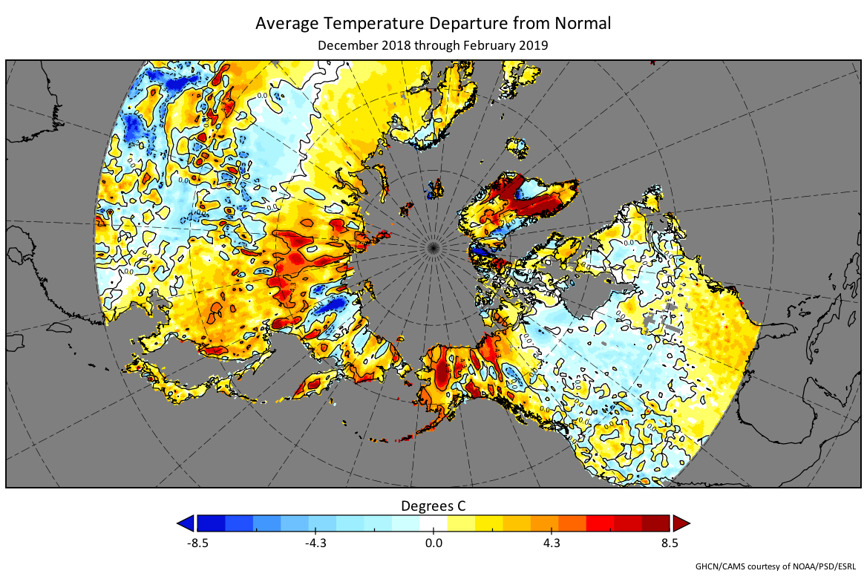
Land Temperatures

Slide 7
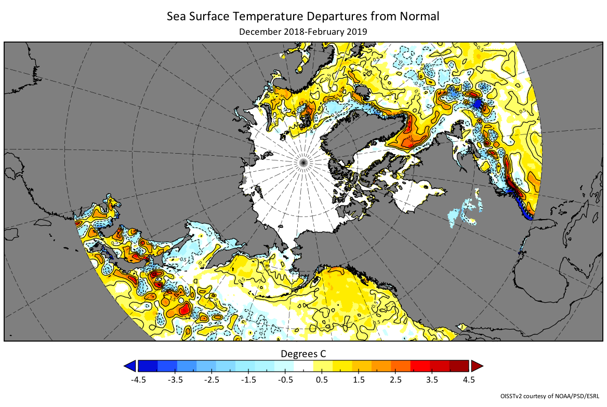
Ocean Temperatures

Slide 8
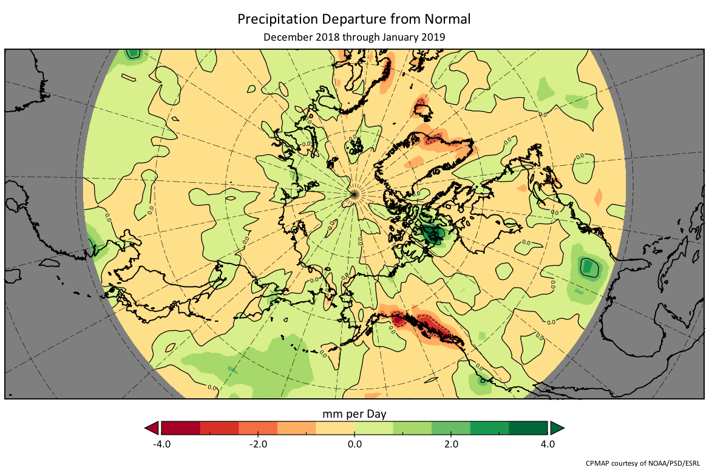
Precipitation

Slide 9
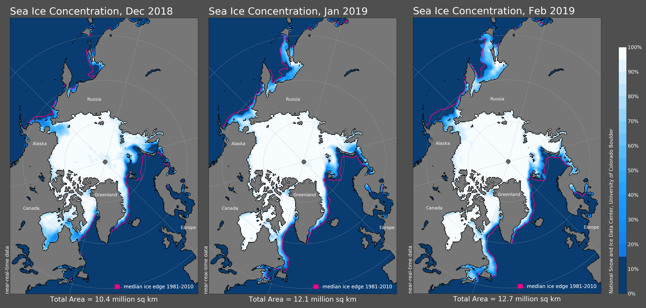
Sea Ice

Slide 10
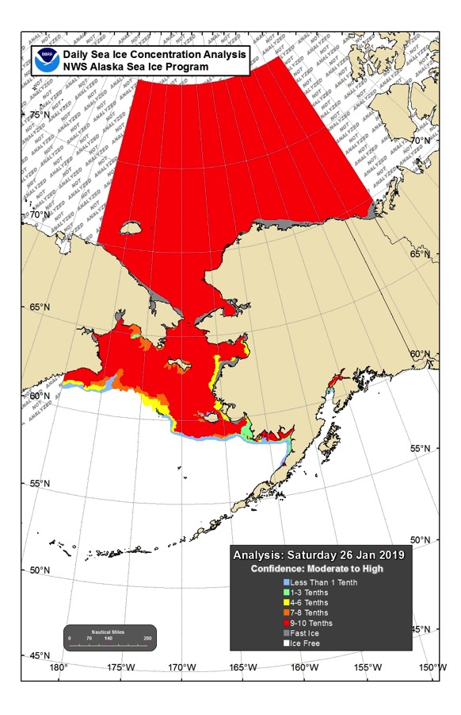
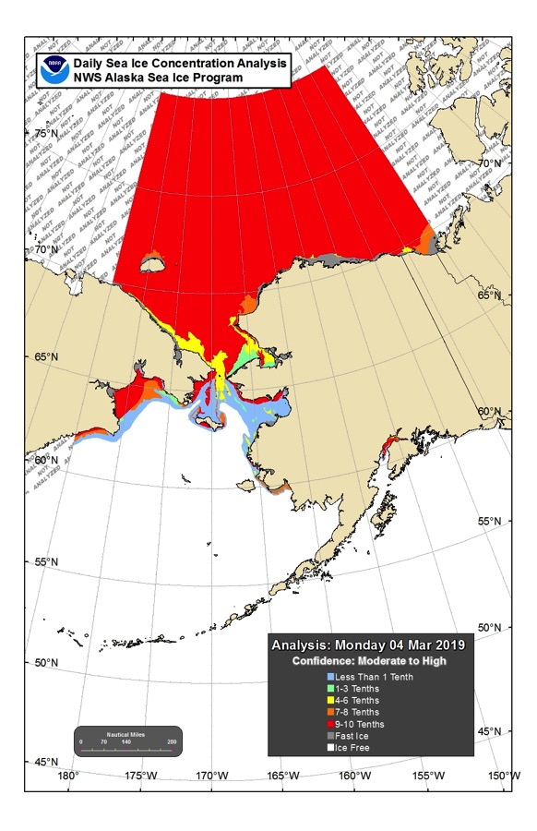
Bering Sea Ice Loss
January 26, 2019
March 04, 2019

Slide 11
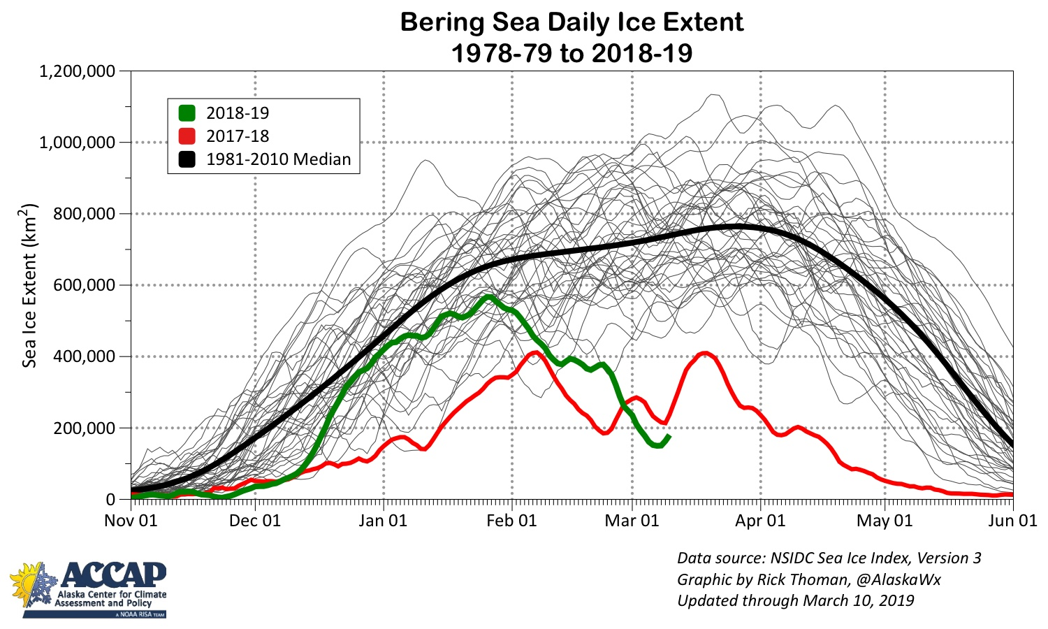
Daily Ice Extent

