Slide 1
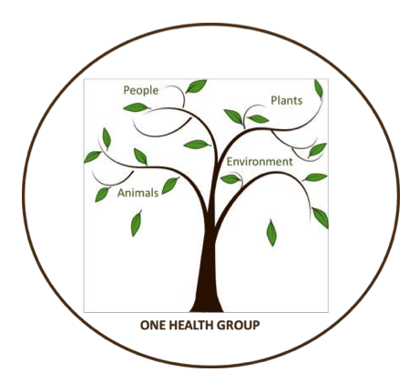
Circumpolar One Heath Winter 2021-22 Climate Review and Spring 2022 Outlook
Rick Thoman
Alaska Center for Climate Assessment and Policy
University of Alaska Fairbanks
March 15, 2021

Slide 3
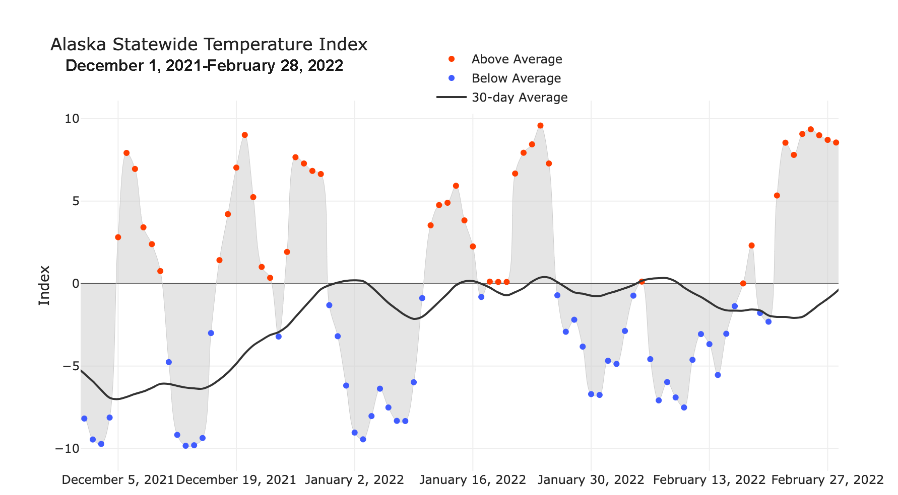
Alaska Daily Temperature Index
Online: http://accap.uaf.edu/tools/statewide-temperature-index

Slide 4
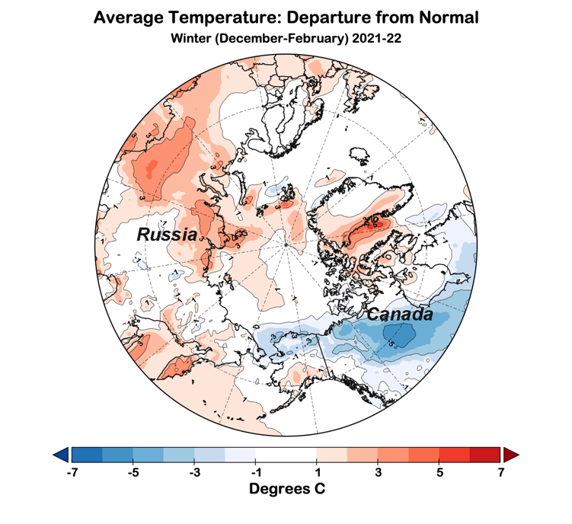
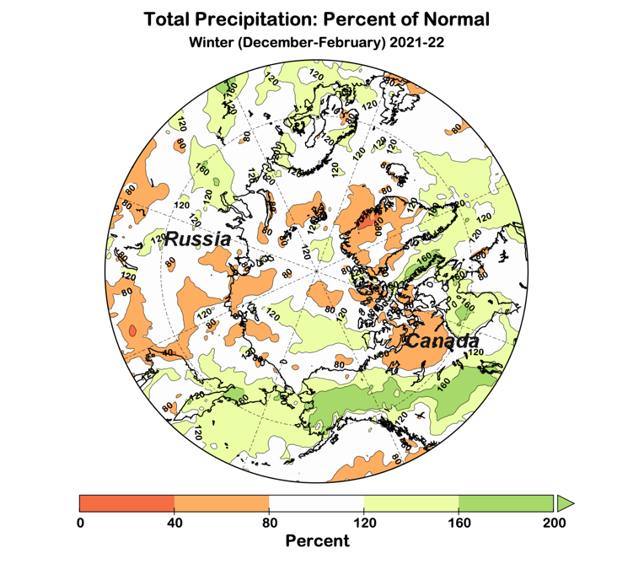
Winter 2021-22 Arctic-wide
Temperature Departures from Average
Precipitation Percent of Average
Data: ERA5 courtesy of EMCWF/Copernicus
1991-2020 Baseline

Slide 5
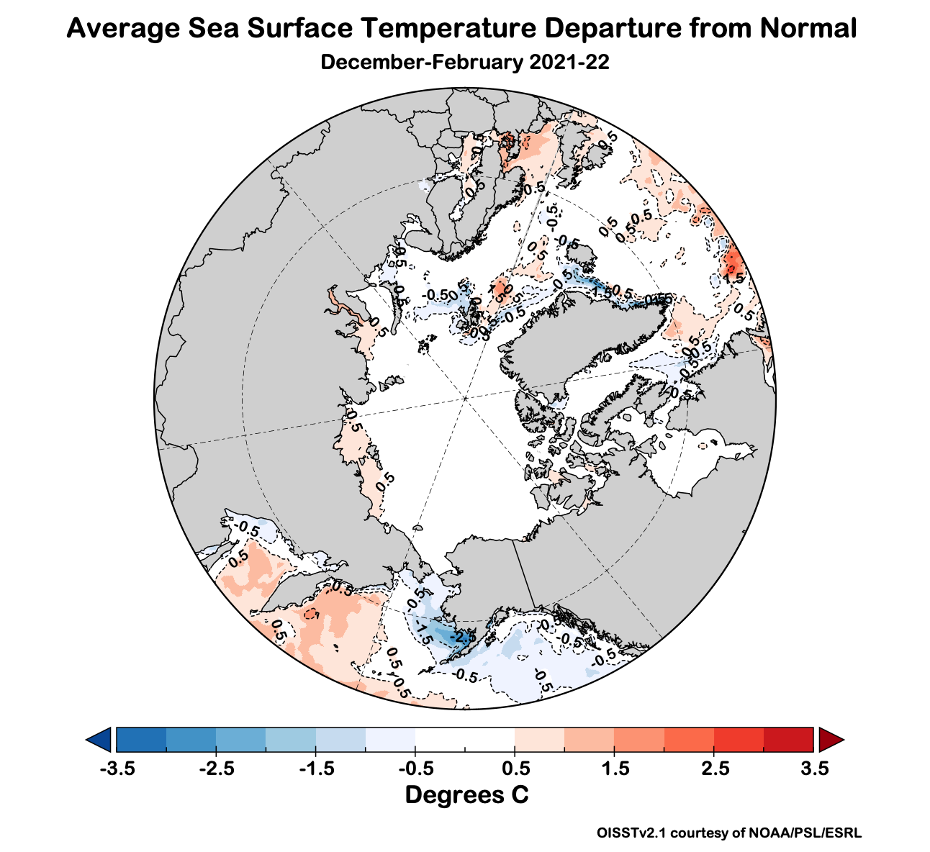
Winter 2021-22 Ocean Temperatures

Slide 6
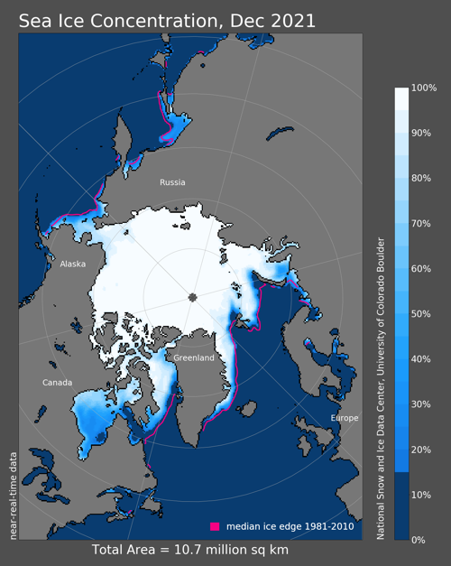
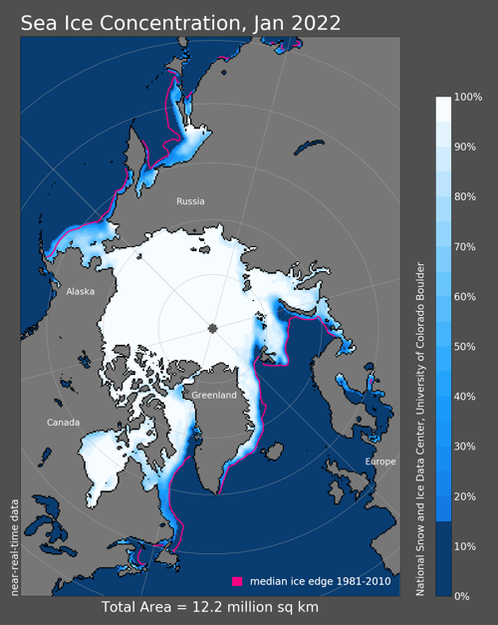
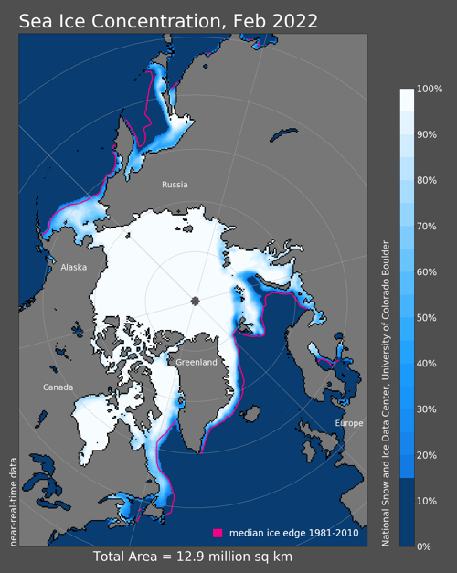
Sea Ice Winter 2021-22
13th lowest
16th lowest
14th lowest
Since 1979

Slide 7
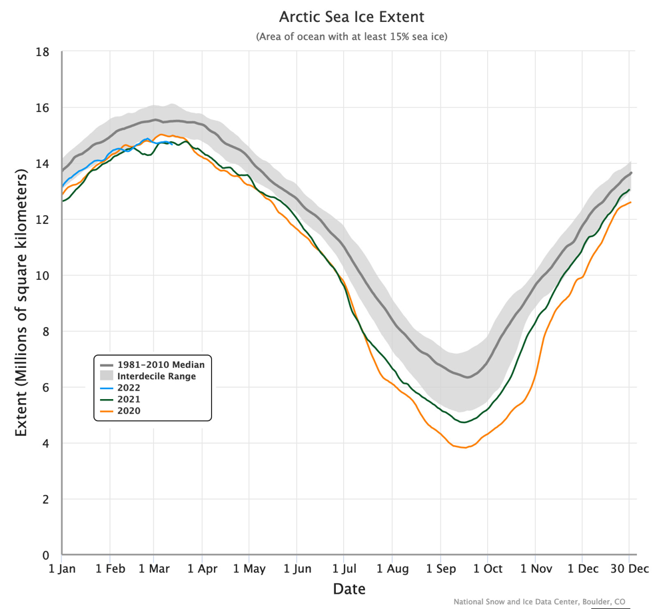
Daily Arctic Sea Ice Extent
Through March 13

Slide 8
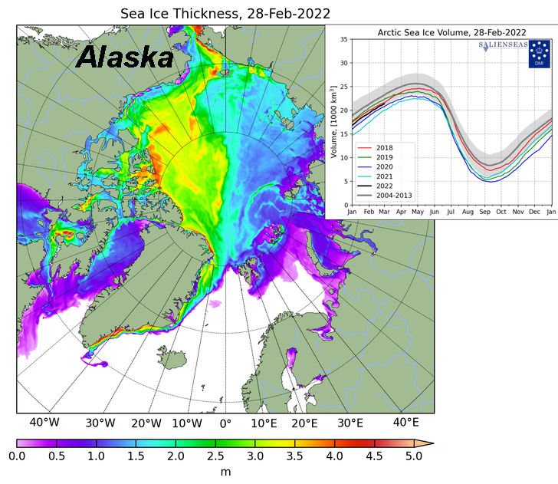
Sea Ice Thickness

Slide 9
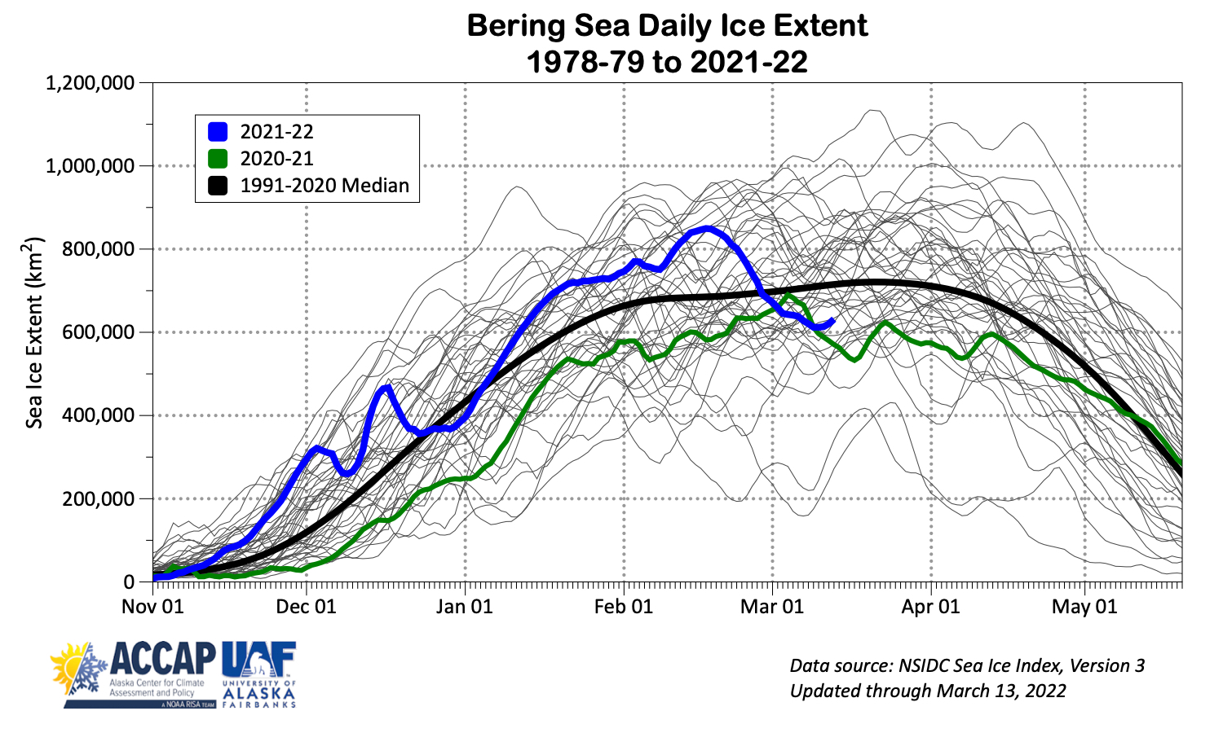
Bering Sea Ice Extent

Slide 10
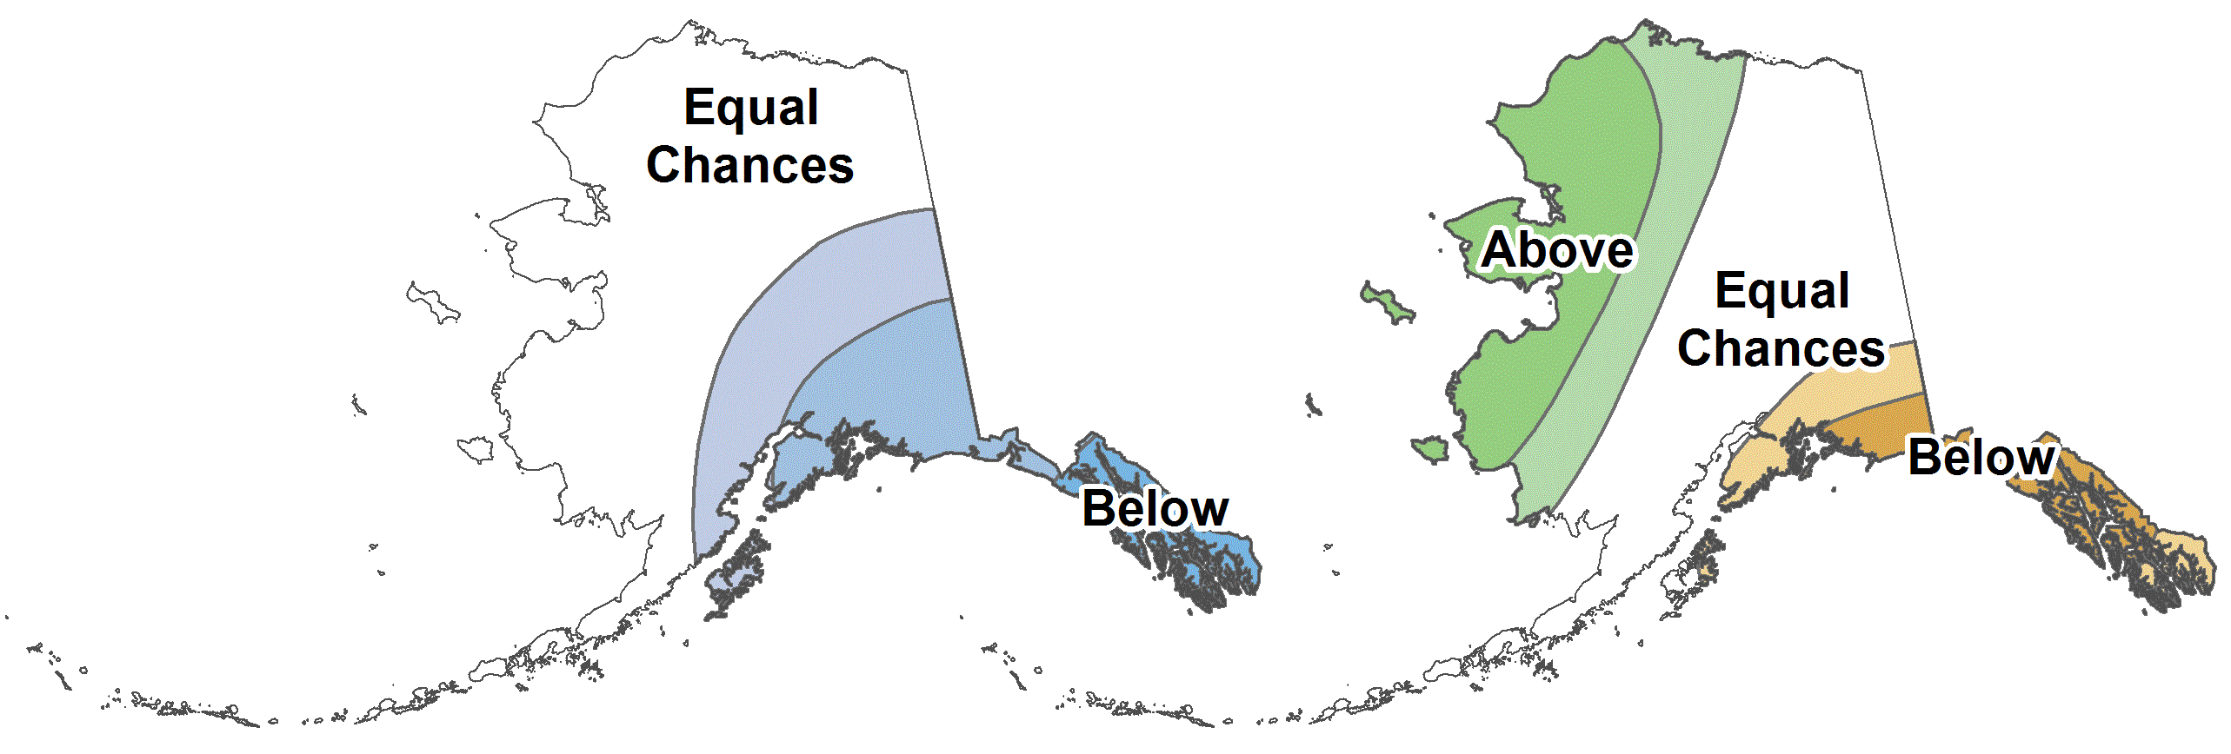
CPC March-May 2022 Outlook
33%
33%
33%
45%
33%
22%
33%
33%
33%
25%
33%
45%
12%
33%
55%
30%
33%
37%
33%
33%
33%
25%
33%
45%
30%
33%
37%
37%
33%
30%
Above%
Normal%
Below%

Slide 11
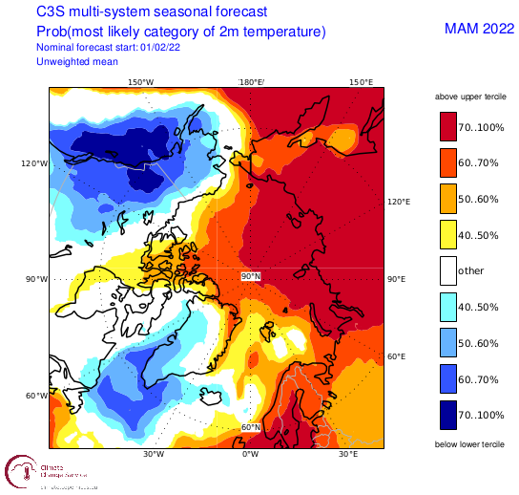
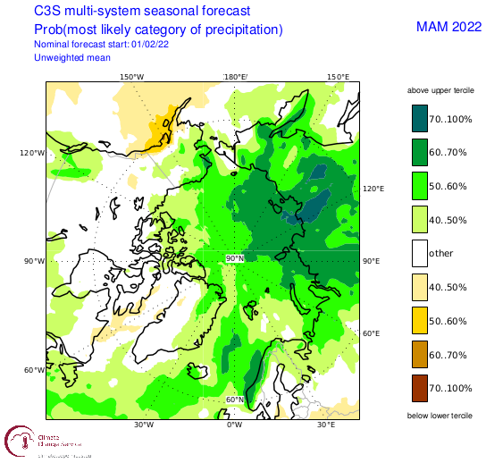
Spring 2022 Arctic Temperature and Precipitation Outlook
Outlooks courtesy Copernicus C3S (Climate Change Service)

Slide 12
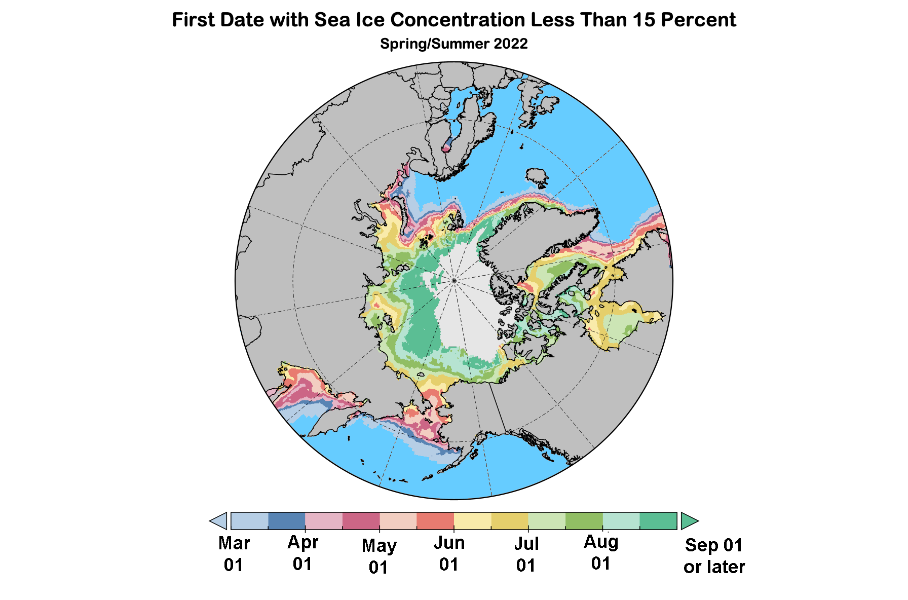
Sea Ice Outlook: First Open Water
Data: NOAA/Climate Prediction Center Exp. Sea Ice Outlook

Slide 13
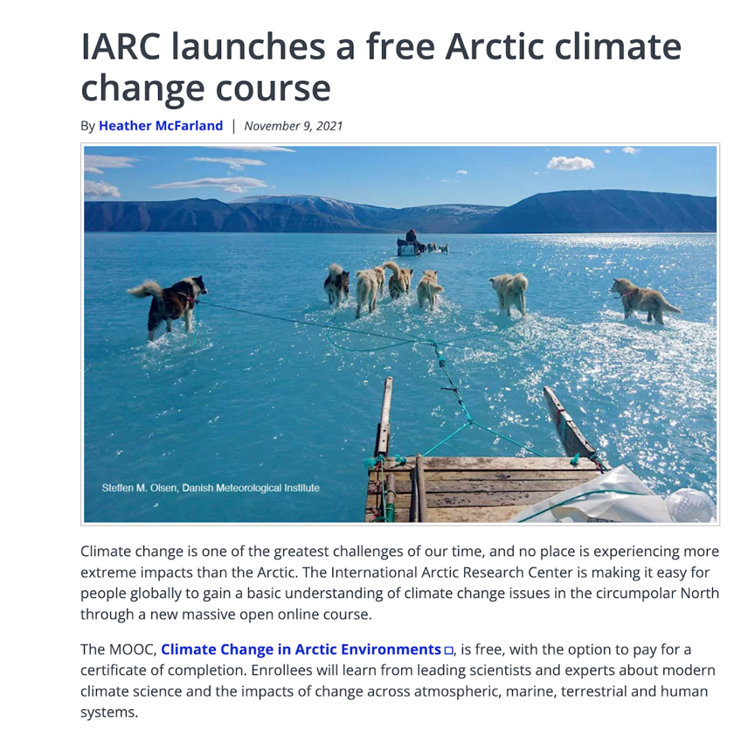
Promo: Climate Change In Arctic Environments
Climate Change In Arctic Environments
Online, free class
Series of short videos from experts
More than just physical science
Open until May 17
https://www.edx.org/course/climate-change-in-arctic-environments

Slide 14
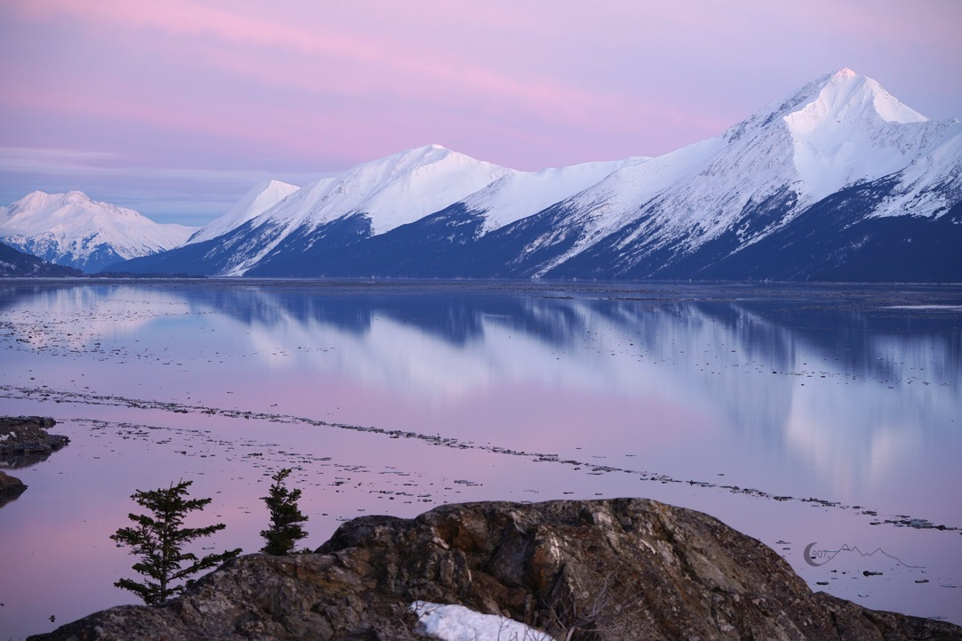
Thanks very much
Photo by D. Moore, Feb 27, 2022

