Slide 1
Circumpolar One Heath Winter 2023-24 Climate Review and Spring 2024 Outlook
Rick Thoman
Alaska Center for Climate Assessment and Policy
University of Alaska Fairbanks
March 12, 2024
rthoman@alaska.edu

Slide 3
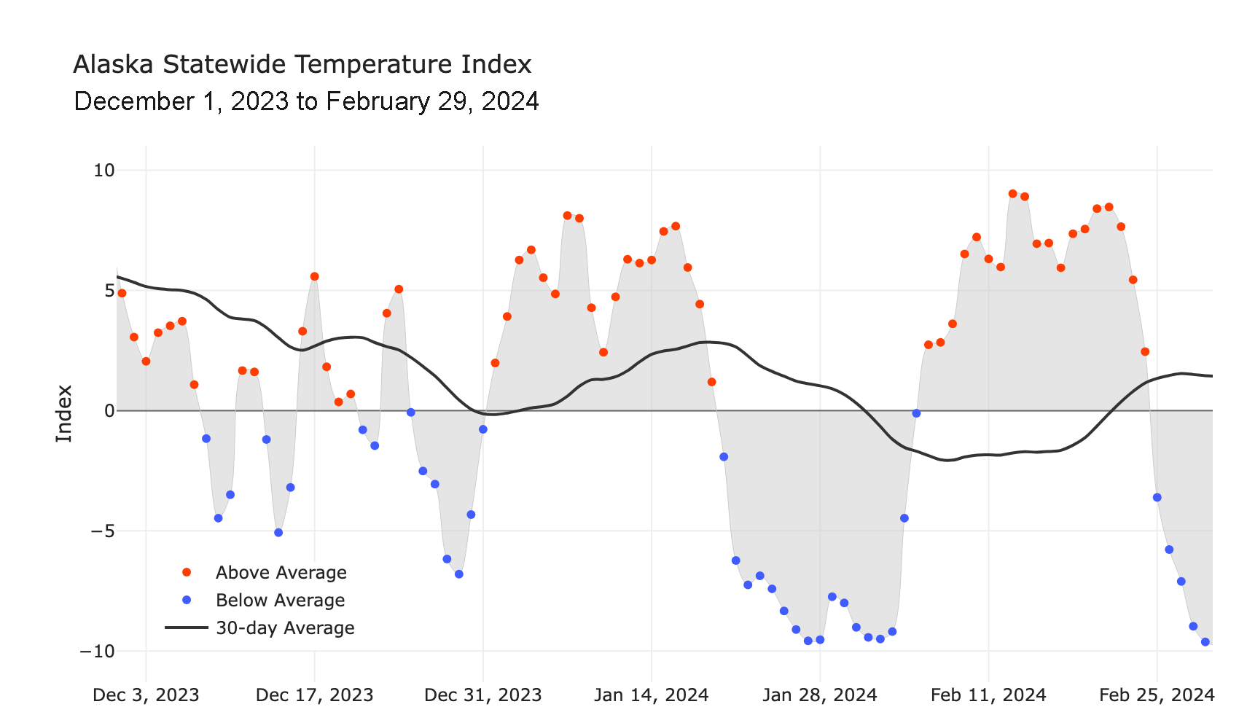
Alaska Daily Temperature Index
Online: http://accap.uaf.edu/tools/statewide-temperature-index

Slide 4
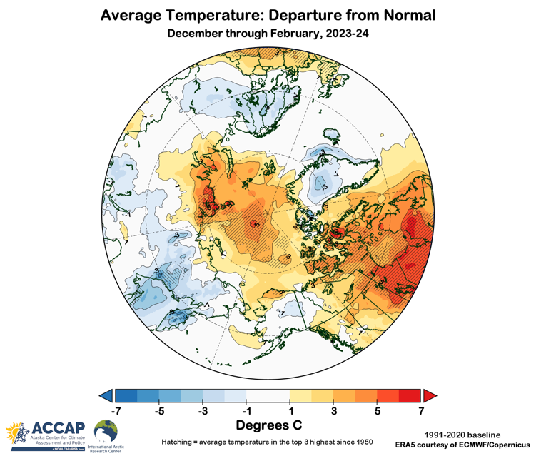
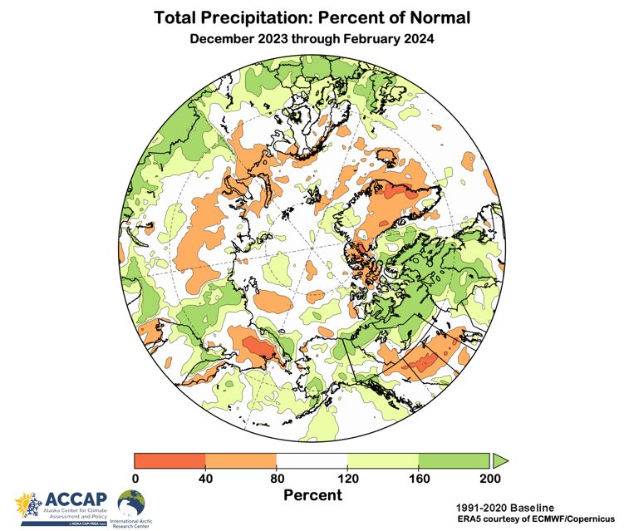
Winter 2023-24 T & P
5rd warmest winter
11rd wettest winter
Temperature Departures from Average
Precipitation Percent of Average
Data: ERA5 courtesy of EMCWF/Copernicus
1991-2020 Baseline

Slide 5
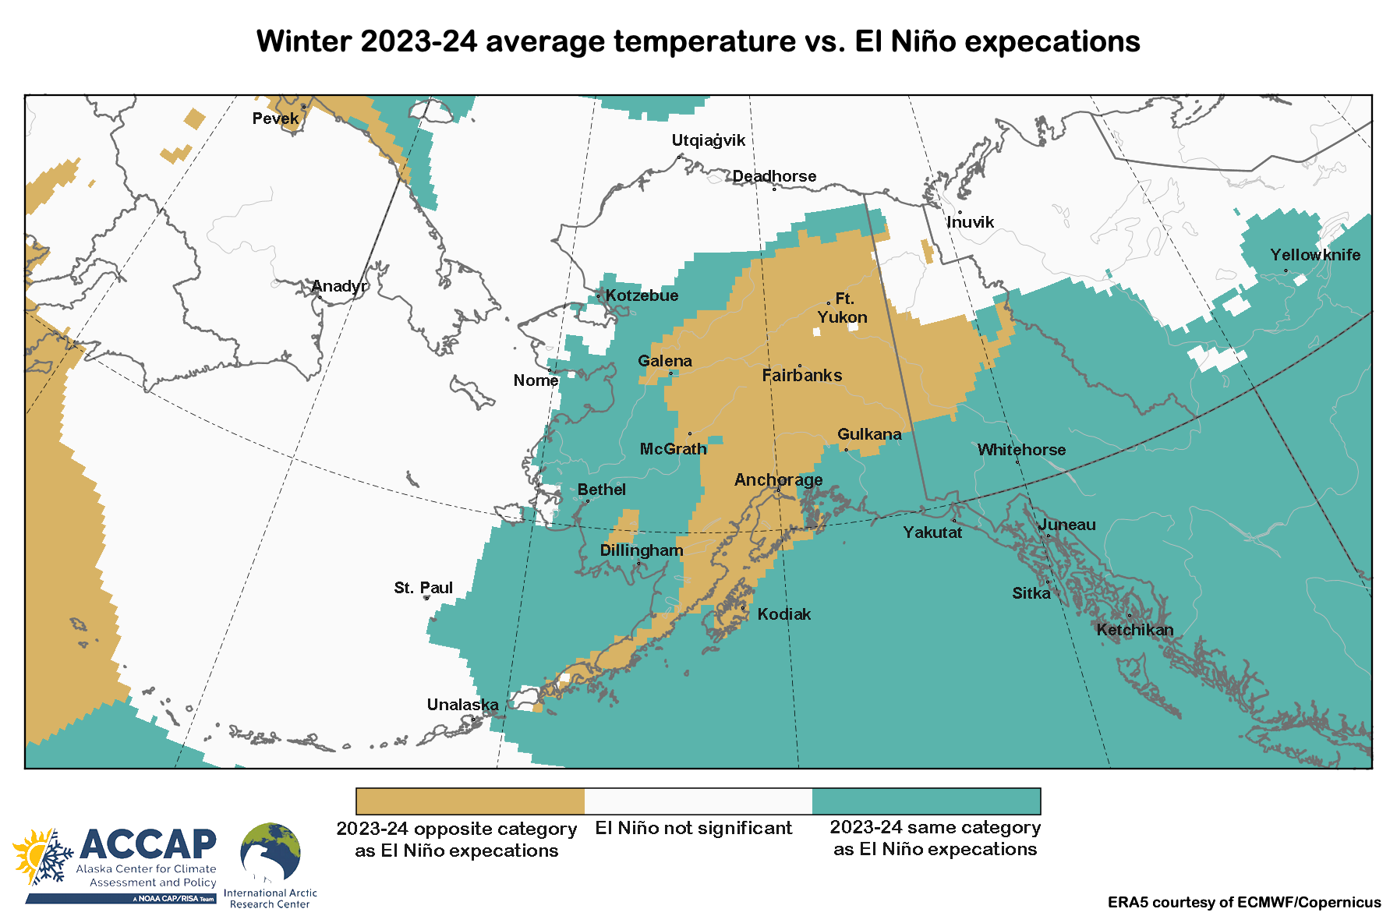
This winter compared to El Niños past

Slide 6
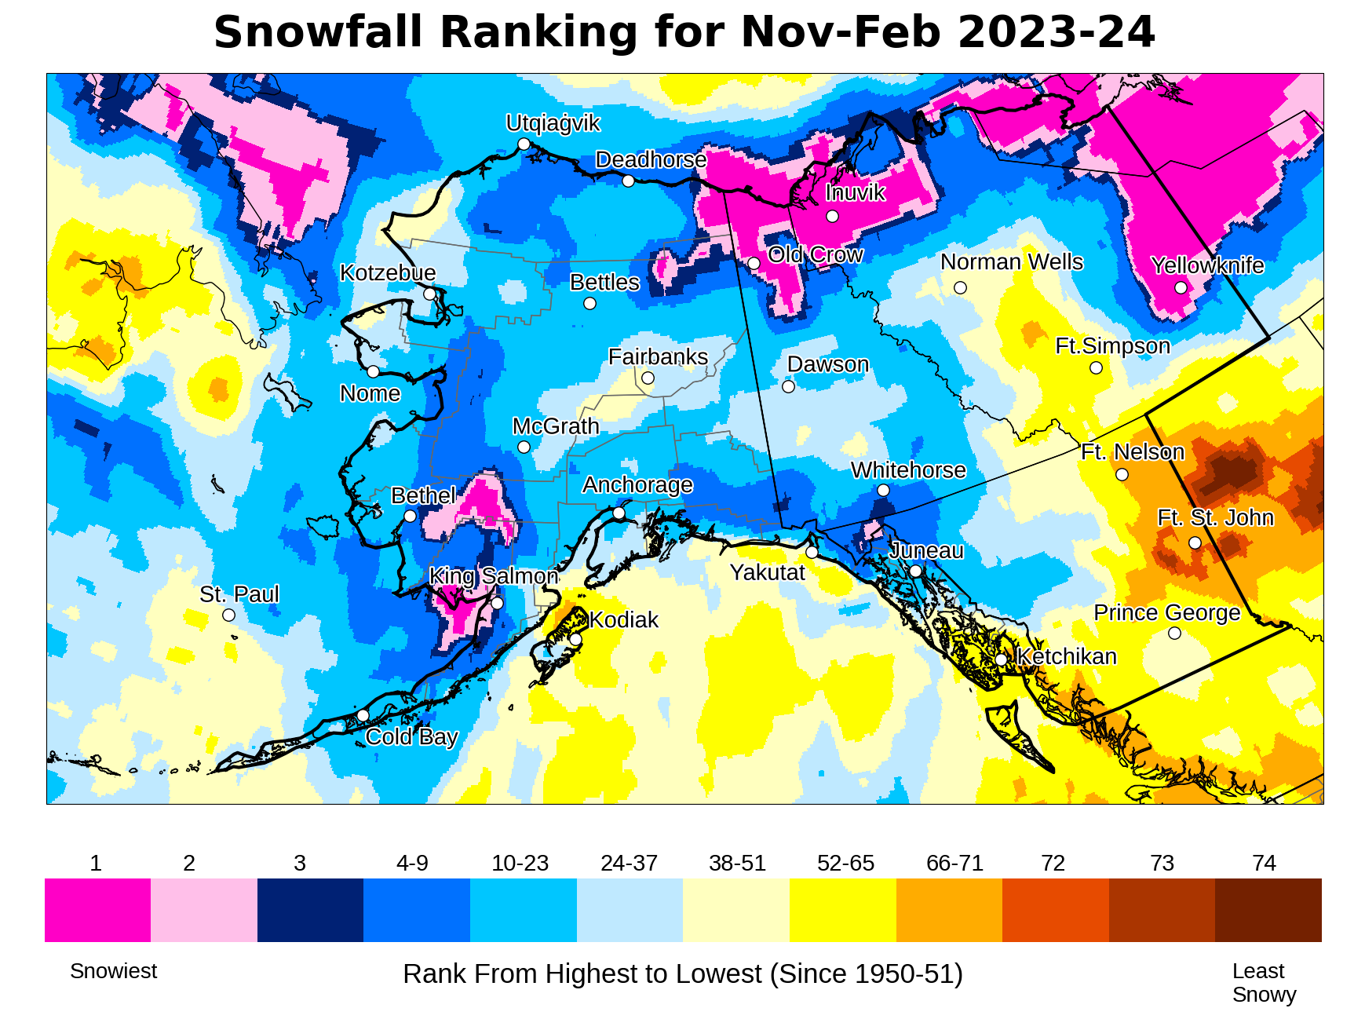
Winter Snowfall Ranks
Courtesy B. Brettscheinder/NWS

Slide 7
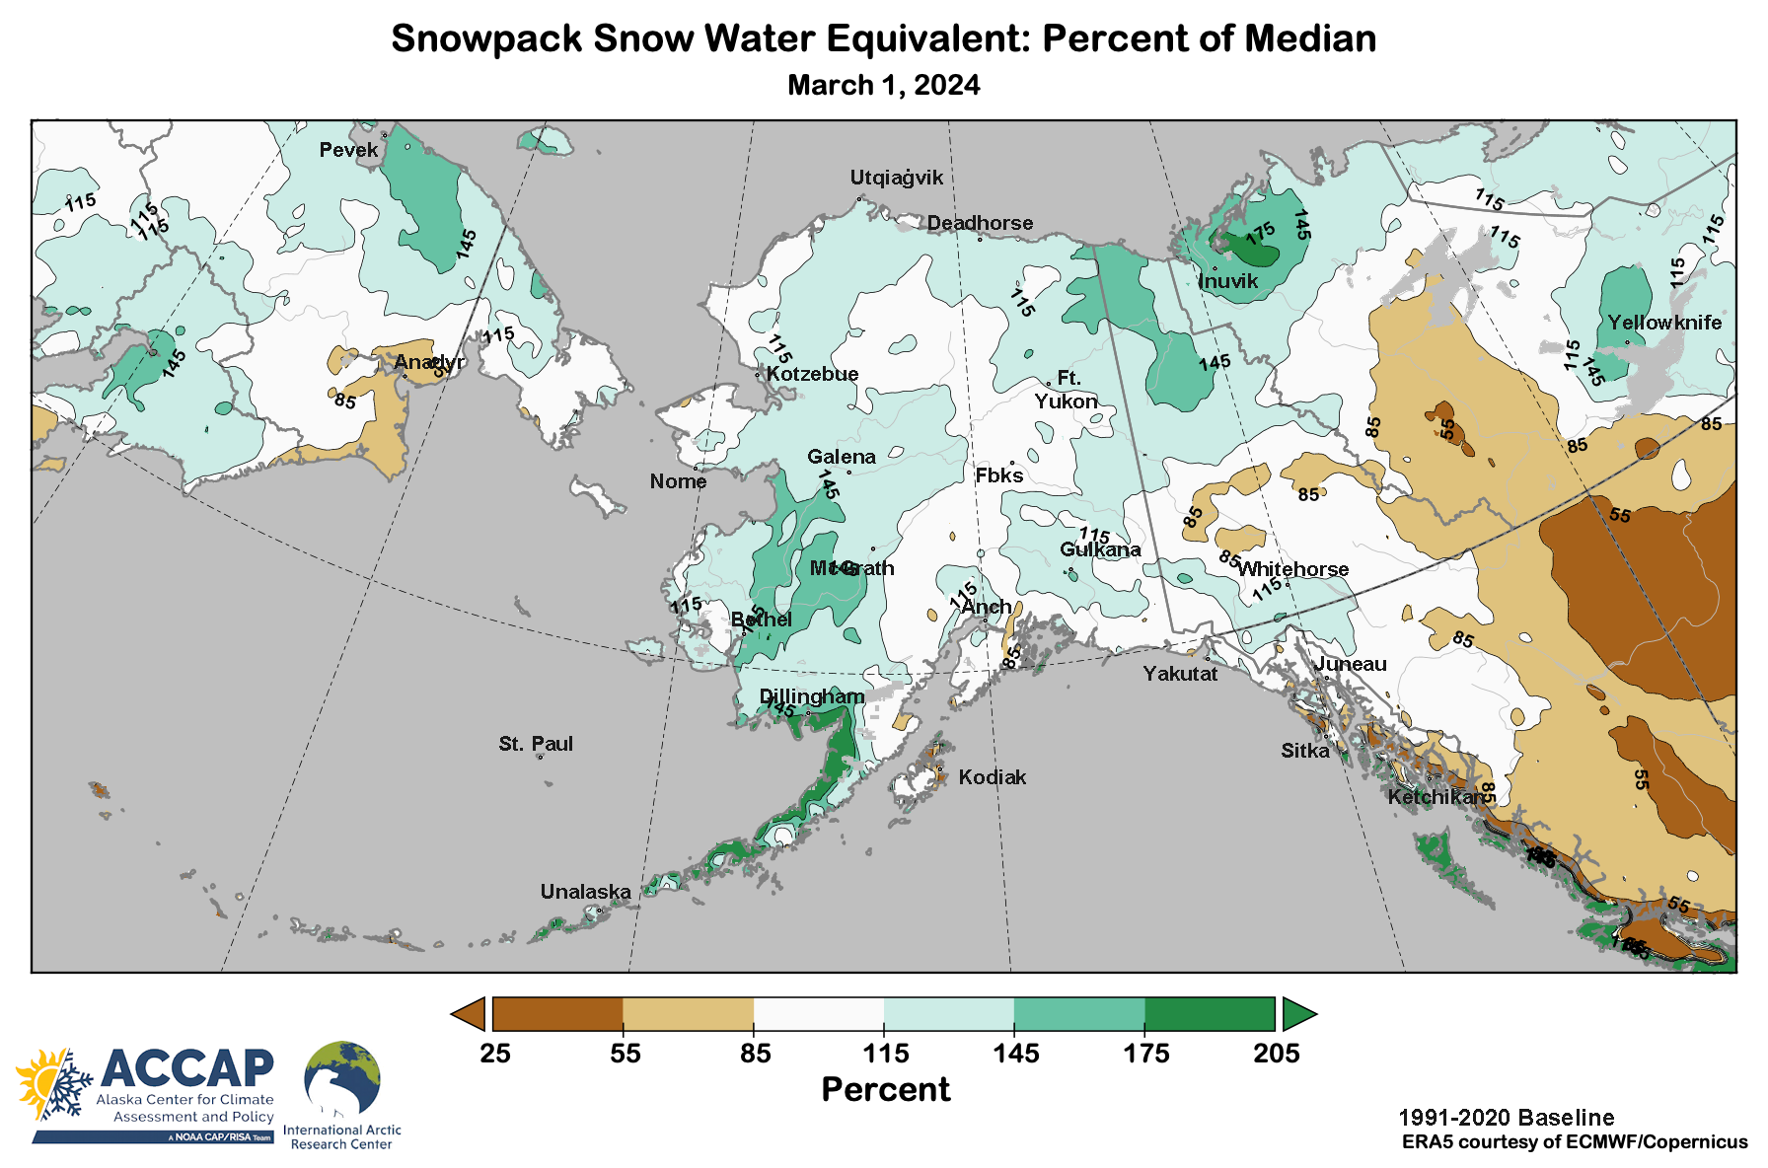
Snowpack analysis

Slide 8
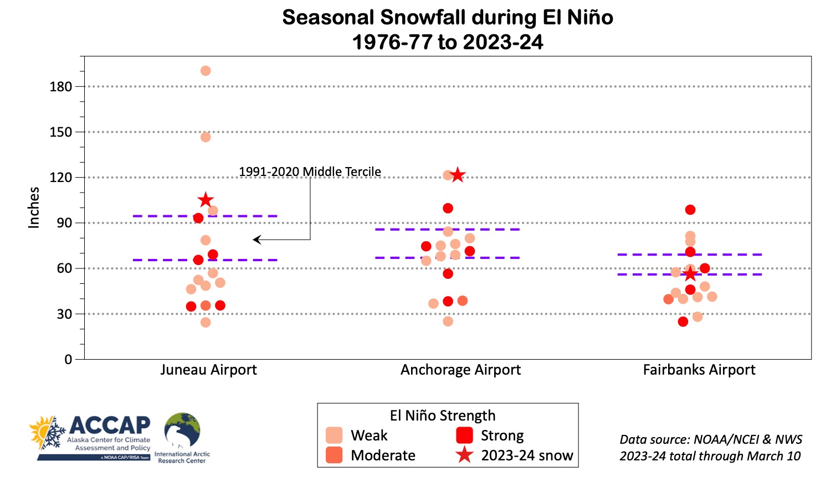
Snowfall vs El Niño

Slide 9
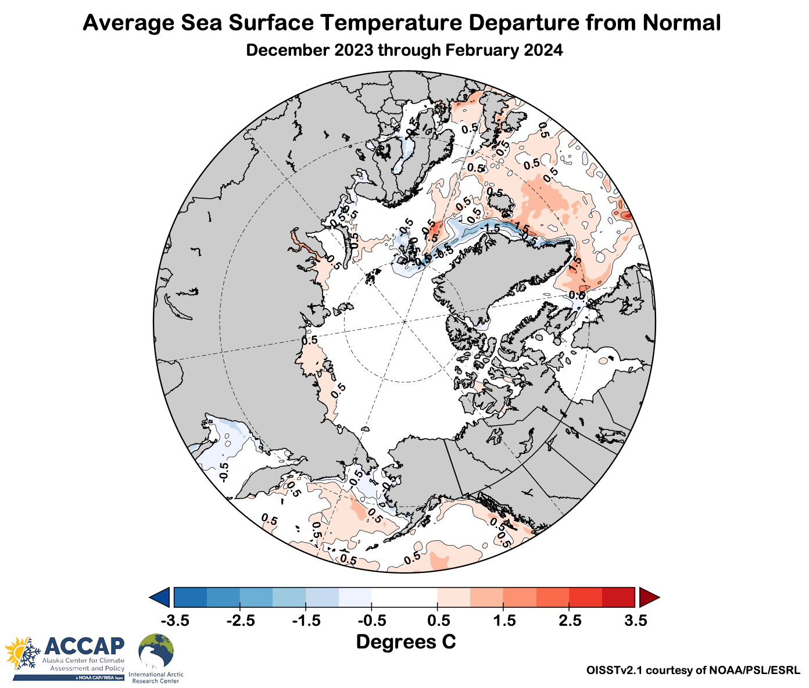
Winter 2023-24 Ocean Temperatures

Slide 10
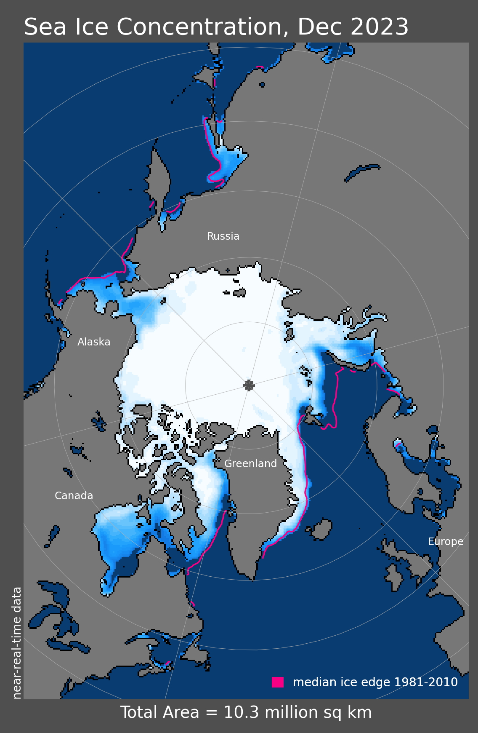
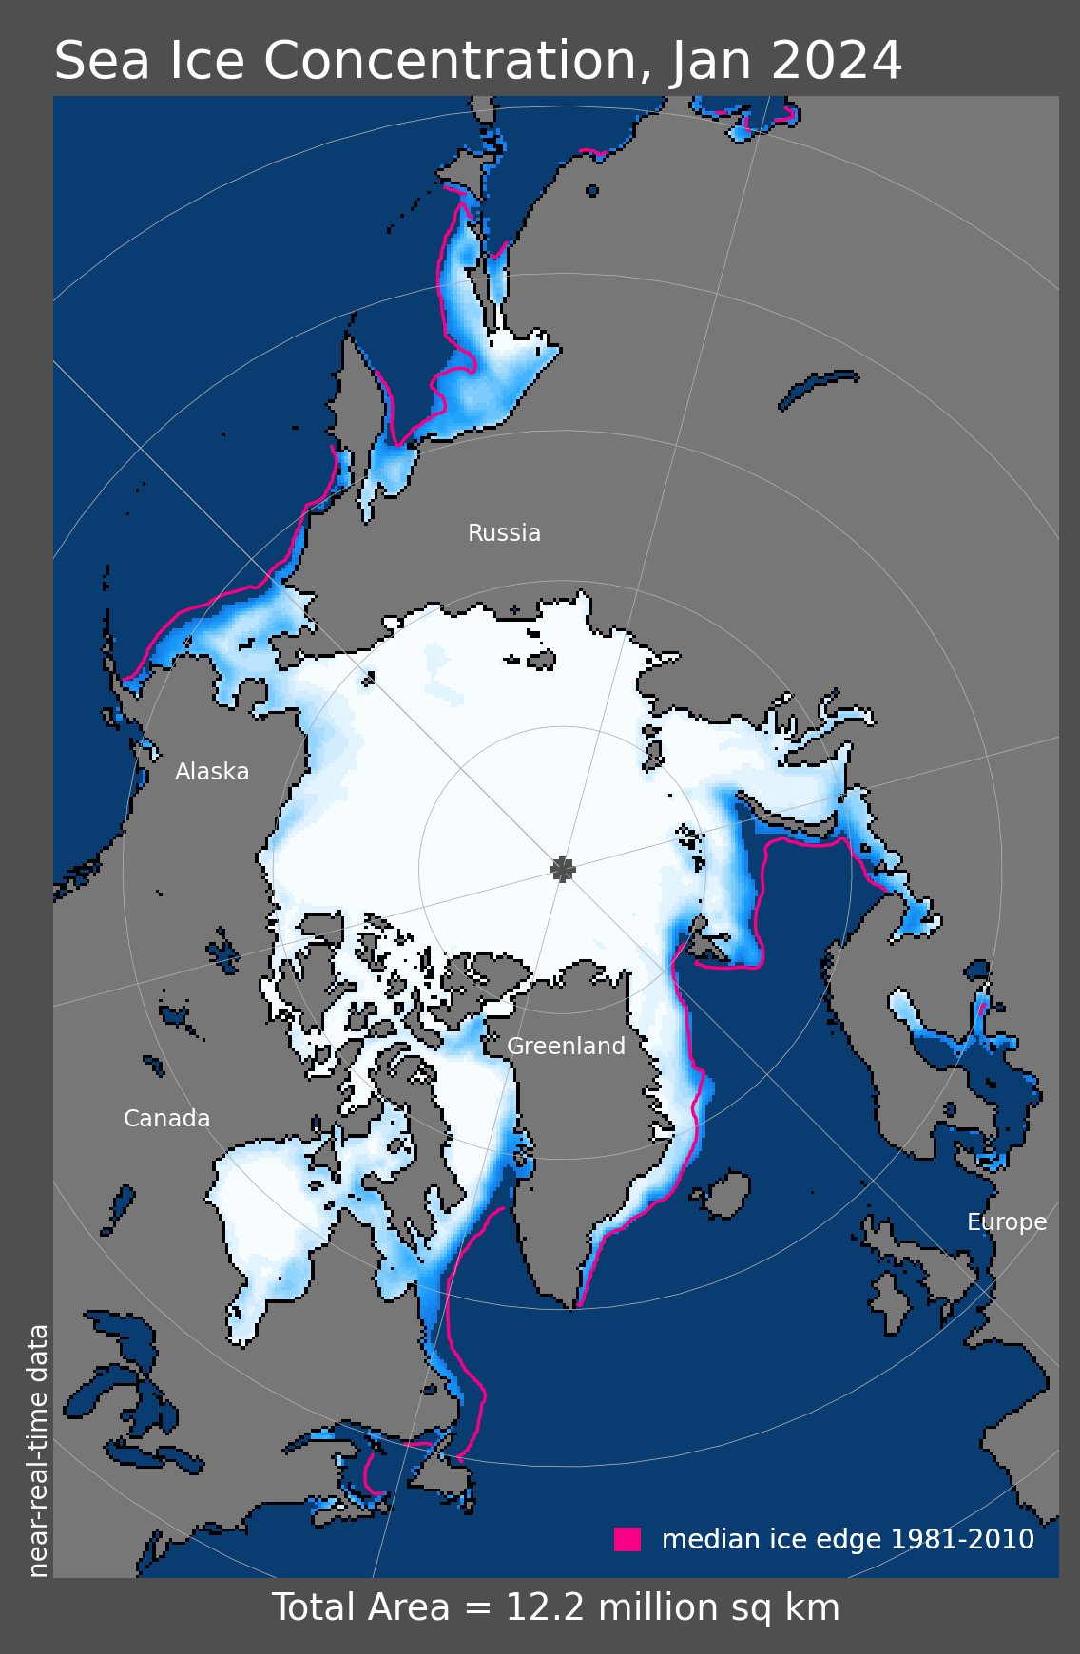
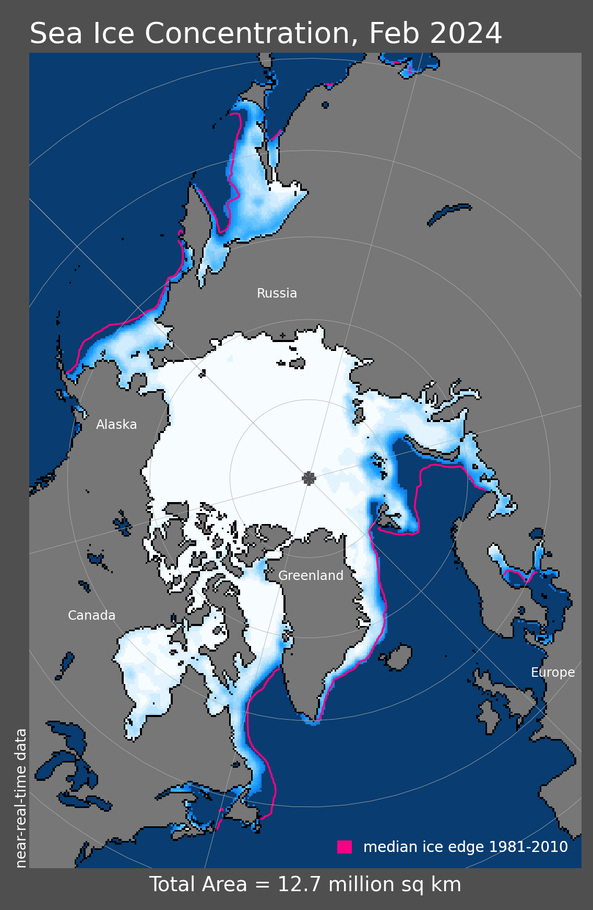
Arctic Sea Ice Extent: Winter 2023-24
9th lowest
20th lowest
15th lowest
Since 1979

Slide 11
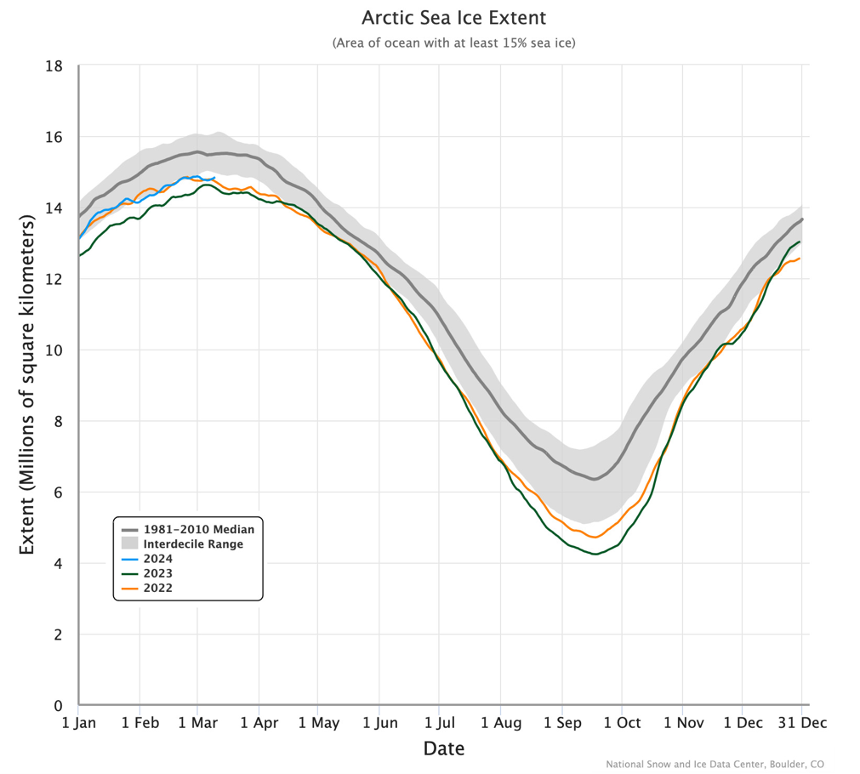
2024 Daily Arctic Sea Ice Extent
Through March 10

Slide 12
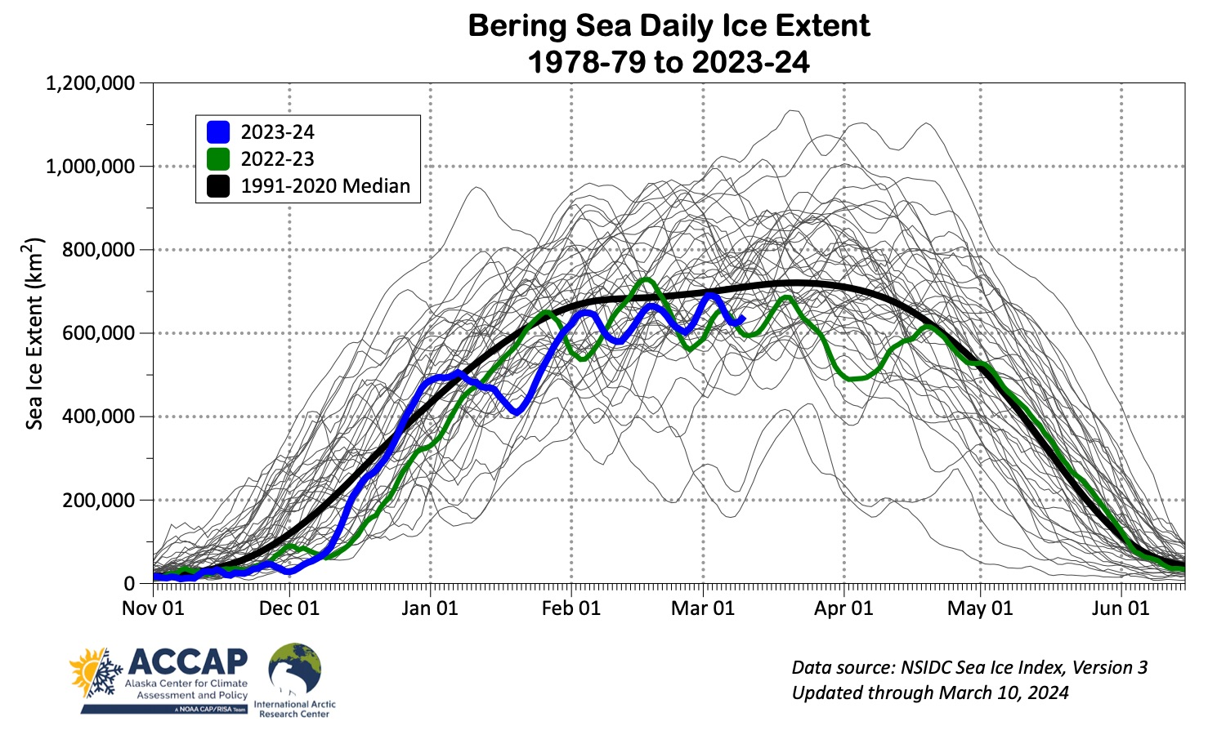
Bering Sea Ice Extent

Slide 13
Spring 2024 Outlooks
Alaska Outlooks
NOAA/Climate Prediction Center
Arctic Outlooks
Copernicus Climate Change Service
Arctic Sea Ice Experimental Outlook
NOAA/Climate Prediction Center

Slide 14
NOAA/NWS Climate Prediction Center March through May 2024 Outlook
45%
33%
22%
55%
33%
12%
37%
33%
30%
33%
33%
33%
45%
33%
22%
55%
33%
12%
45%
33%
22%
37%
33%
30%
Above%
Normal%
Below%
Average Temperature Outlook
Total Precipitation Outlook

Slide 15
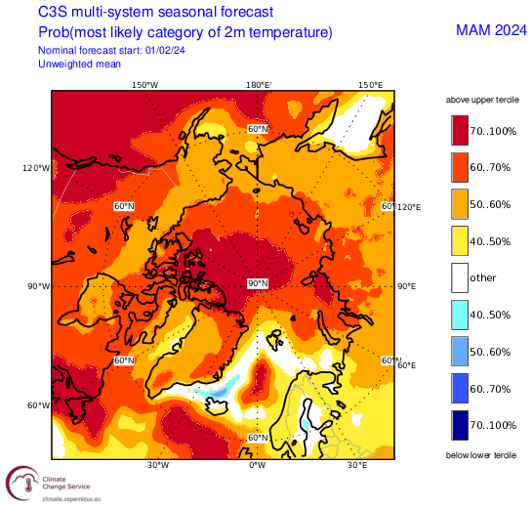
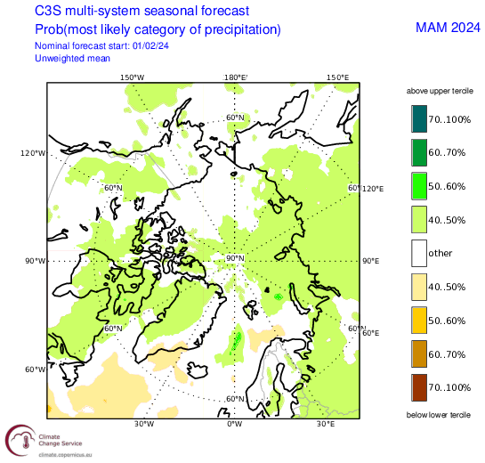
Spring 2024 Arctic Temperature and Precipitation Outlook
Outlooks courtesy Copernicus C3S (Climate Change Service)

Slide 16
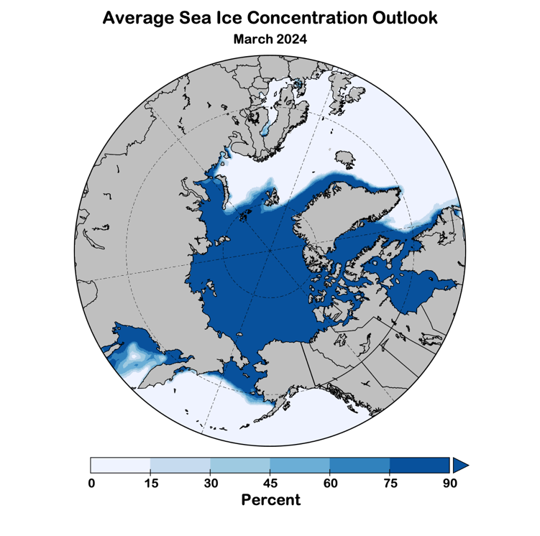
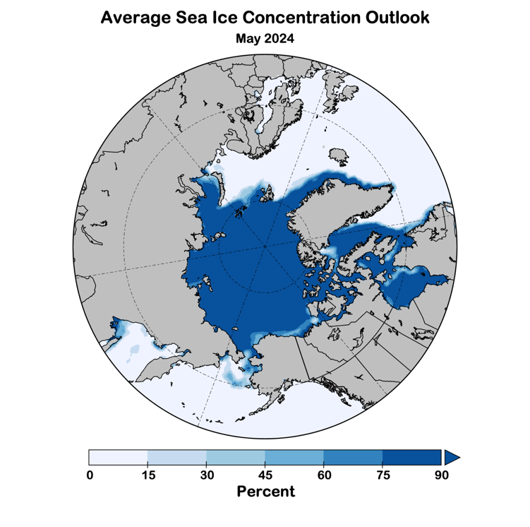
Winter 2023-24 Sea Ice Outlook
Data: NOAA/Climate Prediction Center Exp. Sea Ice Outlook
Outlook produced from late February 2024 data

Slide 17
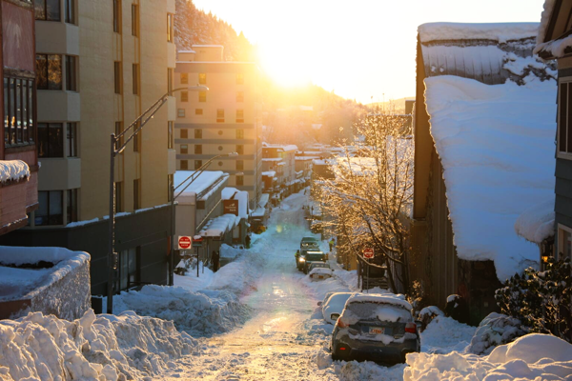
Thanks very much!
Juneau, Alaska
Jan 16, 2024
Image credit: Clarise Larson/KTOO

