Slide 1
Circumpolar One Heath Summer 2021 Climate Review and Autumn 2021 Outlook
Rick Thoman
Alaska Center for Climate Assessment and Policy
University of Alaska Fairbanks
September 14, 2021

Slide 3
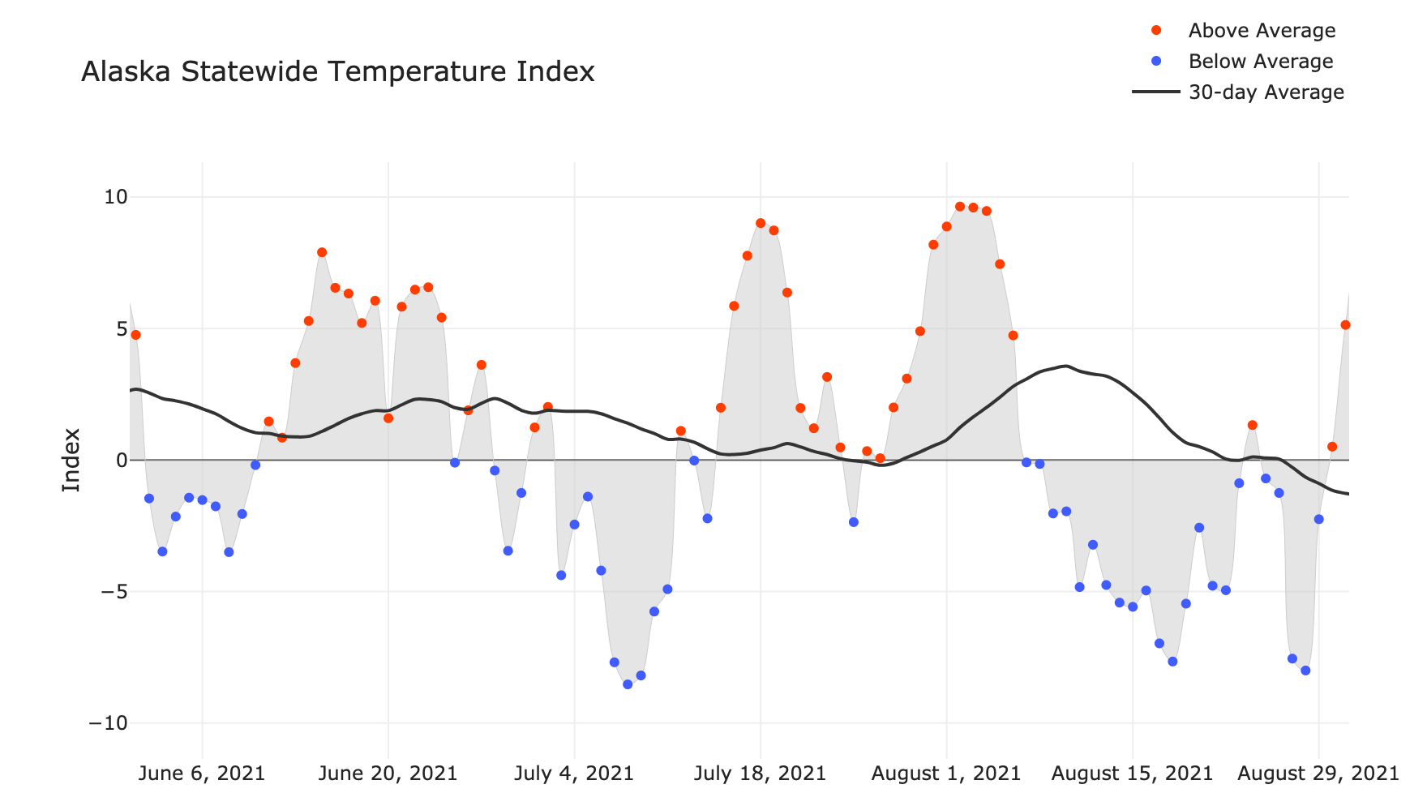
Alaska Daily Temperature Index
Now online: http://accap.uaf.edu/tools/statewide-temperature-index

Slide 4
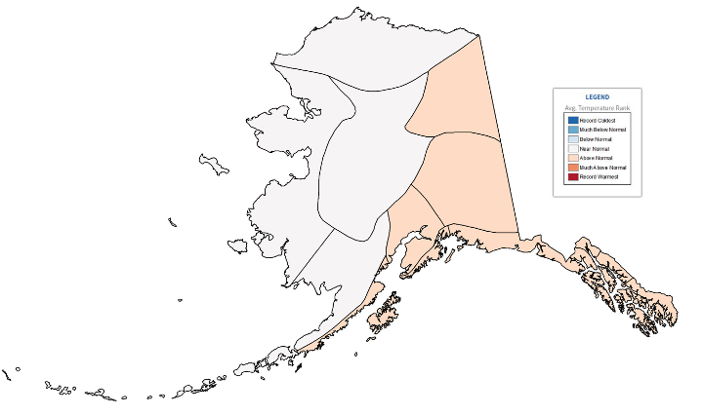
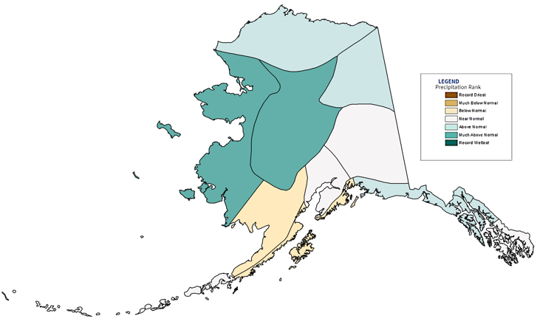
Alaska Regional Rankings Summer (June-August) 2021
NOAA Temperatures Since 1925
NOAA Precipitation Since 1925
Some differences between analyses

Slide 5
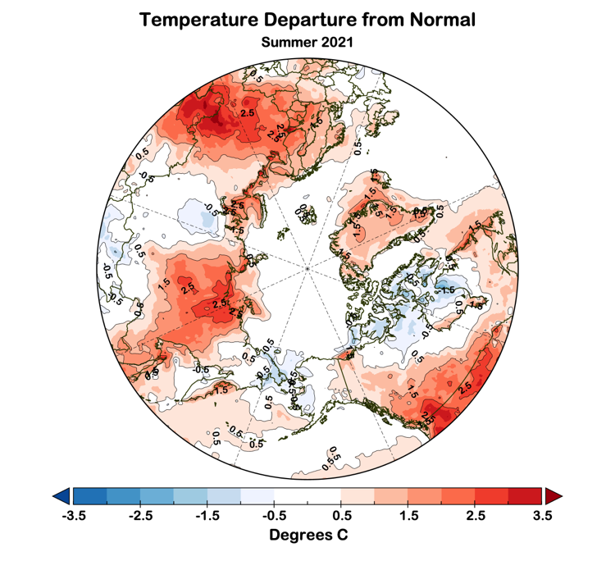
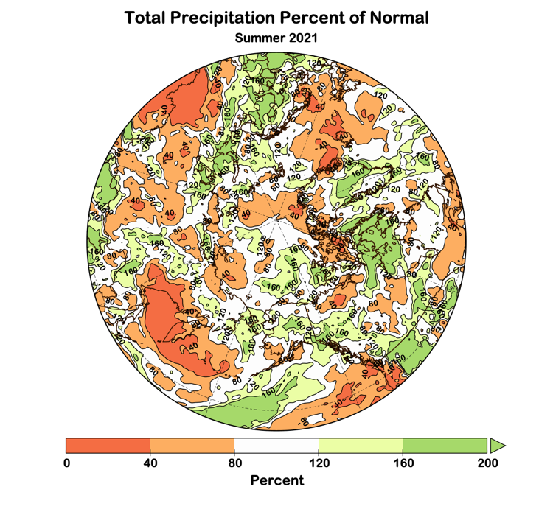
Summer 2021 Arctic-wide
Temperature Departures from Average
Precipitation Percent of Average
Data: ERA5 courtesy of EMCWF/Copernicus
1991-2020 Baseline

Slide 6
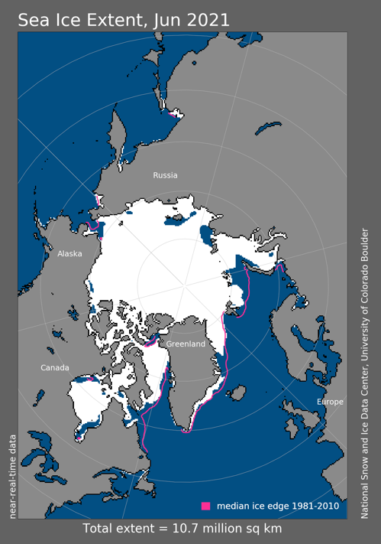
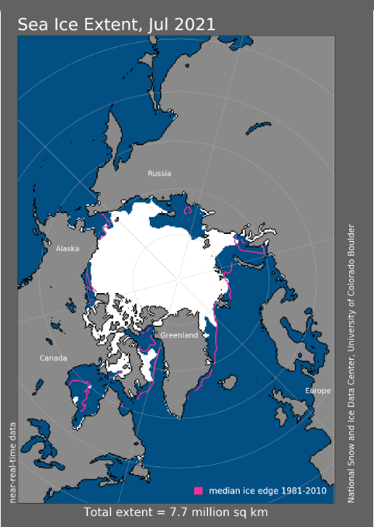
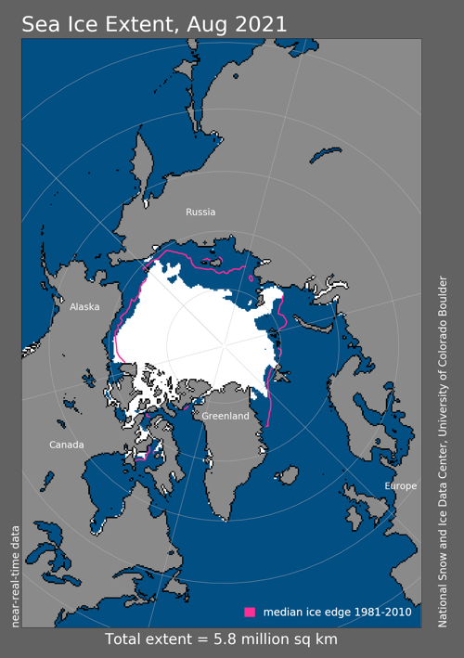
Sea Ice Summer 2021
6th lowest
4th lowest
10th lowest
Since 1979

Slide 7
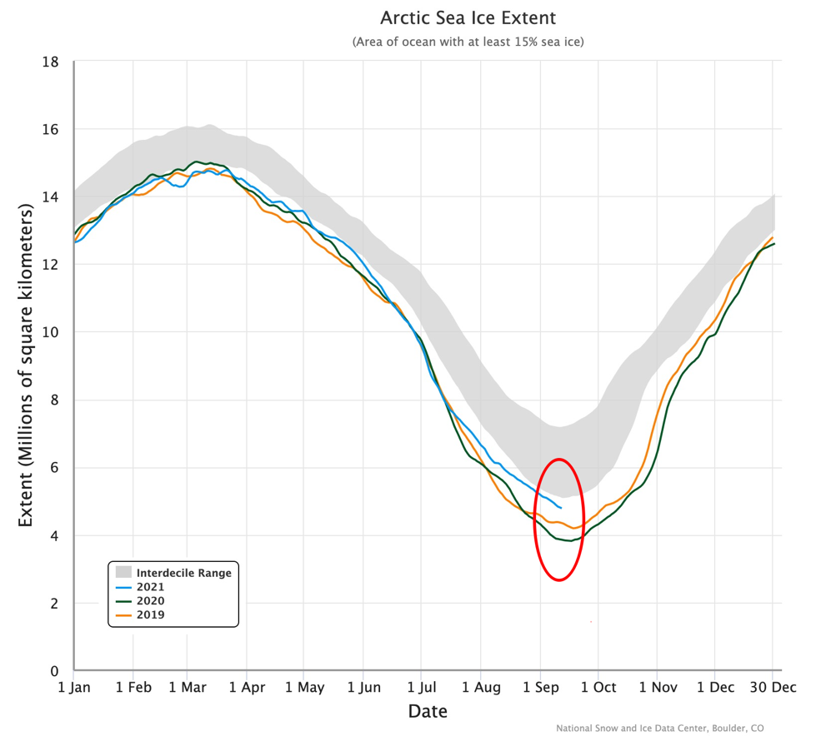
Daily Arctic Sea Ice Extent
Through September 12

Slide 8
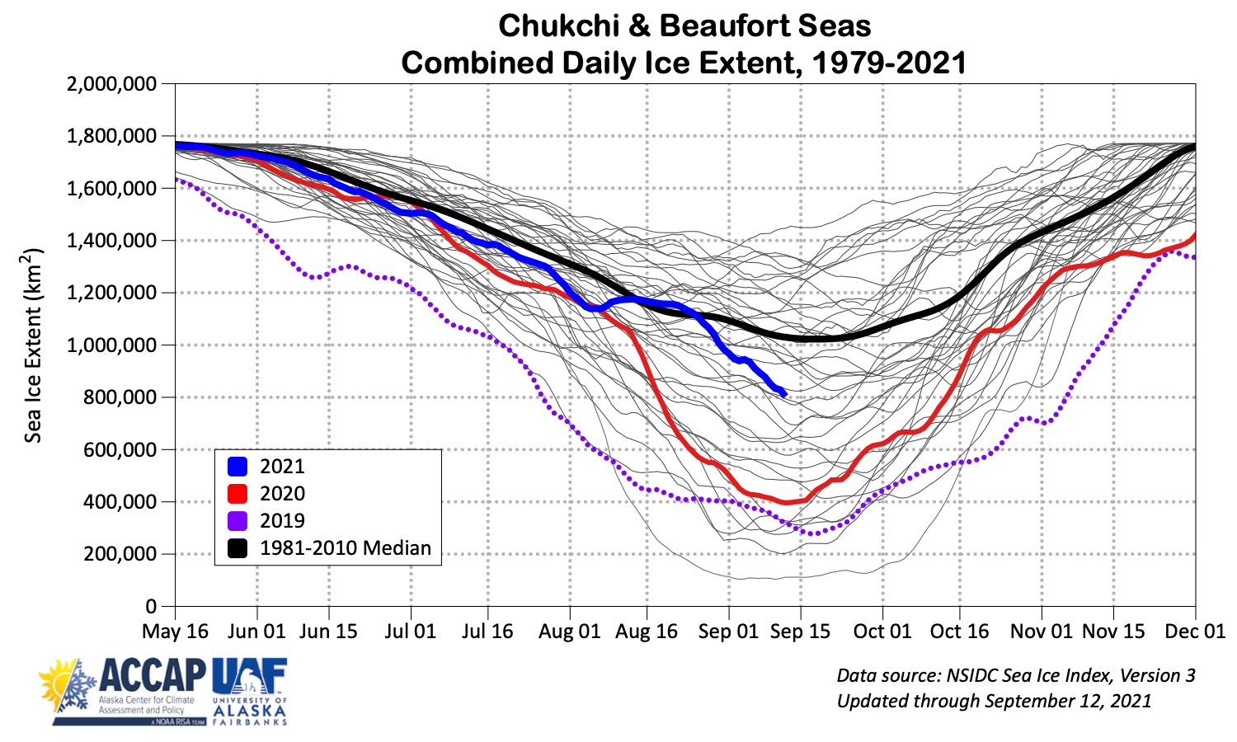
Summer Sea Ice Around Alaska

Slide 9
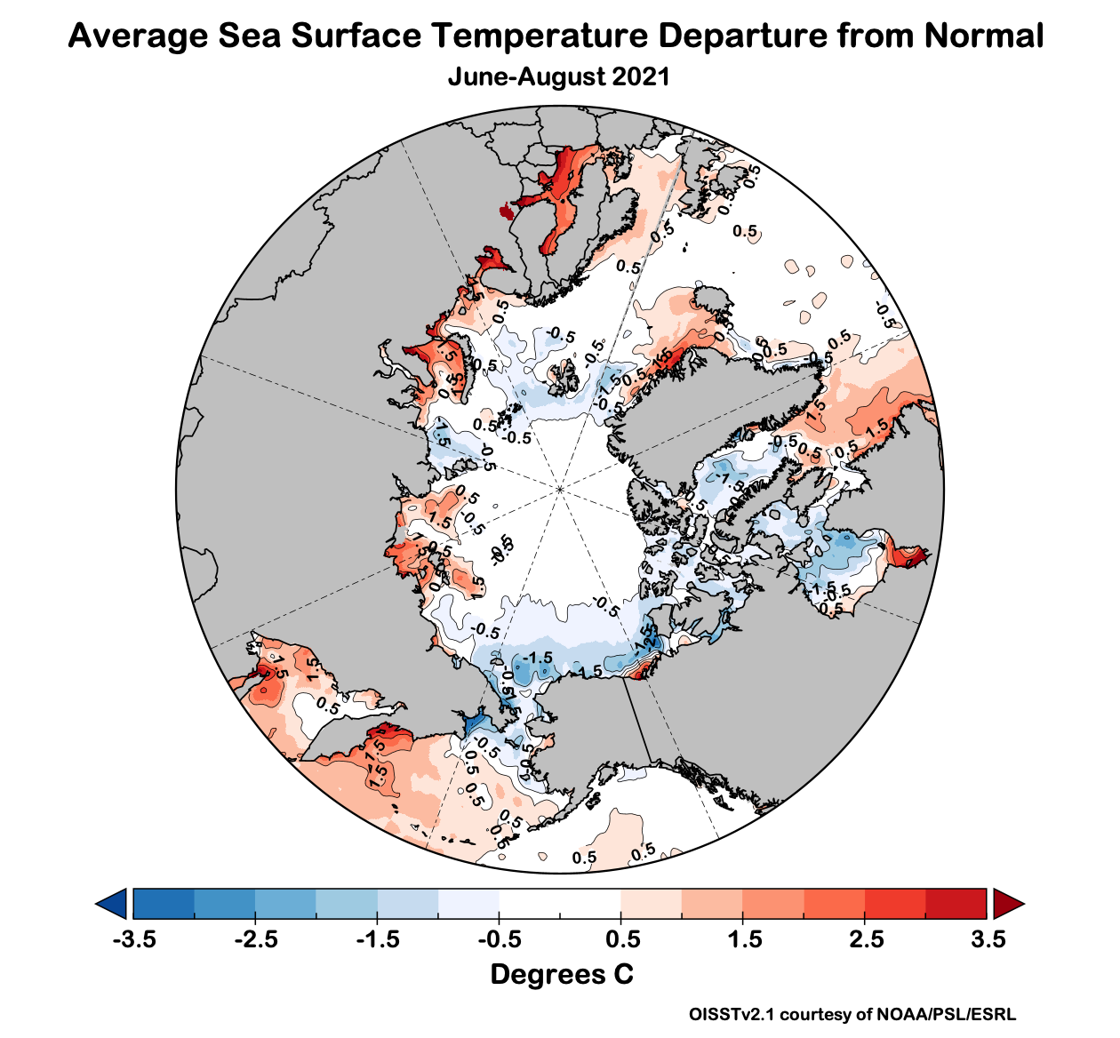
Summer 2021 Ocean Temperatures

Slide 10
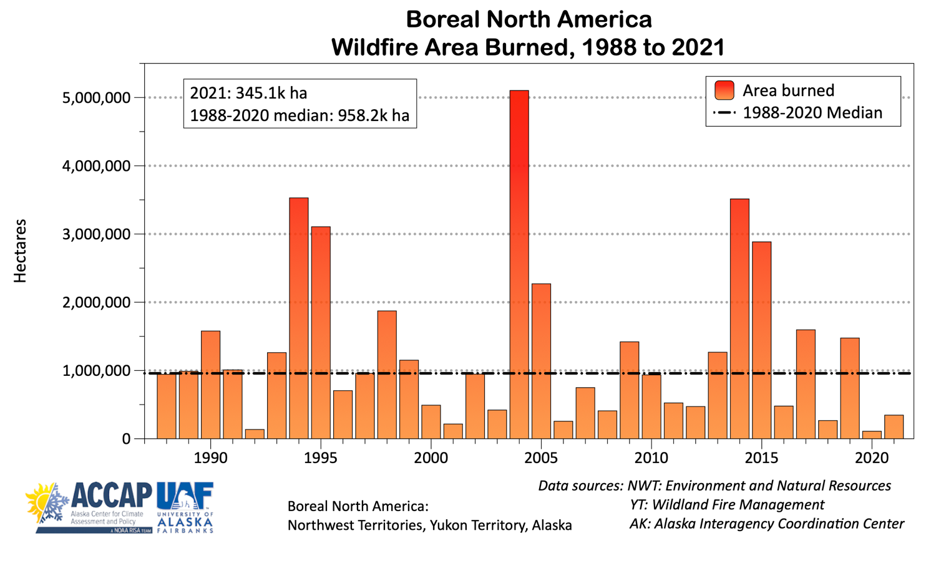
2021 North American Wildfire

Slide 11
2021: High Wildfire Year in Eurasia

Slide 12
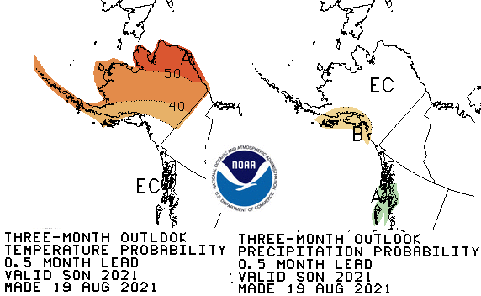
CPC September-November 2021 Outlook
55%
33%
12%
30%
33%
37%
45%
33%
22%
33%
33%
33%
37%
33%
30%
33%
33%
33%
37%
33%
30%
Above%
Normal%
Below%

Slide 13
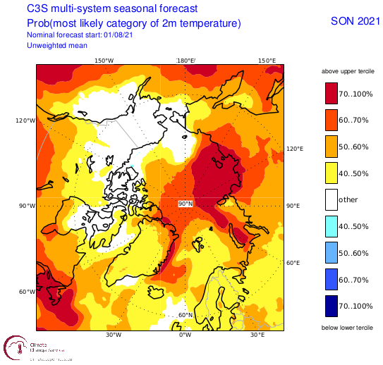
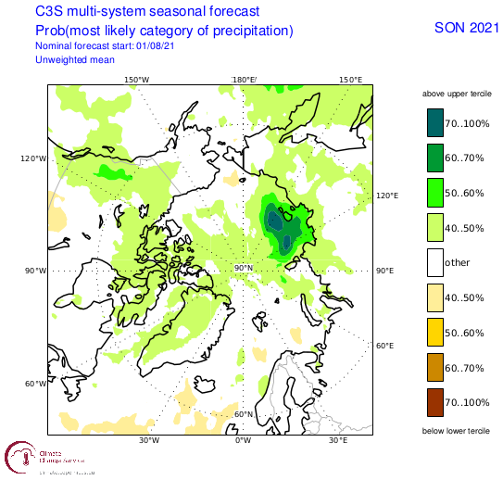
Fall 2021 Arctic Temperature and Precipitation Outlook
Outlooks courtesy Copernicus C3S (Climate Change Service)

Slide 14
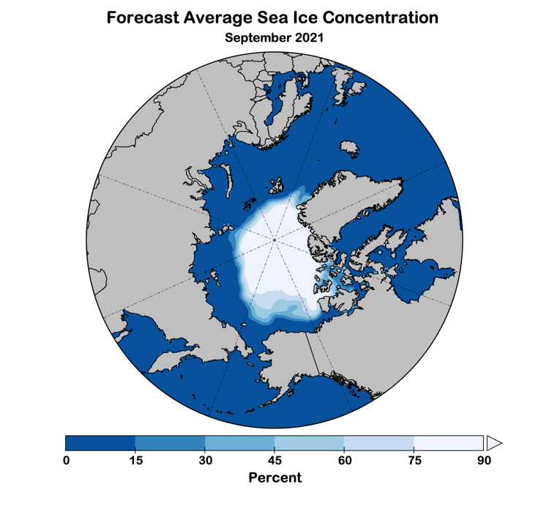
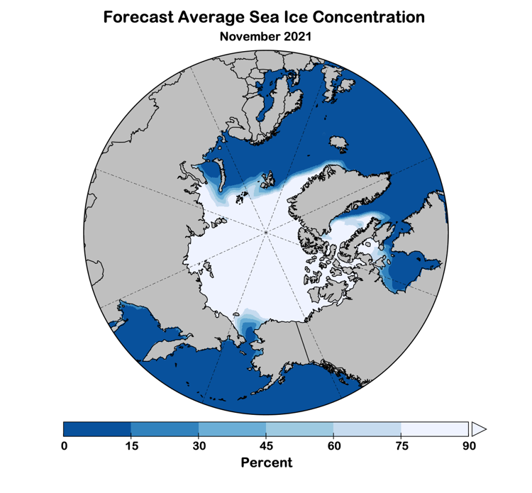
Autumn 2021 Sea Ice Outlook
Data: NOAA/Climate Prediction Center Exp. Sea Ice Outlook

Slide 15
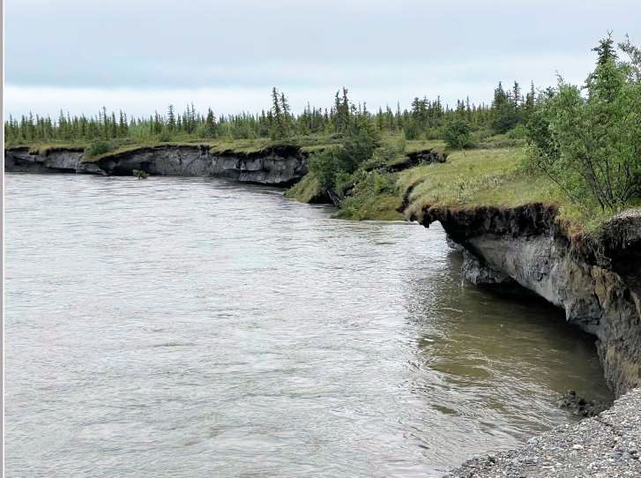
Noatak River Erosion July 2021
Photo credit: LEO/J. Luther

