Slide 1
Circumpolar One Heath Spring 2021 Climate Review and Summer 2021 Outlook
Rick Thoman
Alaska Center for Climate Assessment and Policy
University of Alaska Fairbanks
June 15, 2021

Slide 2
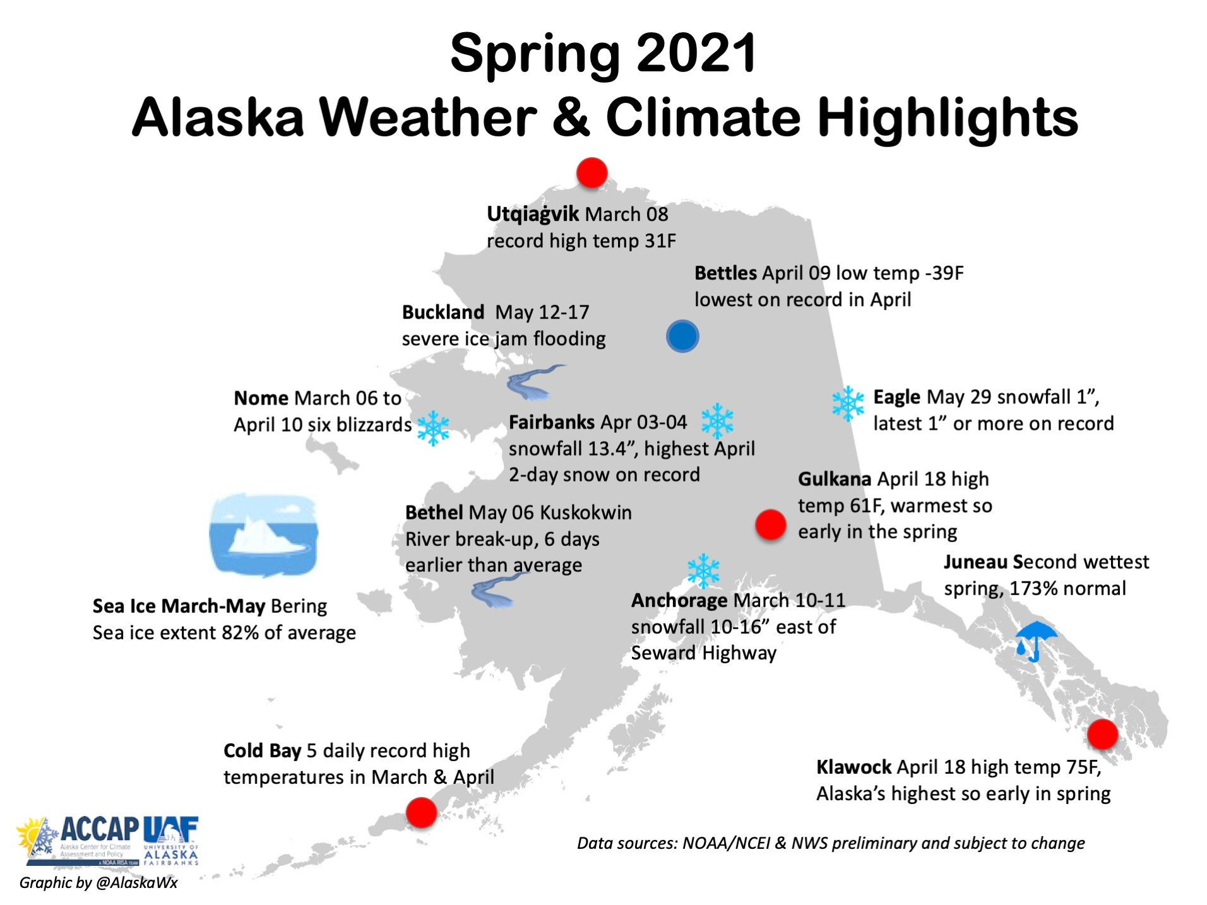

Slide 3
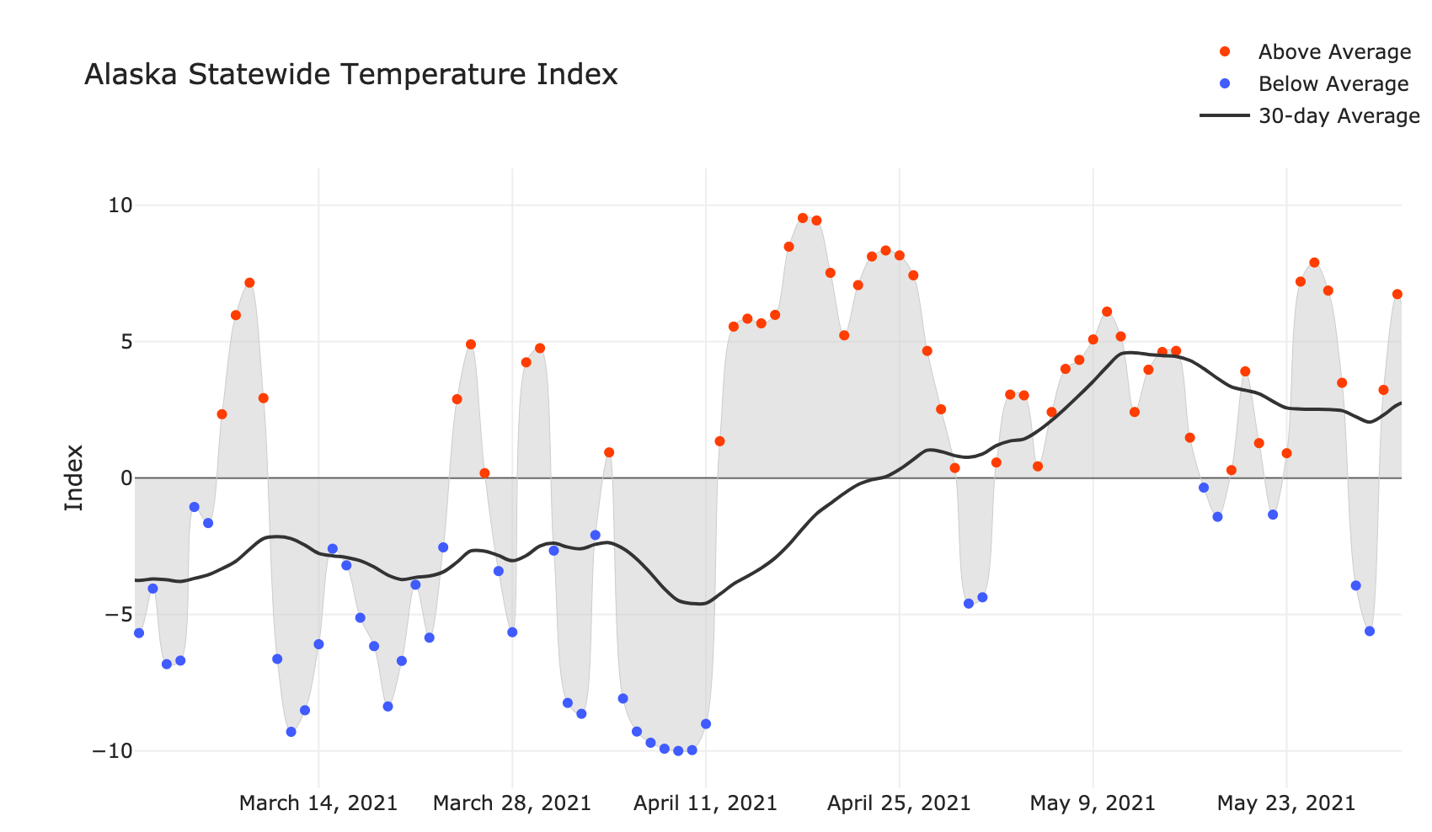
Alaska Daily Temperature Index
Now online: http://accap.uaf.edu/tools/statewide-temperature-index

Slide 4
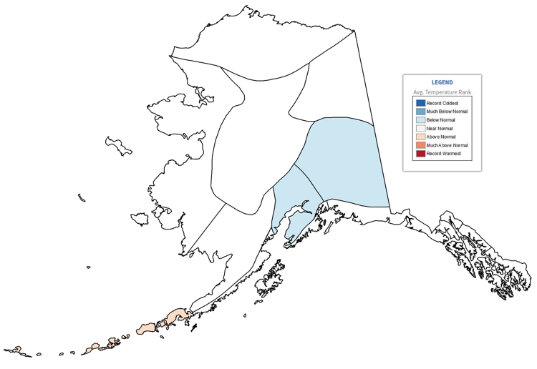
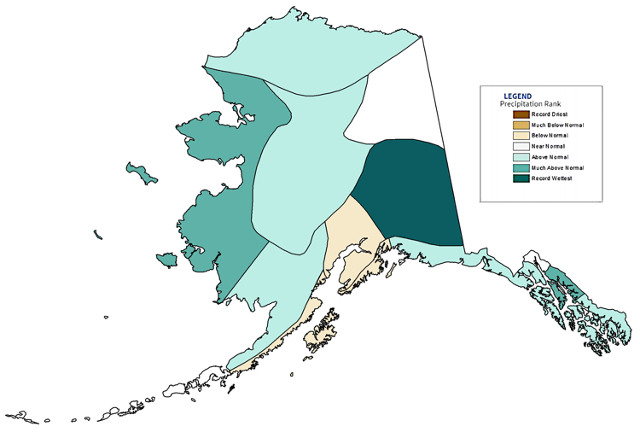
Alaska Regional Spring (March-May) 2021
NOAA Temperatures
NOAA Precipitation
Notes: Change to 1991-2020 ”normal” baseline
Significant differences between analyses

Slide 5
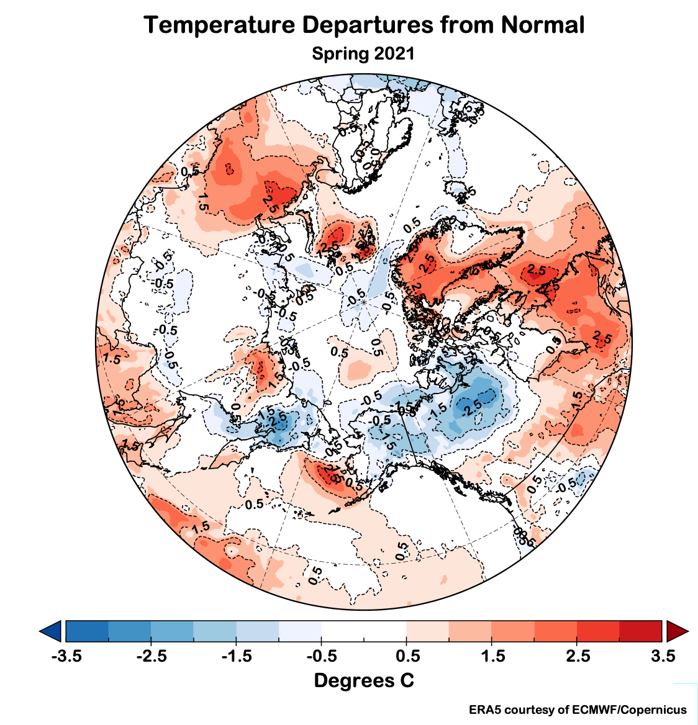
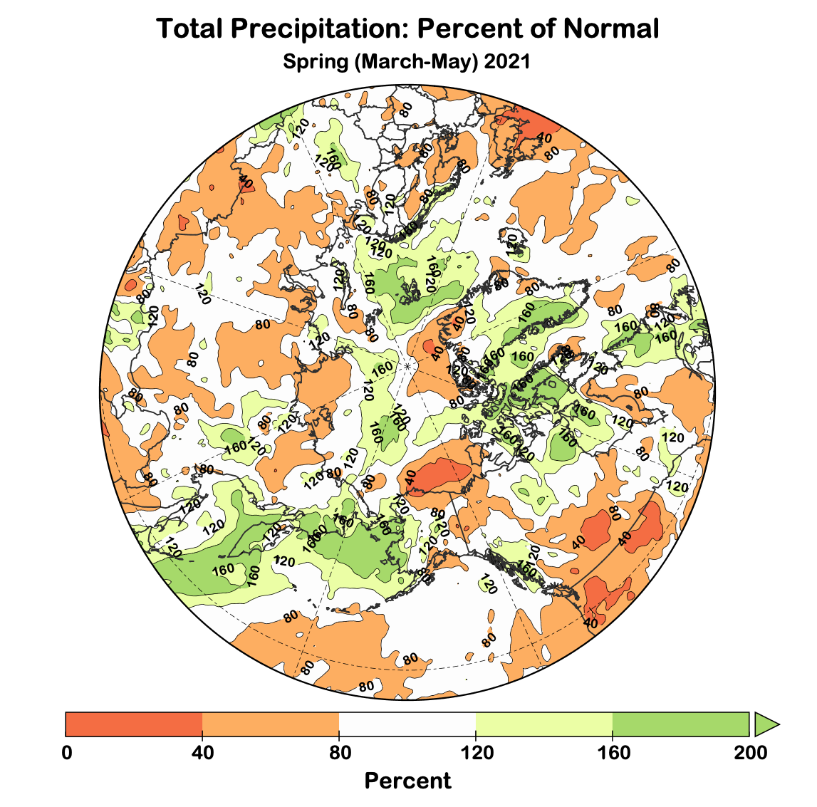
Spring 2021 Arctic-wide
Temperature Departures from Average
Precipitation Departures from Average
Data: ERA5 courtesy of EMCWF/Copernicus
1991-2020 Baseline

Slide 6
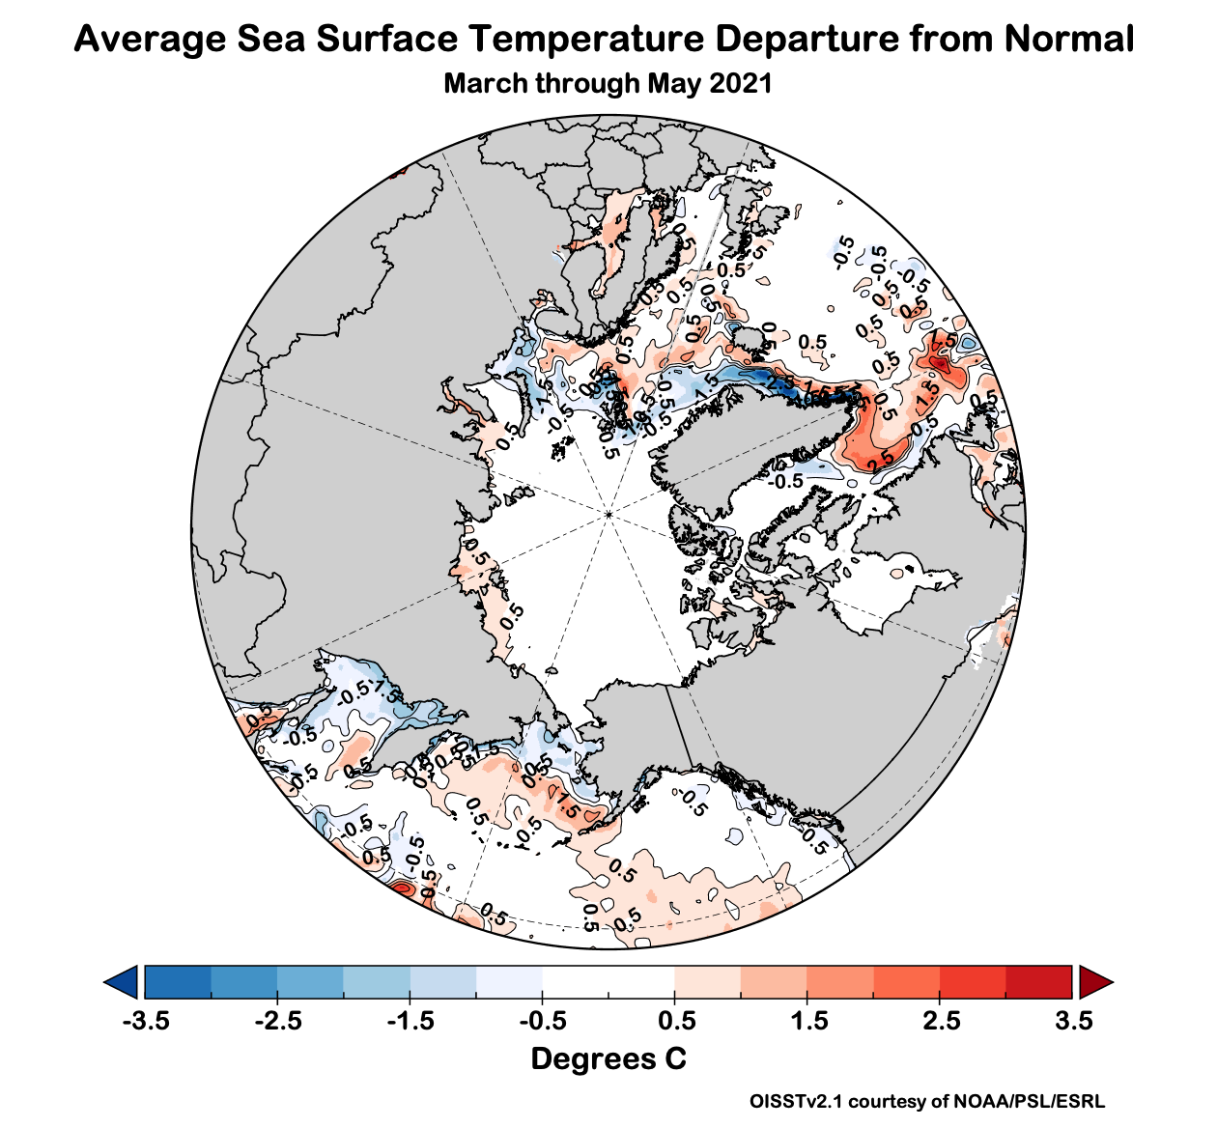
Spring 2021 Ocean Temperatures

Slide 7
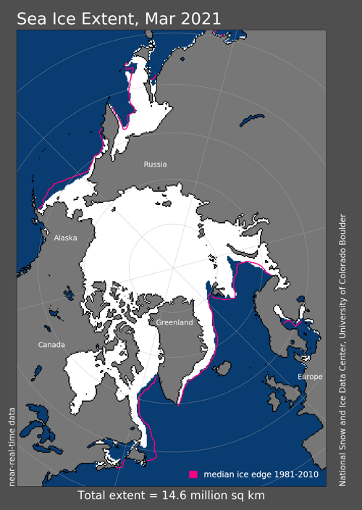
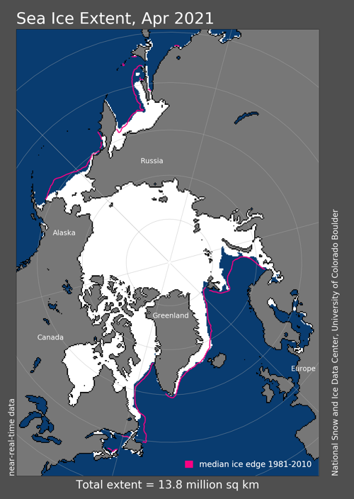
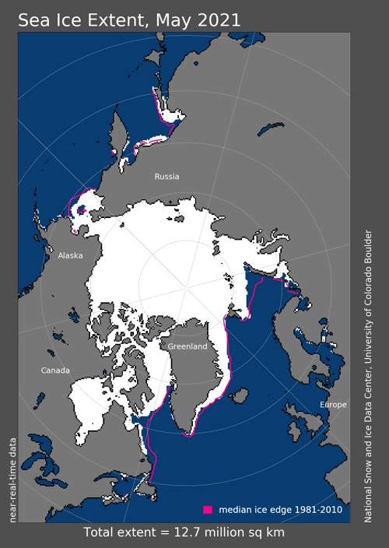
Sea Ice Spring 2021
9th lowest
6th lowest
9th lowest
Since 1979

Slide 8
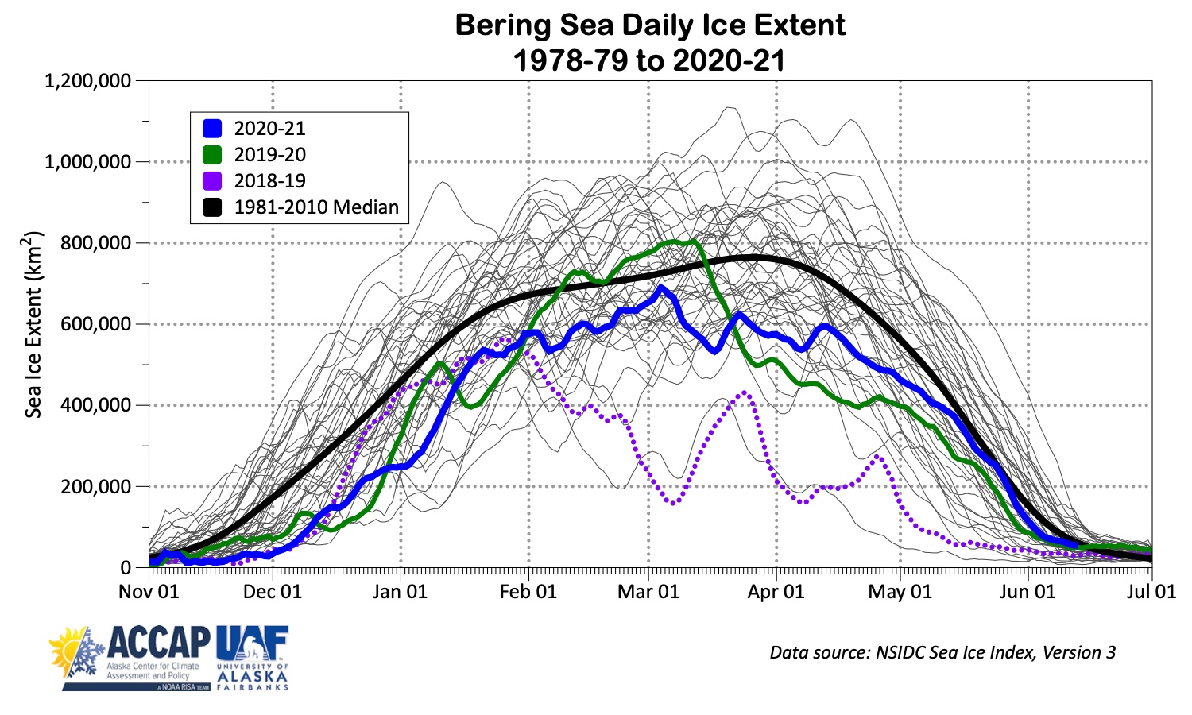
Daily Bering Sea Ice Extent

Slide 9
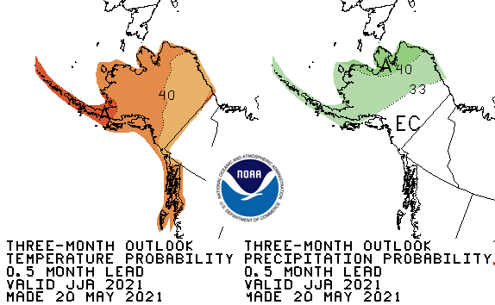
CPC June to August 2021 Outlook
45%
33%
22%
37%
33%
30%
45%
33%
22%
55%
33%
12%
37%
33%
30%
33%
33%
33%
45%
33%
22%
Above%
Normal%
Below%

Slide 10
Summer 2021 Arctic Temperature and Precipitation Outlook
Outlooks courtesy Copernicus C3S (Climate Change Service)

Slide 11
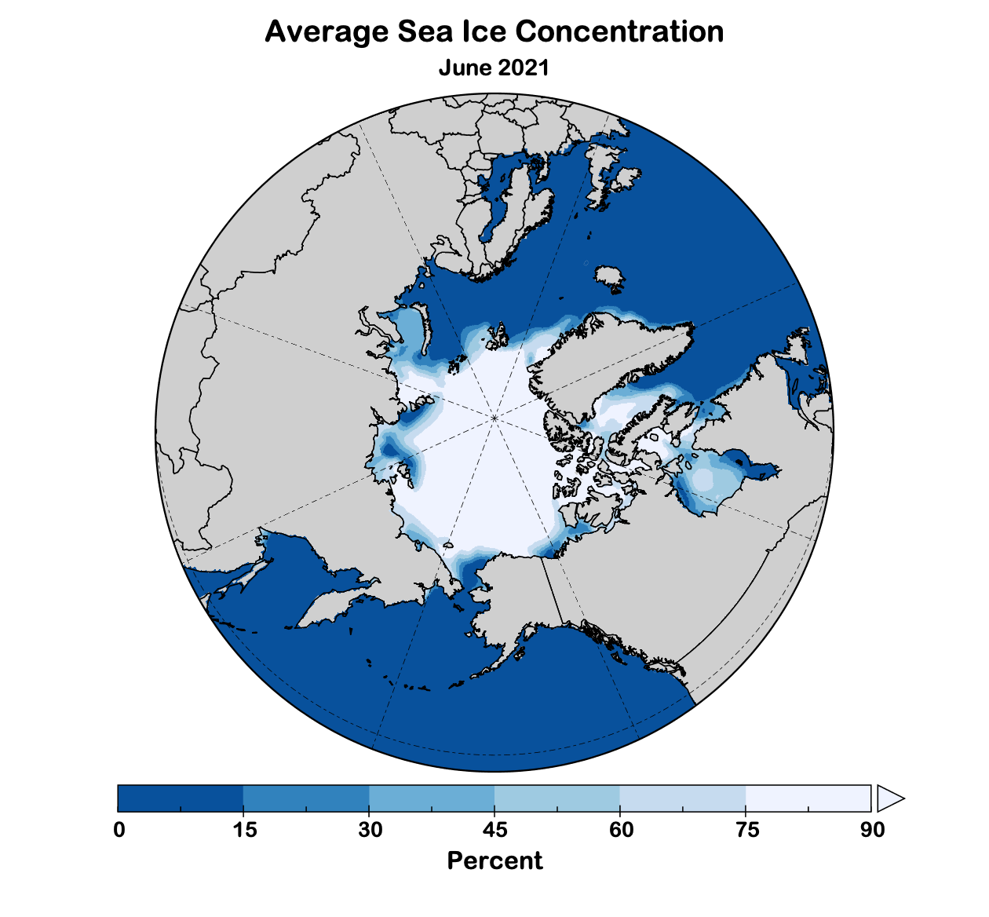
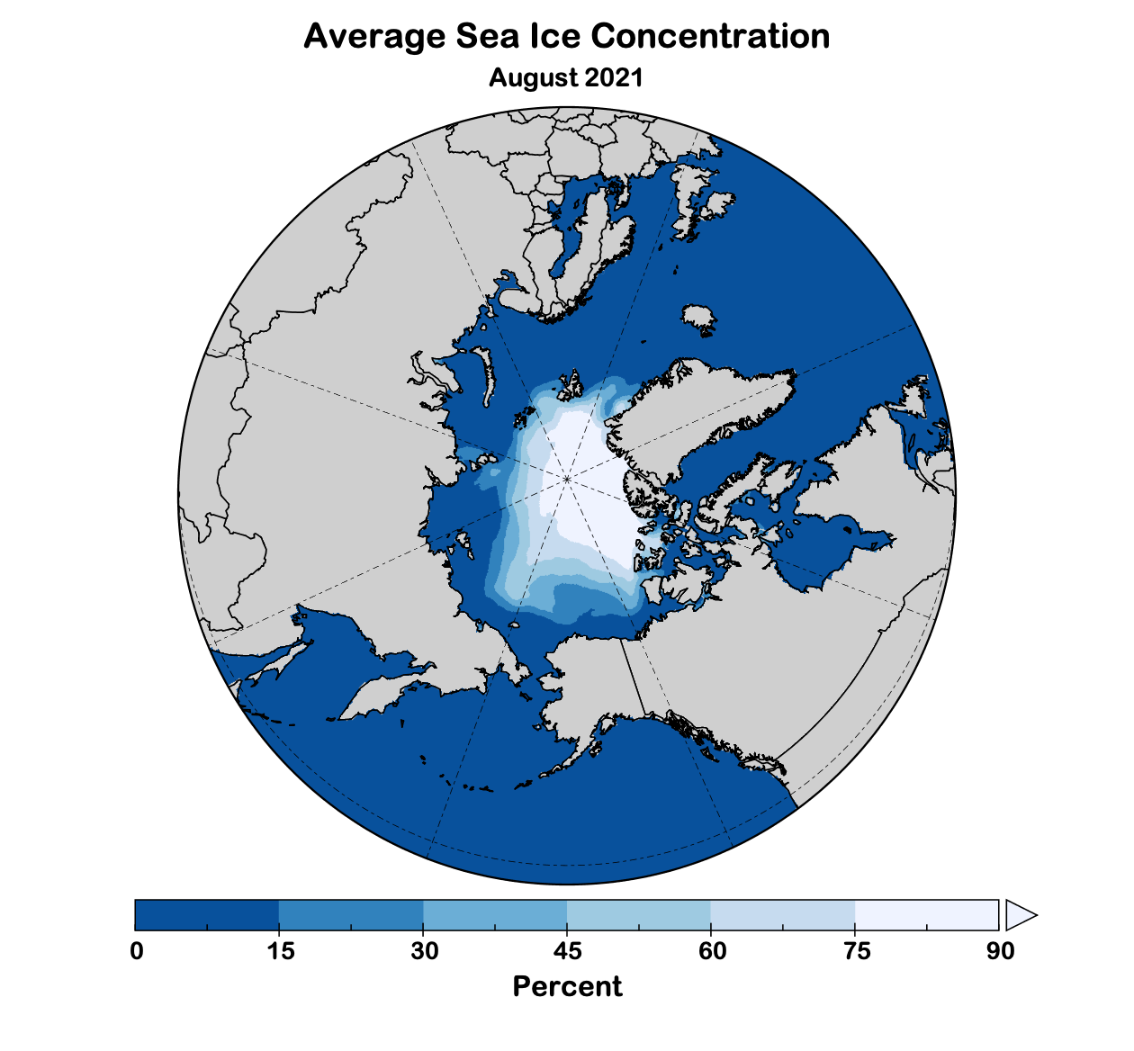
Summer 2021 Sea Ice Outlook
Data: NOAA/Climate Prediction Center Exp. Sea Ice Outlook

Slide 12
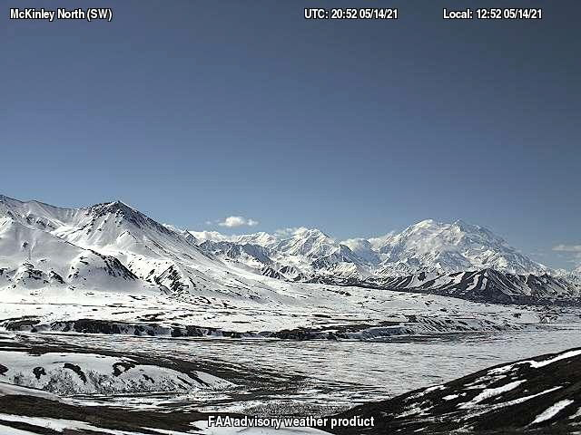
Eielson Visitors Center, Denali NP May 14, 2021
Photo credit: FAA

