Slide 1
Circumpolar One Heath Winter 2022-23 Climate Review and Spring 2023 Outlook
Rick Thoman
Alaska Center for Climate Assessment and Policy
University of Alaska Fairbanks
March 7, 2023

Slide 3
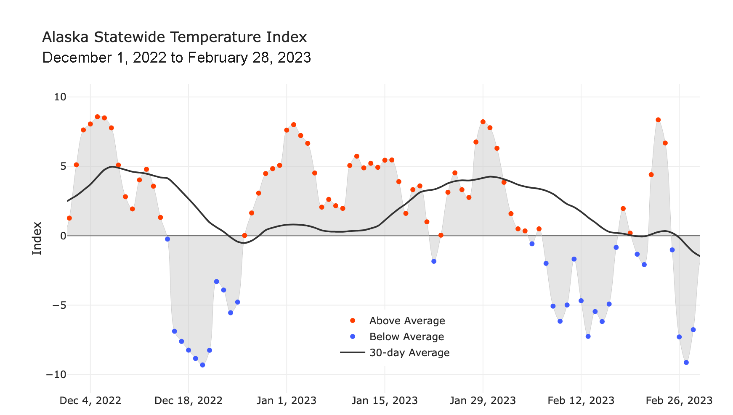
Alaska Daily Temperature Index
Online: http://accap.uaf.edu/tools/statewide-temperature-index

Slide 4
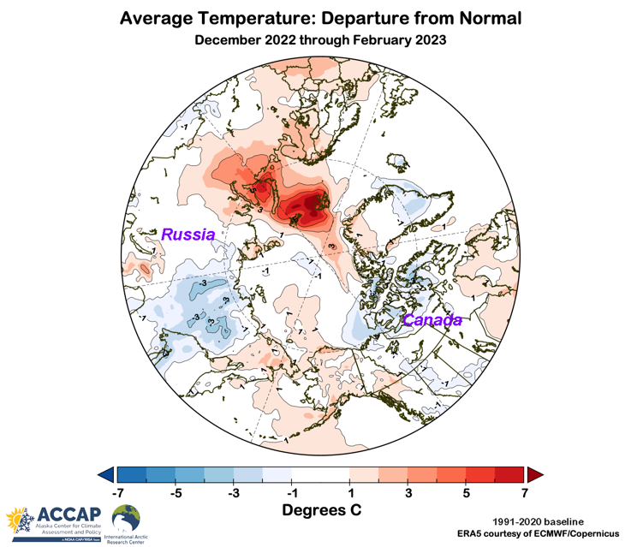
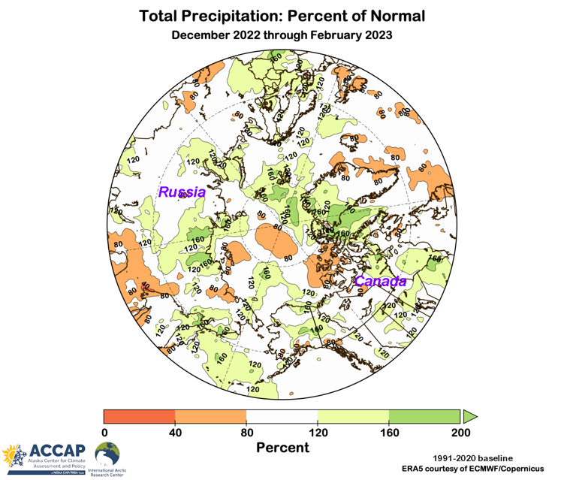
Winter 2022-23 Arctic-wide
Temperature Departures from Average
Precipitation Percent of Average
Data: ERA5 courtesy of EMCWF/Copernicus
1991-2020 Baseline

Slide 5
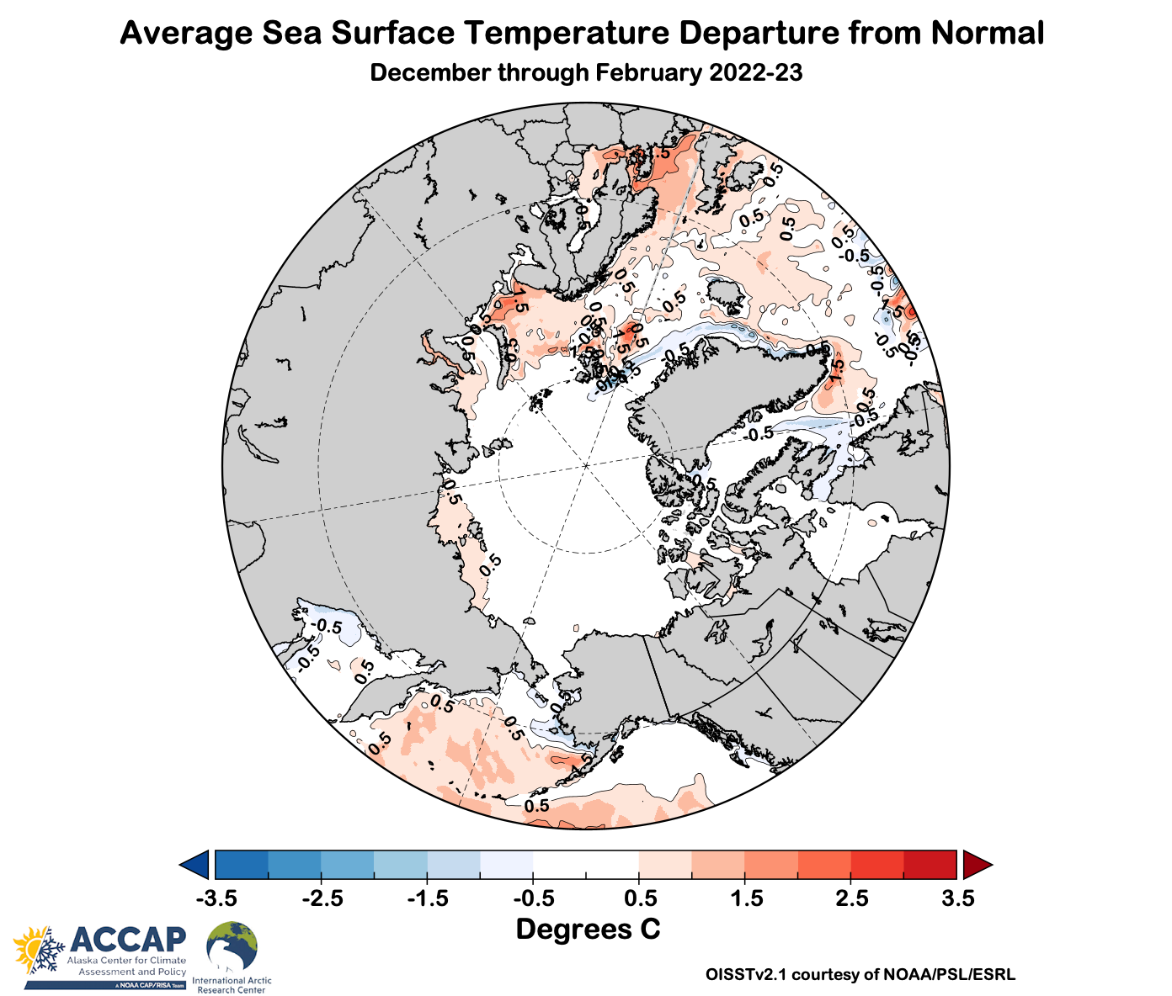
Winter 2022-23 Ocean Temperatures

Slide 6
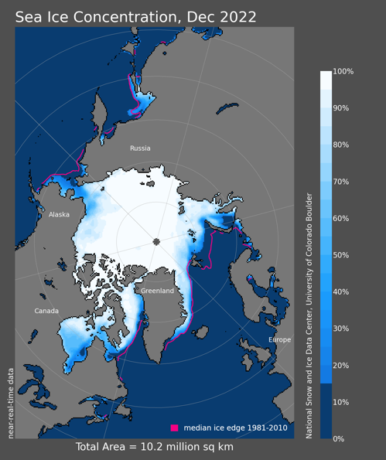
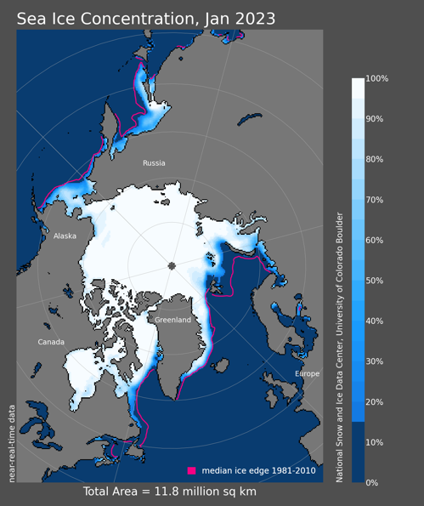
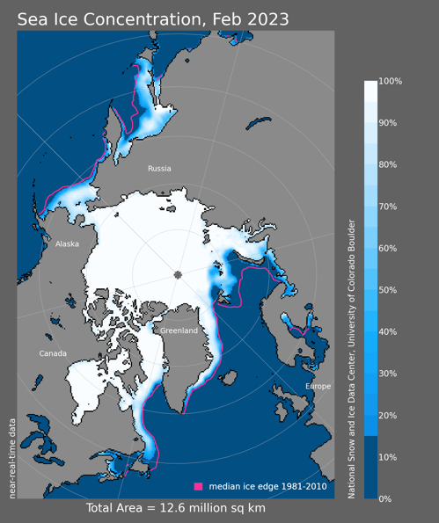
Sea Ice Winter 2022-23
7th lowest
3rd lowest
3rd lowest
Extent Rank since 1979

Slide 7
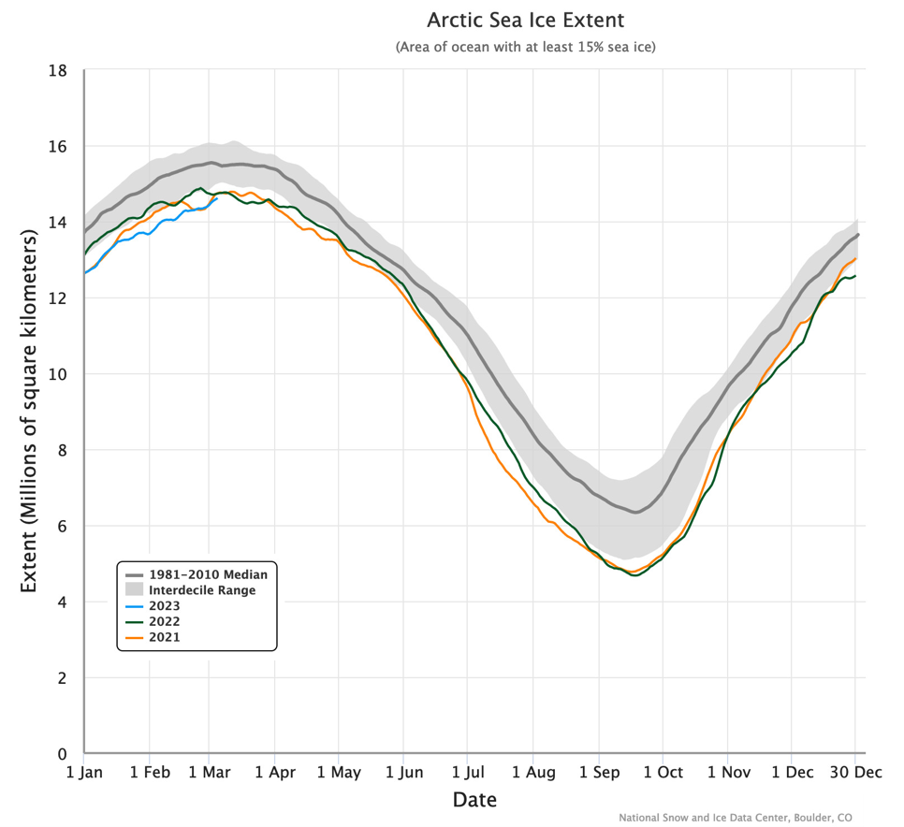
Daily Arctic Sea Ice Extent
Through March 05, 2023

Slide 8
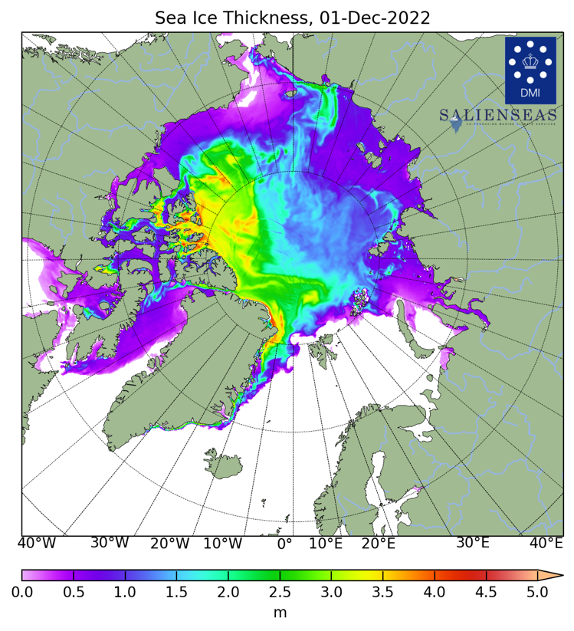
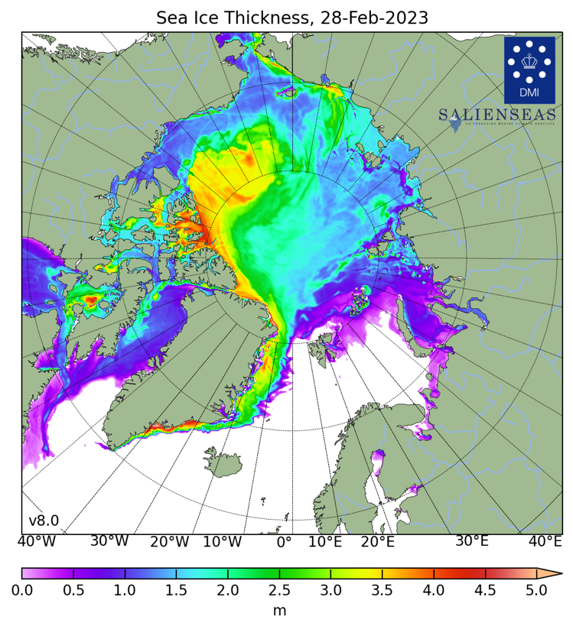
Sea Ice Thickness

Slide 9
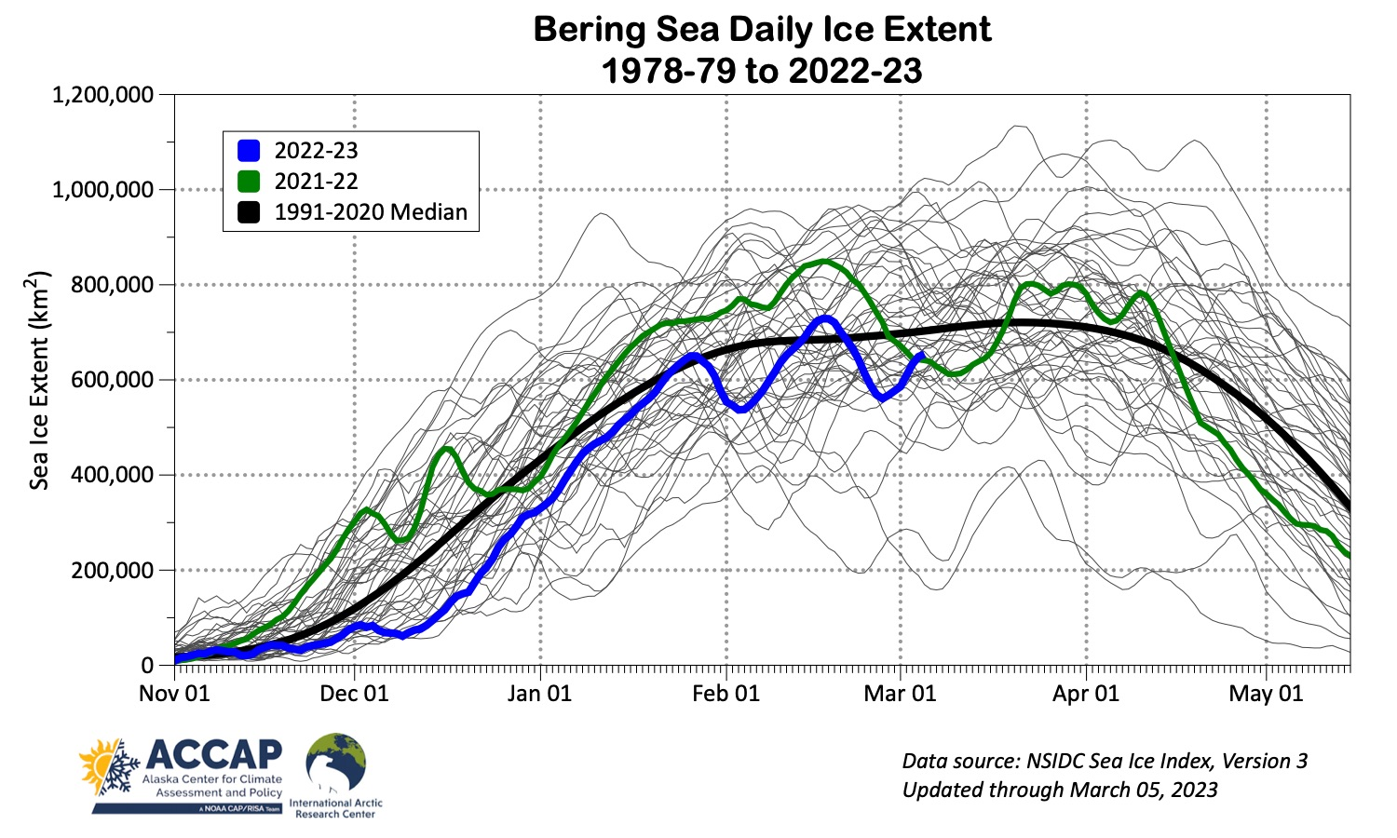
Bering Sea Ice Extent

Slide 10
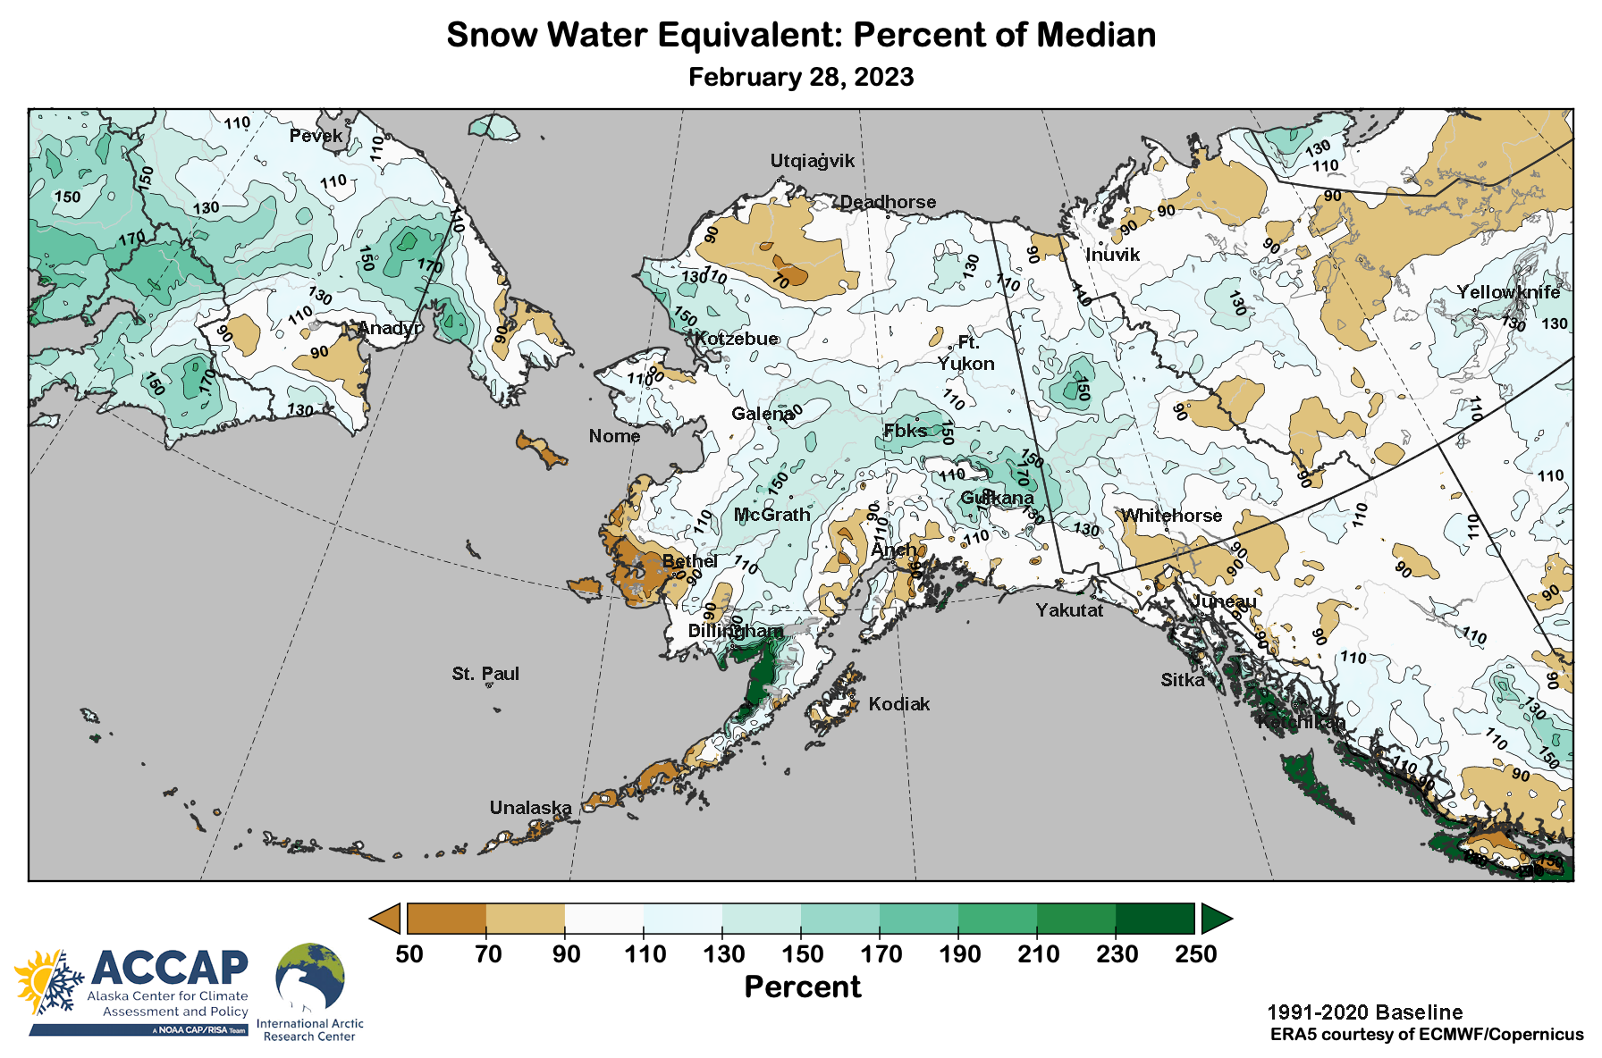
Snowpack

Slide 11
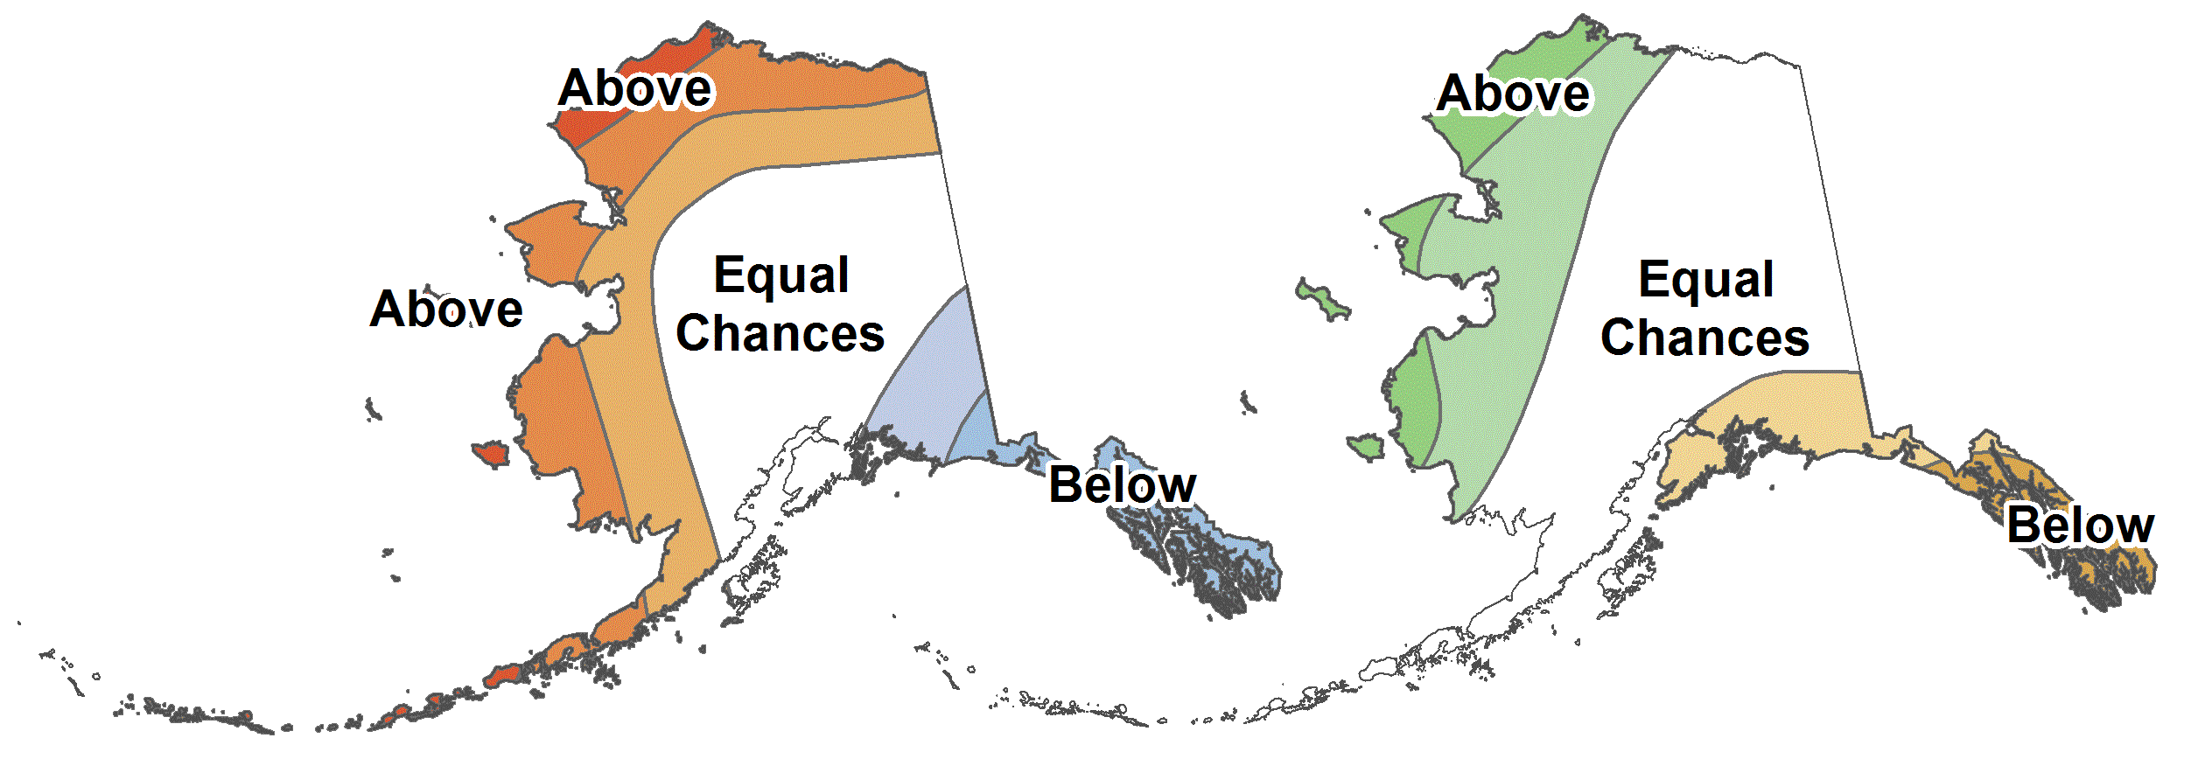
CPC March-May 2023 Outlook
37%
33%
30%
37%
33%
30%
55%
33%
12%
45%
33%
22%
33%
33%
33%
30%
33%
37%
45%
33%
22%
22%
33%
45%
30%
33%
37%
22%
33%
45%
33%
33%
33%
Above%
Normal%
Below%
Average Temperature Outlook
Total Precipitation Outlook

Slide 12
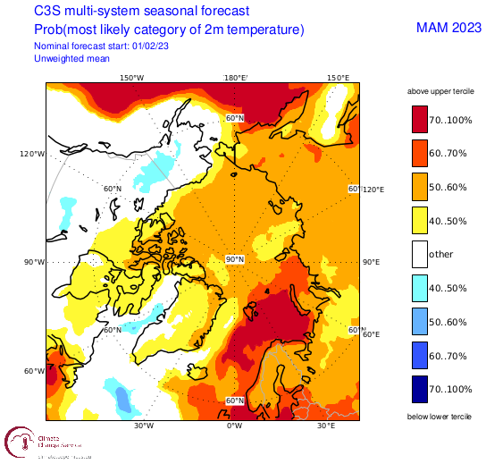
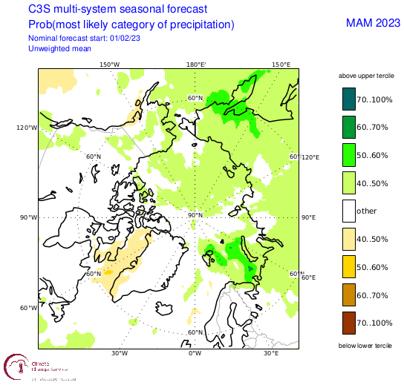
Spring 2023 Arctic Temperature and Precipitation Outlook
Outlooks courtesy Copernicus C3S (Climate Change Service)

Slide 13
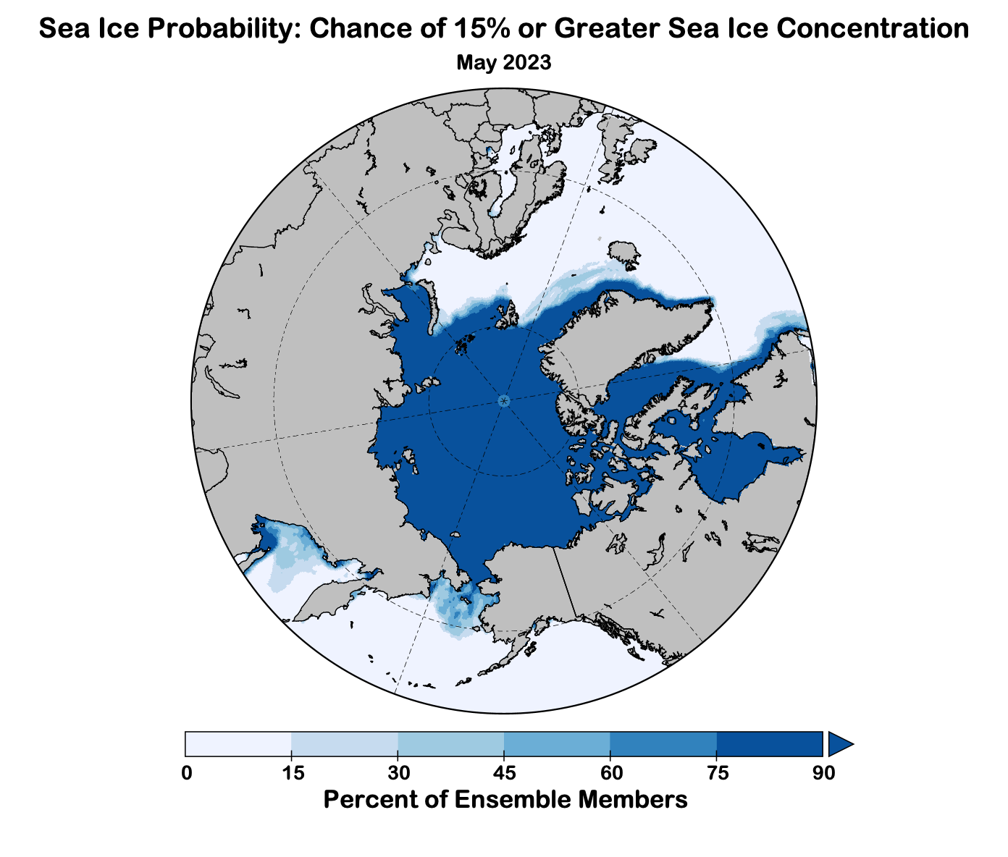
Sea Ice Outlook for May
Outlook made
late January
Data: NOAA/Climate Prediction Center Exp. Sea Ice Outlook

Slide 14
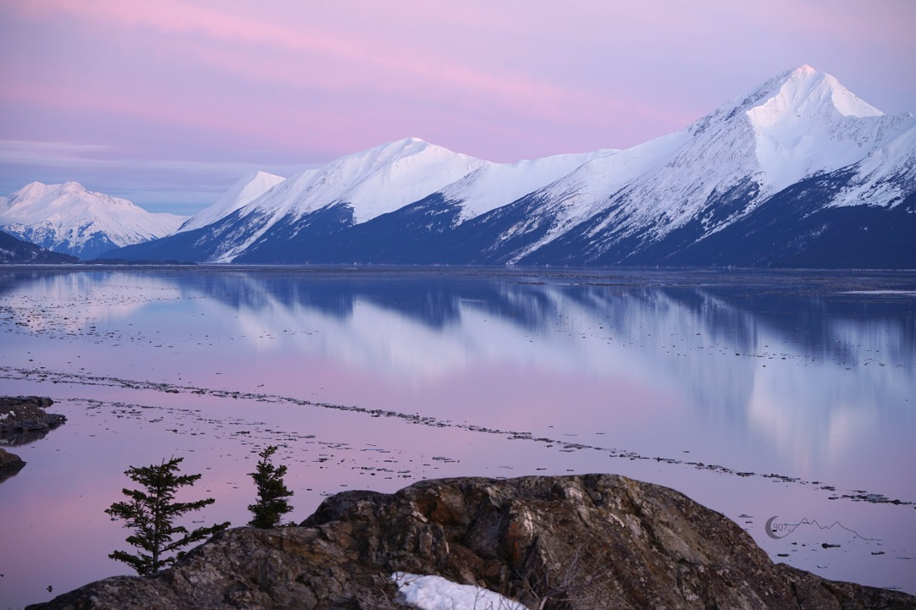
Thanks very much
Photo by D. Moore, Feb 27, 2022

