Slide 1
One Health Affiliations in the LEO Network Directory

Slide 2
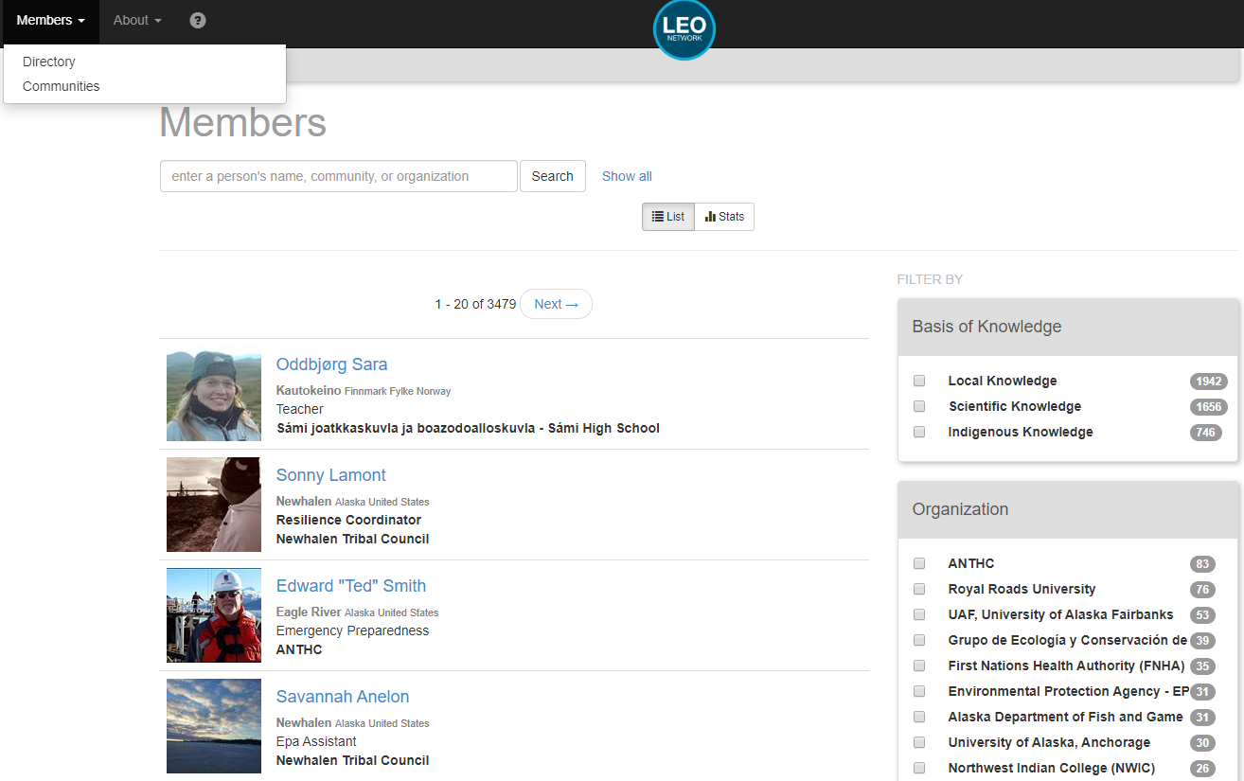
The LEO Directory shows all members of the LEO Network, their home community, and what organizations they are affiliated with.
Using the sidebar, this directory can be searched broadly based on knowledge contribution, or organization…

Slide 3
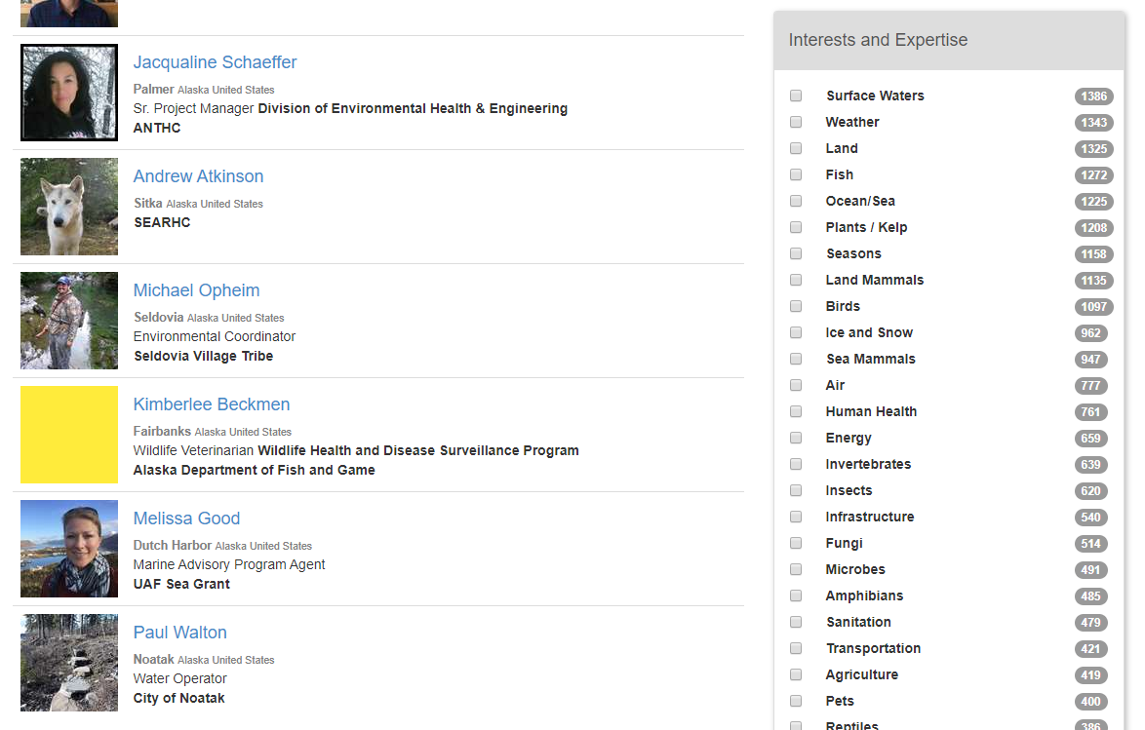
…as well as the areas of interest and expertise

Slide 4
LEO Members can also search the directory using a name, community, or organization.
The One Health Group is growing, and the LEO member directory is a useful tool for learning who is involved, and who may be able to comment on events or trends from a One Health perspective

Slide 5
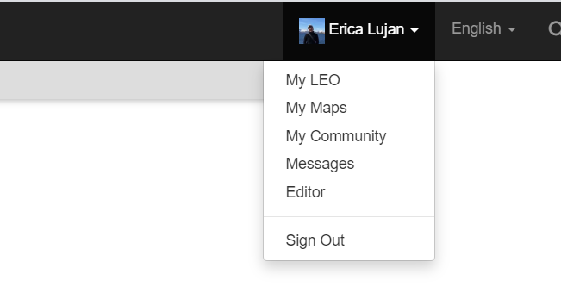
To edit your profile and add a One Health Group affiliation, go to “My LEO” from the drop down menu under your profile.

Slide 6
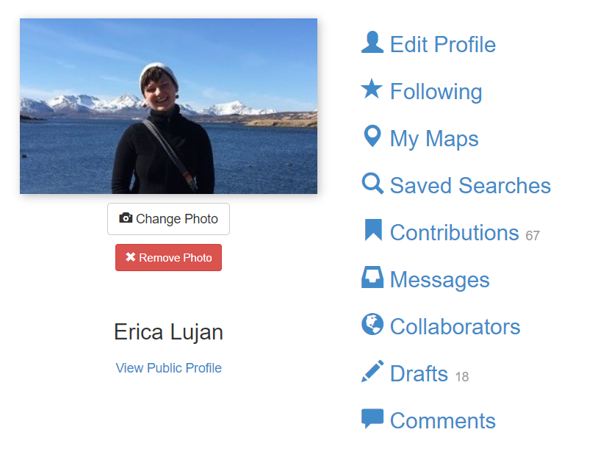
Click “edit profile”

Slide 7
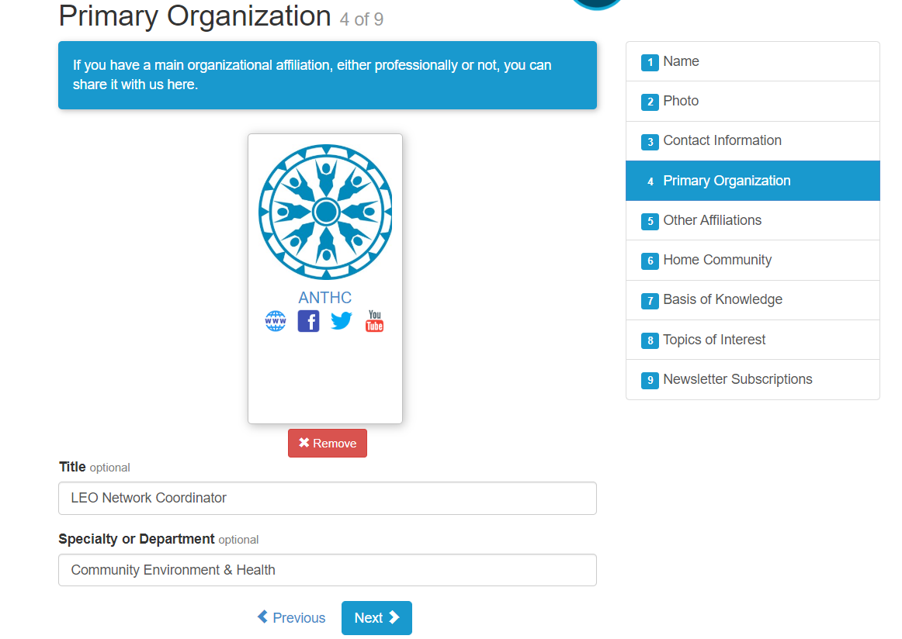
Your primary organization is your main professional association

Slide 8
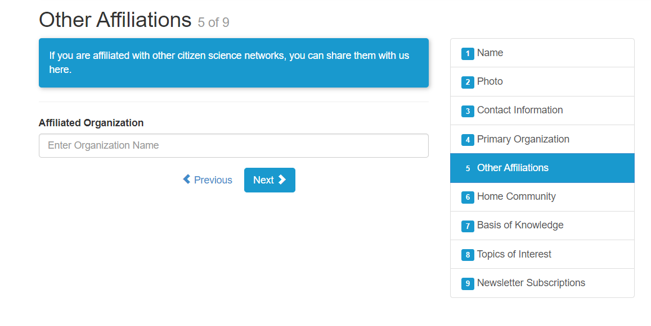
The One Health Group affiliation can be added as an “other affiliation.”

Slide 9
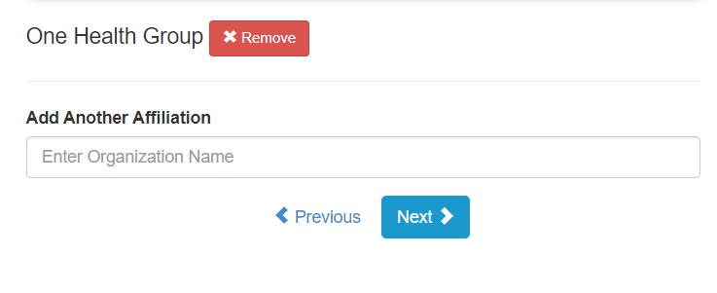
The One Health Group name with autofill, and once selected, will appear above the text box.

Slide 10
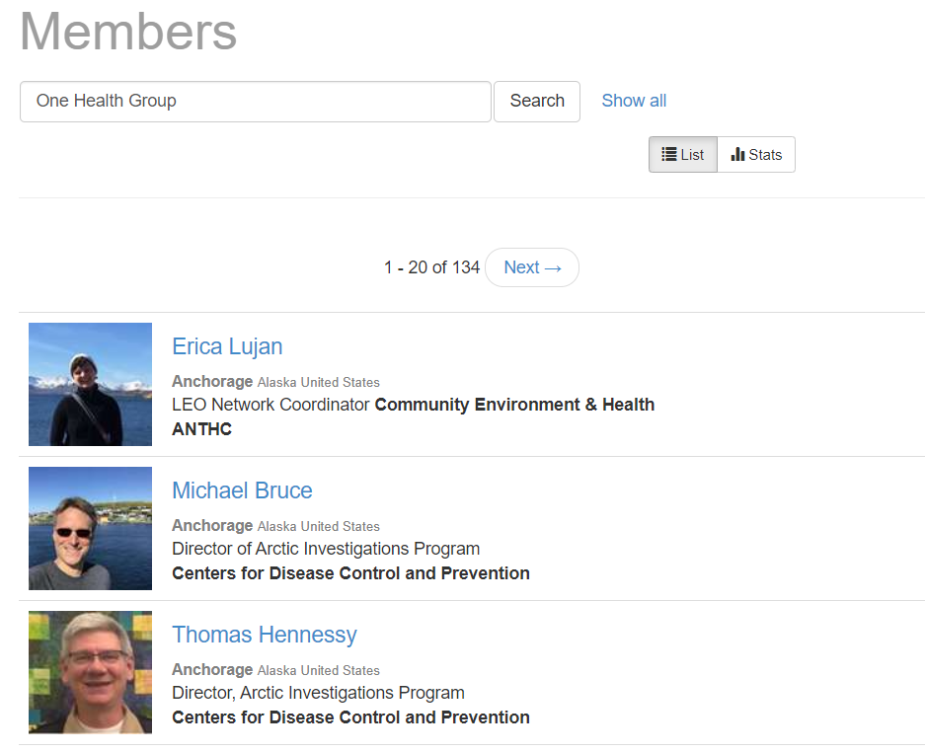
By searching for One Health Group, LEO members can see everyone affiliated with the group

Slide 11
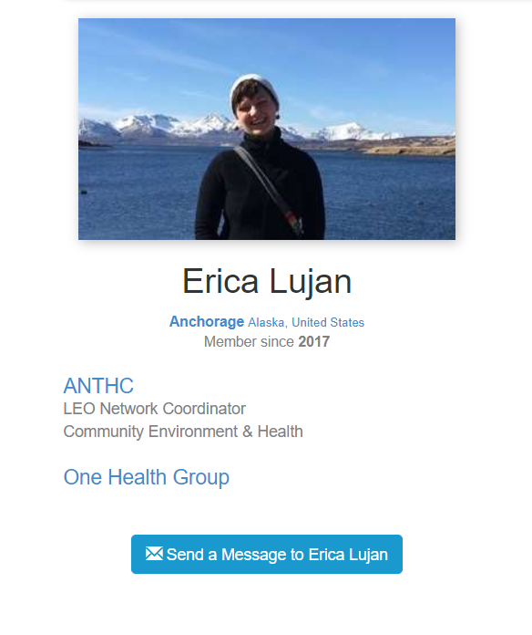
You may also access a full list of LEO Members affiliated with the One Health Group by clicking on the group name from your profile.

Slide 12
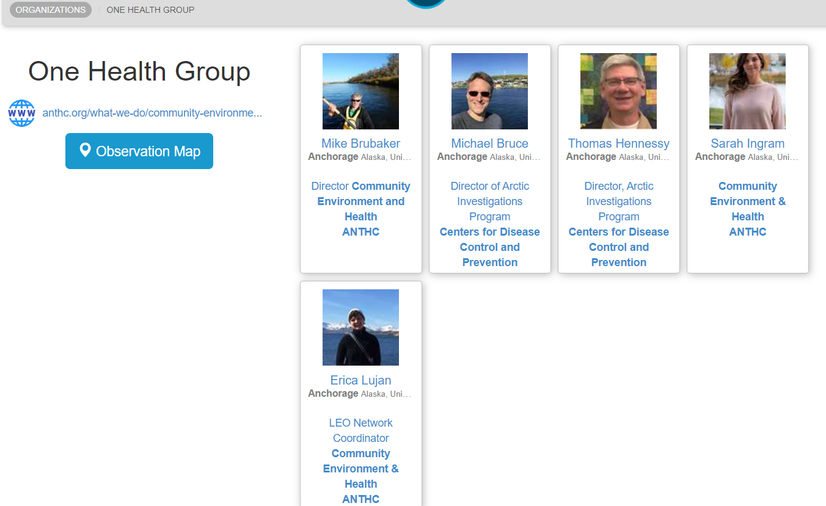
This provides an easy way to network with others in the One Health Group

Slide 13
LEO Members can message back and forth using an internal messaging system that delivers the message to the address the recipient uses to log in to LEO

Slide 14
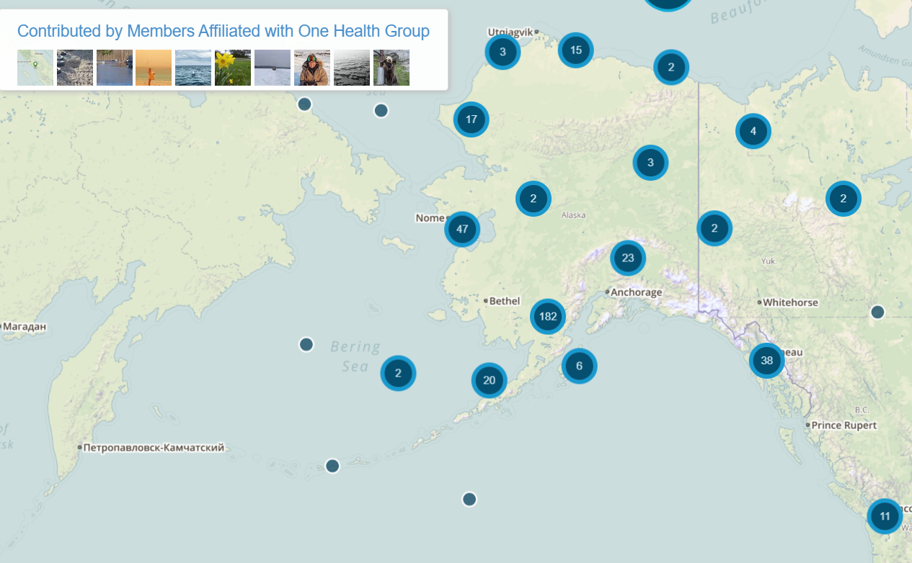
From the One Health Group page, accessed from your LEO profile page, you may also see all the contributions that group members have made to the network

Slide 15
If you have any questions, please contact: Erica Lujan, LEO Network Coordinator enlujan@anthc.org or at 907-729-3596

