Slide 1
Circumpolar One Heath Winter 2019-20 Climate Review and Spring 2020 Outlook
Rick Thoman
Alaska Center for Climate Assessment and Policy
March 03, 2020

Slide 2
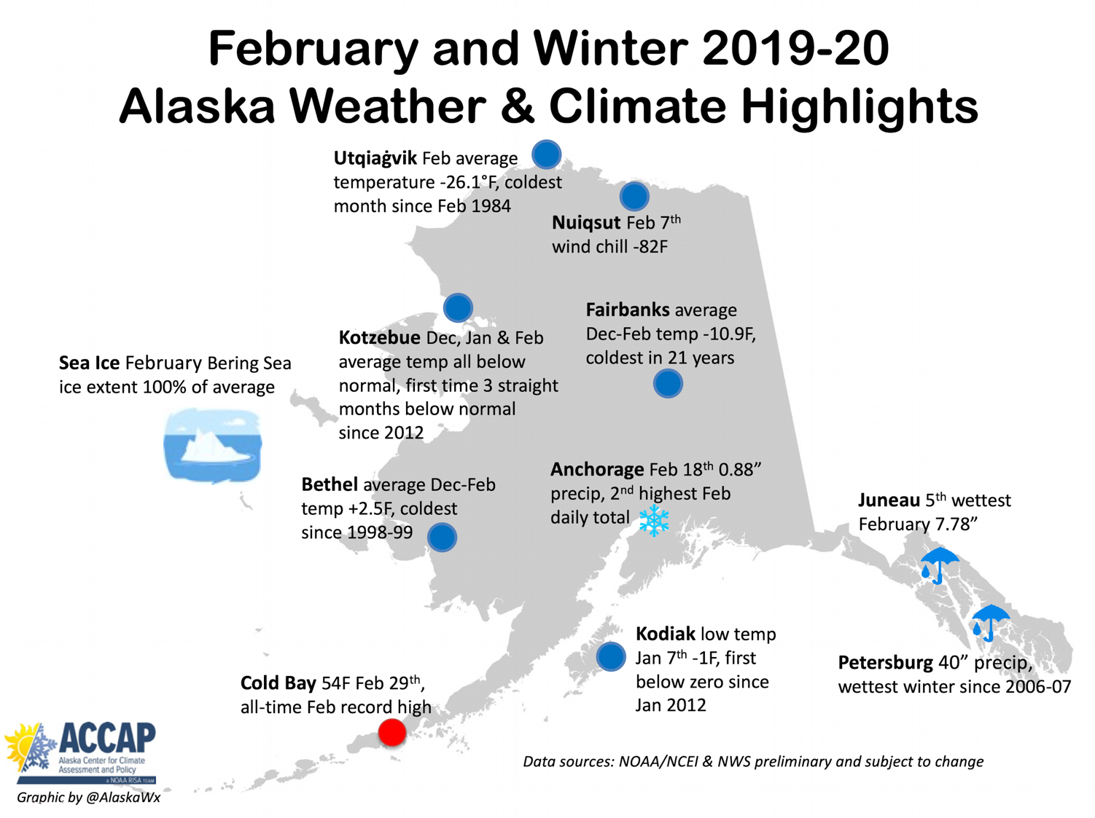

Slide 3
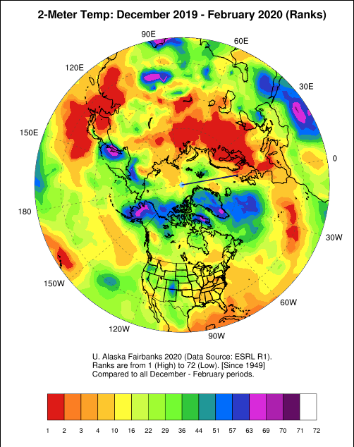
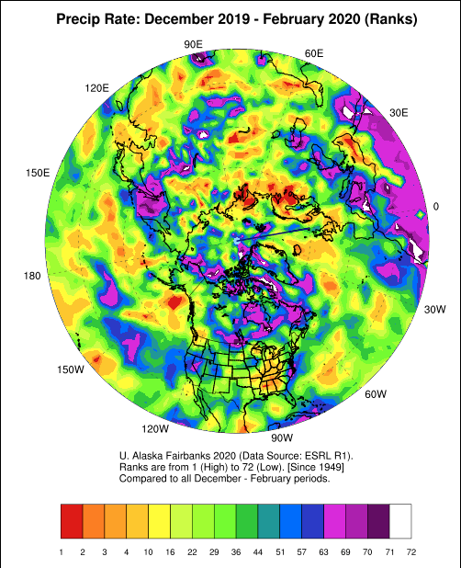
Pan-Arctic Winter Temps and Precip
Poleward of 60N: 14th warmest
(Past 72 years)
Poleward of 60N: 13th wettest
(Past 72 years)

Slide 4
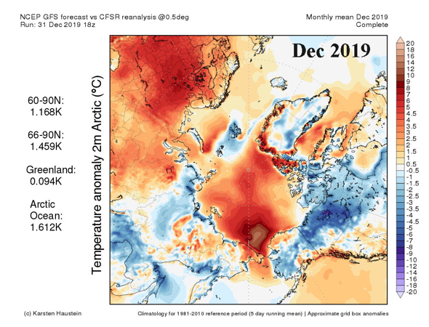
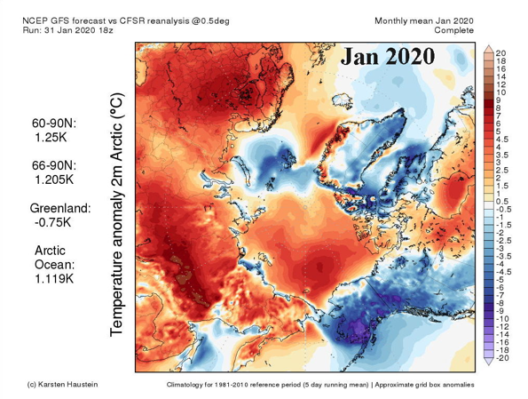
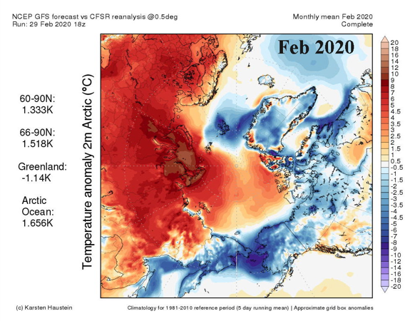
Winter 2019-20

Slide 5
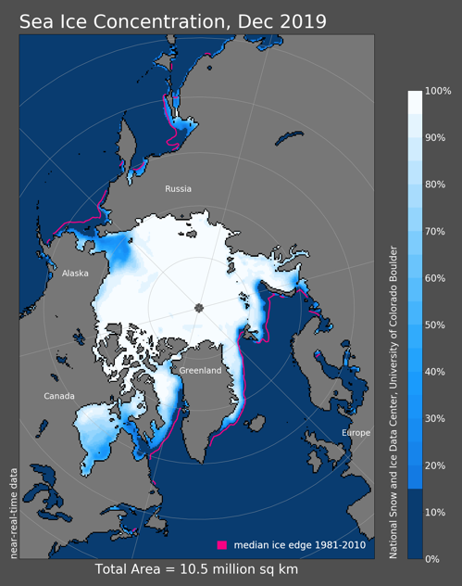
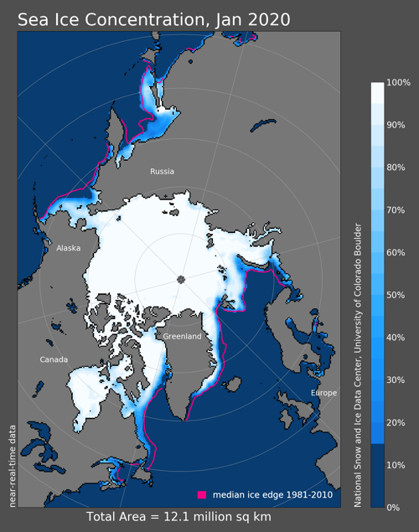
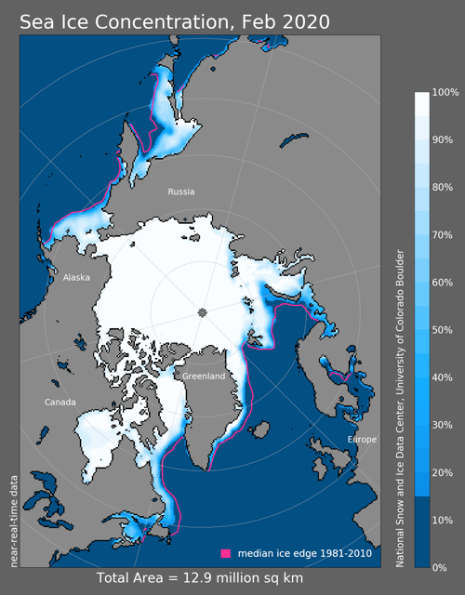
Sea Ice This Winter
Tied 5th lowest
10th lowest
13th lowest

Slide 6
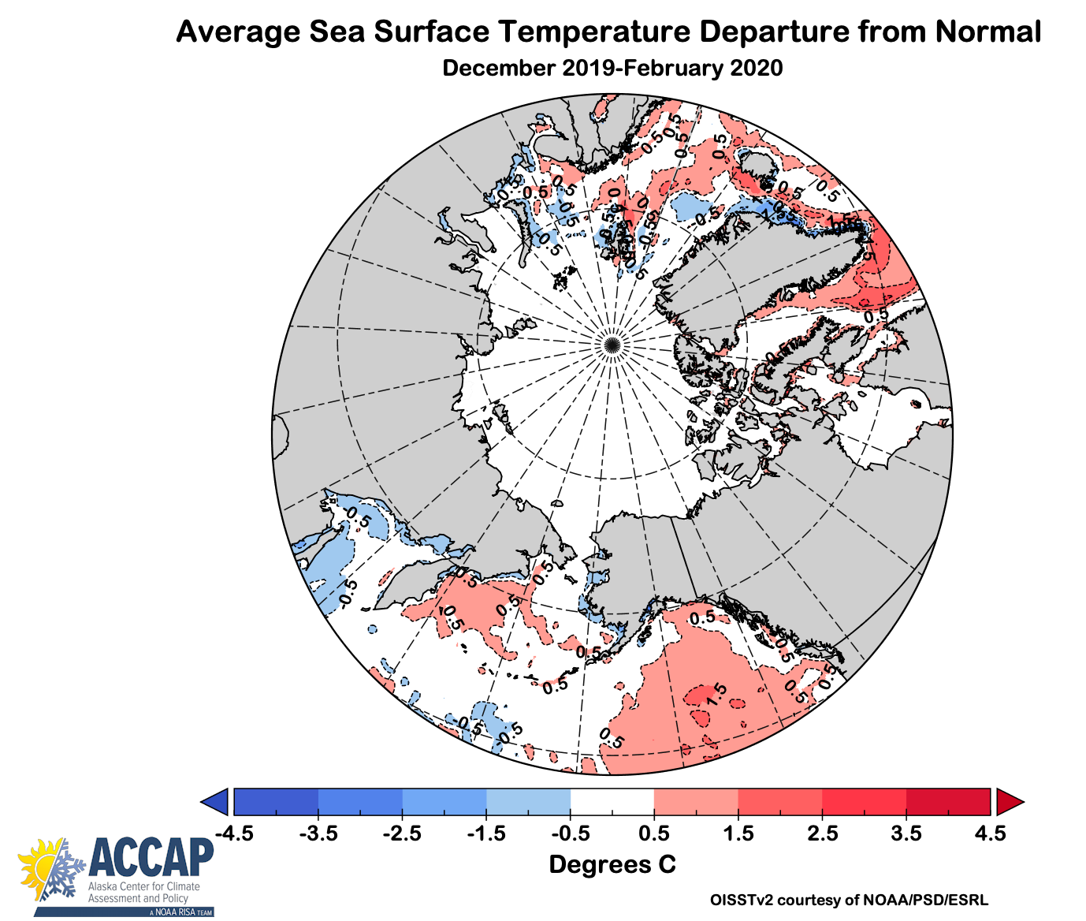
Ocean Temperatures

Slide 7
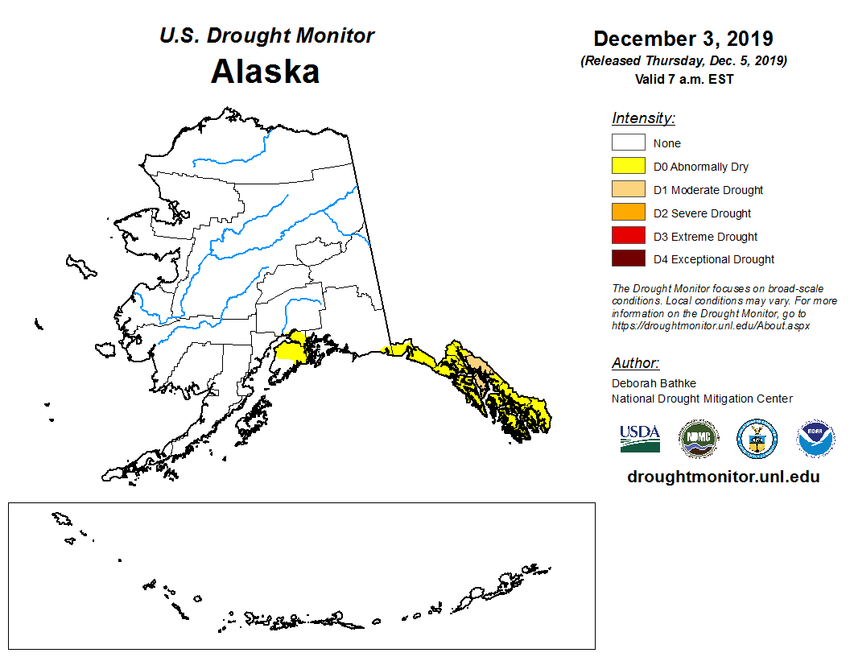
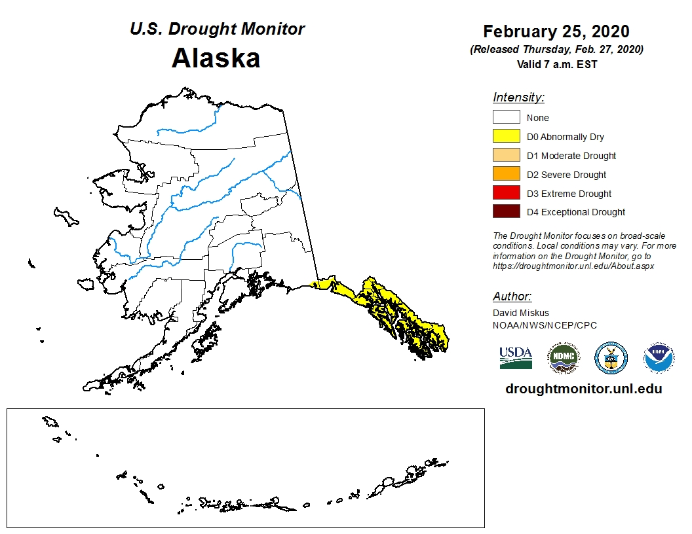
Winter 2019-20 Drought in Alaska
Start of Winter
End of Winter

Slide 8
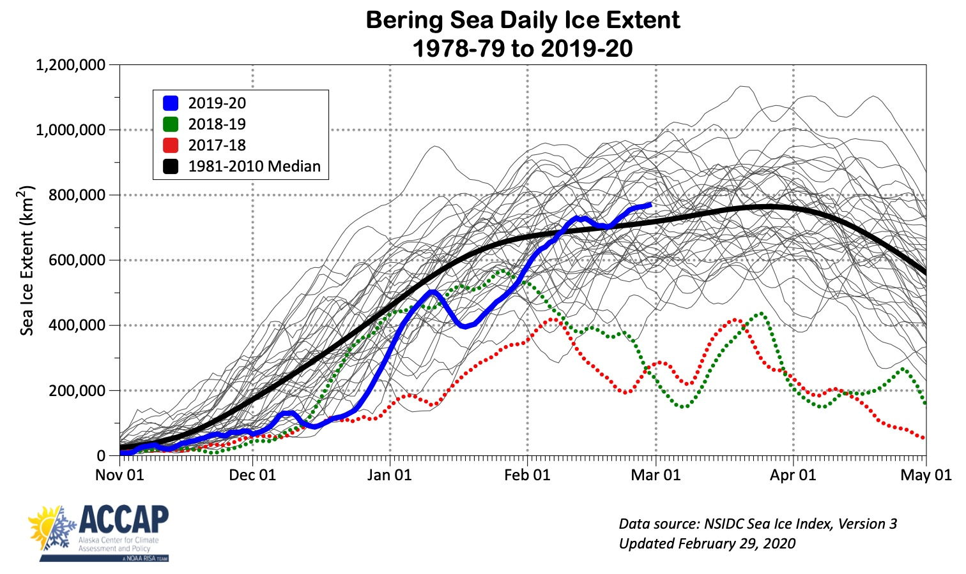
Daily Sea Ice Extent
Chukchi Sea Ice-over Dec 22
Third latest on record

Slide 9
Current Alaska Sea Ice

Slide 10
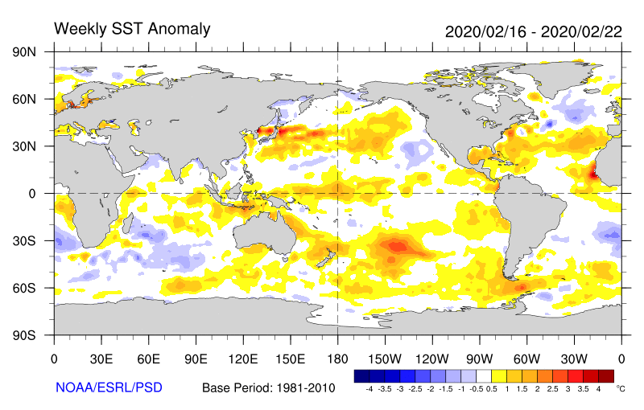
Spring 2020 Outlook
Warm equatorial Pacific west of 150W
Neither El Niño or La Niña
North Pacific mostly warmer than normal
Moderate Arctic sea ice extent (for recent years)

Slide 11
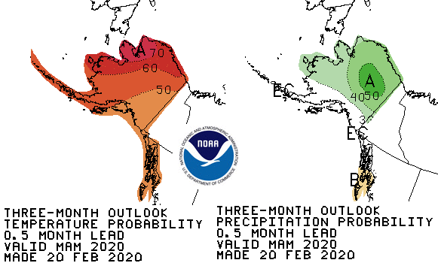
CPC March-May 2020 Outlook
75%
22%
03%
45%
33%
22%
55%
33%
12%
37%
33%
30%
65%
30%
05%
45%
33%
22%
33%
33%
33%
30%
33%
37%
Above%
Normal%
Below%

Slide 12
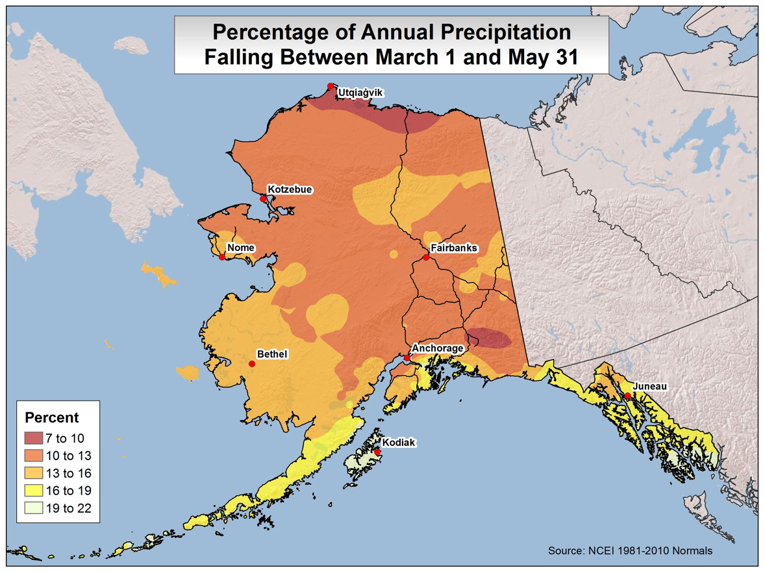
Spring is the Dry Season

Slide 13
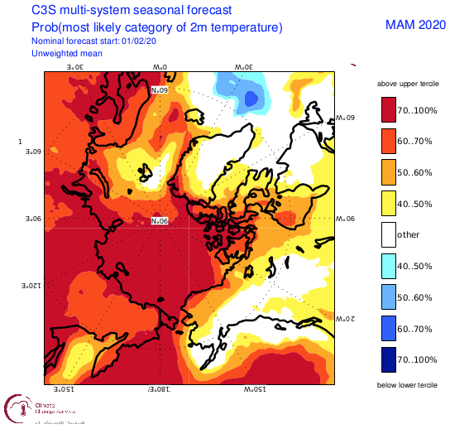
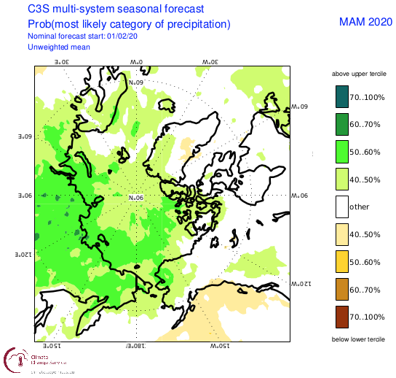
Circumpolar Spring 2020 Outlook
From EU’s Copernicus Climate Change Services

Slide 14
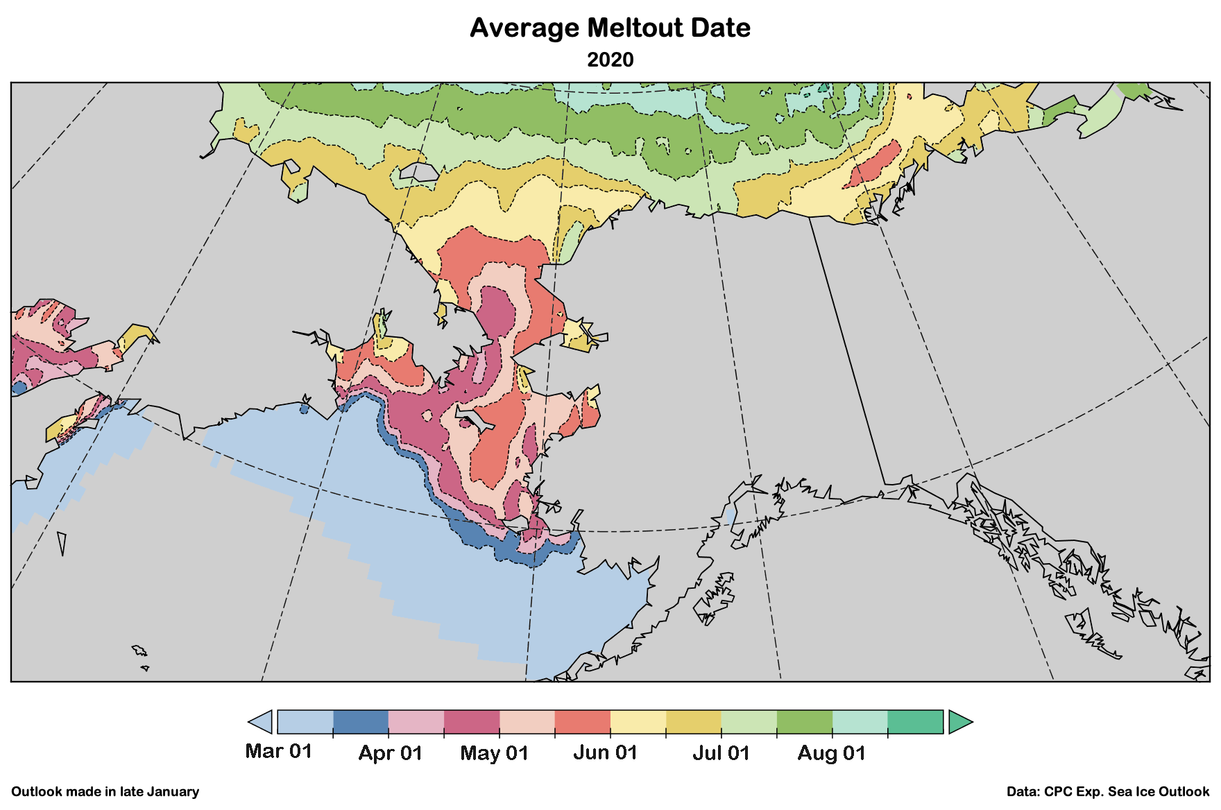
CPC Experimental Sea Ice Forecast

Slide 15
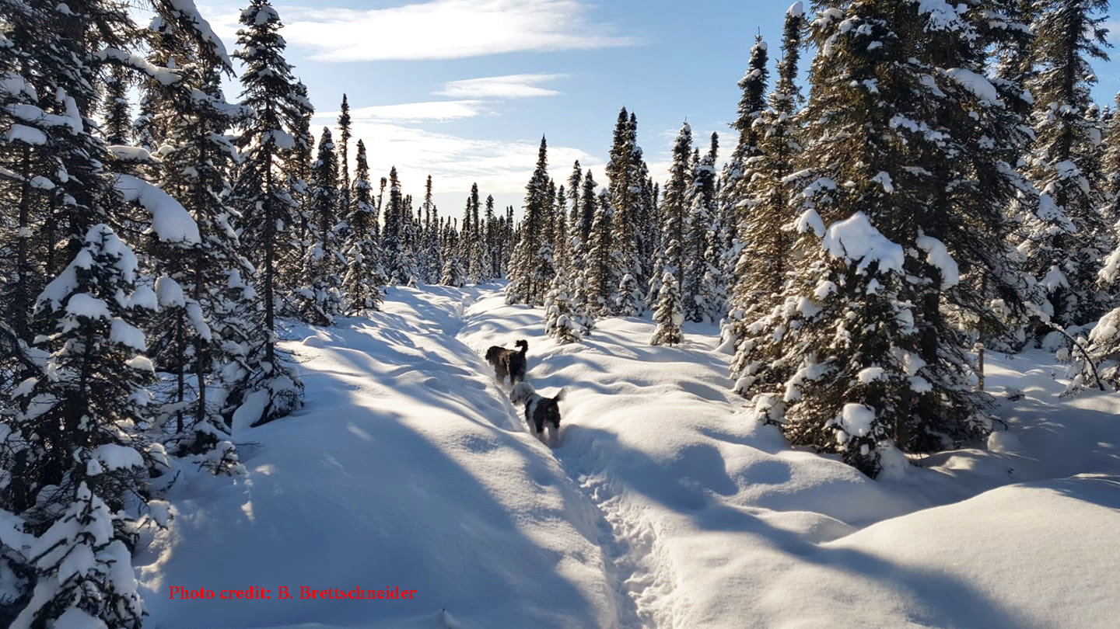
Anchorage Winter Wonderland February 23, 2020

