Slide 1
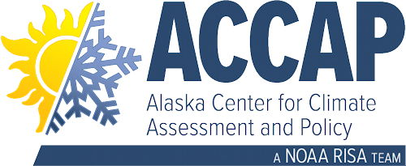
Circumpolar One Heath Summer 2020 Climate Review and Autumn 2020 Outlook
Rick Thoman
Alaska Center for Climate Assessment and Policy
September 15, 2020

Slide 2
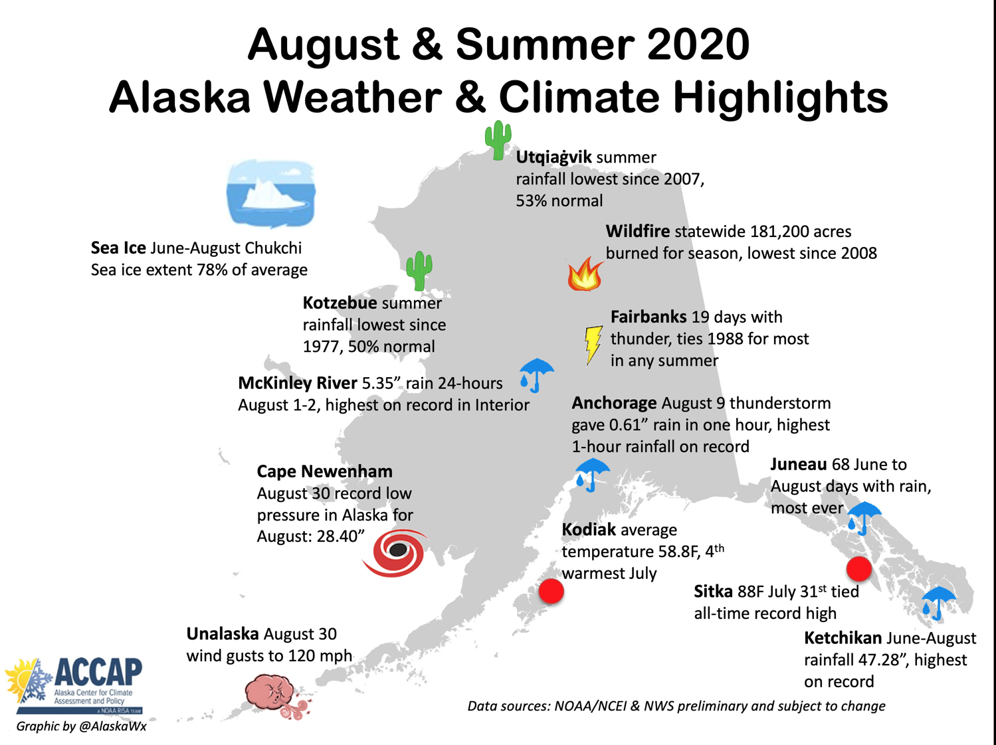

Slide 3
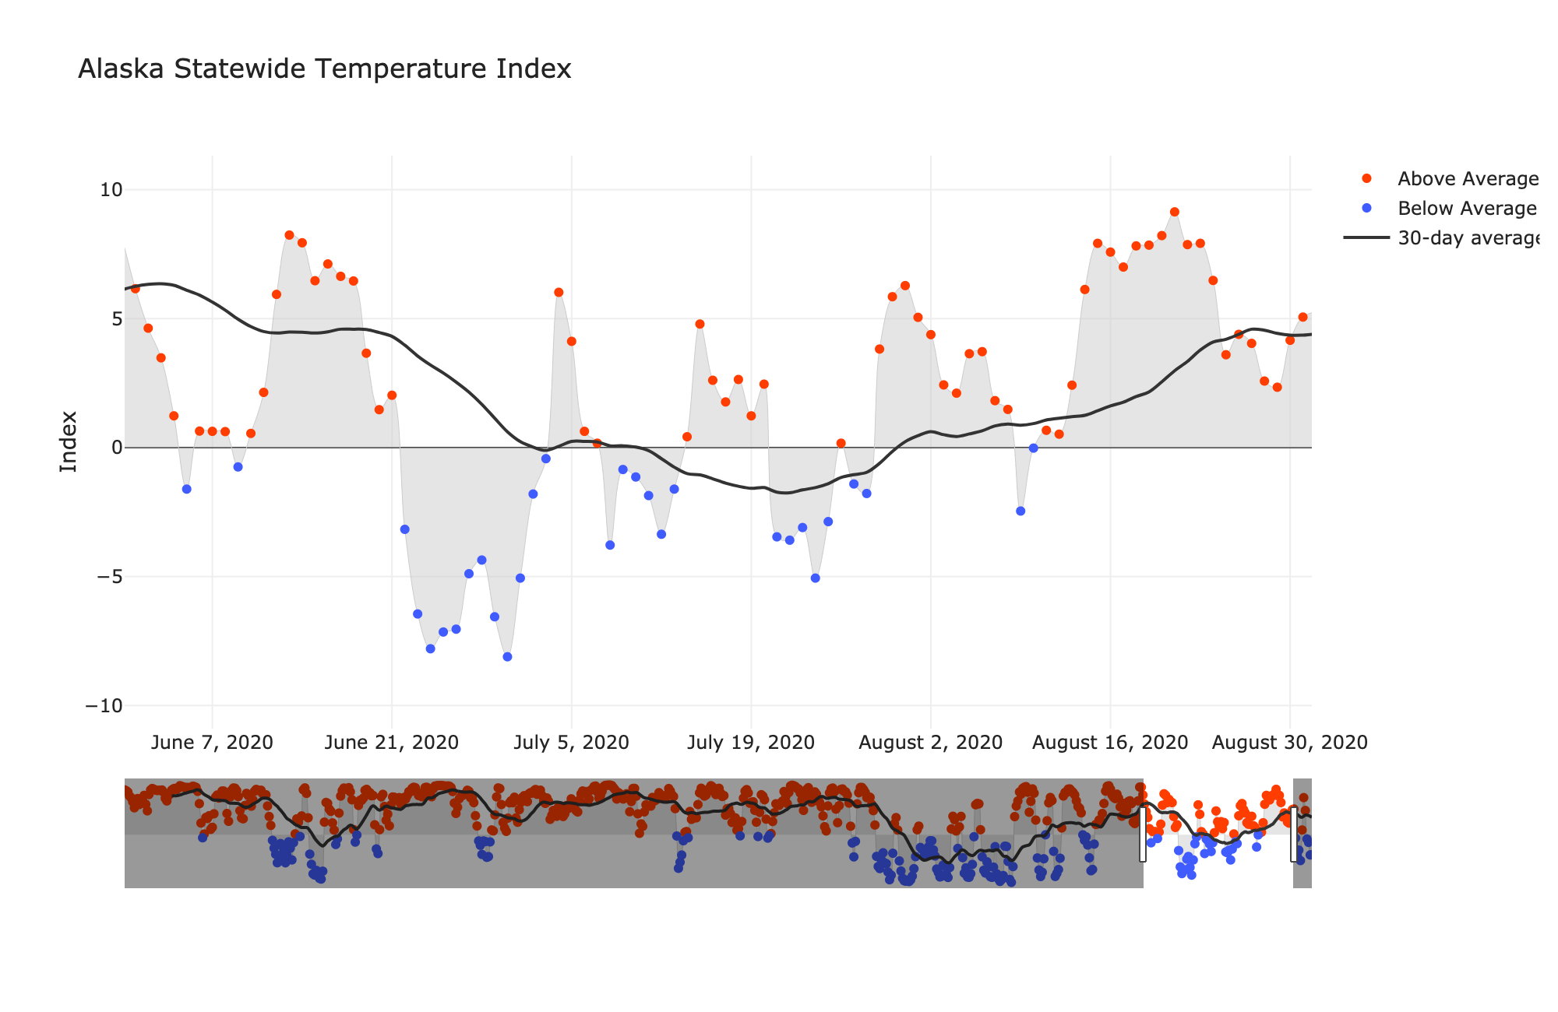
Alaska Daily Temperature Index
Now online: http://accap.uaf.edu/tools/statewide-temperature-index

Slide 4
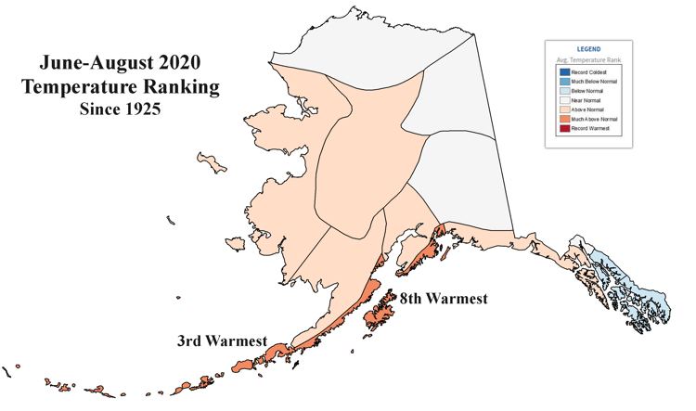
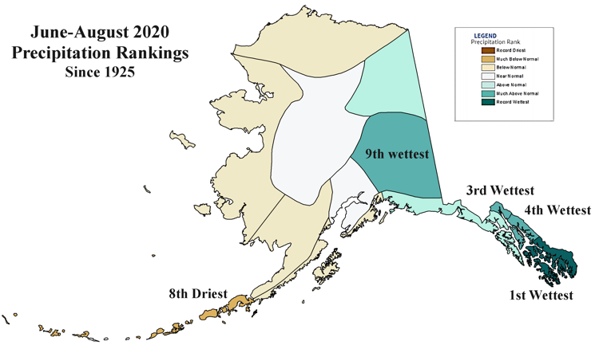
Alaska Regional Summer 2020
Temperatures
Precipitation

Slide 5
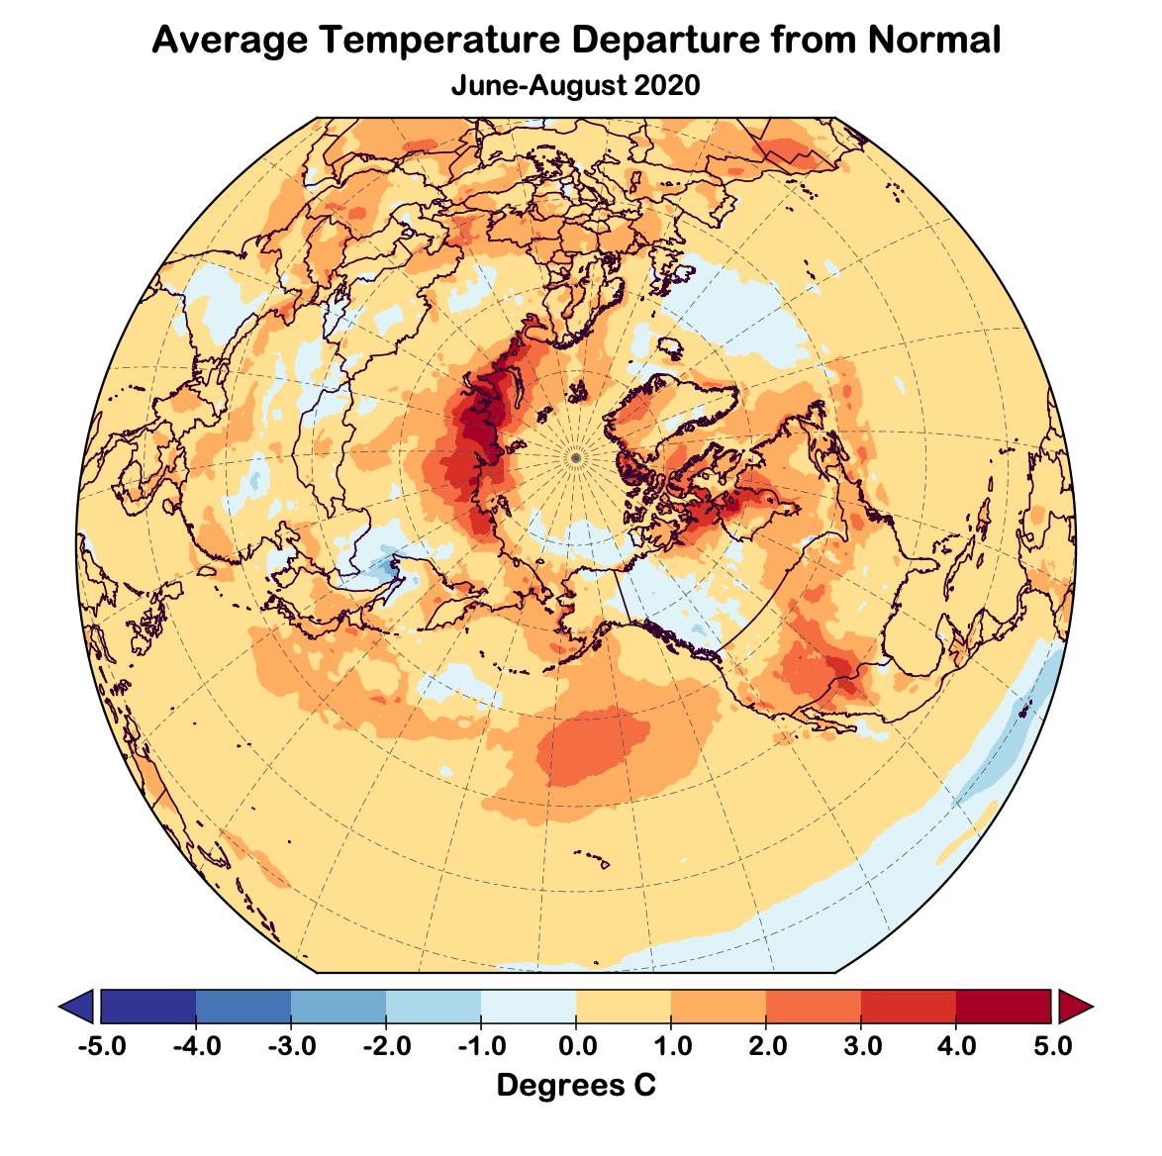
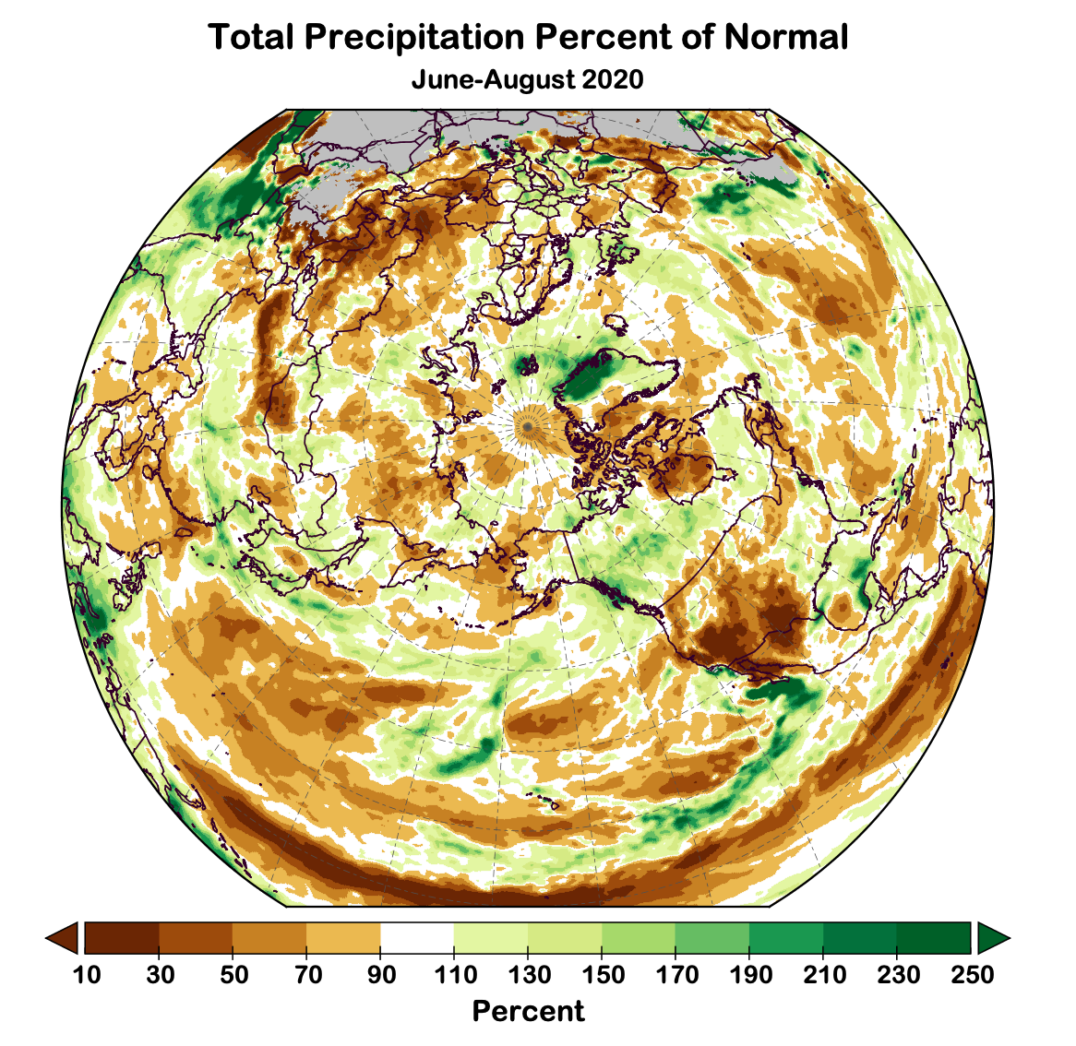
Summer 2020 Arctic-wide
Temperature Departures from Average
Precipitation Departures from Average
Data: ERA5 courtesy of EMCWF/Copernicus
1981-2010 Baseline

Slide 6
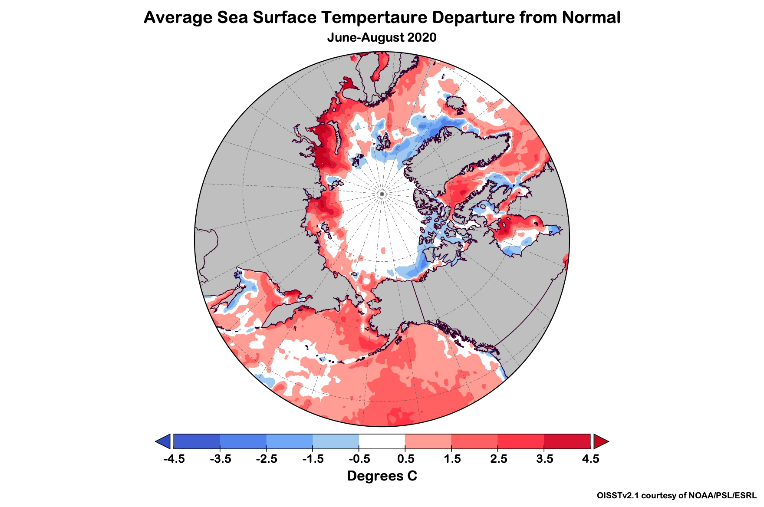
Ocean Temperatures

Slide 7
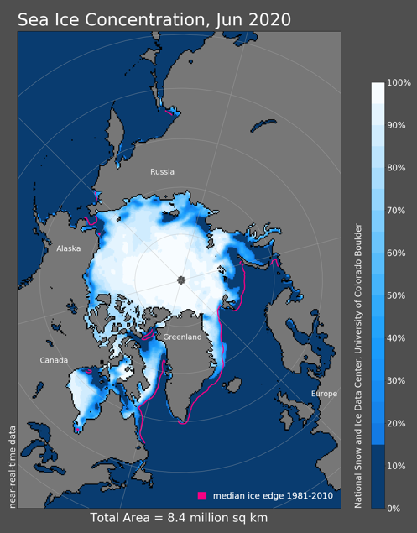
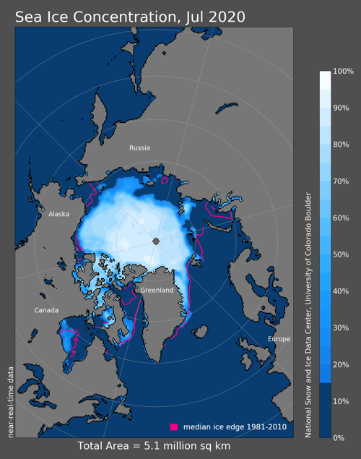
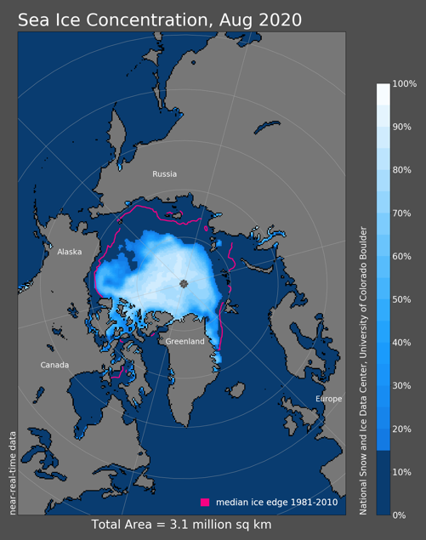
Sea Ice Summer 2020
2nd lowest
1st lowest
3rd lowest
Since 1979

Slide 8
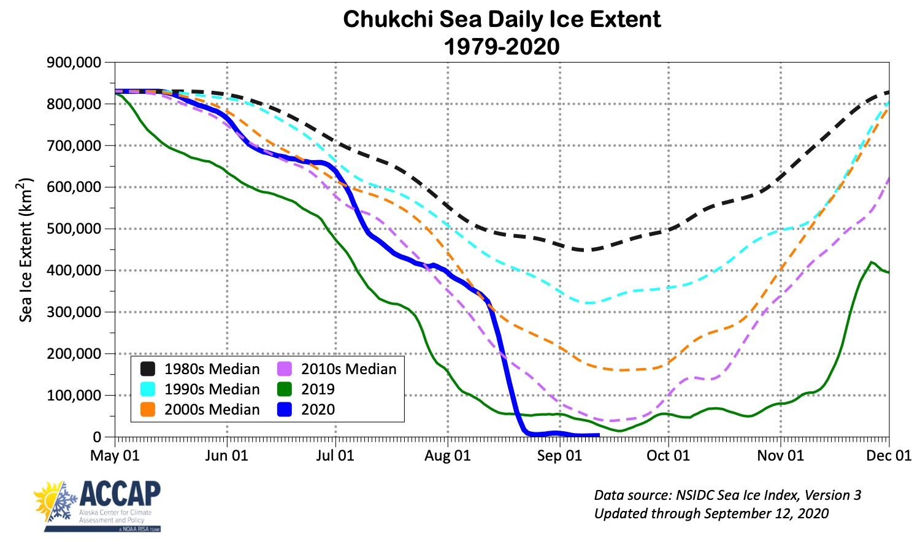
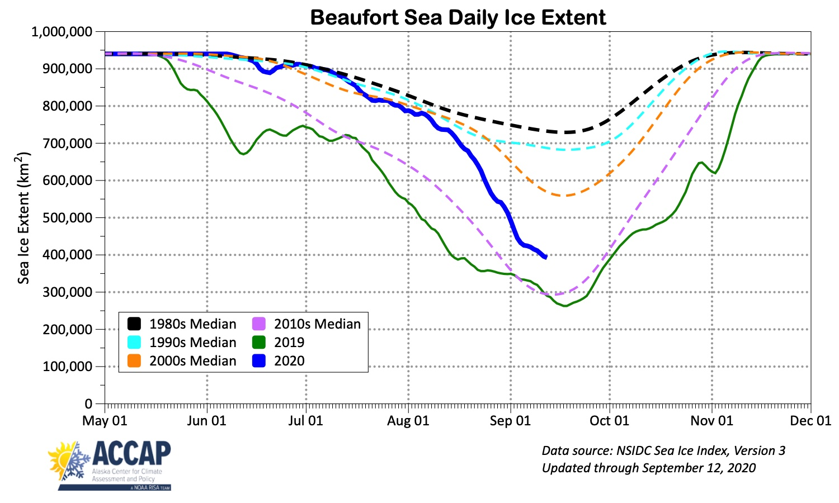
Daily Chukchi-Beaufort Seas Ice Extent

Slide 9
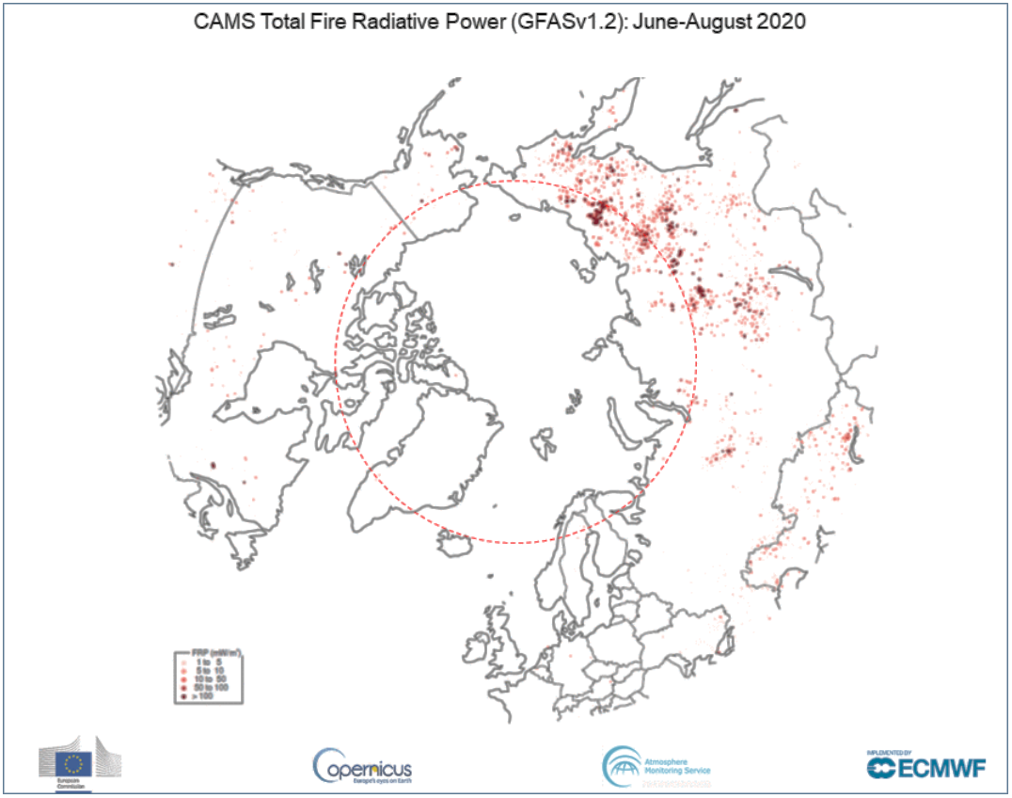
High Latitude Wildfire 2020
Low Year in North America
Alaska: 183k acres (73.8k ha) burned
NWT & YT: 90k acres (32.6k ha) burned
High year in Siberia
Graphic courtesy M. Parrington and
Copernicus Atmosphere Monitoring Service

Slide 10
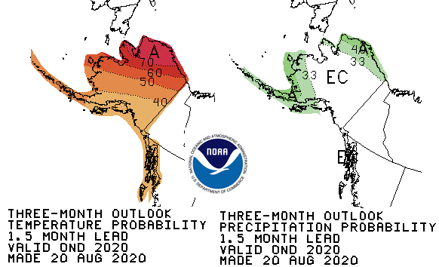
CPC October-December 2020 Outlook
65%
30%
05%
75%
22%
03%
45%
33%
22%
45%
33%
22%
45%
33%
22%
45%
33%
22%
33%
33%
33%
37%
33%
12%
37%
33%
30%
Above%
Normal%
Below%

Slide 11
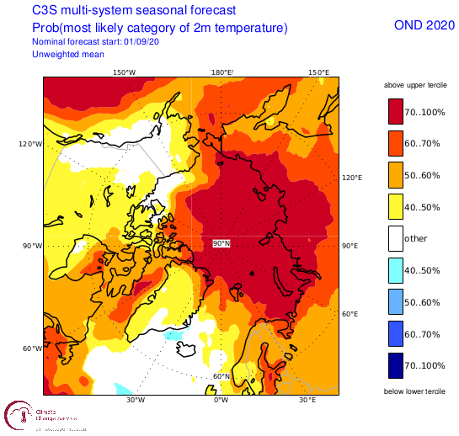
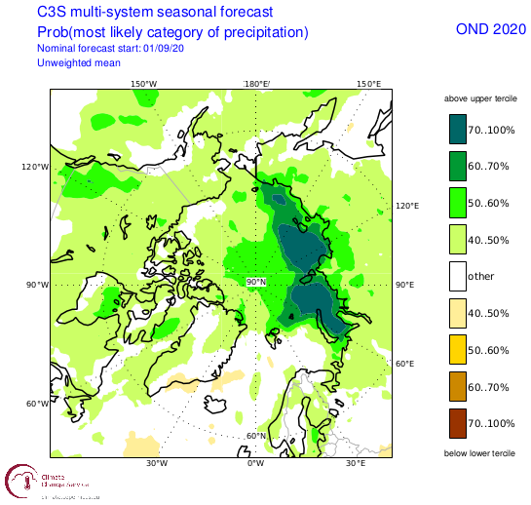
Late Autumn 2020 Arctic Temp and Pcpn Outlook
Outlooks courtesy Copernicus C3S (Climate Change Service)

Slide 12
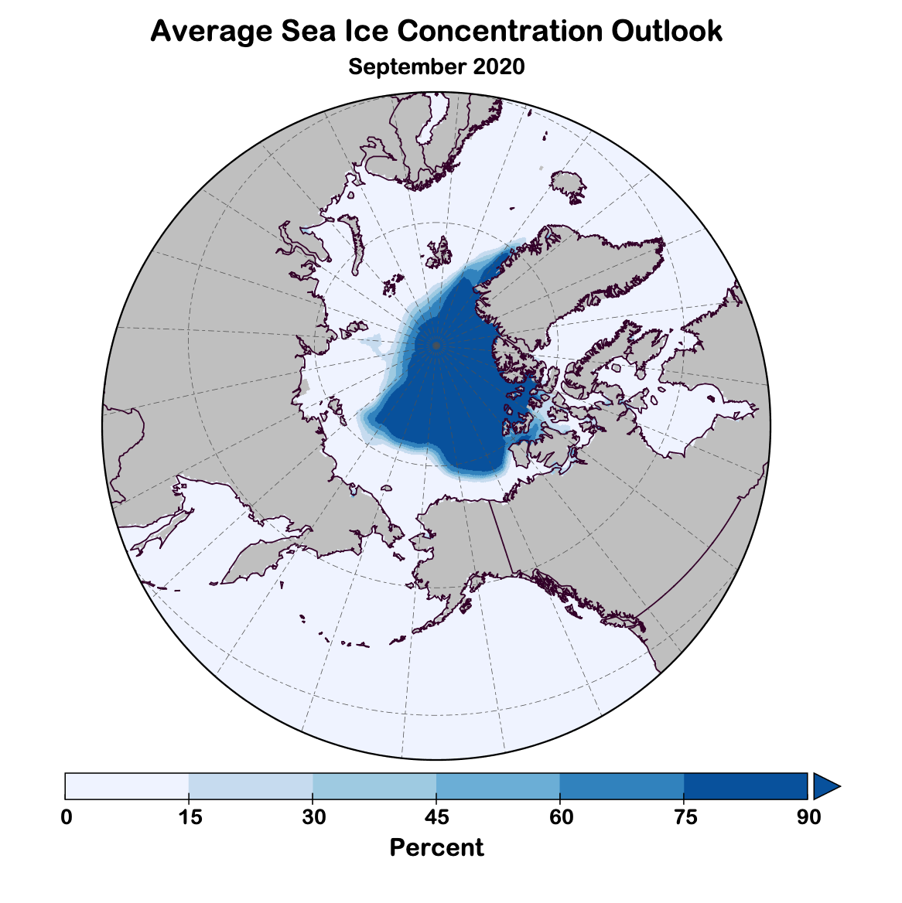
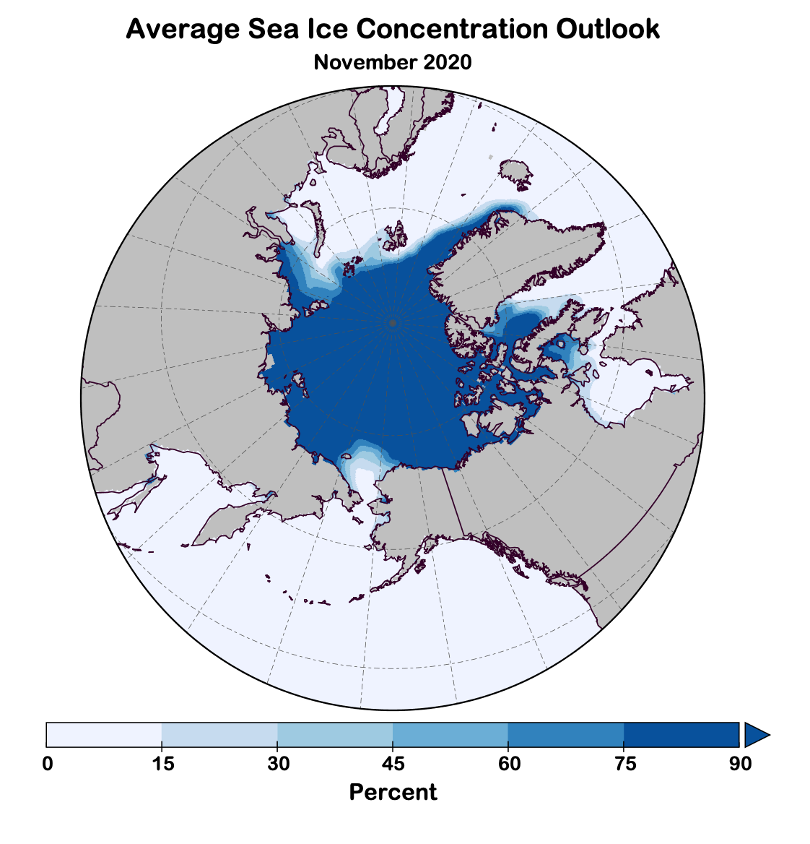
Autumn 2020 Sea Ice Outlook
Data: NOAA/Climate Prediction Center Exp. Sea Ice Outlook

Slide 13
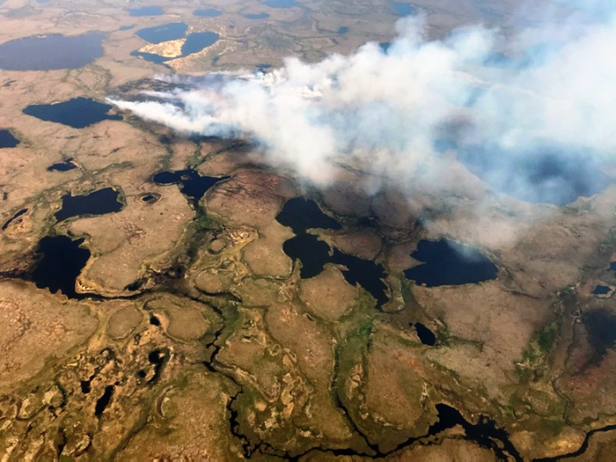
Lou Lake Fire near Newtok, Alaska June 8, 2020

