Slide 1
Circumpolar One Heath Autumn 2022 Climate Review and Winter 2022-23 Outlook
Rick Thoman
Alaska Center for Climate Assessment and Policy
University of Alaska Fairbanks
December 06, 2022

Slide 2
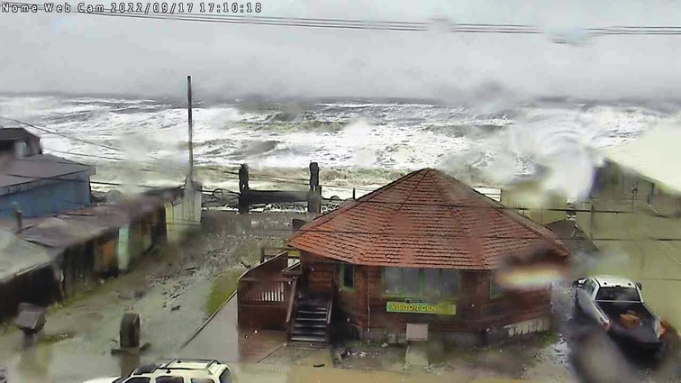
Autumn 2022 Highlights
Ex-Typhoon Merbok
Strongest storm so early in the autumn
Damage along 1000 miles of coastline Kuskokwim Bay to Bering Strait
Highest water levels on record some communities
Community and subsistence infrastructure
Severe erosion

Slide 3
Beyond ex-Merbok
Extremely mild October in Southeast Alaska
Warmest on record at Sitka
69F Petersburg Oct 19th highest Alaska temperature so late in the autumn since 1938
Record snowy October Copper River basin to upper Tanana Valley
Coastal flooding Utqiaġvik Oct 7-8th

Slide 4
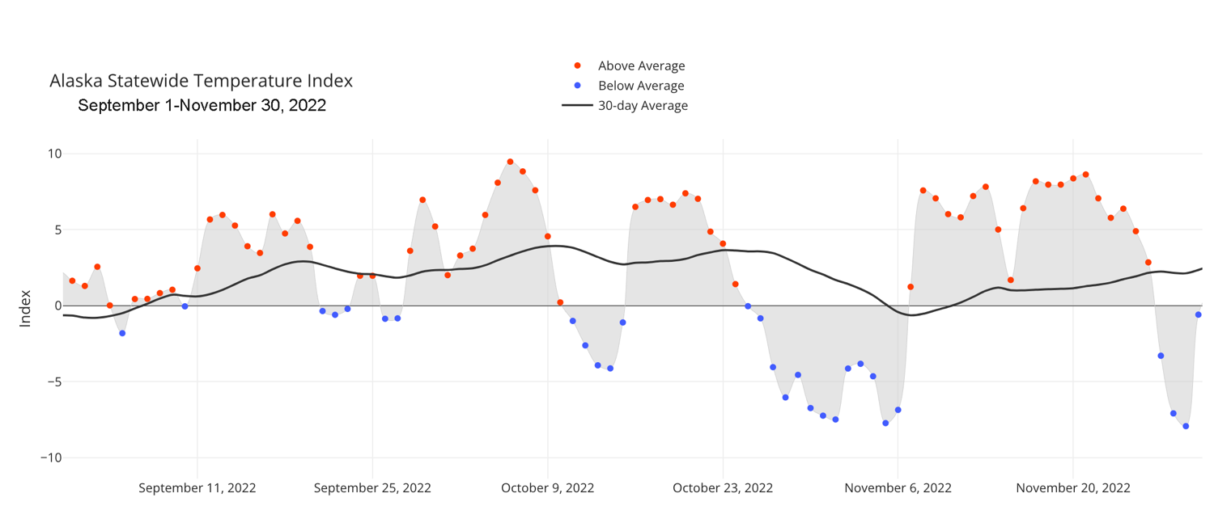
Alaska Daily Temperature Index
Online: http://accap.uaf.edu/tools/statewide-temperature-index

Slide 5
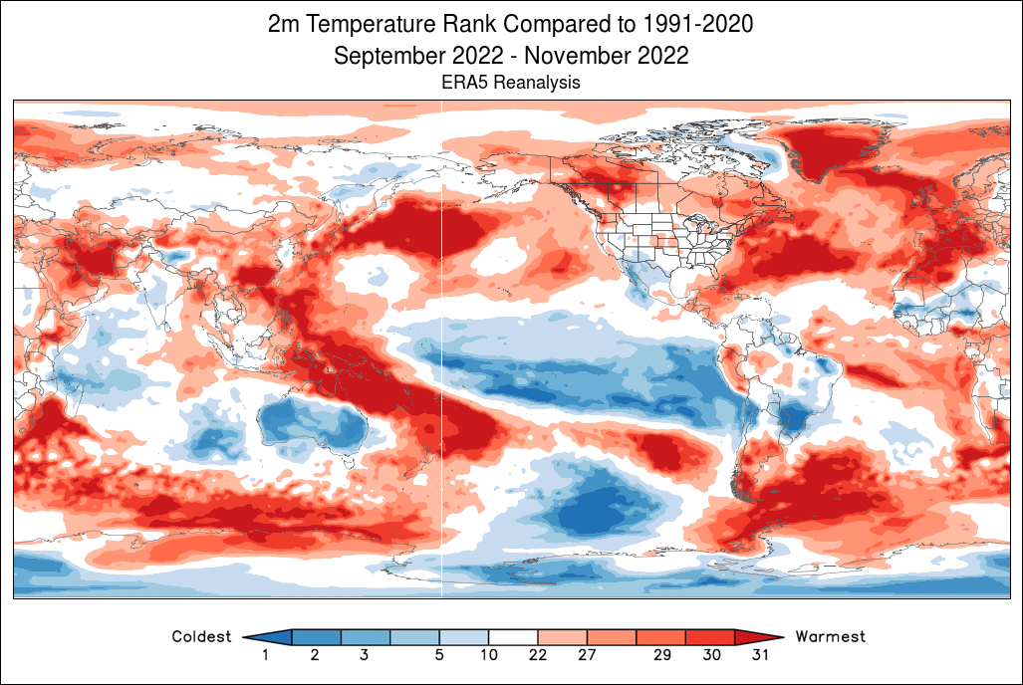
Autumn 2022 Temperature Rank
Data: ERA5 courtesy of World Climate Service
1991-2020 Baseline

Slide 6
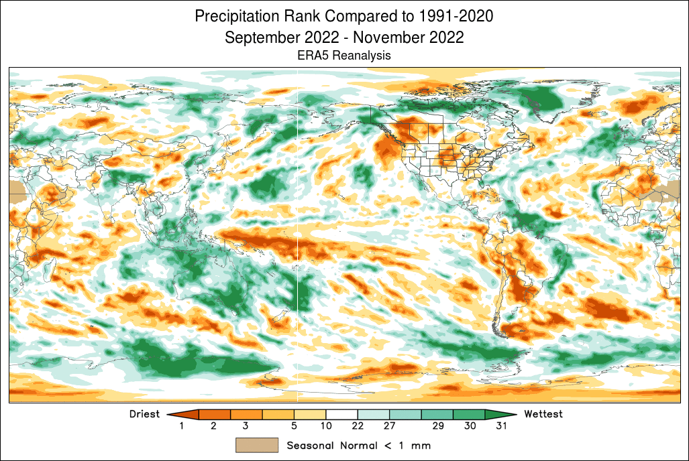
Autumn 2022 Precipitation Rank
Data: ERA5 courtesy of World Climate Service
1991-2020 Baseline

Slide 7
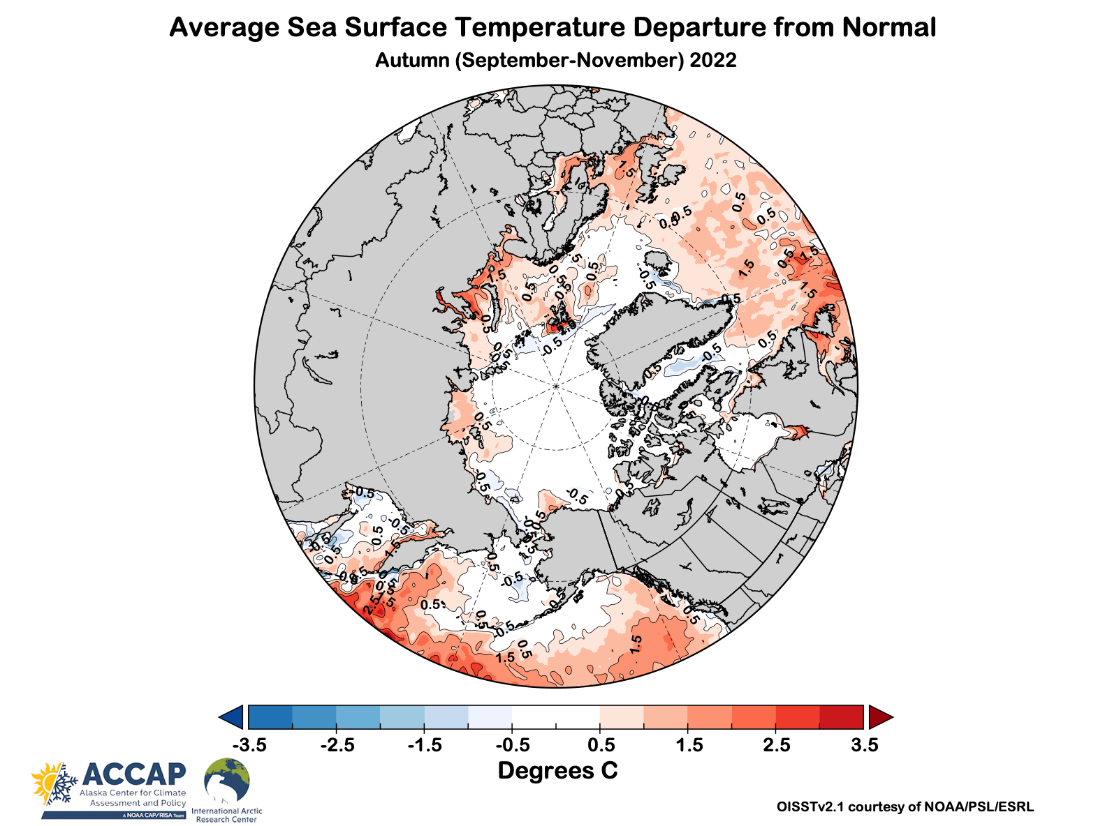
Autumn 2022 Ocean Temperatures

Slide 8
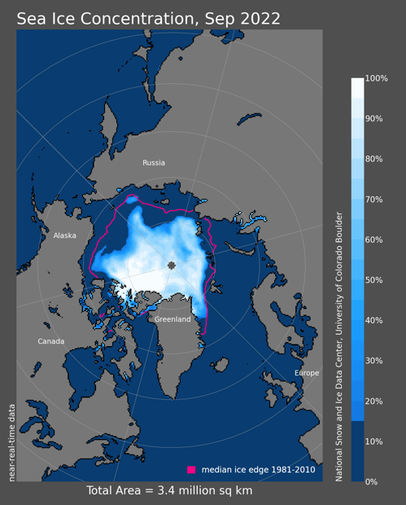
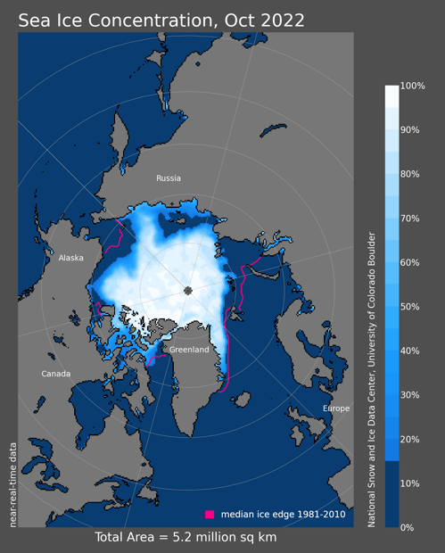
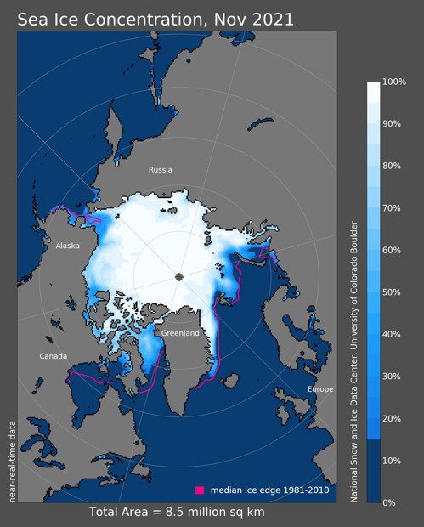
Sea Ice Autumn 2022
11th lowest
8th lowest
8th lowest
Since 1979 (since 1978 for Nov)
2022 Min Ice Extent on Sep 18 4.67 million km², 10th lowest

Slide 9
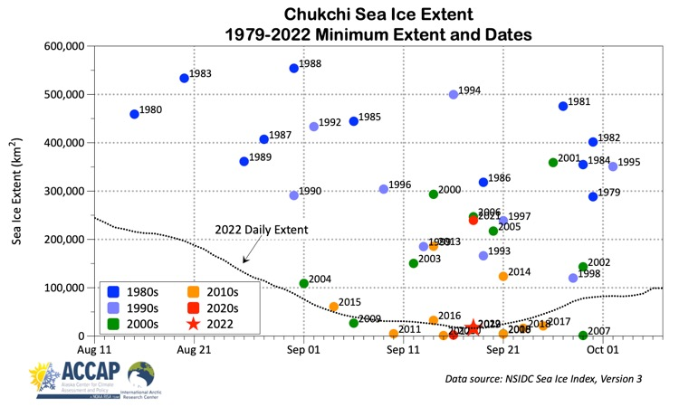
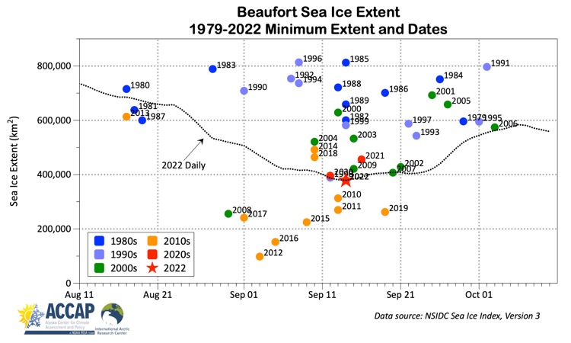
Alaska Seas Ice Minimum

Slide 10
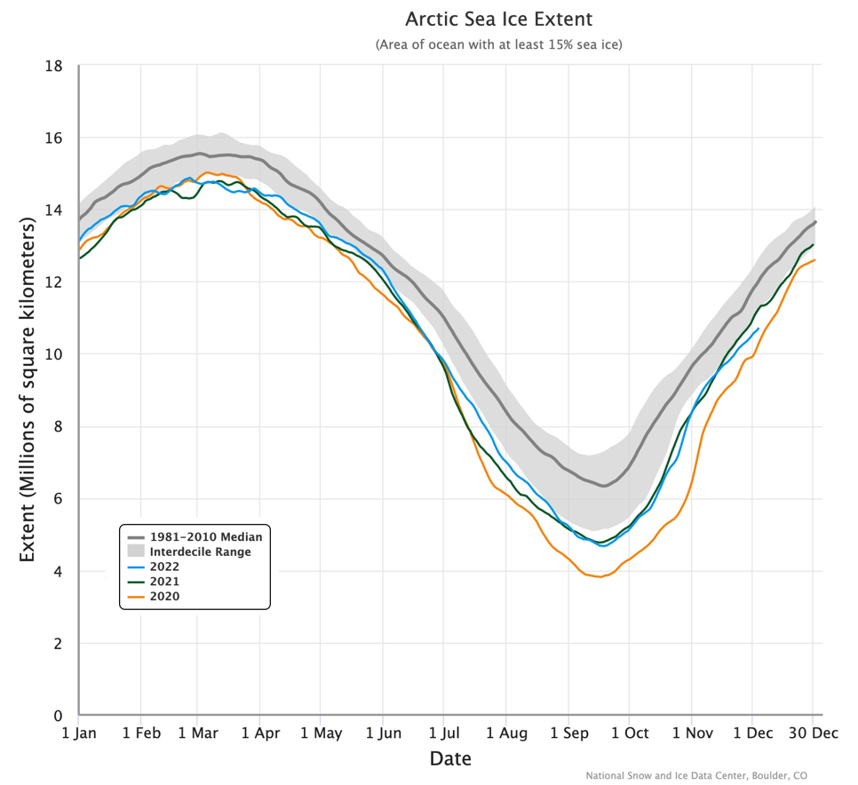
Daily Arctic Sea Ice Extent
Through December 05

Slide 11
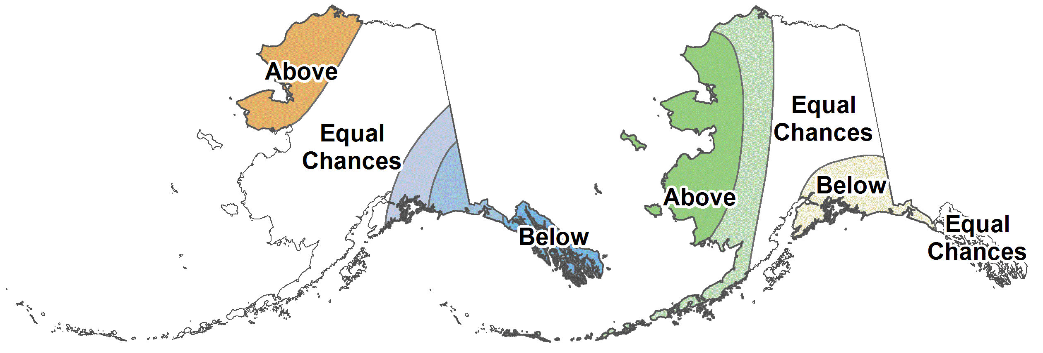
CPC December 2022-February 2023 Outlook
37%
33%
30%
37%
33%
30%
30%
33%
37%
33%
33%
33%
25%
33%
45%
33%
33%
33%
12%
33%
55%
30%
33%
37%
45%
33%
22%
Above%
Normal%
Below%

Slide 12
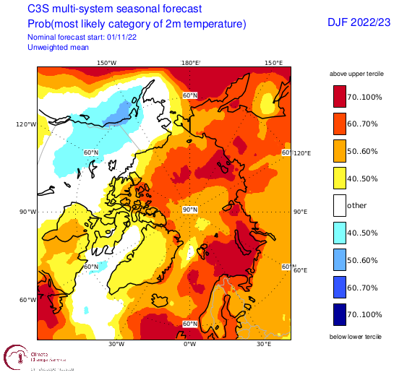
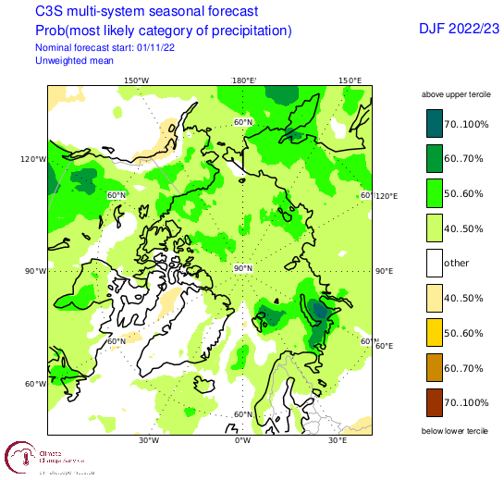
Winter 2022-23 Arctic Temperature and Precipitation Outlook
Outlooks courtesy Copernicus C3S (Climate Change Service)

Slide 13
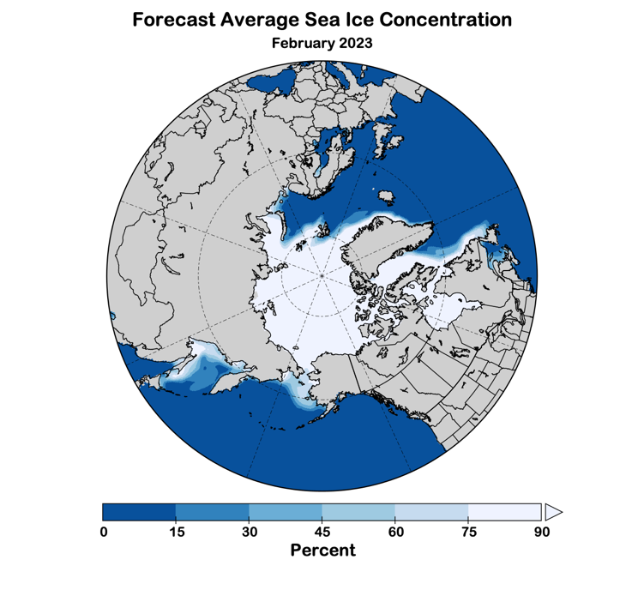
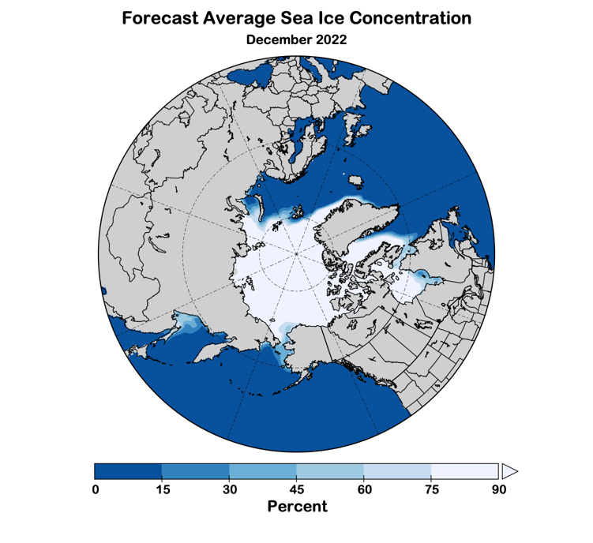
Winter 2022-23 Sea Ice Outlook
Data: NOAA/Climate Prediction Center Exp. Sea Ice Outlook

Slide 14
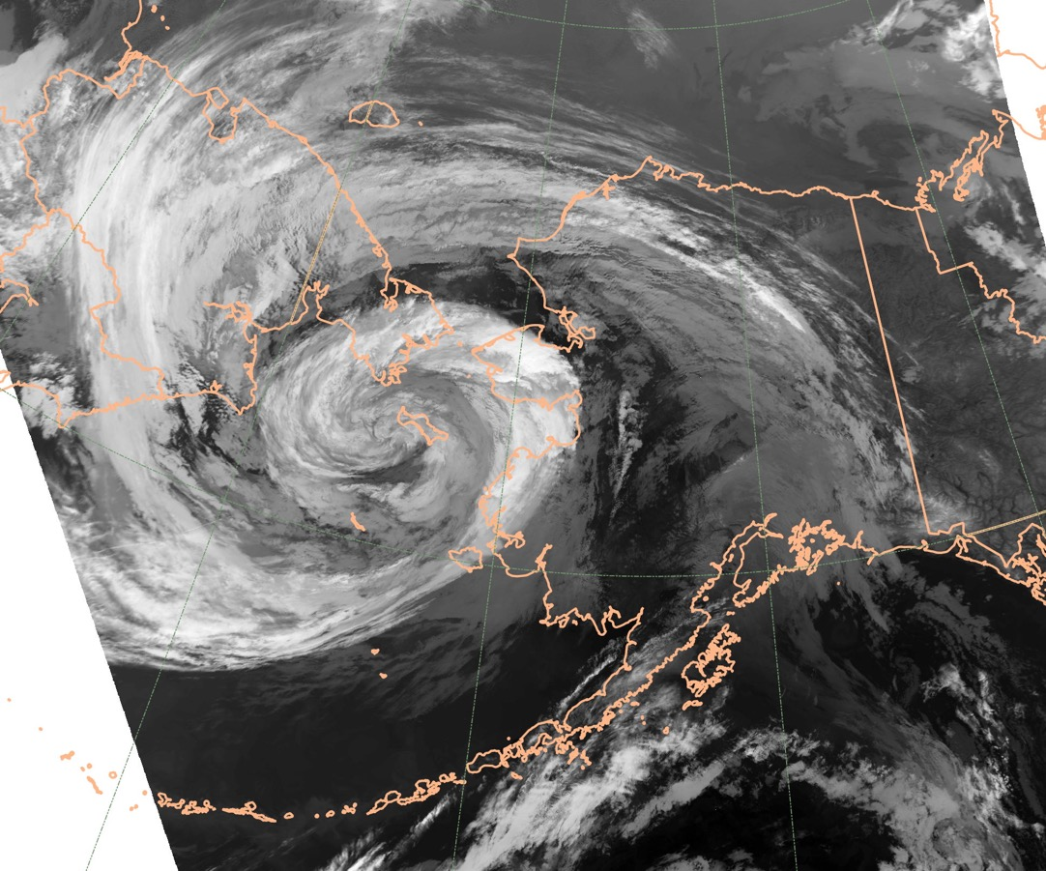
Thanks very much
REMINDER: NOAA’s 2022 Arctic Report Card
will be release Tuesday December 13th

