Slide 1
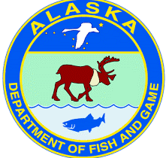
INTERAGENCY UPDATES ON HPAI For the Alaska One Health Group
Andy Ramey – USGS Alaska Science Center Joe McLaughlin – Alaska Division of Public Health
Sarah Coburn – Alaska Dept. of Env. Conservation Kimberlee Beckmen – Alaska Dept. of Fish & Game January Frost – US Fish and Wildlife Service Christina Ahlstrom – USGS Alaska Science Center

Slide 2
Disclaimer
This information is preliminary and is subject to revision. It is being provided to meet the need for timely best science. The information is provided on the condition that neither the U.S. Geological Survey nor the U.S. Government shall be held liable for any damages resulting from the authorized or unauthorized use of the information.

Slide 3
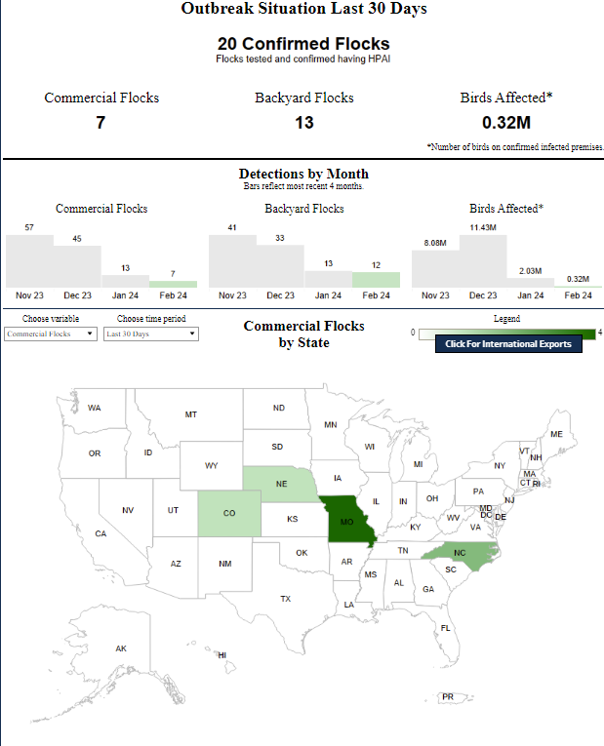
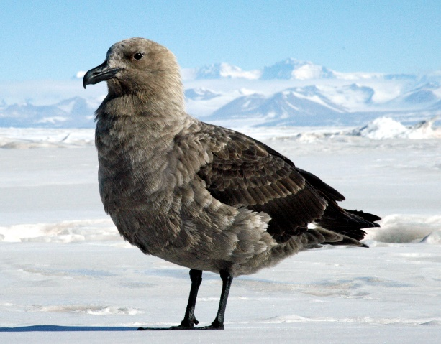
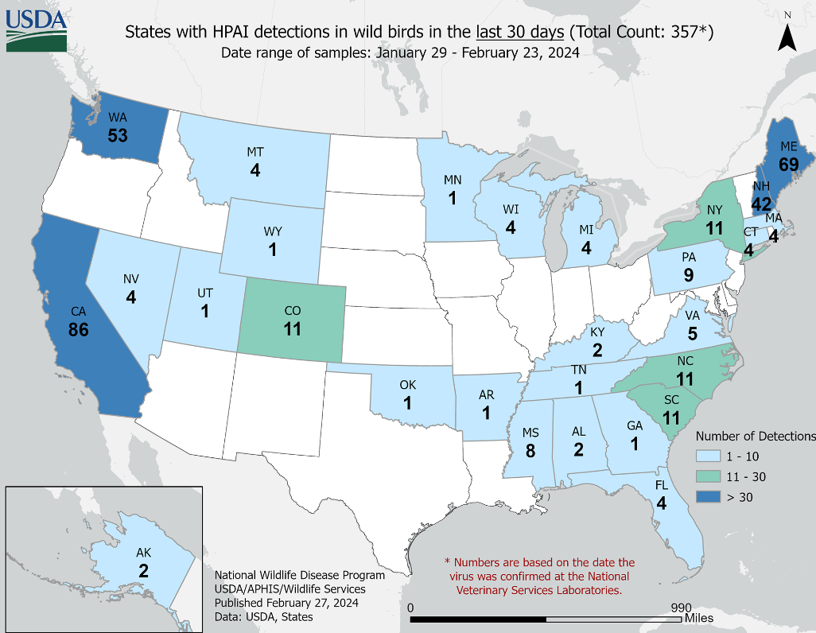
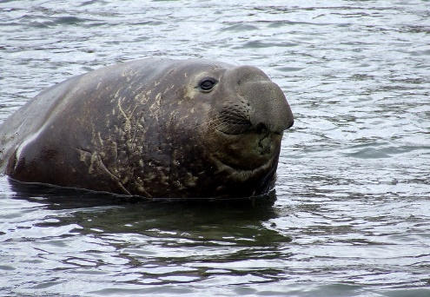
HPAI continues to impact wild birds, wild mammals, and poultry globally.
https://www.reuters.com/business/environment/bird-flu-reaches-mainland-antarctica-first-time-scientists-say-2024-02-26/
https://www.cidrap.umn.edu/avian-influenza-bird-flu/avian-flu-detected-first-time-antarcticas-sea-mammals
Henry Kaiser, NSF
https://www.aphis.usda.gov/aphis/ourfocus/animalhealth/animal-disease-information/avian/avian-influenza/hpai-2022/2022-hpai-commercial-backyard-flocks
size4riggerboots/Flickr cc
https://www.aphis.usda.gov/animal_health/animal_diseases/avian/images/all-hpai-detect-last30days.png
Notes:
HPAI has not gone away.
The geographic spread of HPAI continues, with recent detections among marine mammals inhabiting sub-Antarctic Islands and wild birds inhabiting the Antarctic mainland for the first time in recorded history.
Detections continue among wild birds, poultry, and marine mammals throughout many countries and regions.
Within the past few months, there have been new detections of HPAI in Alaska and other regions of the US.
We might expect future detections in Alaska, with potential for increasing occurrence throughout spring and summer into autumn.
Outbreaks in nontypical hosts of avian influenza, such as pelagic seabirds and marine mammals, are possible.
So now, let’s focus in on HPAI information, research, surveillance, and response relevant to Alaska, starting with an update from Dr. Joe McLaughlin with the Alaska Division of Public Health.

Slide 4
HPAI: human detections/considerations (McLaughlin)
Since January 2020, there have been 24 human cases of HPAI reported to WHO from a number of countries
The most recent 7 cases have all occurred in Cambodia since October 2023
All patients had a history of recent exposure to sick or dead poultry prior to their illness
One of the cases occurred in the US (CO) in April 2022
https://www.cdc.gov/flu/avianflu/chart-epi-curve-ah5n1.html
More info available at: https://www.cdc.gov/flu/avianflu/avian-flu-summary.htm

Slide 5
HPAI: AK poultry detections/considerations (Coburn)
Information, recommendation, etc
For further info: url or email

Slide 6
HPAI: AK wild mammal detections/considerations (Beckmen)
Information, recommendation, etc
For further info: url or email

Slide 7
HPAI: AK wild bird detections/considerations (Frost)
Information, recommendation, etc
For further info: url or email

Slide 8
HPAI: AK statewide research (Ahlstrom)
Information, recommendation, etc
For further info: url or email

