Slide 1
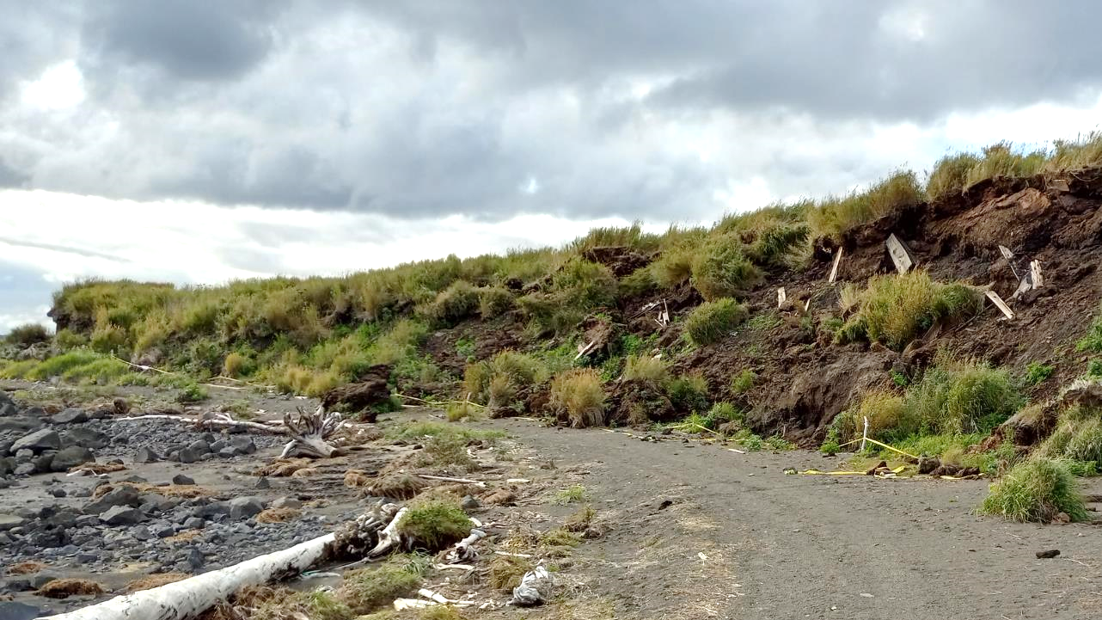
Thank you for taking the time to participate in this discussion on eroding cemeteries in Alaska.
I was not able to make it to Saint Micheal earlier this month as planned.
This talk was originally aimed at sharing results of that trip.
Instead, I am taking this opportunity to address related topic.
There is plenty in this topic that I will not have time to talk about.
Am also trying out a new style of presentation for myself. It is designed so this presentation can stand on its own without my talking through it in case anyone wants to read this presentation without me.

Slide 2
Things you will need to know if you become involved in retrieving
eroding graves: and that you will find out once you do.
By Tom Wolforth
Cultural Resource Manager
Department of Military and Veterans Affairs
tom.wolforth@alaska.gov
ANTHC One Health Group September 17, 2024

Slide 3
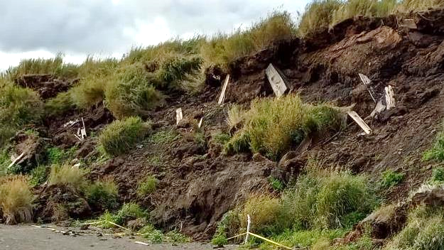
Fundamental concepts and concerns when confronted with eroding cemeteries in Alaska.
There is no Department of Saving Graves.
Hurry up and wait.
Two kinds of concerns: eroded out and soon to erode out.
Old cemeteries have old coffins.
Graves on permafrost sustain skin and hair.
Disease is an unknown.
High tech doesn’t help.
Local crew is preferable.
The process continues after the remains are collected.

Slide 4
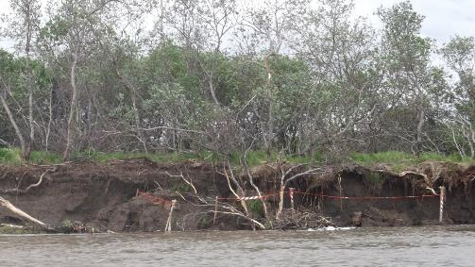
What I have experienced for years now in Alaska: folks in the village call around to some state and federal agency for support, and each agency says “we can’t do anything, but try (fill in the blank) agency. And oh, by the way, before you do anything you need to contact the State Troopers, the State Historic Preservation Office, the Medical Examiner and the State Vital Statistics and the Bureau of Indian Affairs to get permits. No, they can’t help you, but you have to abide by their rules.”
Only when a governor or president of the USA declares a state of emergency can state and federal agencies get involved with funding and labor. Even the actions are limited and they run dry quickly.
There is no Department of Saving Graves.

Slide 5
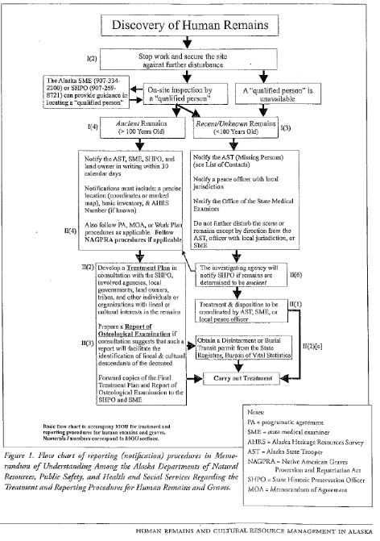
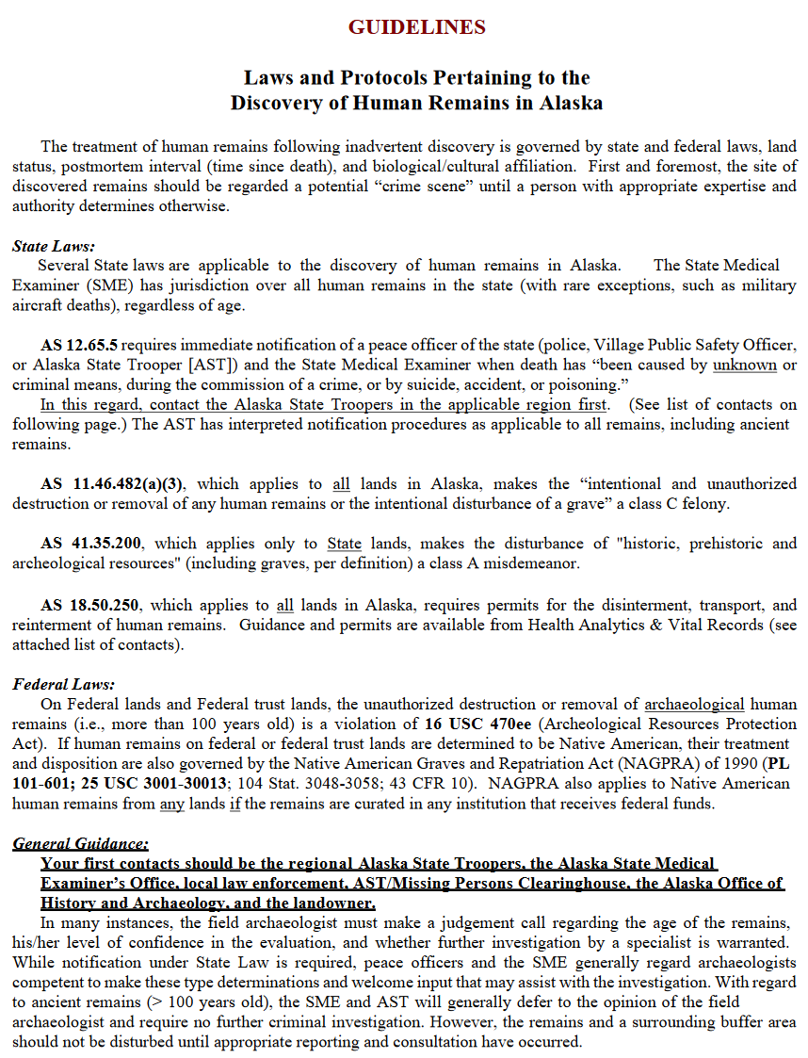
Hurry up …
…and wait.
State law says you must notify these agencies for these reasons:
State Troopers, so they can decide whether these eroding human remains are part of a forensic case like a murder or missing person.
The state medical examiner will help the Troopers decide if these are human remains.
The state Health Analytics and Vital Records (a.k.a. Alaska Bureau of Vital Statistics) are in charge of how deceased people are moved so you must get a permit to move the remains from them so you do not get a Class C Felony.
The State Historic Preservation Office so they can decide if this is a prehistoric archaeological site or a community cemetery. Different laws pertain to these different settings.
None of these groups help you. They only make you do things.
Things, entities, responsibilities are not well-defined.

Slide 6
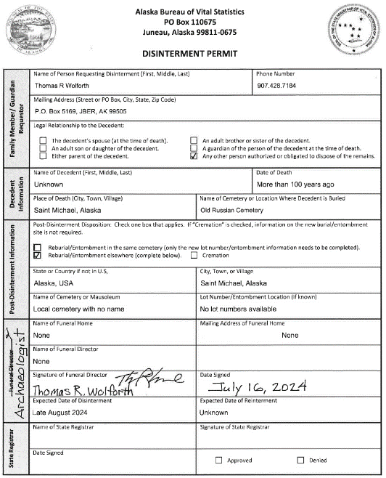
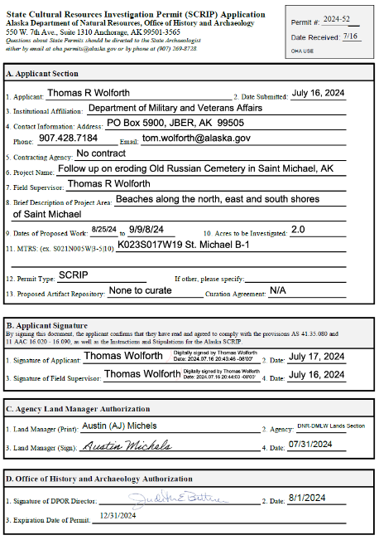
Before you can do anything you are supposed to get these permits:
Permit to move remains. This permit takes a few days to get.
Permit to handle cultural remains on state land (from SHPO). This permit takes 4 to 6 weeks to get.
Permit to handle cultural remains on tribal lands from BIA. I don’t know how long that permit takes to get.
When the cemetery is on federal or tribal land, you will also need to go through the lengthy process of doing a NAGPRA Plan of Action.
Actions conducted on Alaska Native corporation lands will require permits from the local Native Village Corporation the Native Regional Corporation.

Slide 7
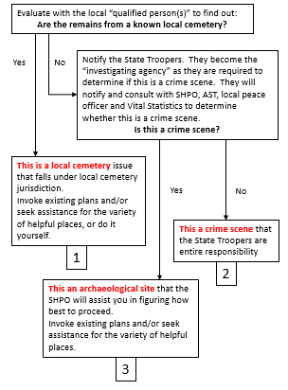
You have discovered human remains in your village and there is no associated “investigating agency” involved.
In other words, these remains have suddenly eroded out of the ground nearby.
Let’s start by figuring out what this is and how, then, is in charge.
I am in the process of re=imagining the process.
Without changing laws, we can alter the way we think and respond.
Among other things, this new way prioritizes involvement and authority of local tribal and city governments in villages, instead of the many agencies that currently direct how things proceed.
I am optimistic that we can abide by all of the laws currently in place and yet streamline the process to prioritize addressing the problem.
Meanwhile, you still need to follow the procedures outlined in the decision tree in the early slides.

Slide 8
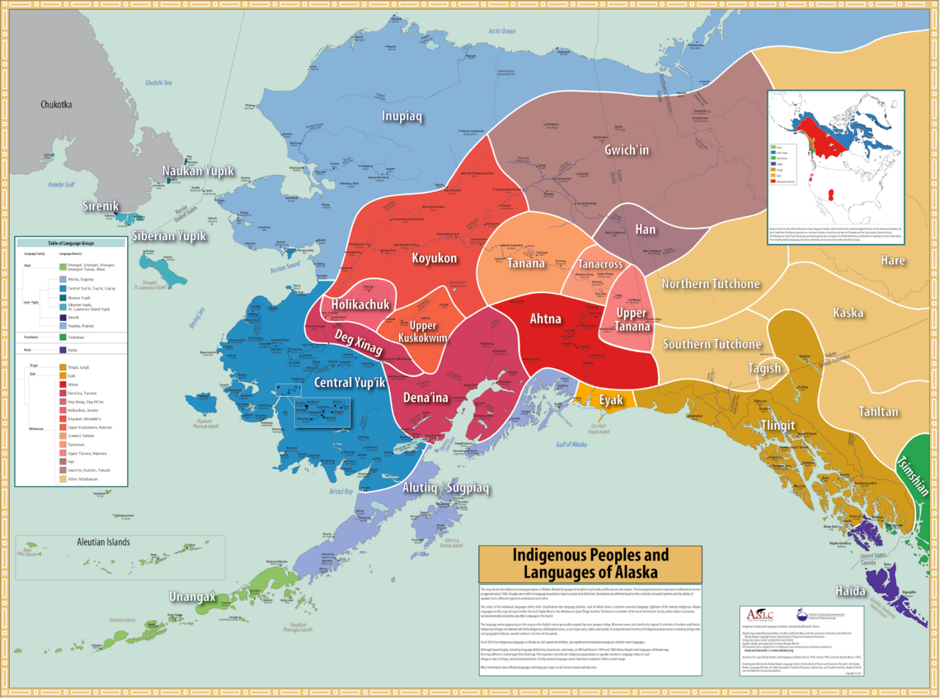
Saint Michael is here.
Anchorage is here.

Slide 9
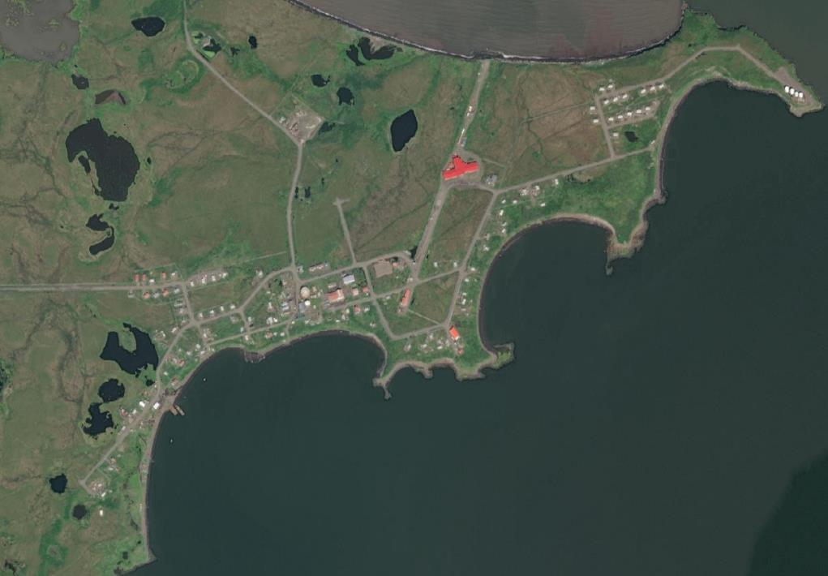

Slide 10
Native Village of Saint Michael (IRA)
President Shirley Martin, John Lockwood, Charlie Fitka, Jr., Tribal Coordinator Paula Myomick,
Darlene, Chiskok, Michelle Snowball, Robin, Andrea, Deloris, Kyle, Charlene Kobuk, Frank Myomick
City of Saint Michael
Mayor Flora Matthias, Administrator Virginia Washington, Clerk Richard,
Treasurer Albert Matthias, Bernie
Saint Michael Native Corporation
Norbert Otten, Jr., James Niksik, Sr., Richard Elachik, Sr., Diane Thompson, Milton
Cheemuk, Vera Niksik, Allen Atchak, Sr.
Village Peace Officers
Jake Selakoff, Dennis Chiskok
Saint Michael Clinic
Kendra
Citizens of Saint Michael
Brent, Bertha, Lorena, Benjamin Kobuk, Marie, Harold and Chuck
Vitus Terminals
Petey, Dominick
Field Crew
Seth Myer, Richard Elachik, Nick Lupsin, Chris Dusenbury
Many thanks to the citizens of Saint Michael for so much, but most of all for your friendship.

Slide 11
U.S. Signal Corps
1867 to 1923
U.S. Army fort
1897 to 1923
North American Trade and Transportation Company 1892 to 1912
Yupik native village
? to 1920
Alaska Commercial Company
1867 to now
Yupik native village
? to 1880
Mikhailovsky Redoubt
1833 to 1867
U.S. Shipyard and
Fort Get There
1897 to 1923
Old Russian Cemetery
1833 to 1930

Slide 12
Old Russian Cemetery
1833 to 1930
= Currently used cemeteries
= Known burial places

Slide 13
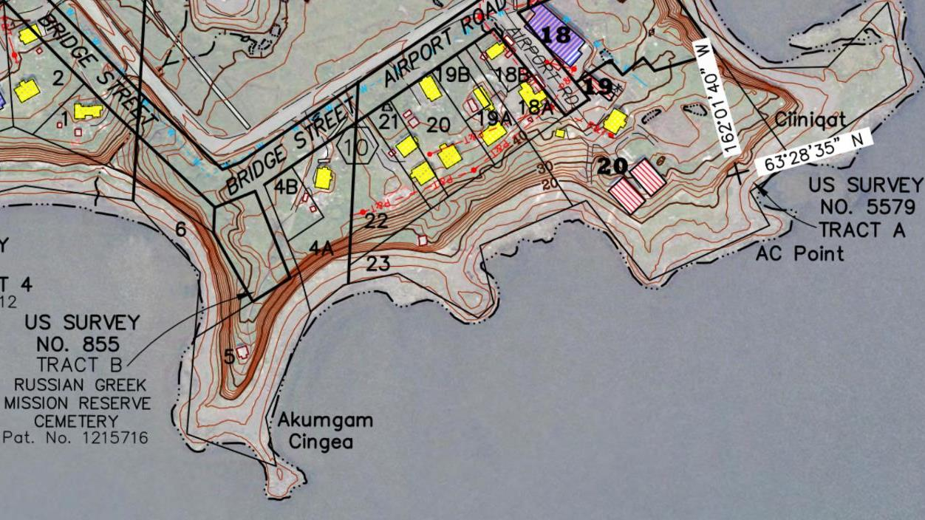
Russian fort from 1833 to 1867
The views of erosion are from this angle
Tachik Bay

Slide 14
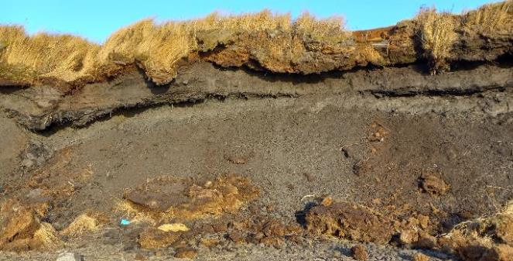
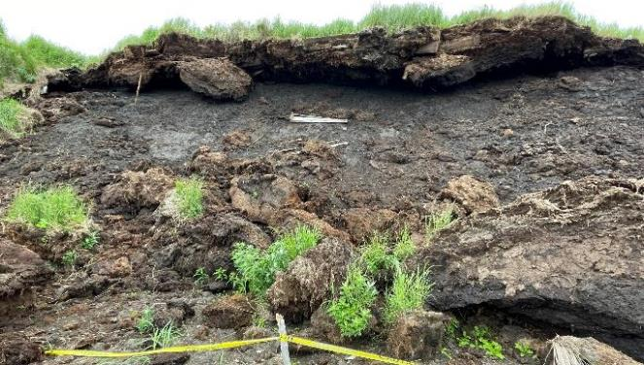
Two kinds of concerns:
eroded out and
soon to erode out.
Exposed coffin.
1 broken coffin on beach.
Two kinds of retrieval were conducted in the autumn of 2023:
Collecting remains that had been torn from the cemetery and scattered on the slope and beach below.
This is the kind of thing that you will encounter when graves are suddenly exposed by erosion at a cemetery.
Removing coffins from the Erosion Danger Zone at the top of the cliff edge before they, too, eroded from their resting places.
This is the kind of thing that you will encounter when you proactively remove intact graves from a cemetery to move them to a safer place.
Sept 2022
Newly exposed coffins.
Some have fallen.
July 2023

Slide 15
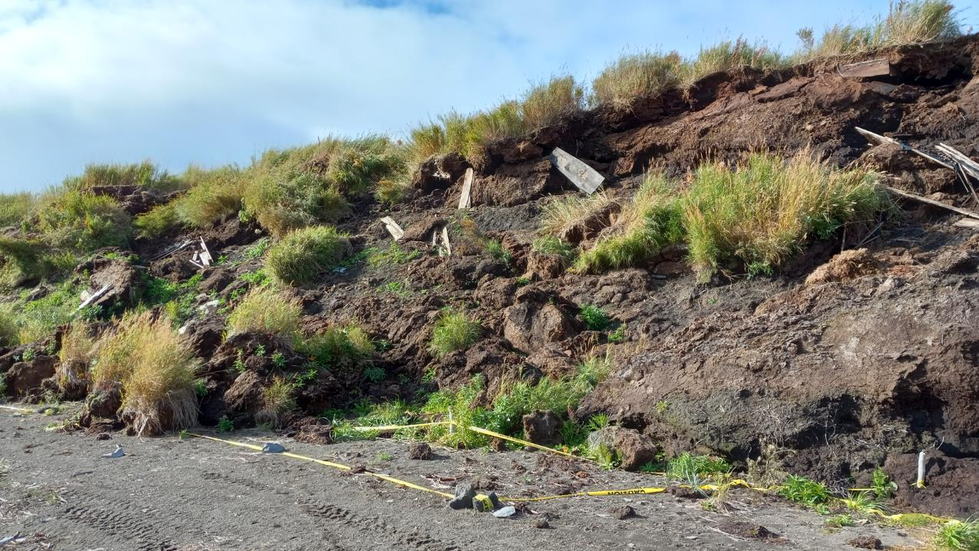
Sept 2023
One year after Merbok Typhoon.
Big rains after July 2023 brought on additional erosion.

Slide 17
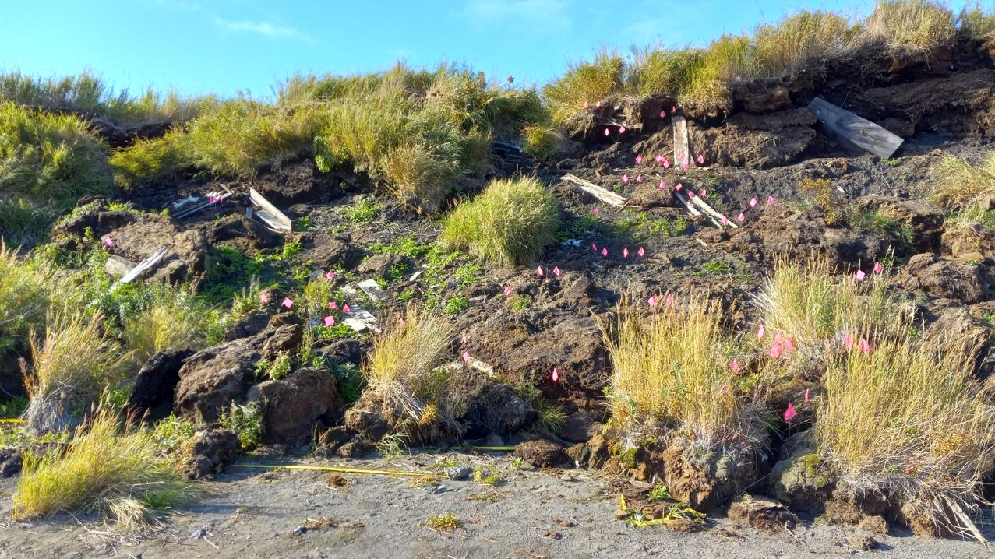
When human remains erode out of cemeteries they may tumble out of their coffins.
That is the case here where coffins have broken apart and the bones and body parts are scattered about. They have mingled with others making it unclear which bones go along with which body.

Slide 18
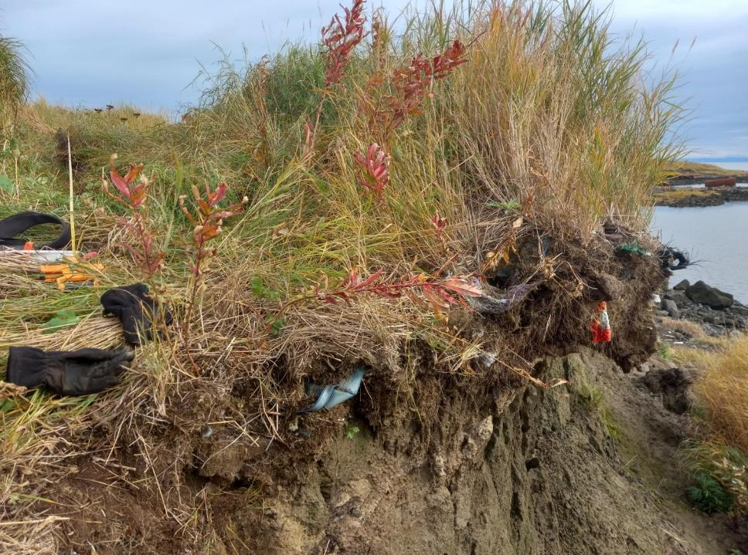
The erosion has not stopped. Big overhangs and deep cracks are present on the ground surface near the cliff edge. Graves are situated along this cliff edge.
There are no grave markers along the edge to show where those graves are.
Our goal was to remove coffins from within an Erosion Danger Zone before the continuing erosion removed them.
We did not have time to use any high technology to find these graves. And anyway the time invested in them would not have yielded any helpful information.
Notice the overhang.

Slide 19
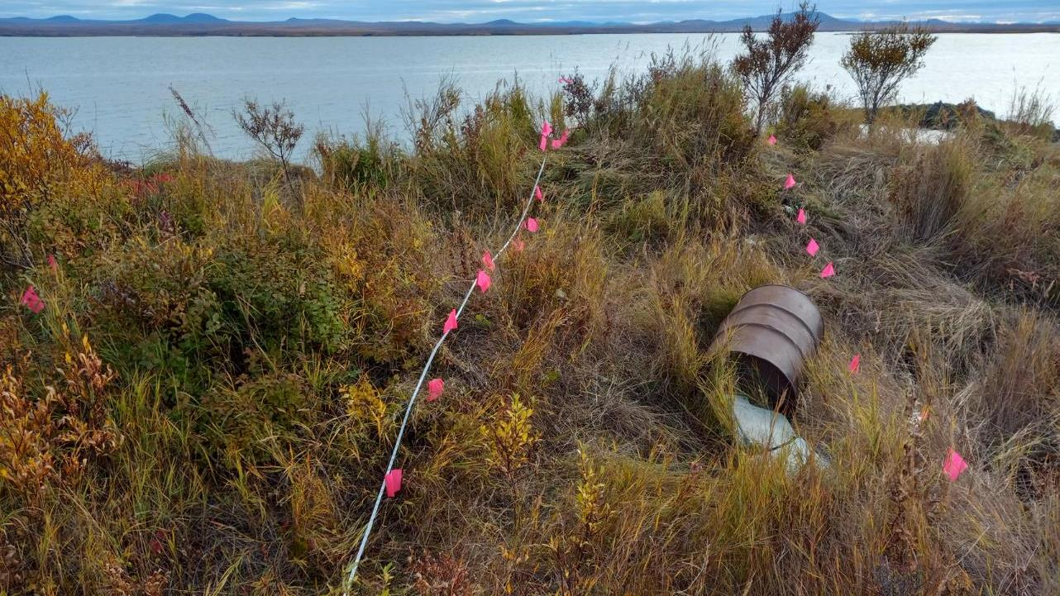
There is so much modern trash in this area where a house was nearby. A metal detector would not isolated graves.
The landform is so undulating, up to six eight feet deep valleys here, that a ground penetrating radar would not work here.
So I laid out a grid and probed systematically in search for coffins.
I used a hot dog roasting probe on a grid that with eight feet wide rows and two foot wide columns.

Slide 20
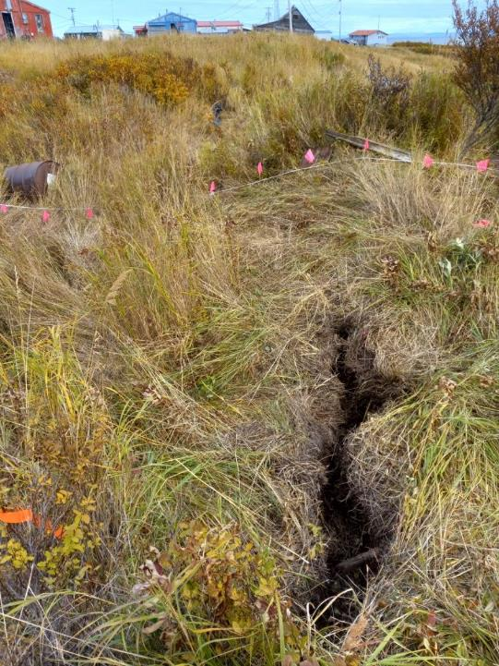
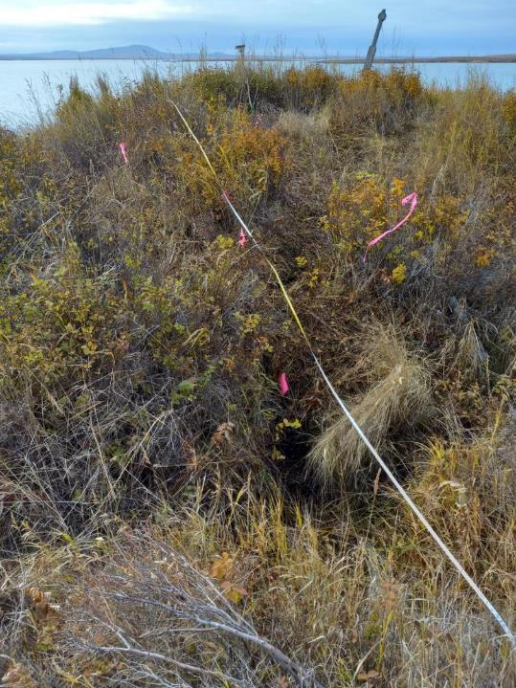
One can reach into the cracks and feel coffins.
The ground appears to crack along planes created by the coffins.
In the far upper right of the image to the right is the rare still standing grave marker. Others are lying about.
You can see some metal trash here and how undulating the terrain is.

Slide 21
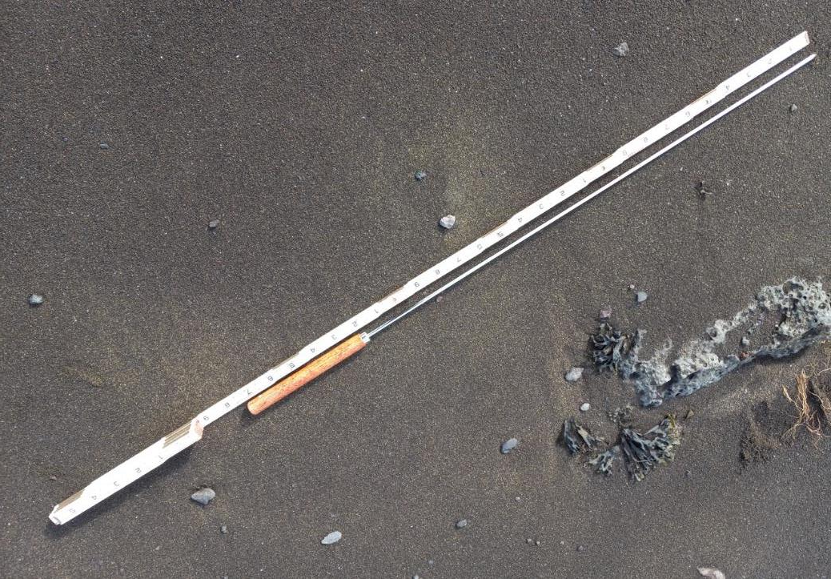
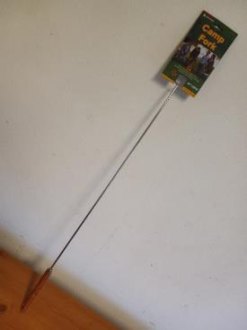

Slide 22
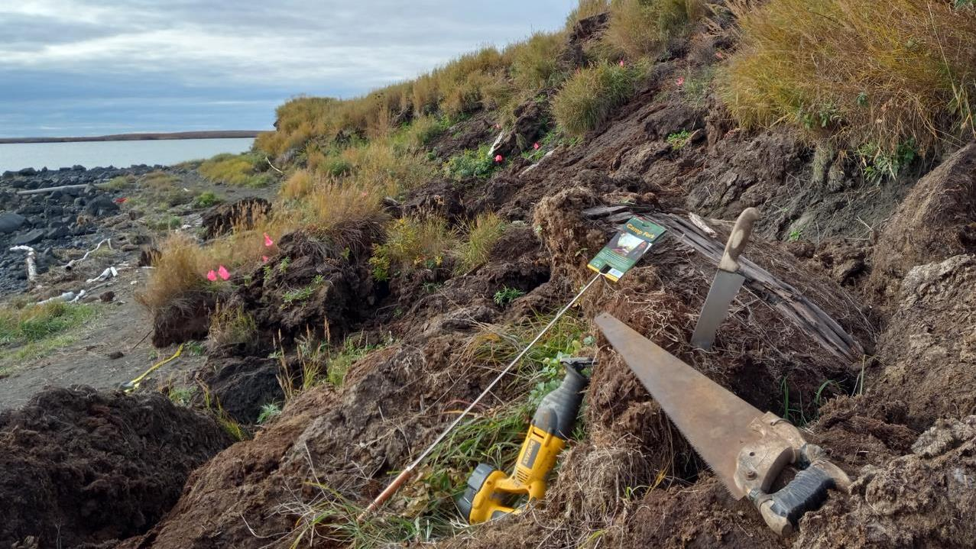
High tech doesn’t help.
These are the tools that we used to find and remove graves.

Slide 23
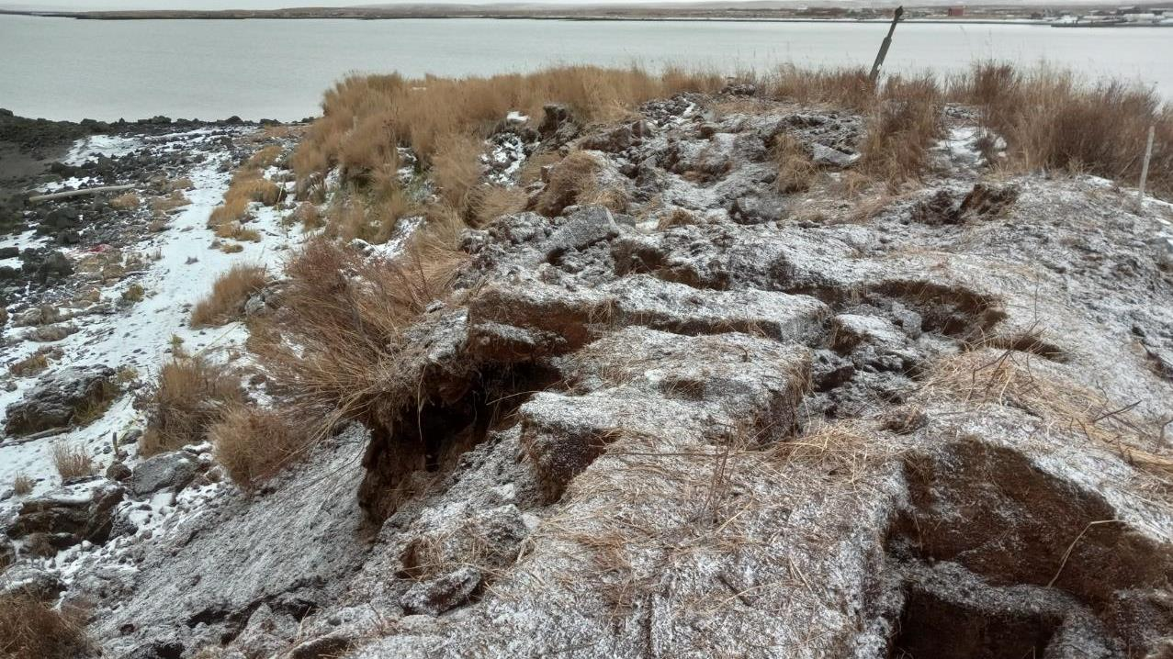
We removed 12 graves from the Erosion Danger Zone.
No clear pattern of graves layout.
2 stacked on top of one another.
Many twisted and turned underground by the eroding earth.
Evidence of underground fire.

Slide 24
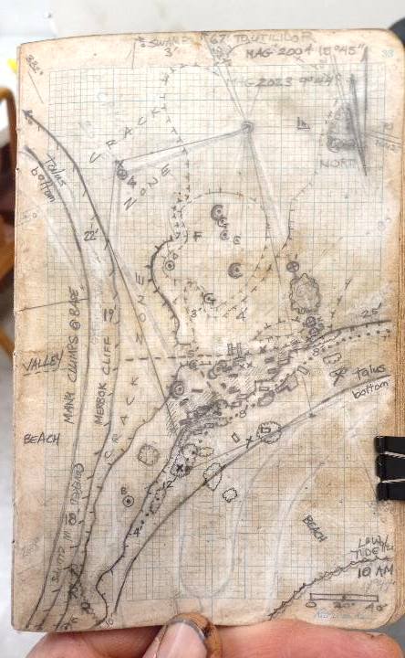
We removed graves from a 20 foot wide Erosion Danger Zone at cliff edge in anticipation of continued erosion for some unknown time.
Cemetery
Erosion continues to take cliff edge to stabilize slope for some unknown amount of more time. Two more years?
Cliff edge in Sept and Oct 2023.
One year of erosion took 8 to 10 feet of cliff edge.
Cliff edge right after Merbok in Oct 2022.
The Merbok storm took 15 to 30 feet of cliff edge.
0 feet 40
Based on 2004 Community Map and others, this is the cliff edge prior to the Merbok typhoon.

Slide 25
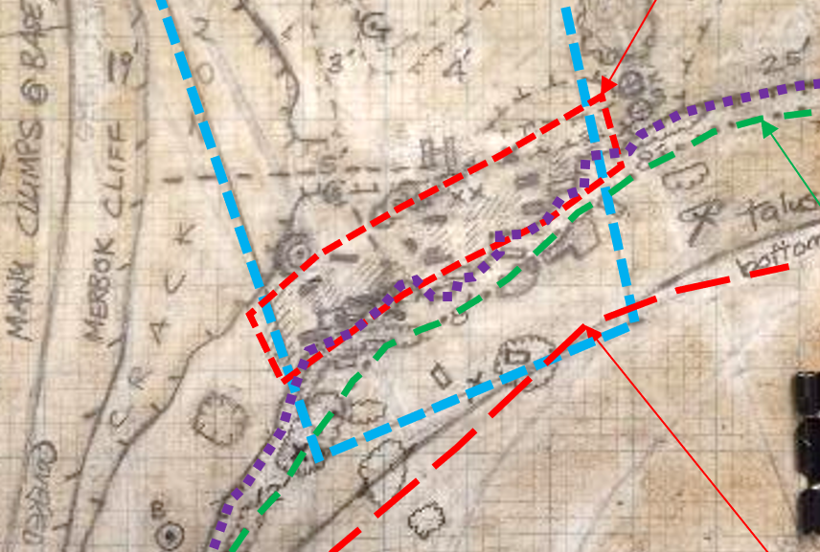
We removed graves from a 20 foot wide Erosion Danger Zone at cliff edge in anticipation of continued erosion for some unknown time.
Cemetery
Erosion continues to take cliff edge to stabilize slope for some unknown amount of more time. Two more years?
10% dug away in Erosion Danger Zone Autumn 2023
5% eroded away Spring/Summer 2023
10% taken away Merbok Typhoon 2022
Cliff edge in Sept and Oct 2023.
One year of erosion took 8 to 10 feet of cliff edge.
Cliff edge right after Merbok in Oct 2022.
The Merbok storm took 15 to 30 feet of cliff edge.
0 feet 40
Based on 2004 Community Map and others, this is the cliff edge prior to the Merbok typhoon.
Cliff edge in 2004

Slide 26
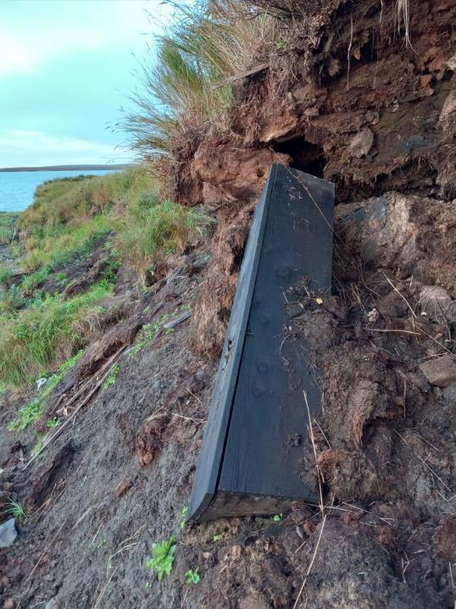
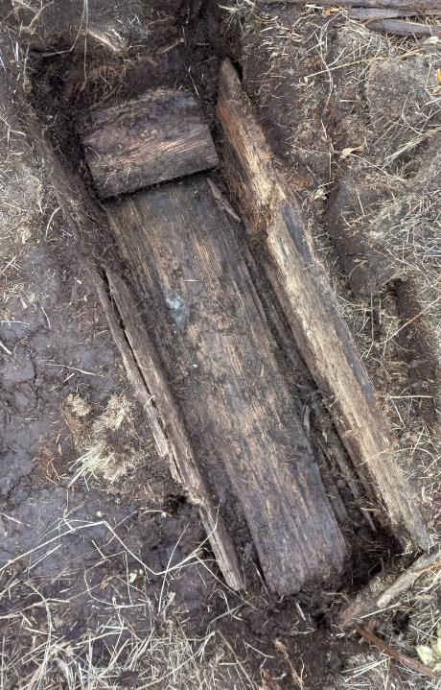
Old cemeteries have old coffins.
Wooden “pillow”
I had thought that I would be digging up entire coffins. The idea being that the coffins would be intact and could then be put back in the ground intact.
We quickly learned that intact coffins are a rarity. There was only four intact coffins.
Many had their lids collapsed down upon the bodies.
The wood was often rotten and it was rare for a coffin sides and bottoms to be holding together.
As a result, we had to remove the remains from within each coffin. Those were taken to the cold morgue where I wrapped them for reburial later.

Slide 27
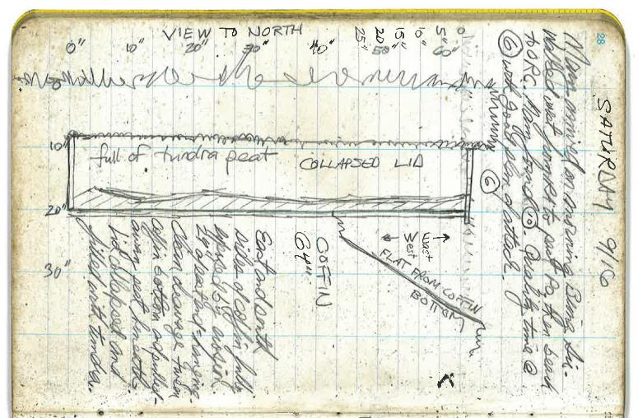
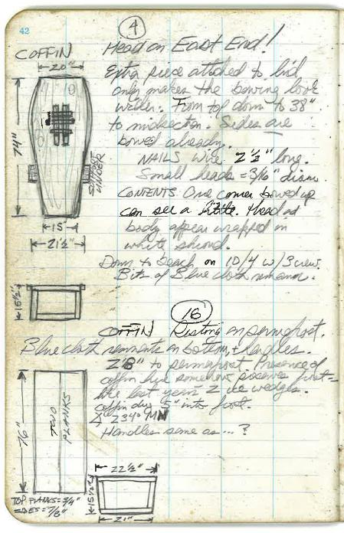
Lid collapsed and pressing down on remains.
Base of coffin only 20 inches below surface, resting on permafrost.

Slide 28
Once you start moving remains you will experience things that you are not used to seeing.
When coffins are resting on permafrost the bodies are well-preserved.
Bodies often retain hair, skin, fingernails, eyelashes, even soft internal tissue.
Unusual things like calcifications of tumors or gall stones.
Archaeologists are not usually trained in observing and handling bodies with tissue.
Other materials are also preserved longer on ice.
Bodies on ice may retain skin and hair.

Slide 29
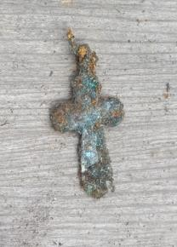
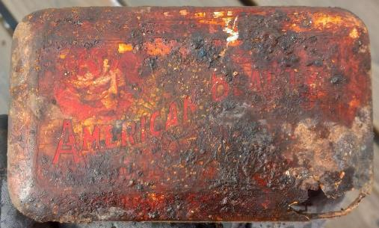
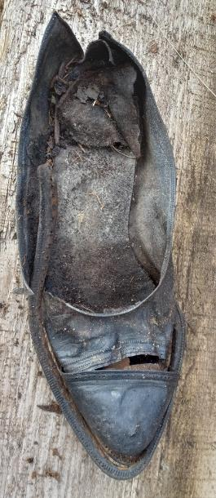
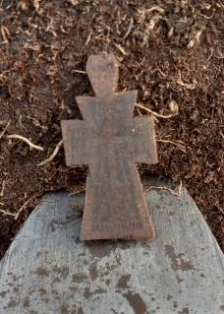
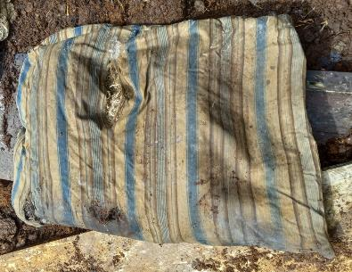

Slide 30
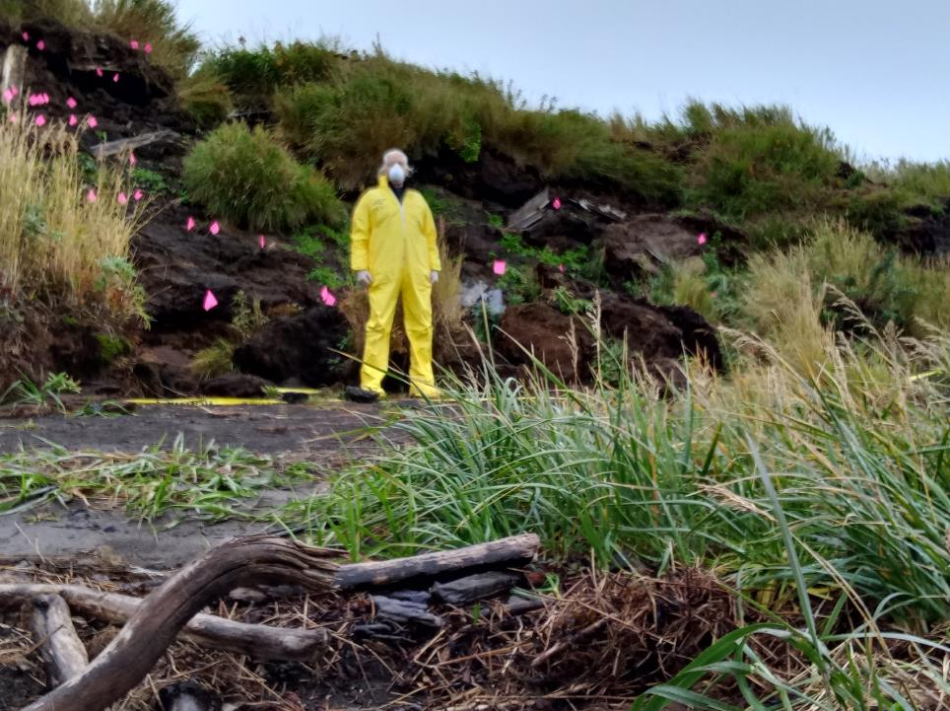
The potential for the retention of disease in these eroding graves that have been resting on ice is not clearly understood.

Slide 31
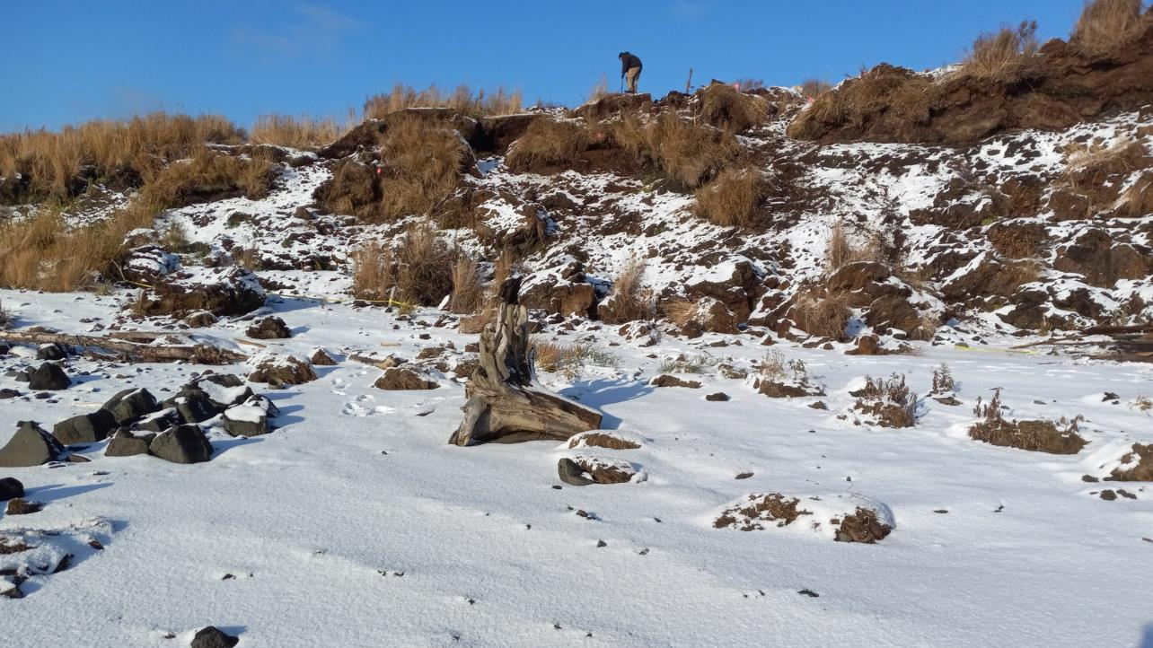
Local crew is preferable.
Through the state’s Division Homeland Security and Emergency Management I was able to hire and work with 4 local men to assist in the work up top.
The tribal government and city officials recommended names to citizens to interview for the job.
It was the ultimate in local stakeholder involvement: citizens working intimately with their ancestors to move them from their uneasy resting places within the land that was eroding away as we worked.
Seth.
Richard.
Nick.
Chris.

Slide 32
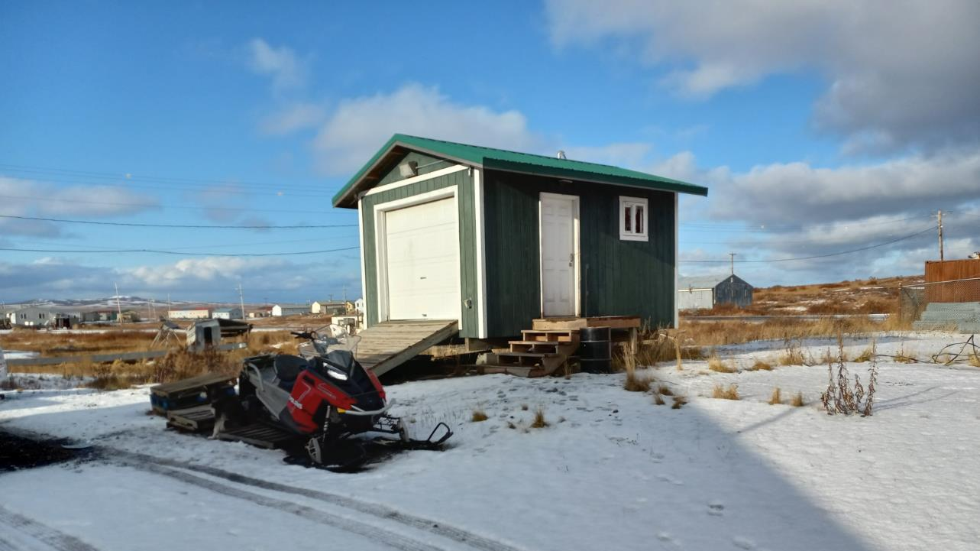
The process continues after the remains are collected.
The remains were wrapped individually in pieces of body bags.
Any number or types of analyses could be conducted pursuant to the desires of the community. None were done for these remains.
They were placed in the old morgue for temporary storage.
Citizens of Saint Michael reburied them a year later.

Slide 33
Remains reburied here.
Remains were removed from here
= Currently used cemeteries
= Known burial places

Slide 34
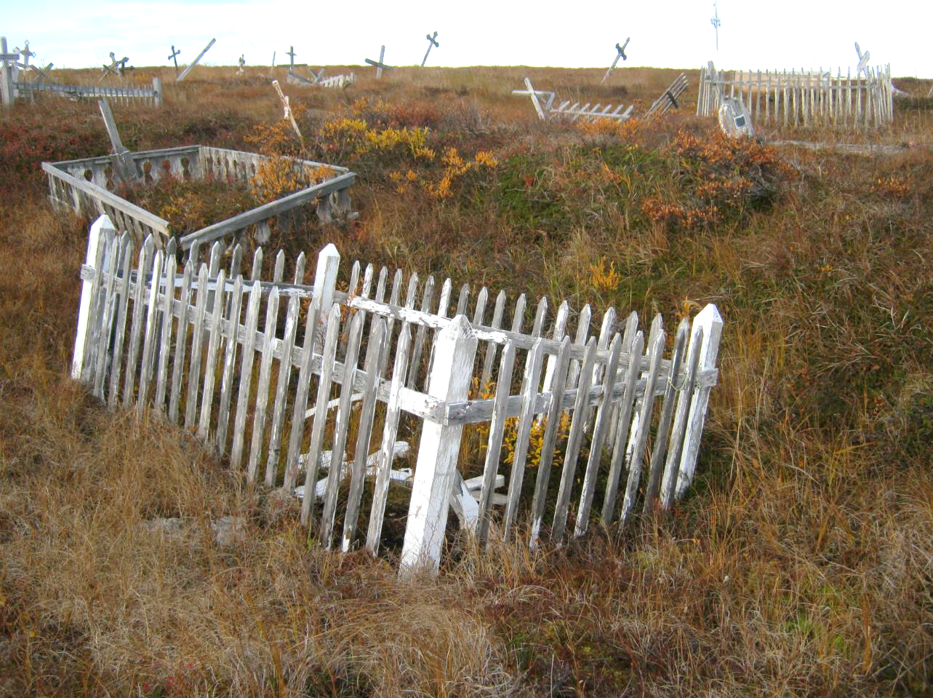
Current burials are placed 6 feet below surface, well below the permafrost layer that is at 2 feet below surface.
This compromises the permafrost and leads to local melting at and around the graves.
Graves sink into the soggy ground.
This problem is much more common than erosion along cliffs.

Slide 35
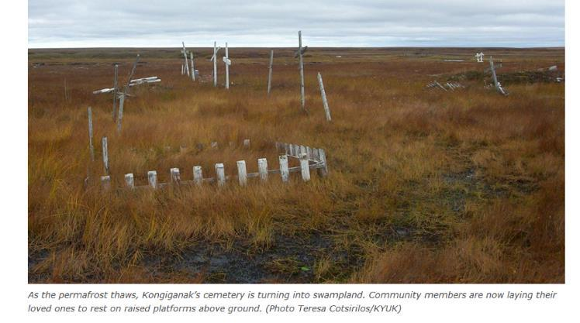
One village is trying this:
Burying their dearly departed above ground.

Slide 36
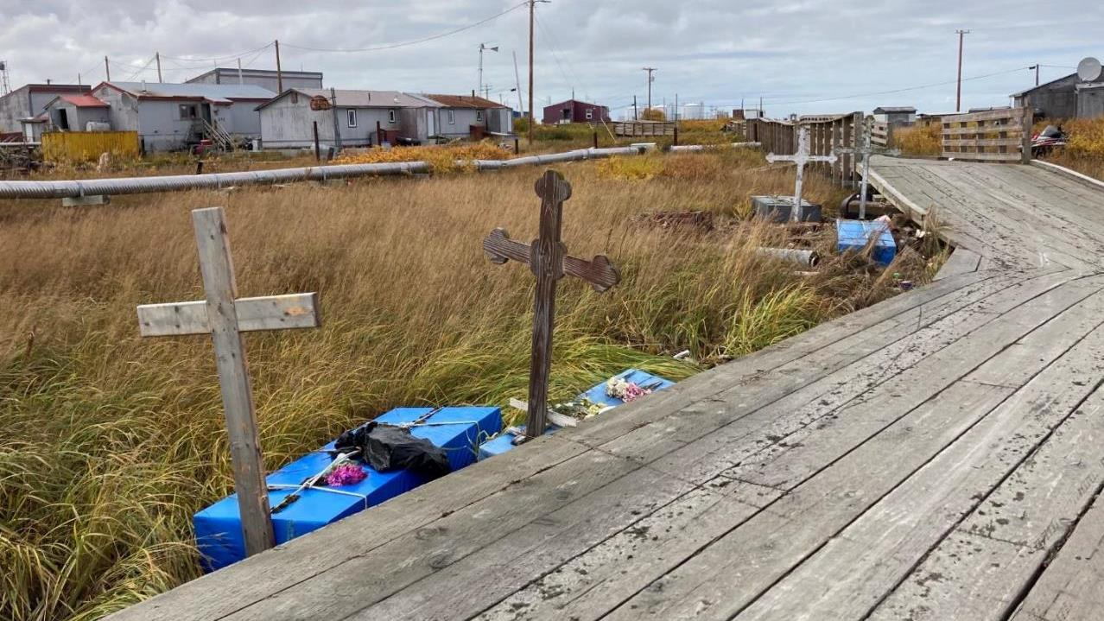
Some villages already bury above ground.
Nunam Iqua right after Merbok in 2022.
Graves floated around.

Slide 37
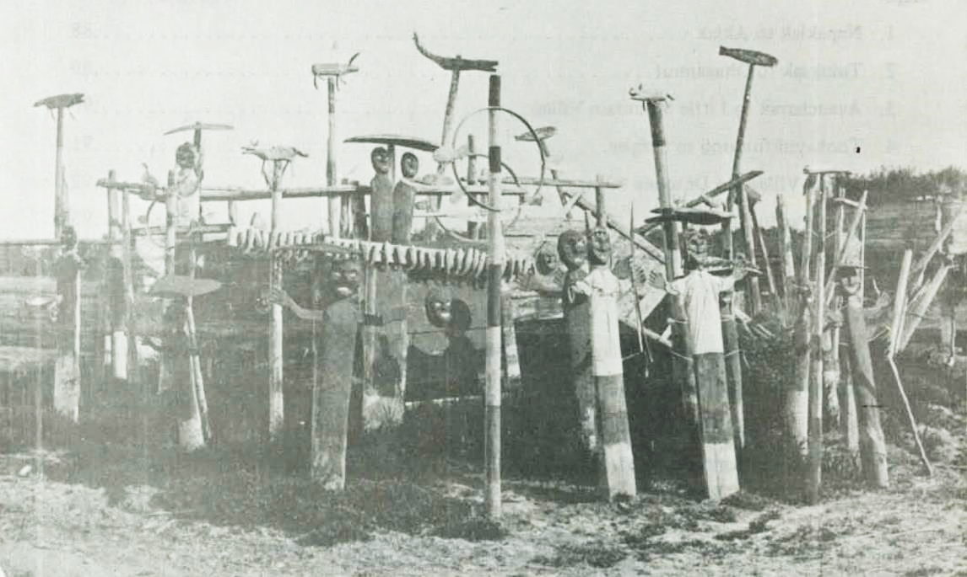
Kihtagamiut (near Akiachak) 1884

Slide 38
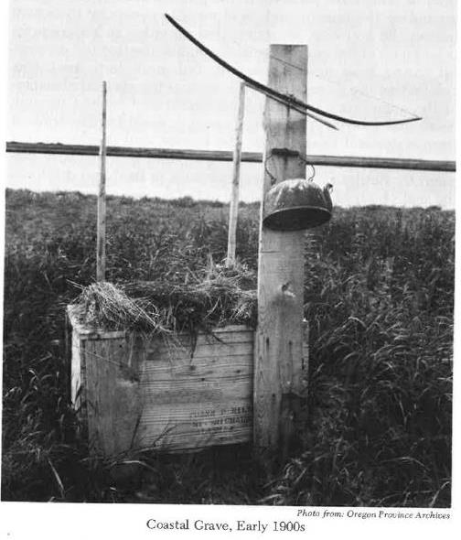
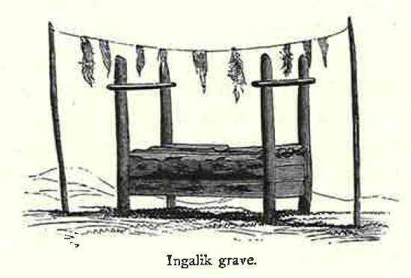
From Dall (1870)
From Fienup-Riordan (1983)

Slide 39
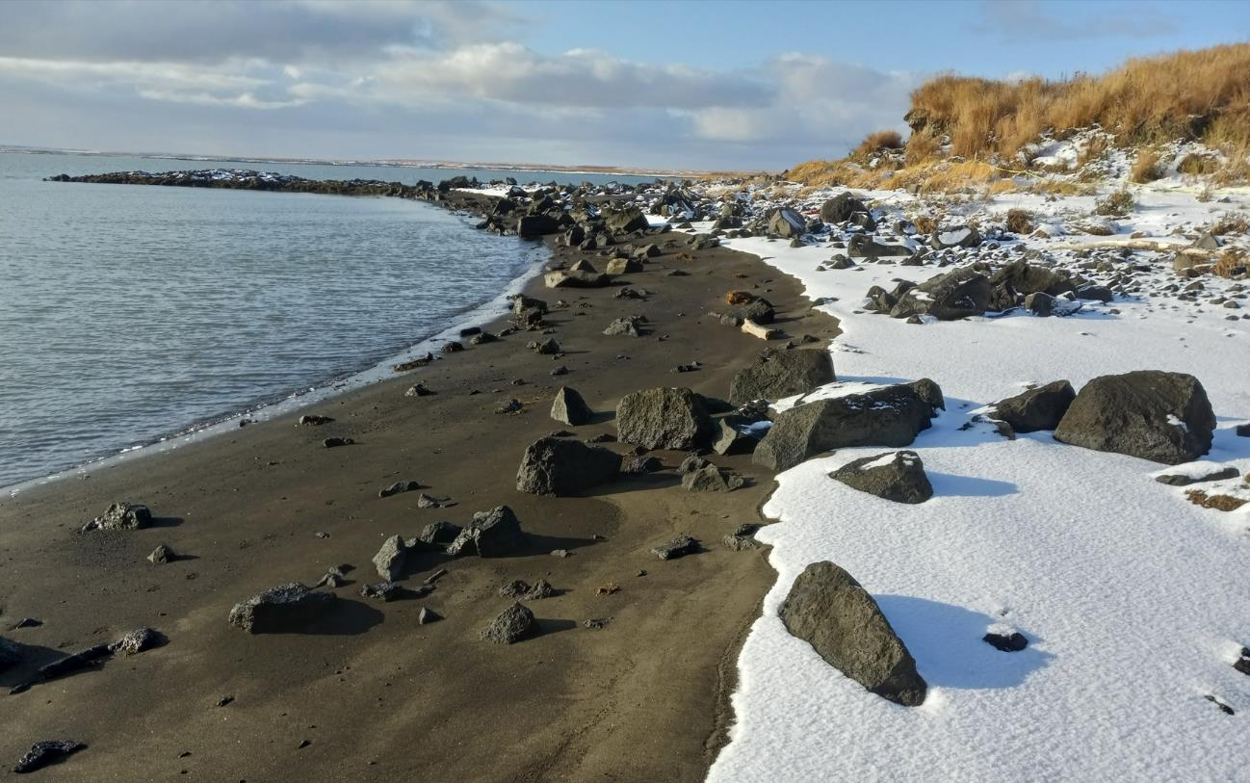
Be ready and plan ahead for:
Permits, notifications and reporting.
Constant communications with local citizens.
Coffins that are falling apart.
Coffins with lids that have collapsed on to the remains.
Scattered remains mixed with others.
Skin and hair and clothes with the remains.
Staying safe with potential disease.
Permafrost and permafrost melting.
Mixing of remains with others, and with more modern debris and things.
The proper tools for the terrain and situation.
Low tech is better than high tech, but that means more human labor intensive.
Hiring local citizens can and should be doing this work.
Equipment and logistics for wrapping and temporary storage.
Coordinating with reburial, and hopefully finding a reburial place that does not further contribute to permafrost melting and erosion.

Slide 40
If you find yourself involved with eroding cemeteries, please let me know and I will be happy to talk with you more about it.

