Slide 1
Chapter 26 | Alaska
Fourth National Climate Assessment, Vol II — Impacts, Risks, and Adaptation in the United States
nca2018.globalchange.gov

Slide 2
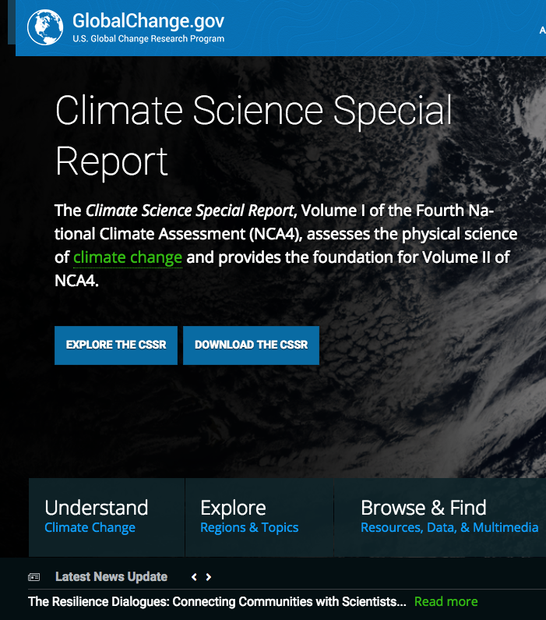
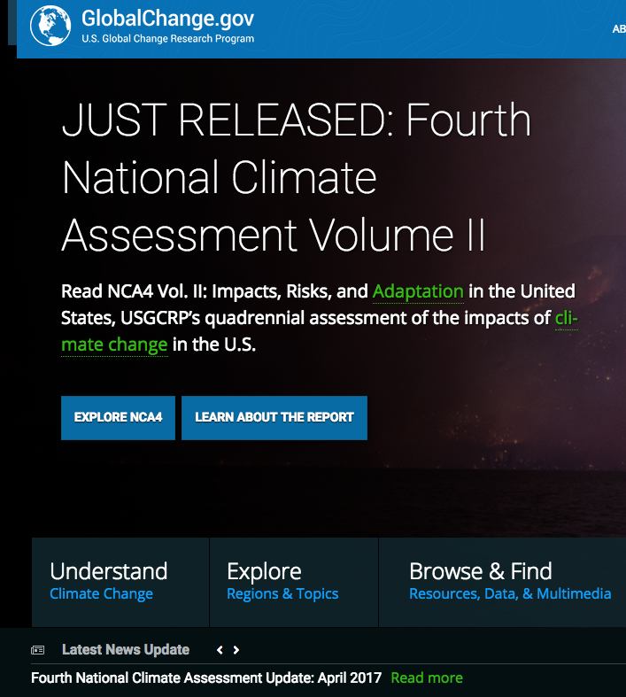
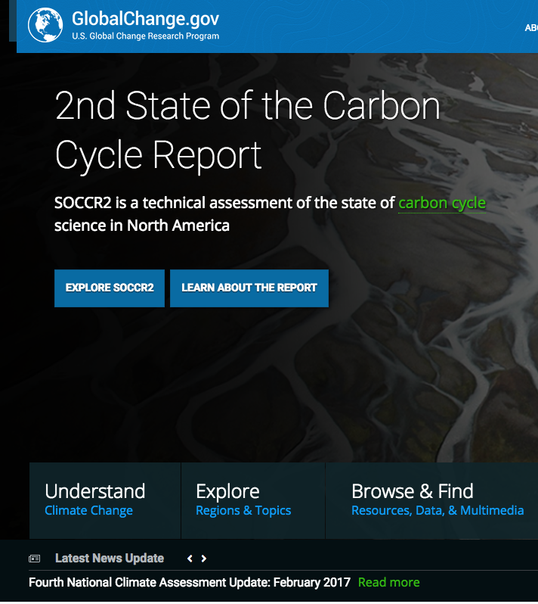
What is the National Climate Assessment?
A synthesis of the scientific information on climate change for the United States:
Causes, both natural and human
Trends and future projections (25-100 yrs)
Impacts on many sectors and regions of the US
Increasingly, adaptation options, strategies, and capacity
https://science2017.globalchange.gov/
https://nca2018.globalchange.gov/
https://carbon2018.globalchange.gov/

Slide 3
FOURTH NATIONAL CLIMATE ASSESSMENT
CHAPTER 26:
ALASKA
Federal Coordinating Lead Author Chapter Lead
Stephen T. Gray, U.S. Geological Survey Carl Markon, U.S. Geological Survey (Retired)
Chapter Authors
Matthew Berman, U. of Alaska, Anchorage, ISER; Laura Eerkes-Medrano, U. of Victoria; Thomas Hennessy, U.S. Centers for Disease Control and Prevention; Henry P. Huntington, Huntington Consulting; Jeremy Littell, U.S. Geological Survey, AKCASC; Molly McCammon, Alaska Ocean Observing System; Richard Thoman, U. of Alaska Fairbanks, ACCAP; Sarah Trainor, U. of Alaska Fairbanks, ACCAP
Review Editor Victoria Herrmann, The Arctic Institute
Contributing Authors: Todd Brinkman, U. of Alaska Fairbanks; Patricia Cochran, Alaska Native Science Commission; Jeff Hetrick, Alutiiq Pride Shellfish Hatchery; Nathan Kettle, U. of Alaska Fairbanks; Robert Rabin, National Oceanic and Atmospheric Administration; Jacquelyn (Jaci) Overbeck, Alaska Department of Natural Resources; Bruce Richmond, U.S. Geological Survey; Ann Gibbs, U.S. Geological Survey; David K. Swanson, National Park Service; Todd Attwood, U.S. Geological Survey; Tony Fischbach, U.S. Geological Survey; Torre Jorgenson, Arctic Long Term Ecological Research; Neal Pastick, U.S. Geological Survey; Ryan Toohey, U.S. Geological Survey; Shad O’Neel, U.S. Geological Survey; Eran Hood, U. of Alaska Southeast; Anthony Arendt, U. of Washington; David Hill, Oregon State U.; Lyman Thorsteinson, U.S. Geological Survey; Franz Mueter, U. of Alaska Fairbanks; Jeremy Mathis, National Oceanic and Atmospheric Administration; Jessica N. Cross, National Oceanic and Atmospheric Administration; Jennifer Schmidt, U. of Alaska Anchorage; David Driscoll, U. of Virginia; Don Lemmen, Natural Resources Canada; Philip Loring, U. of Saskatoon; Benjamin Preston, RAND Corporation; Stefan Tangen, U. of Alaska Fairbanks; John Pearce, U.S. Geological Survey; Darcy Dugan, Alaska Ocean Observing System; Anne Hollowed, National Oceanic and Atmospheric Administration
USGCRP Coordinators: Fredric Lipschultz, Senior Scientist and Regional Coordinator; Susan Aragon-Long, Senior Scientist

Slide 4
NCA4 Vol I: Climate Science Special Report
Released Nov 3, 2017
Key advances:
Detection and attribution
Extreme events (tropical cyclones, tornadoes, atmospheric rivers)
Downscaled information (including sea level rise)
Potential surprises
Climate model weighting
Summarized in Our Changing Climate chapter of NCA4 Vol II
Read and download the report at science2017.globalchange.gov
Notes:
Not only can the CSSR be downloaded and read at science2017.globalchange.gov, but users can access high-resolution graphics for use in their own presentations; dig into the underlying datasets or references; and more.

Slide 5
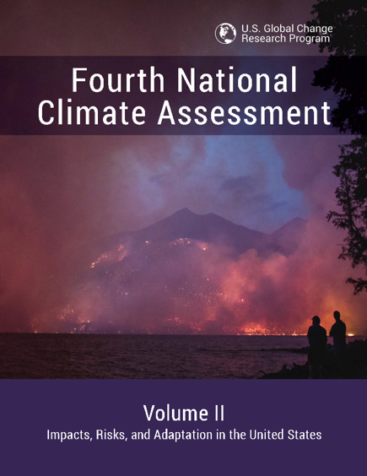
NCA4 Vol II: Impacts, Risks, and Adaptation in the U.S.
Released Nov 23, 2018
Policy relevant, but not policy prescriptive
Places a strong emphasis on regional information
Assesses a range of potential impacts
Uses case studies
NCA4 Vol II is available at nca2018.globalchange.gov
Notes:
Not only can the CSSR be downloaded and read at science2017.globalchange.gov, but users can access high-resolution graphics for use in their own presentations; dig into the underlying datasets or references; and more.

Slide 6
Table of Contents
Overview
Our Changing Climate (1)
National Topics (15)
Water
Energy Supply, Delivery and Demand
Land Cover and Land-Use Change
Forests
Ecosystems, Ecosystem Services, and Biodiversity
Coastal Effects
Oceans and Marine Resources
Agriculture and Rural Communities
Built Environment, Urban Systems, and Cities
Transportation
Air Quality
Human Health
Tribes and Indigenous Peoples
Climate Effects on U.S. International Interests
Sector Interactions, Multiple Stressors, and Complex Systems
Regional Chapters (10)
Northeast
Southeast
U.S. Caribbean
Midwest
Northern Great Plains
Southern Great Plains
Northwest
Southwest
Alaska
Hawai`i and U.S.-Affiliated Pacific Islands
Response (2)
Reducing Risks Through Adaptation Actions
Reducing Risks Through Emissions Mitigation
Appendices
Process
Information Quality Act
Data Tools and Scenarios
International
Frequently Asked Questions
Notes:
Multiple rounds of comments have informed our current NCA4 chapter list, and new chapters like air quality and international effects have emerged in response. In addition, the US Caribbean has been split out from the Southeast regional chapter, and the Great Plains have been split into the Northern and Southern Great Plains so as not to have a chapter that spans the Mexican to Canadian borders.

Slide 7
Ch. 26 | Alaska
26
Climate changes
What does that mean, practically speaking?
Alaska is warming faster than the planet –
2.6 times the global rate (North Slope).
A nearly ice-free Arctic in summer time is expected by mid-century.
Permafrost thaw is expected to continue and accelerate.
The growing season is expected to increase by 20-40 days
Precipitation is expected to increase.
More precipitation will fall as rain, less as snow.

Slide 8
Observed and Projected Changes in Annual Average Temperature
Ch. 26 | Alaska
(a) The graph shows Alaska statewide annual average temperatures for 1925–2016. The record shows no clear change from 1925 to 1976 due to high variability, but from 1976–2016 a clear trend of +0.7°F per decade is evident. (b) The map shows 1970–1999 annual average temperature. Alaska has a diverse climate, much warmer in the southeast and southwest than on the North Slope. (c) The map shows projected changes from climate models in annual average temperature for end of the 21st century under a lower scenario (RCP4.5). (d) The map is the same as (c) but for a higher scenario (RCP8.5). Sources: (a) National Weather Service and U.S. Geological Survey, (b–d) U.S. Geological Survey.

Slide 9
Ch. 26 | Alaska
26
Key Messages: Alaska
1 – Marine Ecosystems
2 – Terrestrial Processes
3 – Human Health
4 – Indigenous Peoples
5 – Economic Costs
6 – Adaptation

Slide 10
Fig. 26.2: Polar Bears and Walruses
Ch. 26 | Alaska
Changes in seasonal sea ice affect polar bear and walrus. Changes in spring ice melt have affected the ability of Alaska coastal communities to meet their walrus harvest needs, resulting in low harvest levels in recent years. There is a direct connection between climate impacts and community well being.
(a) An adult female polar bear and cub are shown near Kaktovik, Alaska, in September 2015. (b) Walruses gathered on the shores of the Chukchi Sea near Point Lay, Alaska, in September 2013. Photo credits: (a) Stewart Breck, USDA (b) Ryan Kingsbery, USGS.

Slide 11
Ch. 26 | Alaska
26
Key Message #1
Marine Ecosystems
Retreating and thinning arctic summer sea ice
increasing temperatures
ocean acidification.

Slide 12
Fig. 26.3: Projected Changes in Arctic Ocean Acidity
Ch. 26 | Alaska
Less acidic
The time series shows the projected decline in the annual average aragonite saturation (one of the consequences of increased ocean acidity, or lower pH) for the Bering Sea, Chukchi Sea, Beaufort Sea, and for the entire Pacific-Arctic region under the higher scenario (RCP8.5). Aragonite saturation is a metric used to assess ocean acidification and the ability for organisms to build shells and skeletons. The annual average saturation state for the Beaufort Sea surface waters likely crossed the saturation horizon—a tipping point—around 2001, meaning it is currently undersaturated and its marine ecosystems are vulnerable to the impacts of ocean acidification during most of the year. The Chukchi Sea is projected to first cross this threshold around 2030 and then likely remain under the threshold after the early 2040s; the Bering Sea is projected to be a concern after 2065. Source: adapted from Mathis et al. 2015.¹⁸
More acidic, ecosystems vulnerable
Notes:
18: Mathis, J.T., J.N. Cross, W. Evans, and S.C. Doney, 2015: Ocean acidification in the surface waters of the Pacific–Arctic boundary regions. Oceanography, 28 (2), 122-135. http://dx.doi.org/10.5670/oceanog.2015.36

Slide 13
Fig. 26.4: Changes to North Pacific Marine Ecosystems in a Warming Climate
Ch. 26 | Alaska
As sea ice thins and retreats earlier in the season, it is anticipated that food webs under the ice will switch from a benthic-dominated (lower in the water to seafloor) to a pelagic-dominated (middle to higher in the water) marine ecosystem. Source: Moore and Stabeno 2015.⁷⁸
Notes:
78: Moore, S.E. and P.J. Stabeno, 2015: Synthesis of Arctic Research (SOAR) in marine ecosystems of the Pacific Arctic. Progress in Oceanography, 136, 1-11. http://dx.doi.org/10.1016/j.pocean.2015.05.017

Slide 14
Ch. 26 | Alaska
26
Key Message #2
Terrestrial Processes
Permafrost thaw,
coastal and river erosion,
increasing wildfire,
glacier melt.

Slide 15
Fig. 26.5: Erosion Rates Along Alaska’s North Coast
Ch. 26 | Alaska
The map is of the north coast of Alaska and shows color-coded shoreline erosion rates, which can lead to the loss of habitat, cultural resources, and infrastructure. Source: adapted from Gibbs and Richmond 2015.¹⁹
Notes:
19: Gibbs, A.E. and B.M. Richmond, 2015: National Assessment of Shoreline Change: Historical Shoreline Change Along the North Coast of Alaska, U.S.–Canadian Border to Icy Cape. U.S. Geological Survey Open-File Report 2015–1048. U.S. Geological Survey, 96 pp. http://dx.doi.org/10.3133/ofr20151048

Slide 16
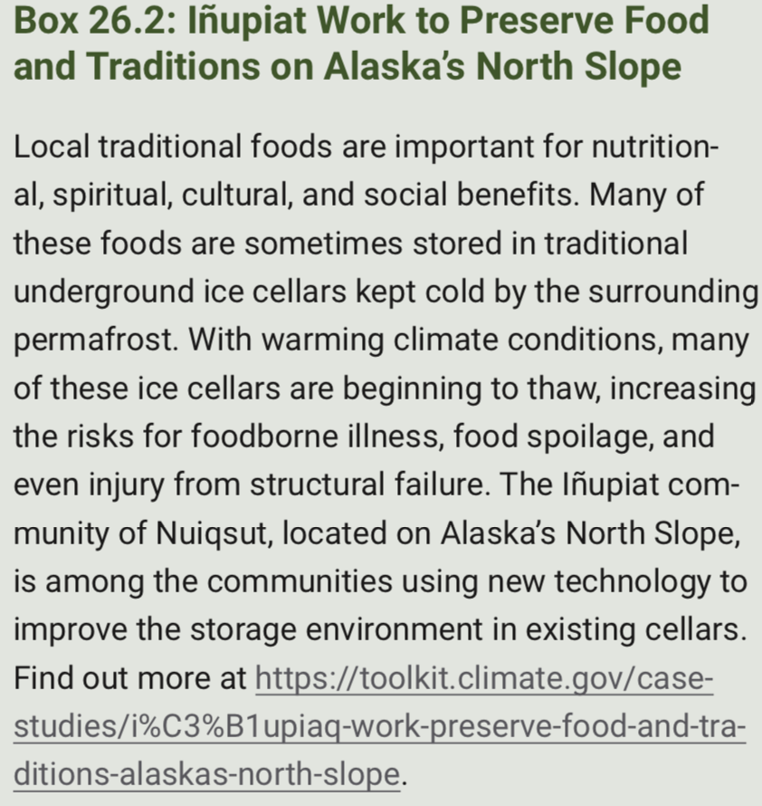
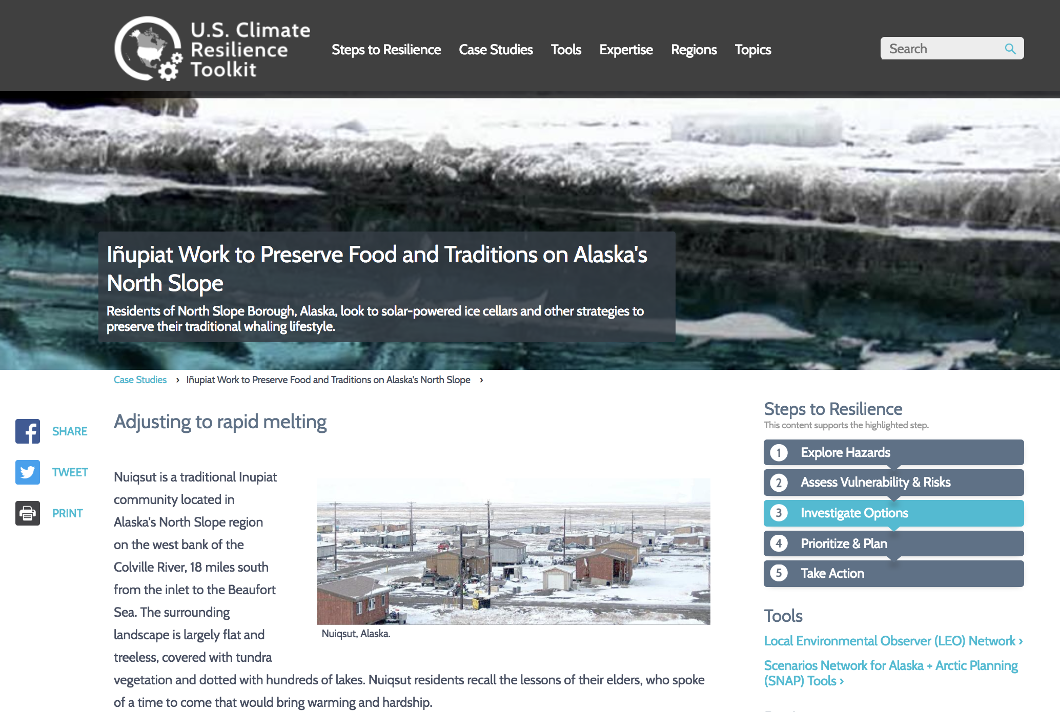
Ch. 26 | Alaska
26
Permafrost thaw case study

Slide 17
Ch. 26 | Alaska
26
Key Message #3
Human Health
increased injuries,
smoke inhalation,
damage to vital water and sanitation systems,
decreased food and water security,
new infectious diseases.
The threats are greatest for rural residents, especially those who face increased risk of storm damage and flooding, loss of vital food sources, disrupted traditional practices, or relocation.

Slide 18
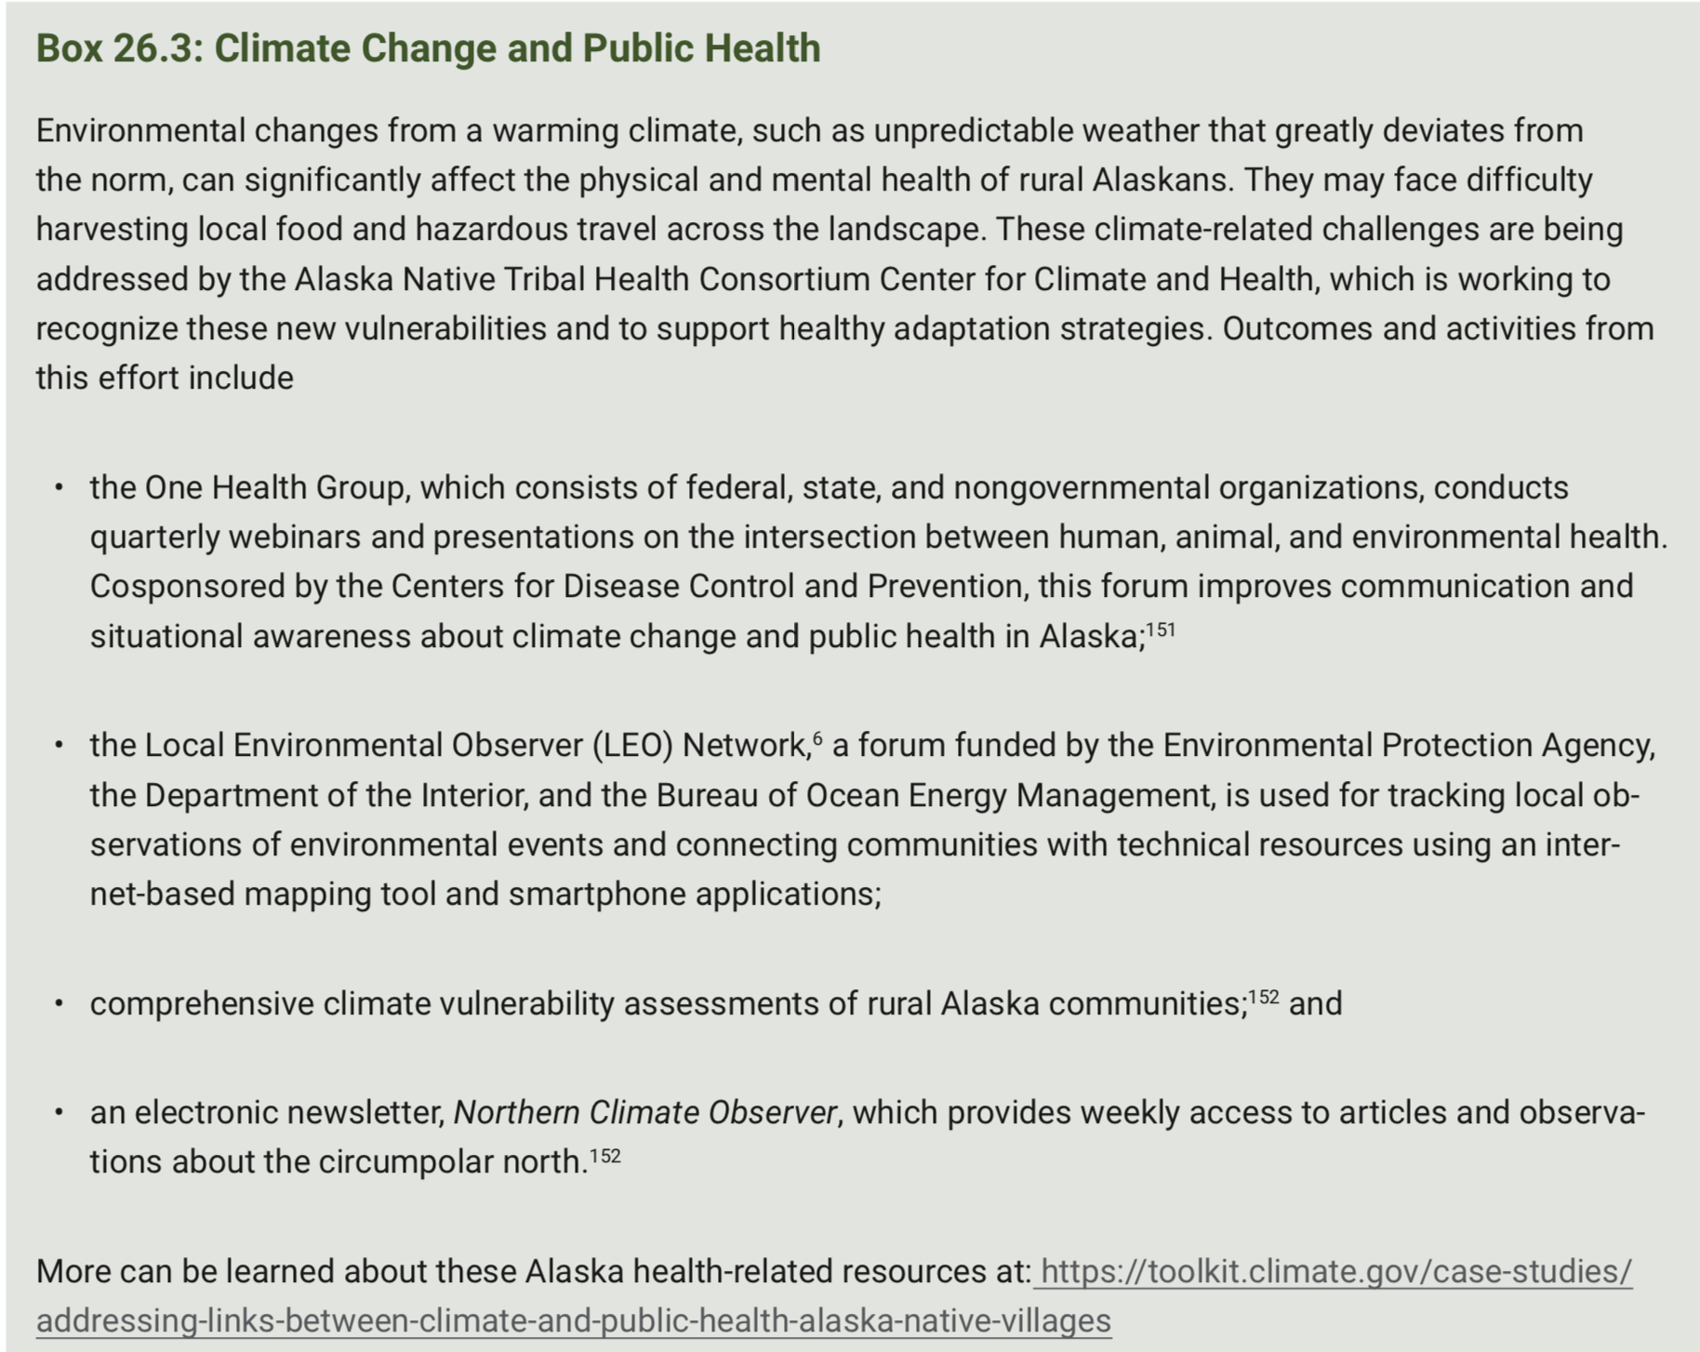
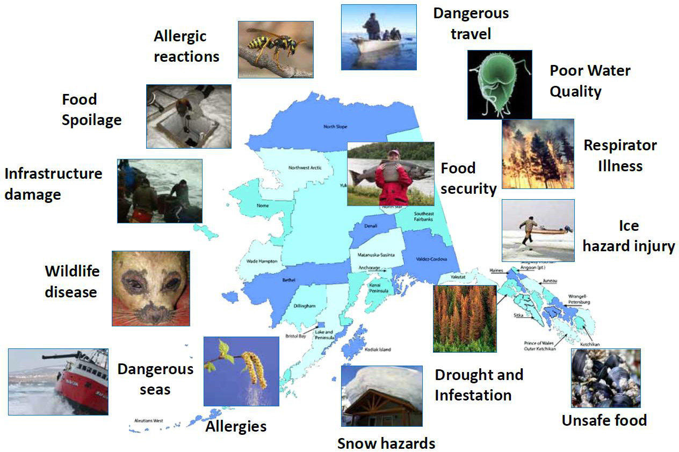
Ch. 26 | Alaska
26
Human health

Slide 19
Ch. 26 | Alaska
26
Key Message #4
Indigenous Peoples
Flexible, community-driven adaptation strategies would lessen these impacts

Slide 20
Fig. 26.6: Variable Weather Affects Harvest Levels
Ch. 26 | Alaska
“One net result of all these changes is an overall decrease in food security for residents of Alaska Native communities.”
These images of marine mammal meat drying on racks in Gambell, Alaska, in (a) June 2012 and (b) July 2013 illustrate the interannual variability of harvests due to sea ice and weather conditions and suggest what the future may hold if ice and weather trends continue. Photo credit: Henry P. Huntington.

Slide 21
Ch. 26 | Alaska
26
Key Message #5
Economic Costs
damage to infrastructure that will be costly to repair or replace,
reducing heating costs
These effects are very likely to grow with continued warming.

Slide 22
Ch. 26 | Alaska
26
Economic costs
Economic Costs
The cost of a warming climate is projected to be huge, potentially ranging from $3 to $6 billion, between 2008 and 2030
Proactive adaptation could reduce that by half or more.

Slide 23
Fig. 26.7: Wildfire Destroys Homes Near Willow, Alaska
Ch. 26 | Alaska
The 7,220-acre Sockeye Fire near Willow, Alaska, totally destroyed 55 residences and damaged 44 in mid-June 2015. Photo courtesy of Matanuska-Susitna Borough/Stefan Hinman.
A recent estimate projected an increase in wildfire suppression costs of $25 million more per year (in 2015 dollars, 3% discount rate) under the lower scenario (RCP4.5) above the 2002–2013 annual average by the end of
the century.

Slide 24
Fig. 26.8: Energy Needed for Heating Decreases Across Much of Alaska
Ch. 26 | Alaska
The chart shows the percentage change in annual heating degree days for the period 2000–2015 (as compared to 1950–1979) for six Alaska communities. Every 1% decline in heating degree days could potentially yield $10 million of annual savings in heating costs. Source: University of Alaska Anchorage, NOAA NCEI, and ERT Inc.

Slide 25
Ch. 26 | Alaska
26
Key Message #6
Adaptation
Direct engagement and partnership with communities is a vital element of adaptation in Alaska.

Slide 26
Fig. 26.9: Adaptation Planning in Alaska
Ch. 26 | Alaska
The map shows tribal climate adaptation planning efforts in Alaska. Research is considered to be adaptation under some classification schemes.^{1,2} Alaska is scientifically data poor, compared to other Arctic regions.³ In addition to research conducted at universities and by federal scientists, local community observer programs exist through several organizations, including the National Weather Service for weather and river ice observations;⁴ the University of Alaska for invasive species;⁵ and the Alaska Native Tribal Health Consortium for local observations of environmental change.⁶ Additional examples of community-based monitoring can be found through the website of the Alaska Ocean Observing System.⁷ Source: adapted from Meeker and Kettle 2017.⁸
“In the midst of negative impacts from climate change, Alaska Native communities display remarkable capacity for response and adaptation”
Notes:
1: SEGCC, 2007: Confronting Climate Change: Avoiding the Unmanageable and Managing the Unavoidable. Report Prepared for the United Nations Commission on Sustainable Development. Bierbaum, R., J.P. Holdren, M. MacCracken, R.H. Moss, P.H. Raven, and H.J. Schellnhuber, Eds. Scientific Expert Group on Climate Change, Sigma Xi and the United Nations Foundation, Research Triangle Park, NC and Washington, DC, 144 pp. http://www.globalproblems-globalsolutions-files.org/unf_website/PDF/climate%20_change_avoid_unmanagable_manage_unavoidable.pdf
2: Tompkins, E.L., W.N. Adger, E. Boyd, S. Nicholson-Cole, K. Weatherhead, and N. Arnell, 2010: Observed adaptation to climate change: UK evidence of transition to a well-adapting society. Global Environmental Change, 20 (4), 627-635. http://dx.doi.org/10.1016/j.gloenvcha.2010.05.001
3: U.S. Arctic Research Commission, 2013: Report on the Goals and Objectives for Arctic Research 2013-2014. U.S. Arctic Research Commission, Arlington, VA and Anchorage, AK, 24 pp. https://storage.googleapis.com/arcticgov-static/publications/goals/usarc_goals_2013-14.pdf
4:NOAA, [2016]: National Weather Service Cooperative Observer Program. https://www.weather.gov/coop/
5: BioMap Alaska, 2012: BioMap Alaska: Citizen science for Alaska's oceans [web site]. Alaska Center for Climate Assessment & Policy, Fairbanks. http://www.biomapalaska.org/
6: ANTHC-LEO, 2017: Local Environmental Observer (LEO) Network. Alaska Native Tribal Health Consortium (ANTHC), Anchorage, AK, accessed August, 2017. http://www.leonetwork.org
7: AOOS, 2017: Harmful Algal Bloom Information System for Kachemak Bay, Alaska. Alaska Ocean Observing System (AOOS), Anchorage, AK, accessed August, 2017. http://www.aoos.org/k-bay-hab/
8: Meeker, D. and N. Kettle, 2017: A Synthesis of Climate Adaptation Planning Needs in Alaska Native Communities. Alaska Center for Climate Assessment and Policy, Fairbanks, 28 pp. https://accap.uaf.edu/Tribal_synthesis

Slide 27
Ch. 26 | Alaska
26
Adaptation
Enhanced communication, coordination, knowledge sharing, and collaboration are important components of adaptation in Alaska.
This includes between communities, among scientists and communities, and across government bodies at the tribal, community, borough, state, and national levels.

Slide 28
Markon, C., S. Gray, M. Berman, L. Eerkes-Medrano, T. Hennessy, H. Huntington, J. Littell, M. McCammon, R. Thoman, and S. Trainor, 2018: Alaska. In Impacts, Risks, and Adaptation in the United States: Fourth National Climate Assessment, Volume II [Reidmiller, D.R., C.W. Avery, D.R. Easterling, K.E. Kunkel, K.L.M. Lewis, T.K. Maycock, and B.C. Stewart (eds.)]. U.S. Global Change Research Program, Washington, DC, USA. doi: 10.7930/NCA4.2018.CH26
https://nca2018.globalchange.gov/chapter/alaska

Slide 29
