Slide 1
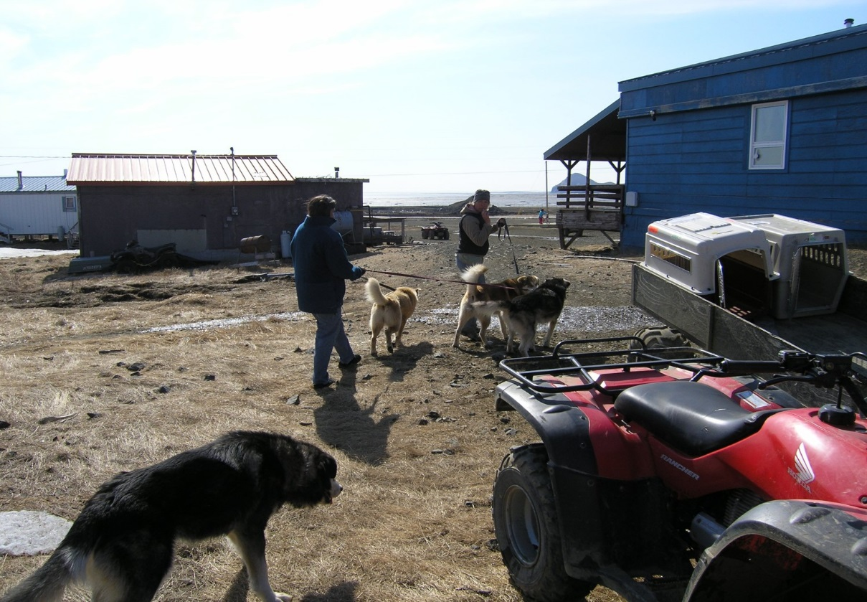
Solutions for Rural Alaskan Communities Underserved With Veterinary Care

Slide 2
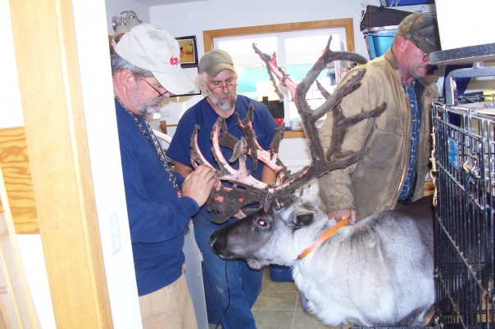
Is Rural Alaska Underserved? No data exists to quantify veterinary needs in rural Alaska

Slide 3
Alaska Veterinary Statute Sec. 08.98.050 (7) requires the Alaska veterinary board to: - monitor the standards and availability of veterinary services provided in the state. A state wide study/ survey needs to be done

Slide 4
Assuming that this lack of rural veterinary care exists, what does it affect?
-increase risk and incidence of zoonotic diseases - increase risk of human dog bites , maulings and death by mauling - psychological trauma from witnessing or participating in euthanasia of unwanted or injured/ ill dogs and cats

Slide 5
Possible Solutions: -Rural veterinary hub clinics -Telemedicine -Non-surgical sterilization -Local animal control

Slide 6
Rural Veterinary Hub Clinics Who will pay for these?
Rural Economic Development Grants
Non-profit groups
Local community efforts

Slide 7
Telemedicine (telehealth)
Veterinary telemedicine is illegal in Alaska unless it is directly between an Alaskan licensed veterinary technician and an Alaska licensed veterinarian.
Recently passed SB 74 allows distance telehealth with physicians and others but not veterinarians. Veterinary medicine should legally allow for telemedicine.

Slide 8
Non- Surgical Sterilization The goal of non- surgical sterilization should be permanent sterilization or 1 year minimum duration sterilization that can be timed with rabies vaccination
Male dogs
Zueterin (in bankruptcy)
Calcium Chloride
Suprelorin (desorelin)- not in US
Female dogs
- Suprelorin (desorelin)
GonaCon/other hormonal products
Other confidential immunological products (promising and affordable)
Rabies/ immunocontreceptive combination products

Slide 9
Local Animal Control
Partnerships with animal adoption placement partners for unwanted animals
Access to spay/ neuter and economic development grants
Access to training for humane euthanasia
Partnership with state rabies lay vaccinator program
Partner with telemedicine
Partner with non-surgical sterilization
Brings local input into veterinary needs

Slide 10
Local input into the veterinary care issue
The people of rural Alaska need to have representation with the Alaskan veterinary board. Because of the low population and the widespread geography, this representation does not exist.
Possible solutions are:
-Add a rural public member to the veterinary board
-Creation of a Rural Alaskan Veterinary Advisory Board. This board can select a representative who will be a public member of the Alaska veterinary board

