Slide 1
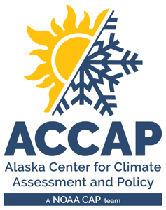
Circumpolar One Heath Summer 2024 Climate Review Fall 2024 Climate Outlook
Rick Thoman
Alaska and Arctic Climate Specialist
rthoman@alaska.edu
September 17, 2024

Slide 2
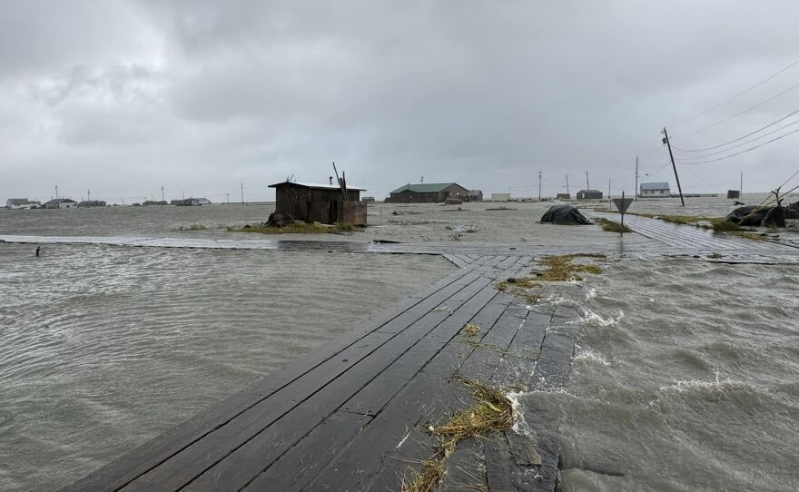
Summer 2024 Alaska Highlights
Western Alaska
Excessive storminess in July & August
Severe coast flooding Kukso coast Aug 16-19, ex-typhoon Ampil Aug 21
North Slope
All-time record high temperatures central North Slope coast early August
Interior
Early summer wildfire and smoke
Southcentral
Rainy, especially July
August 19 Tuntutuliak Flooding
Credit: C. Ondola and KYUK

Slide 3
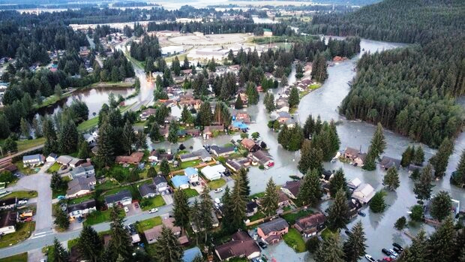
Summer 2024 Alaska Highlights
Southeast
Record high July rainfall Juneau
Mendenhall River flooding early August
Ketchikan landslide
Moderate drought southern Southeast since early July
Image credit:
Alaska Division of Homeland Security and Emergency Management

Slide 4
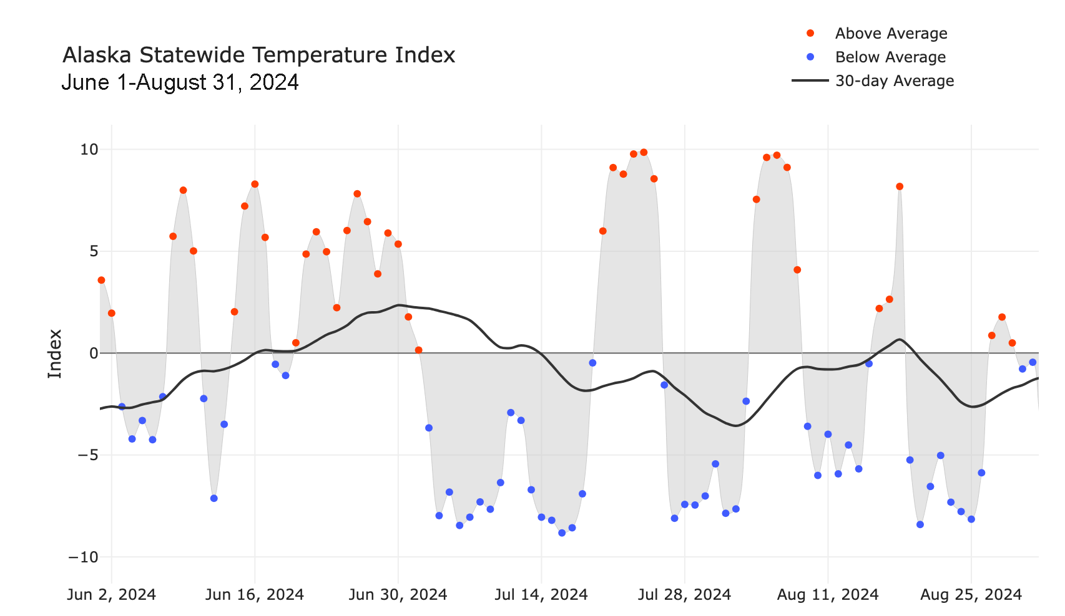
Alaska Daily Temperature Index

Slide 5
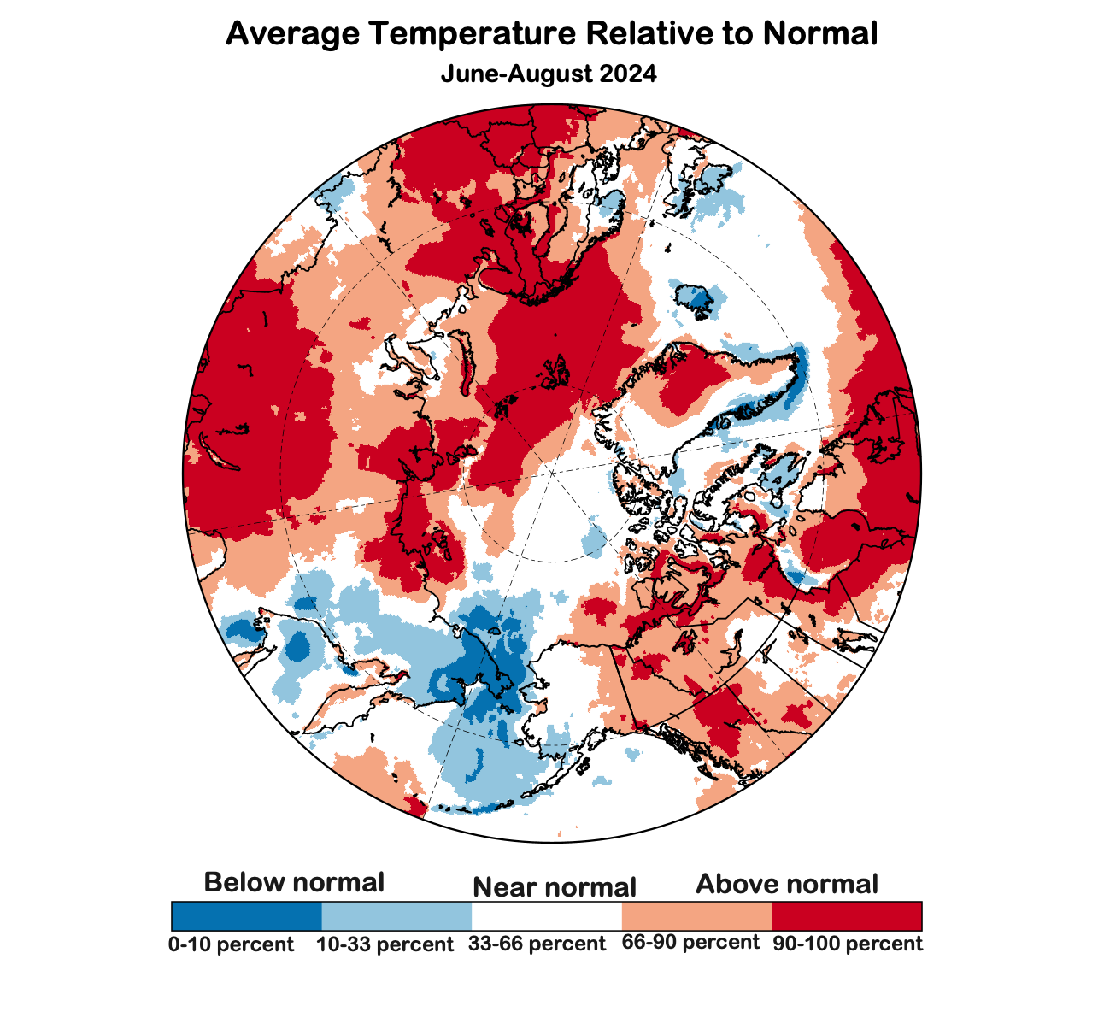
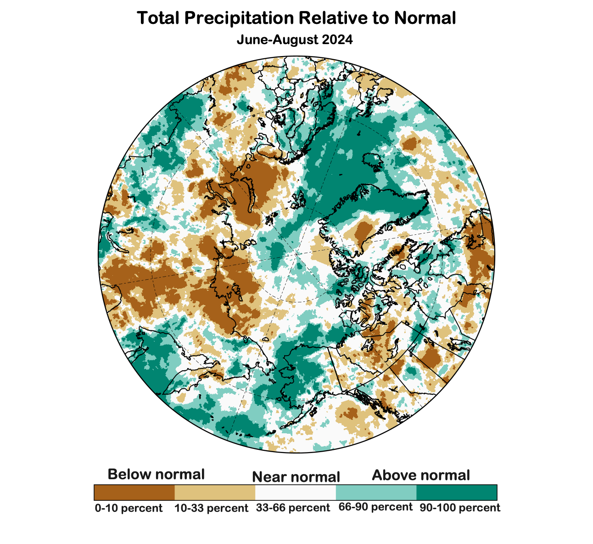
Summer 2024 Temp and Precipitation
Since 1950:
6th warmest Summer
Since 1950:
8th wettest Summer
Data: ERA5 courtesy of EMCWF/Copernicus
1991-2020 Baseline
Notes:
AK Summer: 45% of Alaska land area temp above normal, first summer since 2014 with less than half of the state warmer than normal
YT Summer: 4th summer in a row 100% above normal
NWT Summer: 99% above normal but lowest since 2021
AK Summer: 83% of Alaska land area above normal precipitation. Highest since 1998

Slide 6
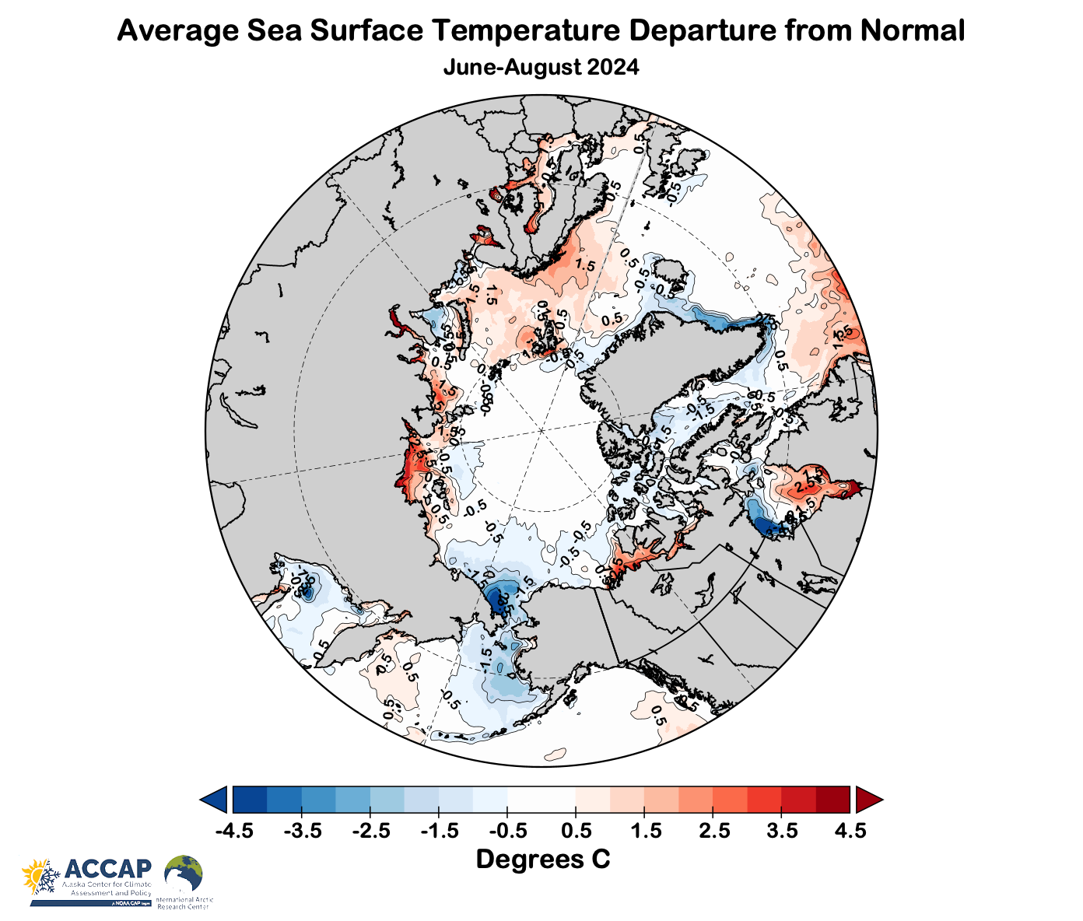
Summer 2024 sea surface temperatures
1991-2020 baseline
Source: NOAA

Slide 7
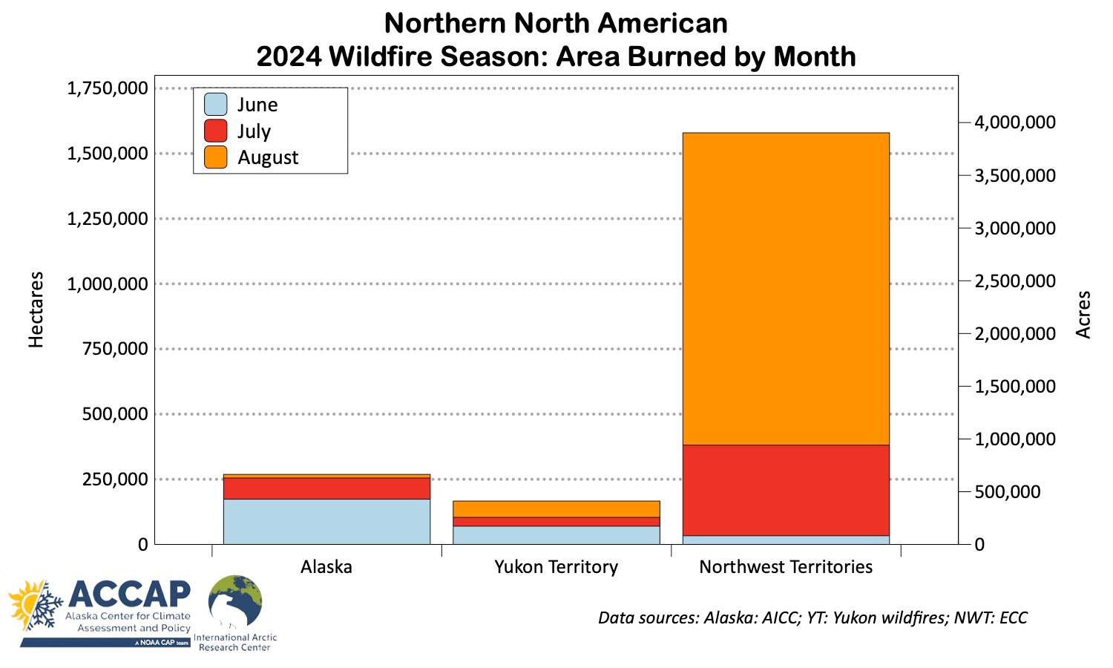
2024 Northern North American Wildfire

Slide 8
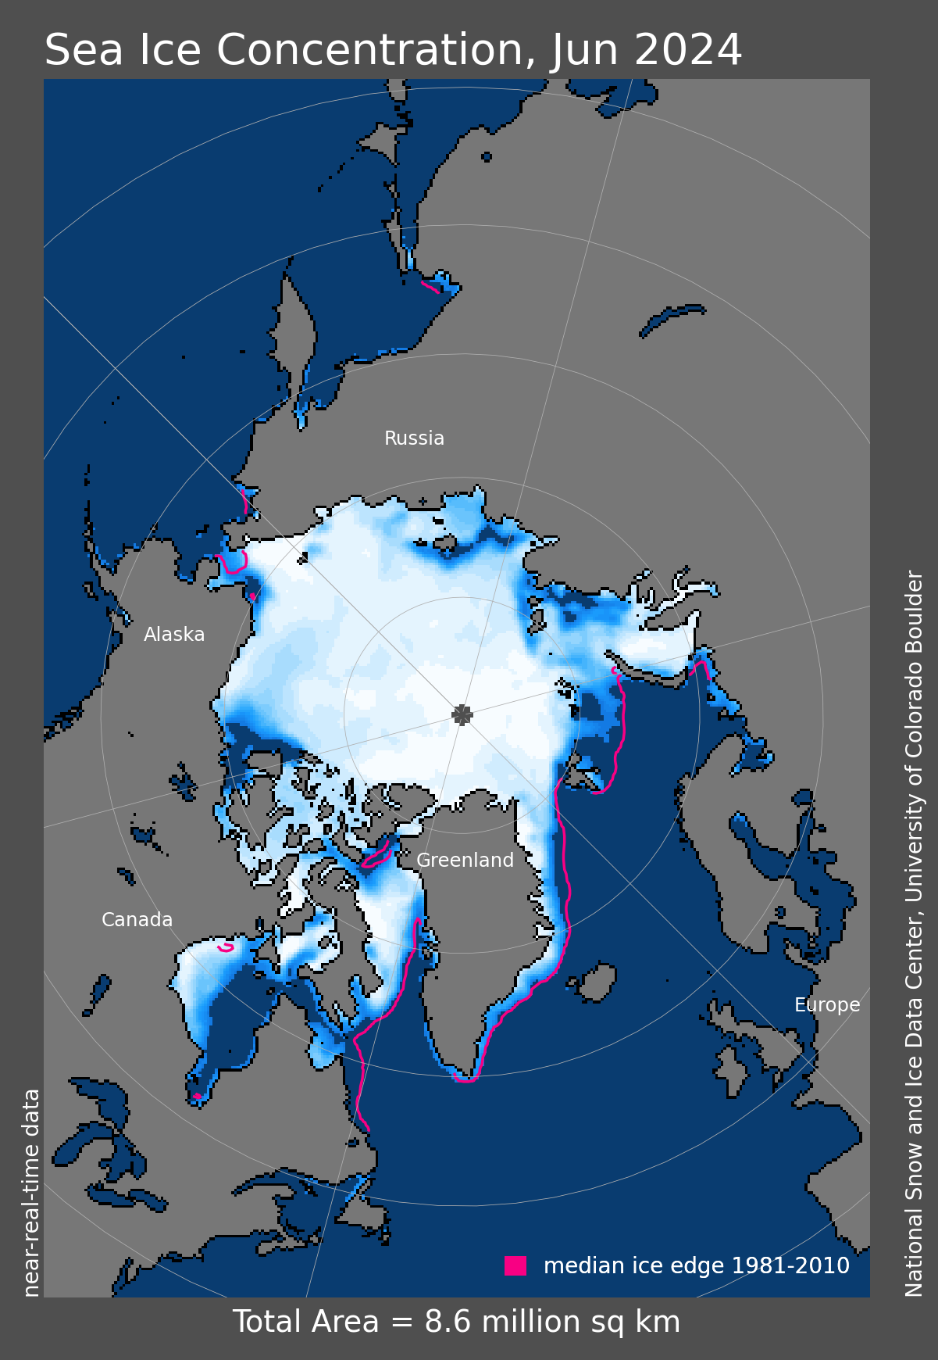
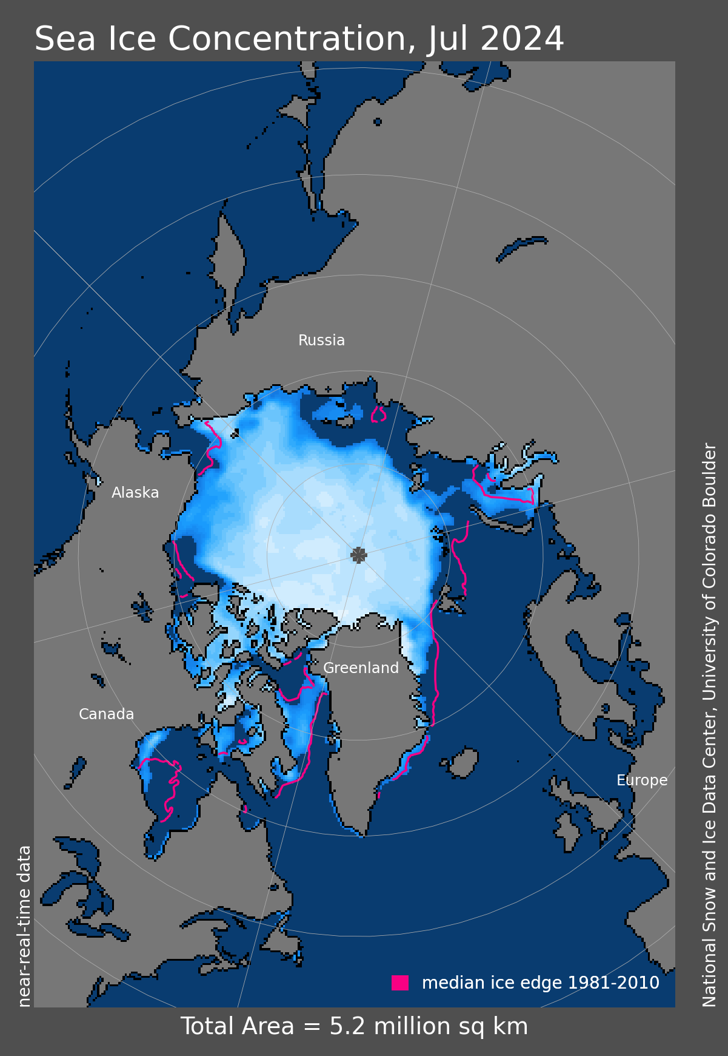
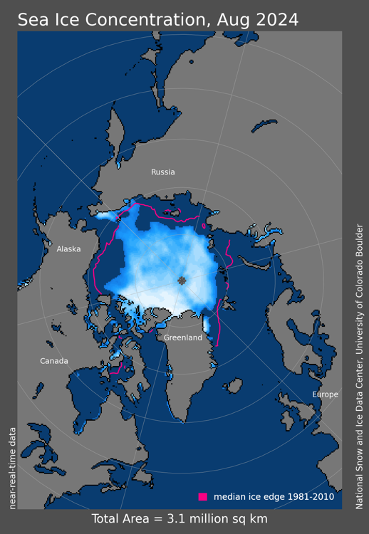
Arctic Sea Ice Extent: Summer 2024
12th lowest
6th lowest
4th lowest
Since 1979

Slide 9
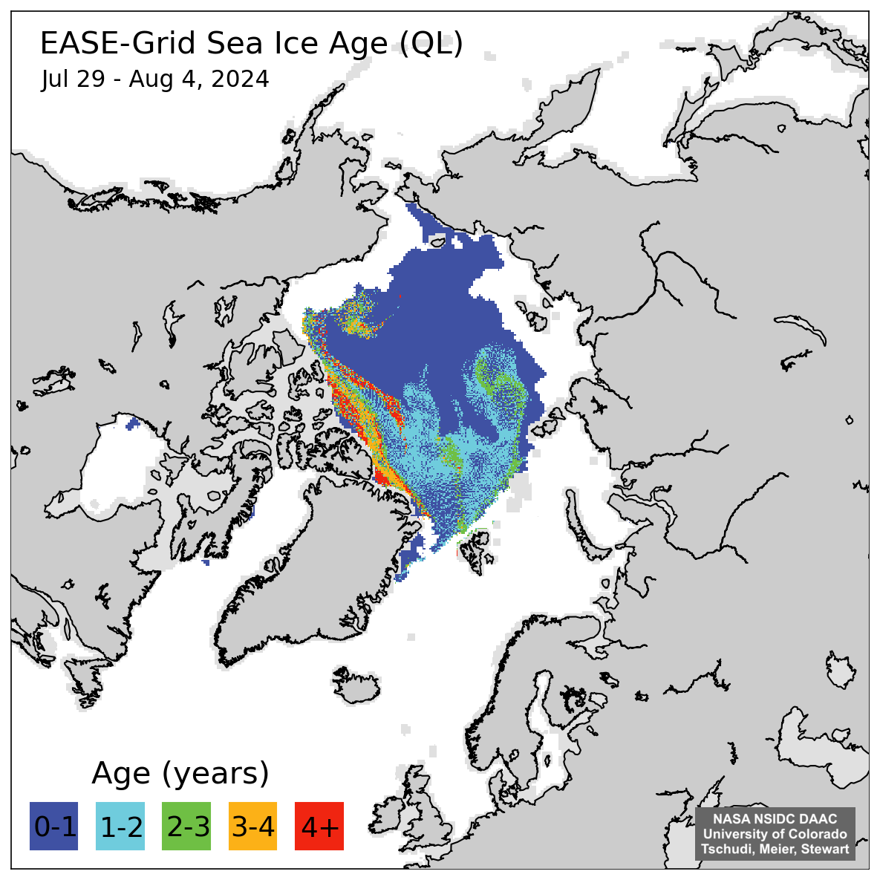
Arctic Sea Ice Age: August 2024
Analysis and graphic
courtesy NSIDC

Slide 10
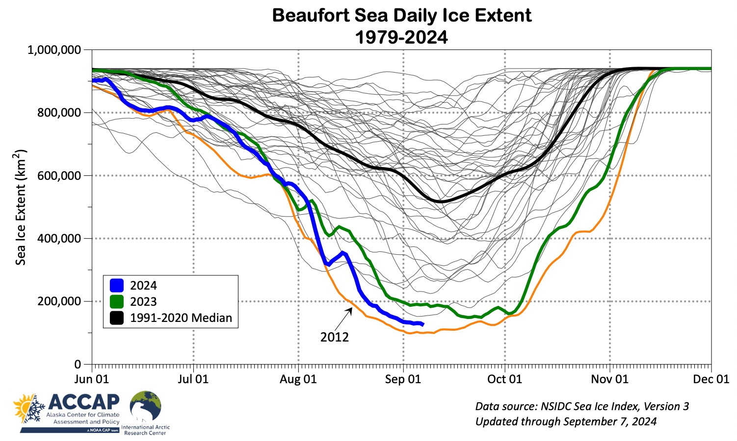
Beaufort Sea Ice Extent

Slide 11
Fall 2024 Outlooks
Arctic Sea Ice Experimental Outlook
NOAA/Climate Prediction Center
Alaska and past La Niñas
Arctic Outlooks
Copernicus Climate Change Service

Slide 12
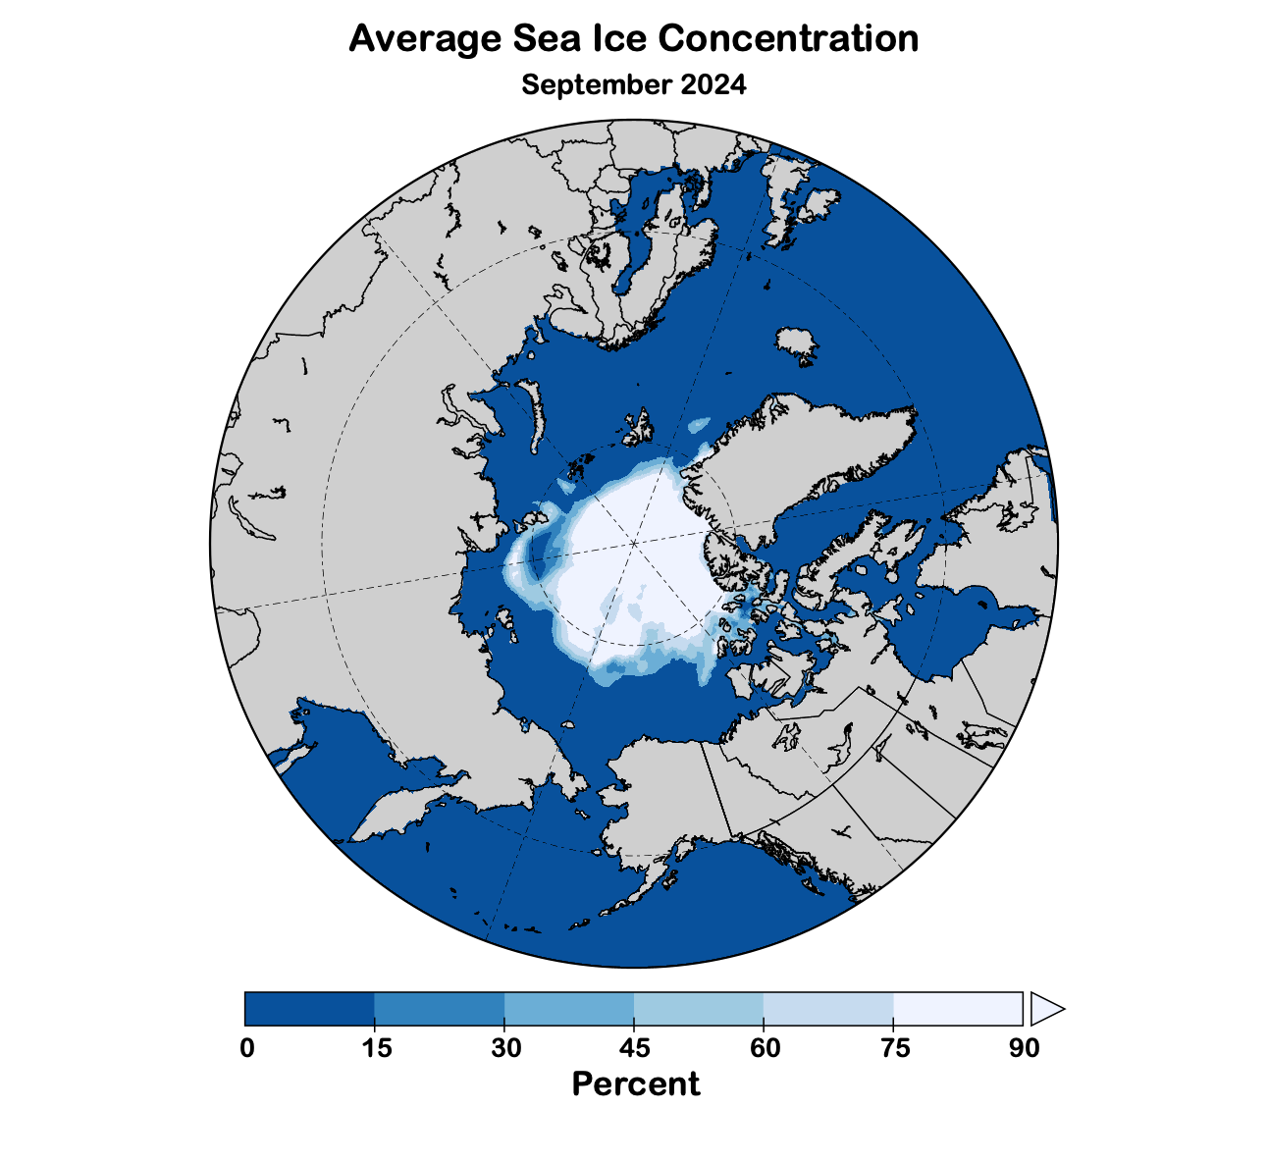
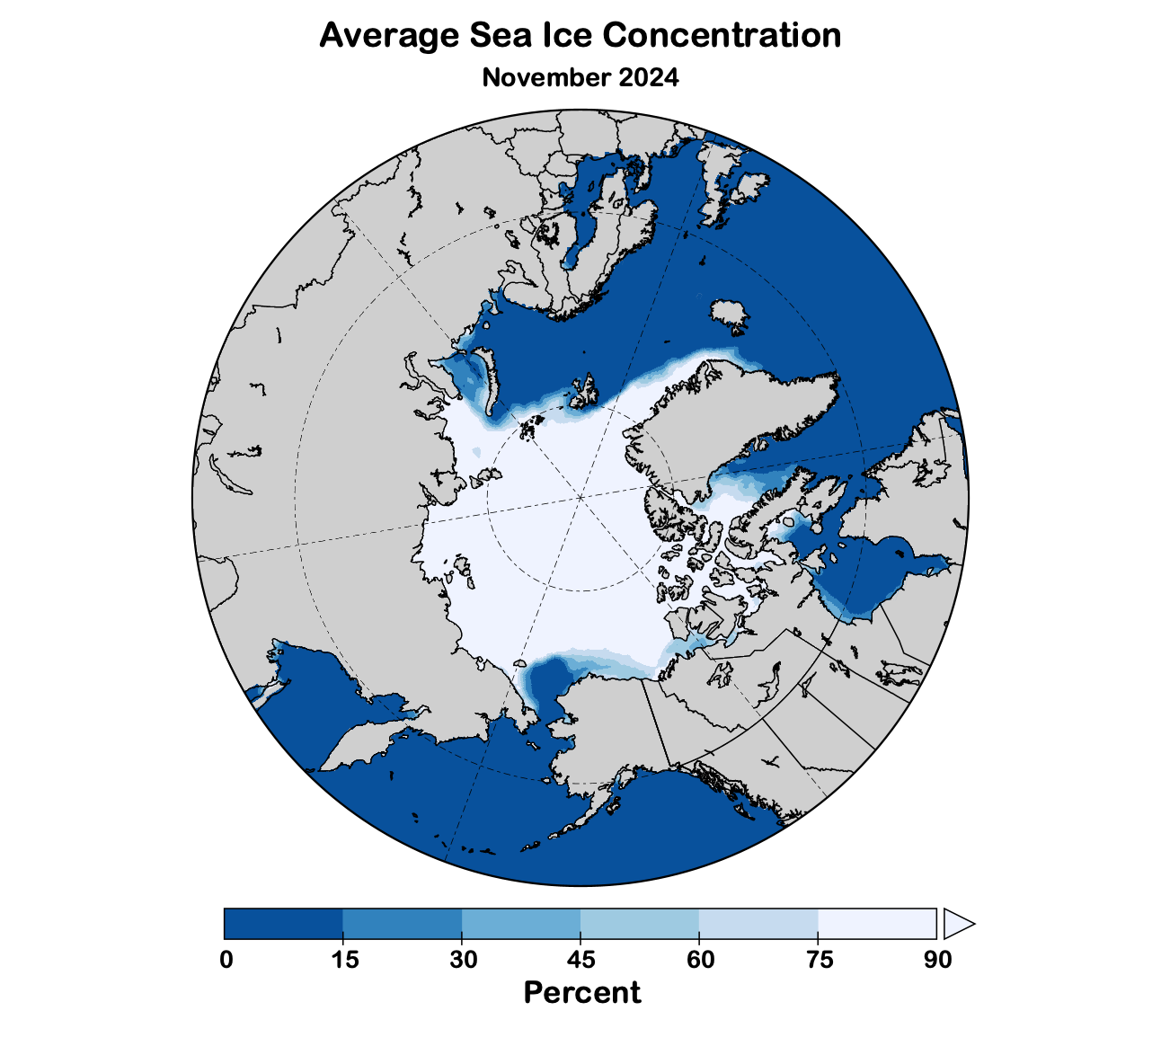
Sea Ice Outlook: Fall 2024
Data: NOAA/Climate Prediction Center Exp. Sea Ice Outlook
Outlook produced from late August 2024 data

Slide 13
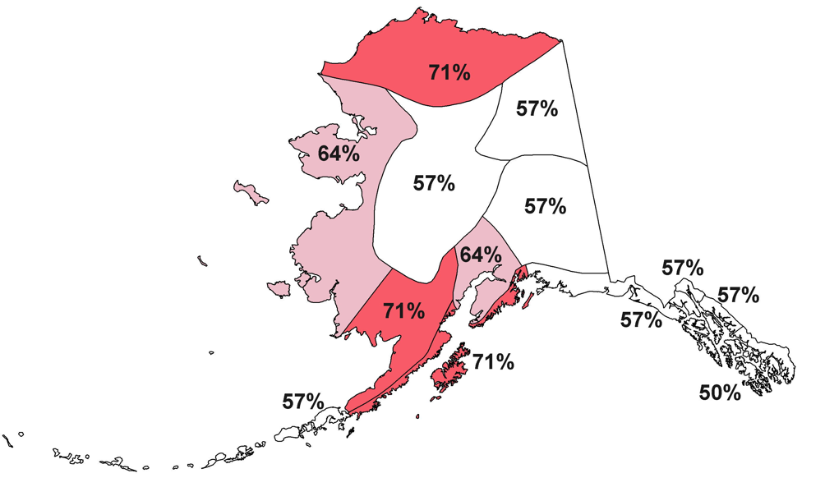
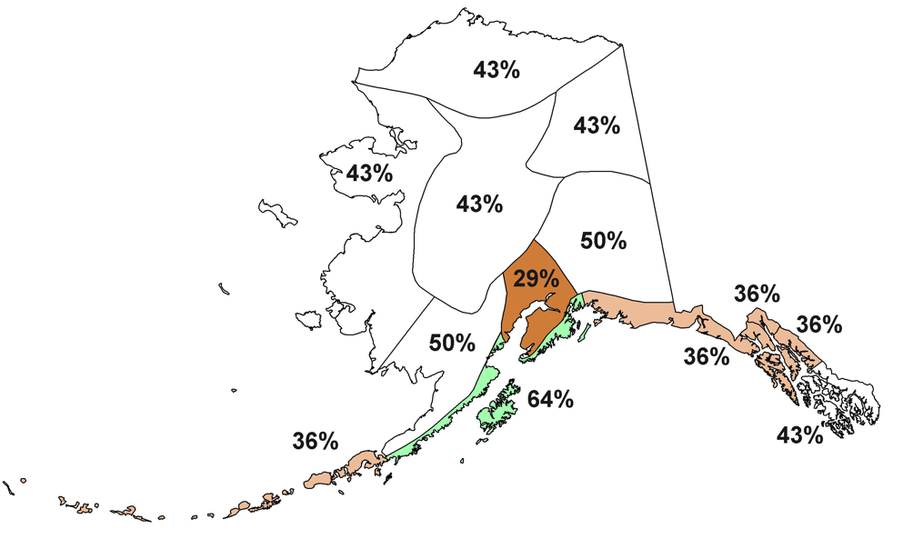
La Niña and Alaska Autumns
Temperature
Percent seasons above normal
Precipitation
Percent seasons above normal
14 Weak to Moderate La Niña autumns since 1976

Slide 14
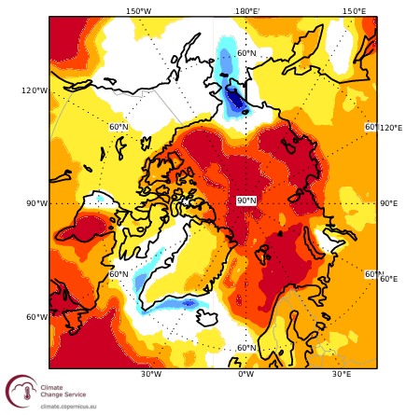
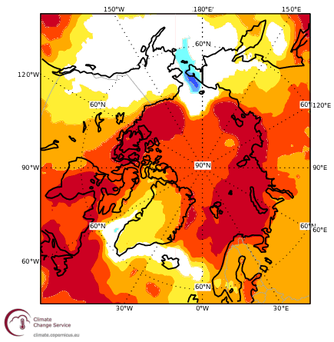
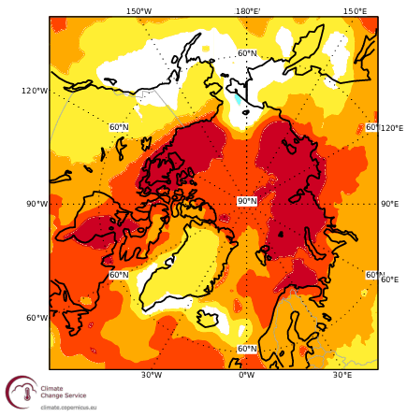
Fall 2024 Monthly Temperature Outlook
September
October
November
Outlooks courtesy Copernicus C3S (Climate Change Service)

Slide 15
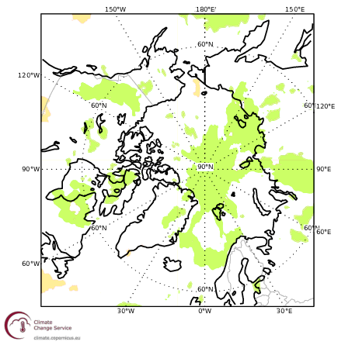
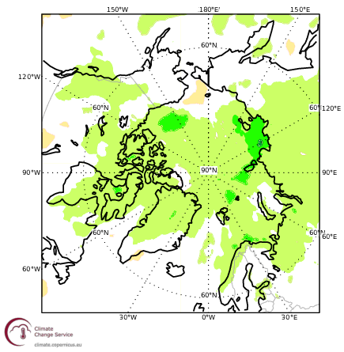
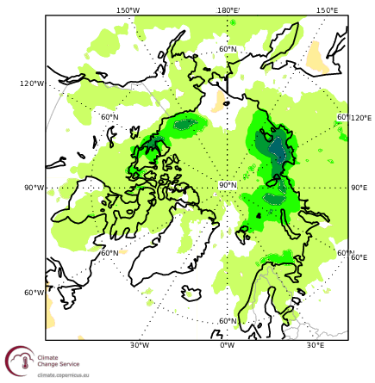
Fall 2024 Monthly Precipitation Outlook
September
October
November
Outlooks courtesy Copernicus C3S (Climate Change Service)

Slide 16
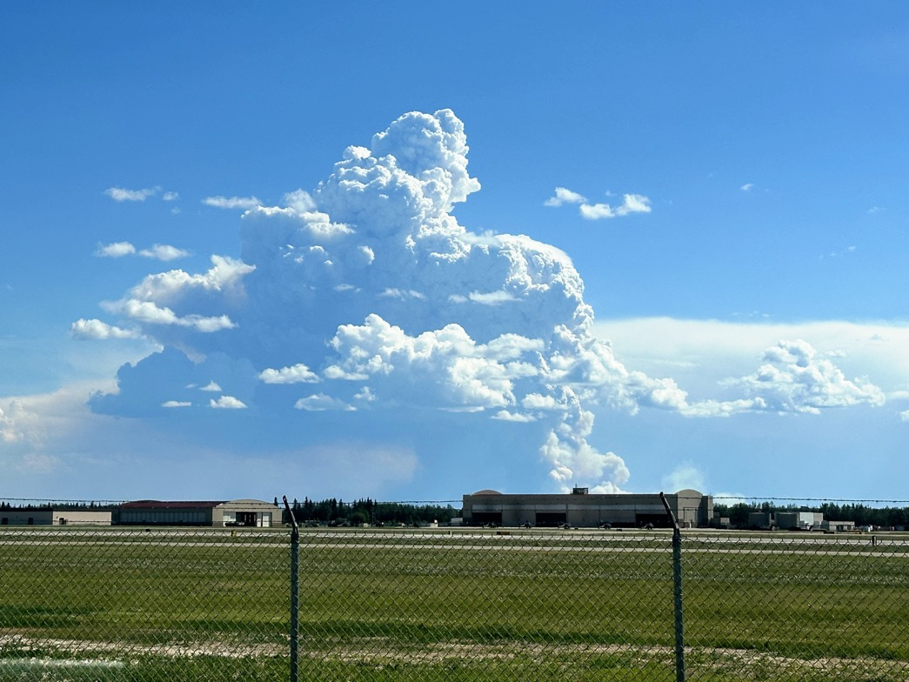
Thanks very much Questions?
June 17th: McDonald Fire from Ft. Wainwright
Credit: K. Hefington, BLM AFS

